Slide 1
Nutrition Agent – The Smartest AI Nutrition Assistant
CAPSTONE PROJECT
Presented By:
PARVESH MUSHRAF A
PANIMALAR ENGINEERING COLLEGE COMPUTER SCIENCE ENGINEERING

Slide 2
OUTLINE
Problem Statement
Proposed System/Solution
System Development Approach (Technology Used)
Algorithm & Deployment
Result (Output Image)
Conclusion
Future Scope
References

Slide 3
Problem Statement
In an era of growing health awareness, individuals seek personalized nutrition guidance. Existing tools offer generic plans and lack adaptability to lifestyle, allergies, or cultural preferences. Scalability remains a challenge for nutritionists. There's a need for an AI assistant that offers dynamic, interactive, and tailored diet planning using natural language, image, or voice input.

Slide 4
Proposed Solution
Our Nutrition Agent is an AI-driven assistant that uses IBM Granite (LLMs) and IBM Cloud Lite to provide: - Personalized meal plans based on health goals, conditions, and preferences - Smart food swaps and contextual nutritional advice - Dynamic adaptation based on continuous feedback - Multimodal input: text, image, and voice Powered by RAG (Retrieval-Augmented Generation), it pulls real-time data from trusted sources.

Slide 5
System Approach
“The system approach outlines the development and implementation of the Nutrition Agent.”. Here's a suggested structure for this section:
System requirements
Python 3.9+
Flask.
Transformers (HuggingFace).
IBM Cloud SDK.
Library required to build the model
transformers
flask
docker

Slide 6
Algorithm & Deployment
Algorithm: - Use Retrieval-Augmented Generation (RAG) - IBM Granite LLM prompts crafted to align with dietary preferences Deployment: - Flask app containerized via Docker - Hosted on IBM Code Engine - Secured via environment variables and authentication

Slide 7
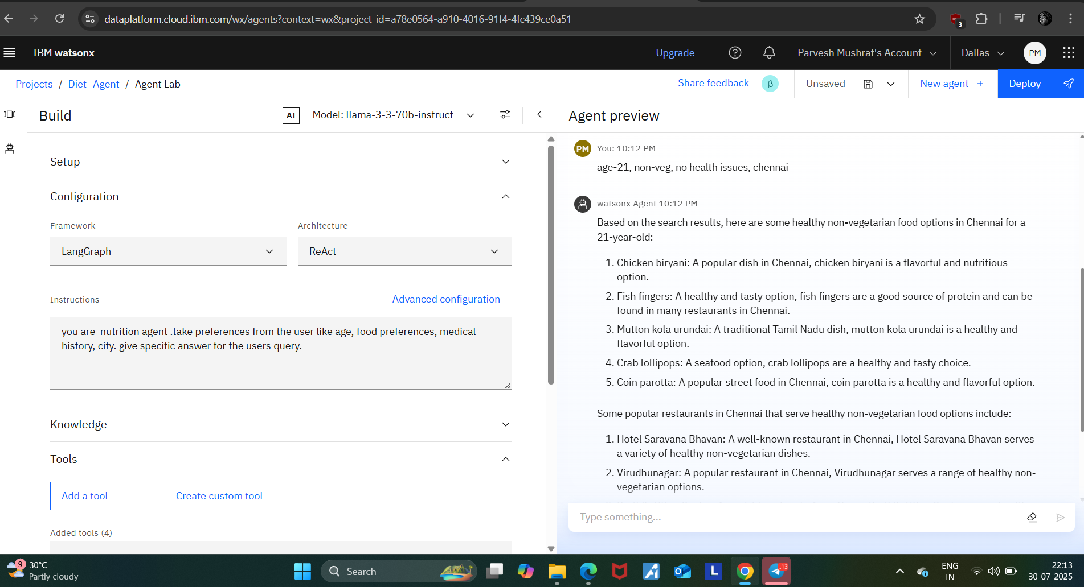
Result
The agent responds accurately to natural queries like: - “Suggest a high-protein meal under 600 calories.” - “What can I eat if I’m gluten-intolerant and diabetic?”

Slide 8
Conclusion
This AI-powered assistant delivers tailored nutritional guidance in real-time. It mimics expert consultations and evolves with user feedback."Our Nutrition Agent addresses limitations of existing tools by offering scalable, accurate, and accessible nutritional support using AI."

Slide 9
Future scope
- Integrate wearable health data (e.g., from fitness trackers) - Add multilingual support for broader reach. - Enhance image recognition for food identification. - Connect with dietician feedback loop.

Slide 10
References
- USDA FoodData Central.
- IFCT India Nutrition Dataset.
- WHO/ICMR dietary guidelines.
- IBM Watson Discovery & Granite documentation.

Slide 11
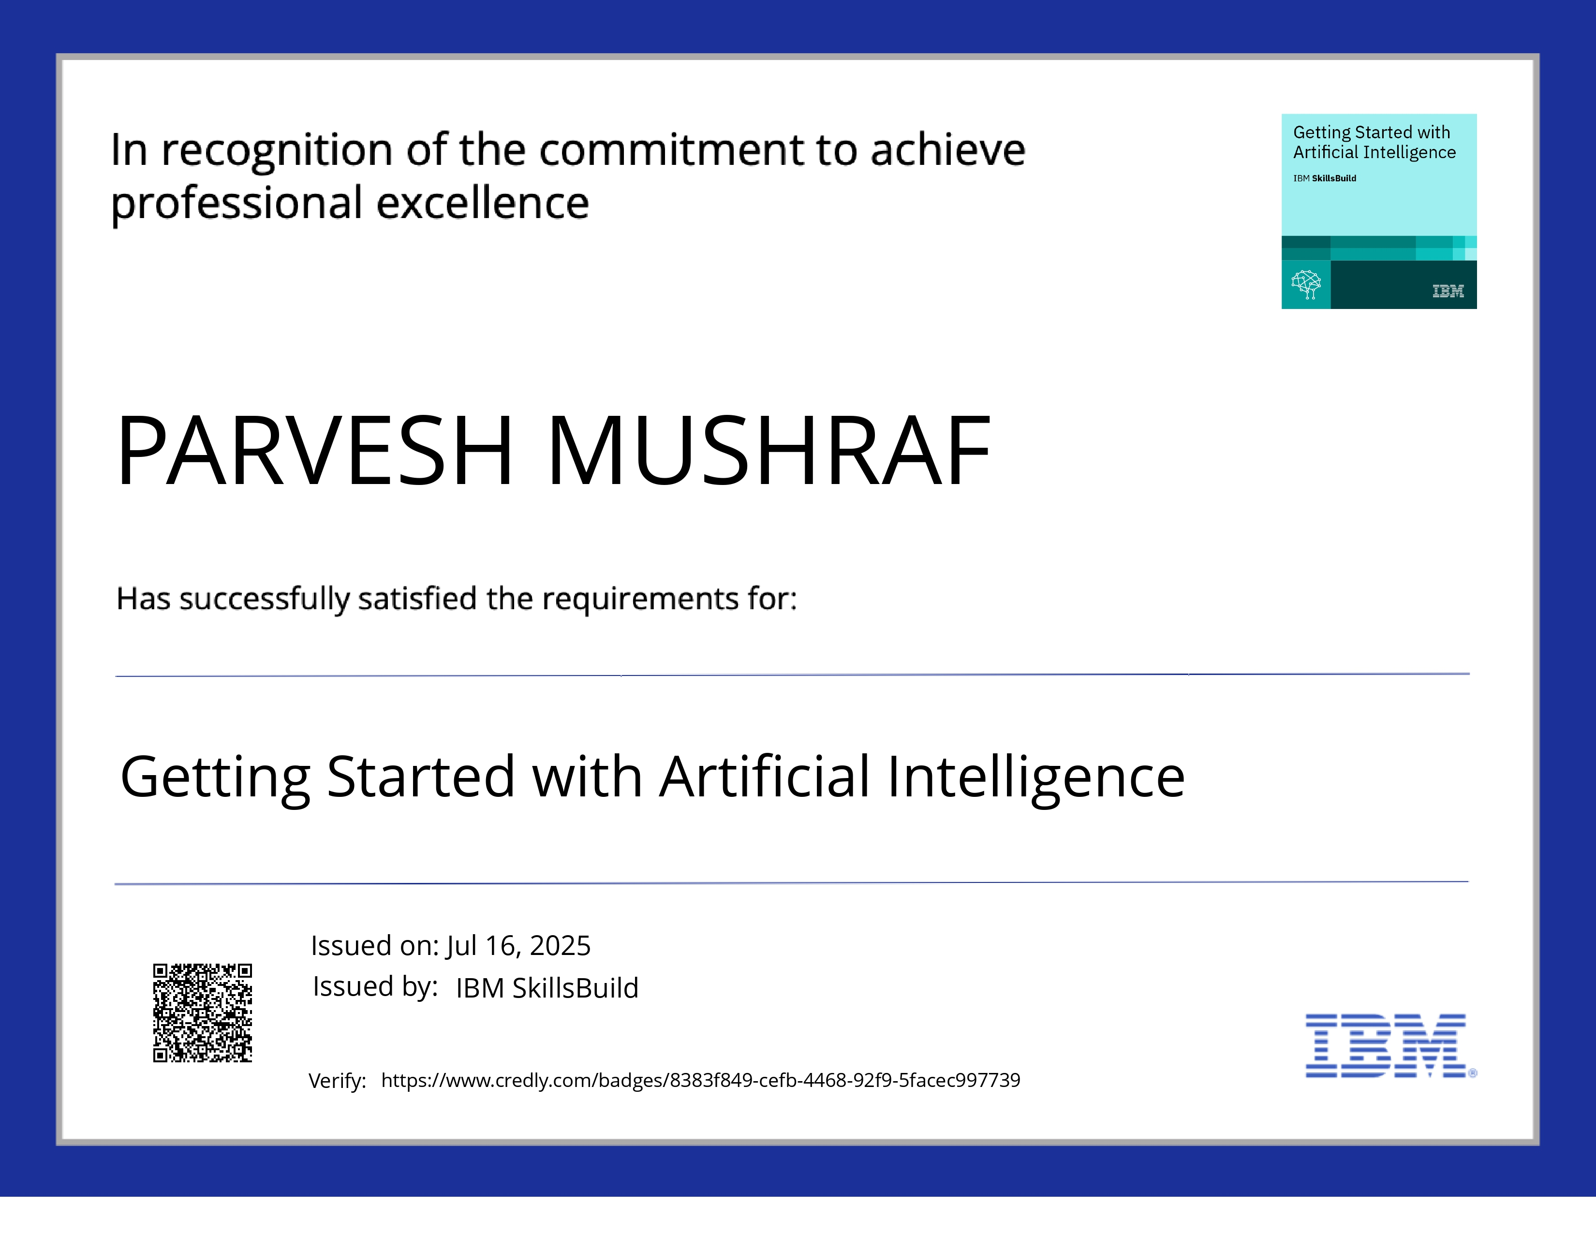
IBM Certifications

Slide 12
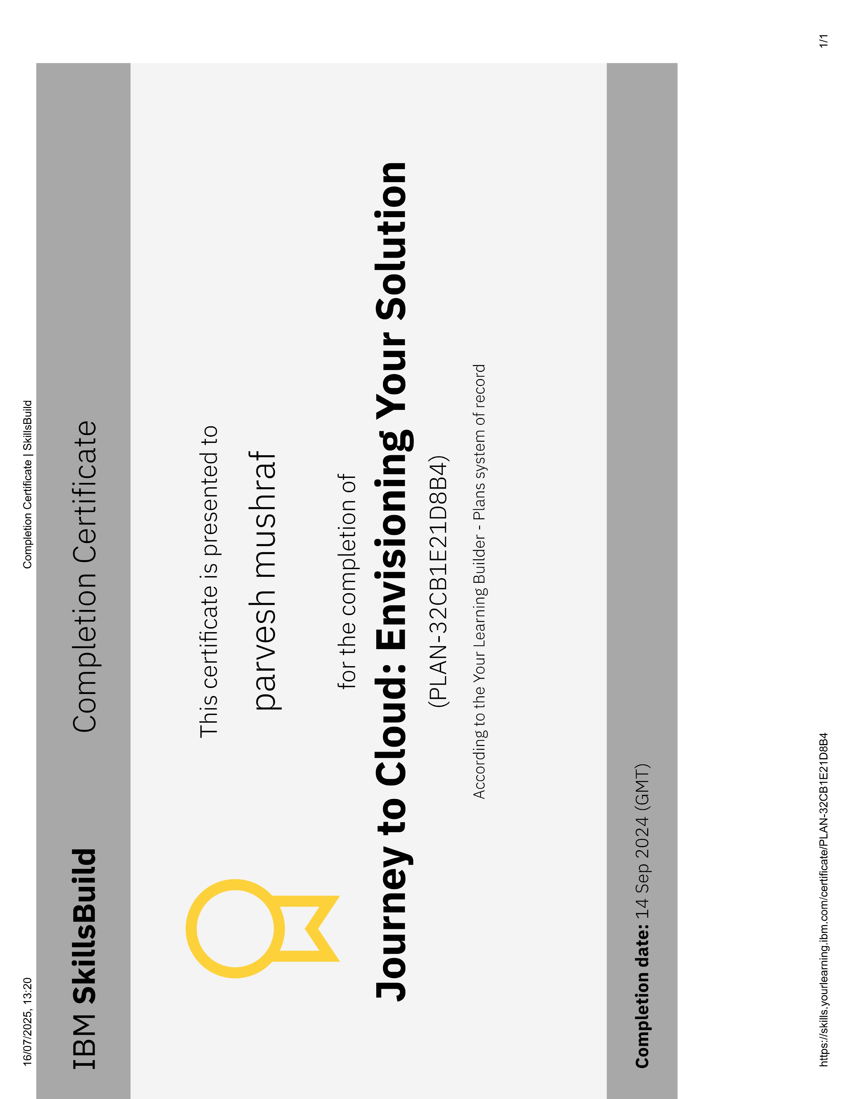
IBM Certifications

Slide 13
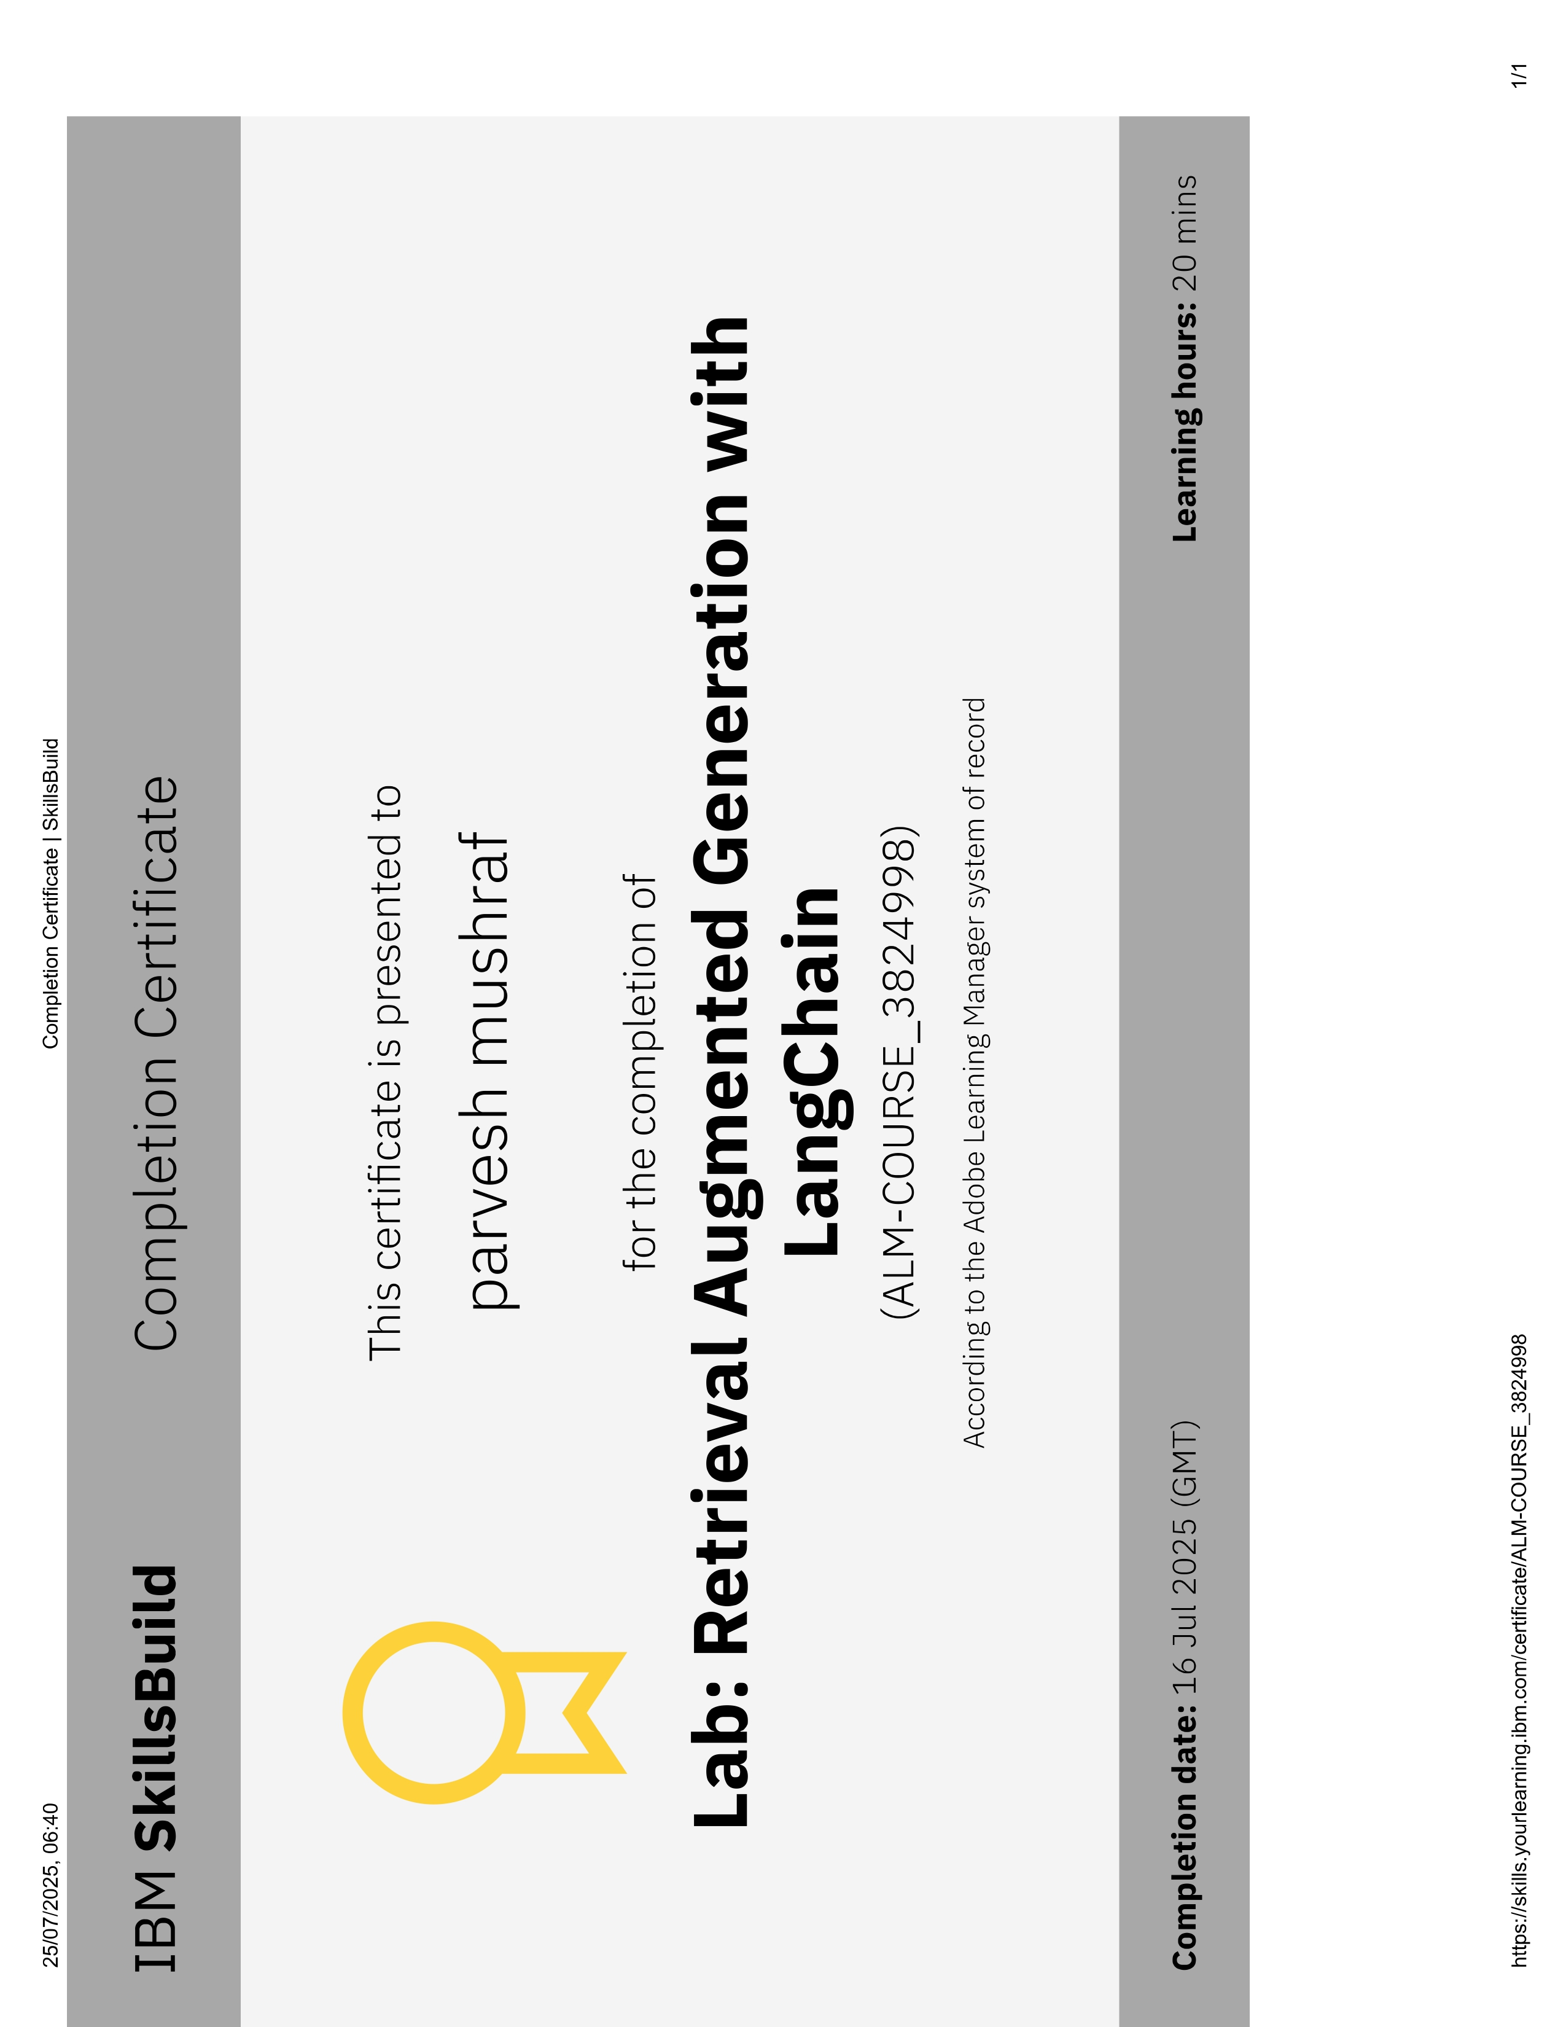
IBM Certifications

Slide 14
THANK YOU

