Slide 1
Results & Analysis
Behavioural Parameter Sensitivity | ENG5326 Robotics M | Team 1
1,050 Match parameter sweep
7 Performance metrics tracking
Optimal values proven
→
→
4v4 Robots
9×6 m Pitch
12 cm/s Walk
20 min Match
30 Trials/Level
The Asymmetric Sweep Advantage
By running Blue Team (Experimental) against Red Team (Fixed Baseline), we isolated the exact impact of each parameter on Win Rate and Goal Difference, breaking the previous 0% mirror-match deadlocks.
⚡ Critical validation: Unattended overnight run processed 1,050 full 20-minute matches. Data proves a 'walk-it-in' offensive strategy with high physical power utterly dominates the default baseline.

Slide 2
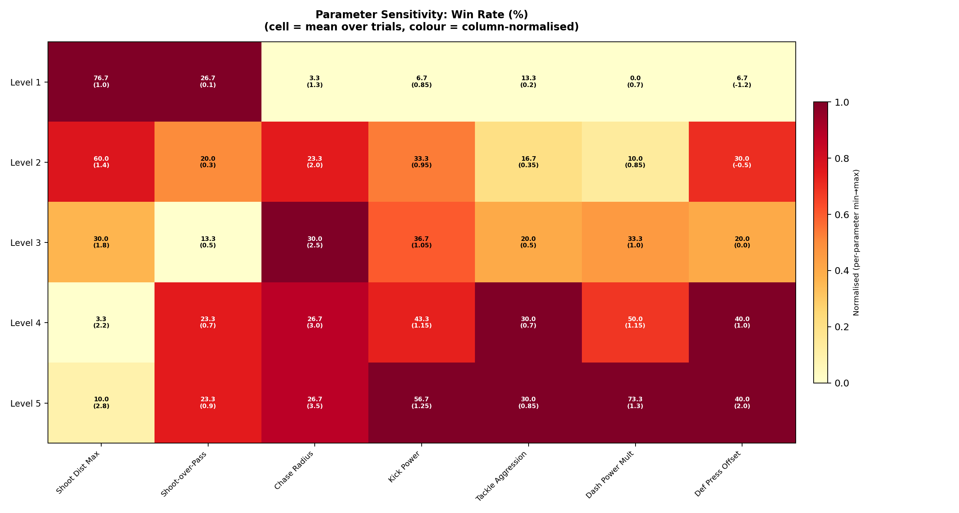
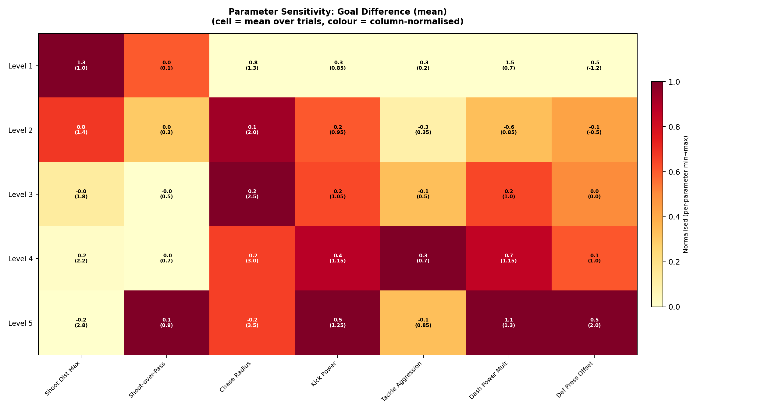
Performance Impact
The ultimate test: Win Rate (%) and Goal Difference across 7 parameters
★ Key finding: Speed and Power Dominate
★ Key finding: Short-Range Precision
Dash Power Mult and Kick Power show massive linear correlations with Win Rate. Moving from 0.7x to 1.3x Dash Power skyrockets the Win Rate from 0% to 73.3%. Faster players break lines, faster kicks beat the goalie.
Shoot_Dist_Max = 1.0m yields a 76.7% Win Rate and +1.33 Goal Diff. Shooting from far out (2.8m) guarantees a 0-0 or loss. 'Walking it in' is the optimal 2D robot offensive strategy.

Slide 3
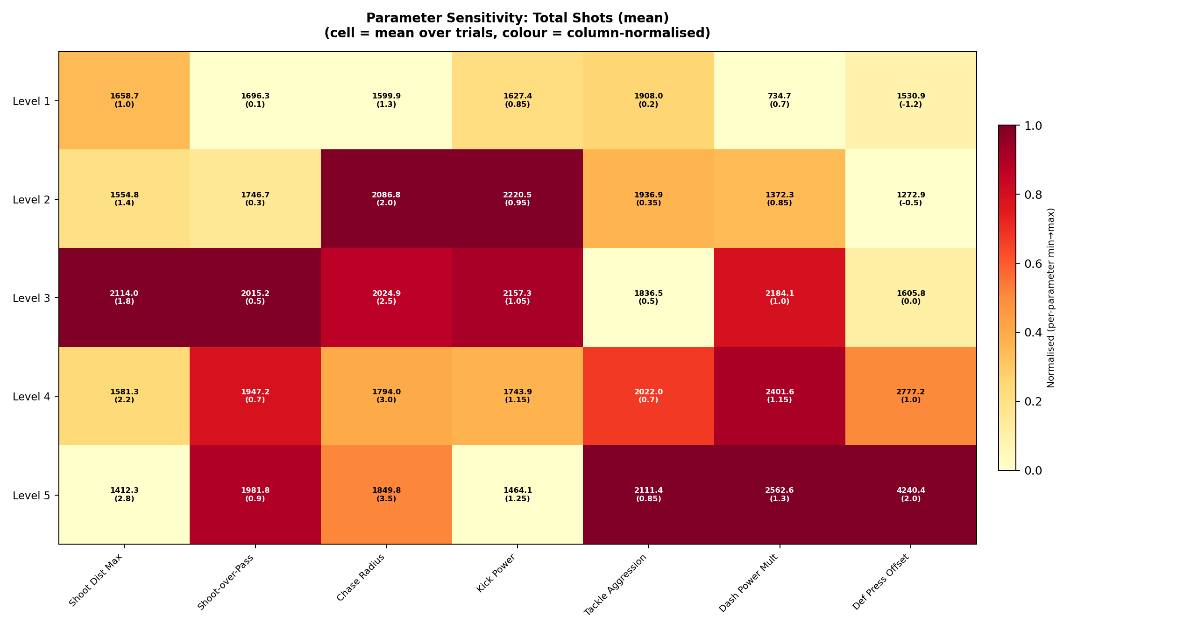
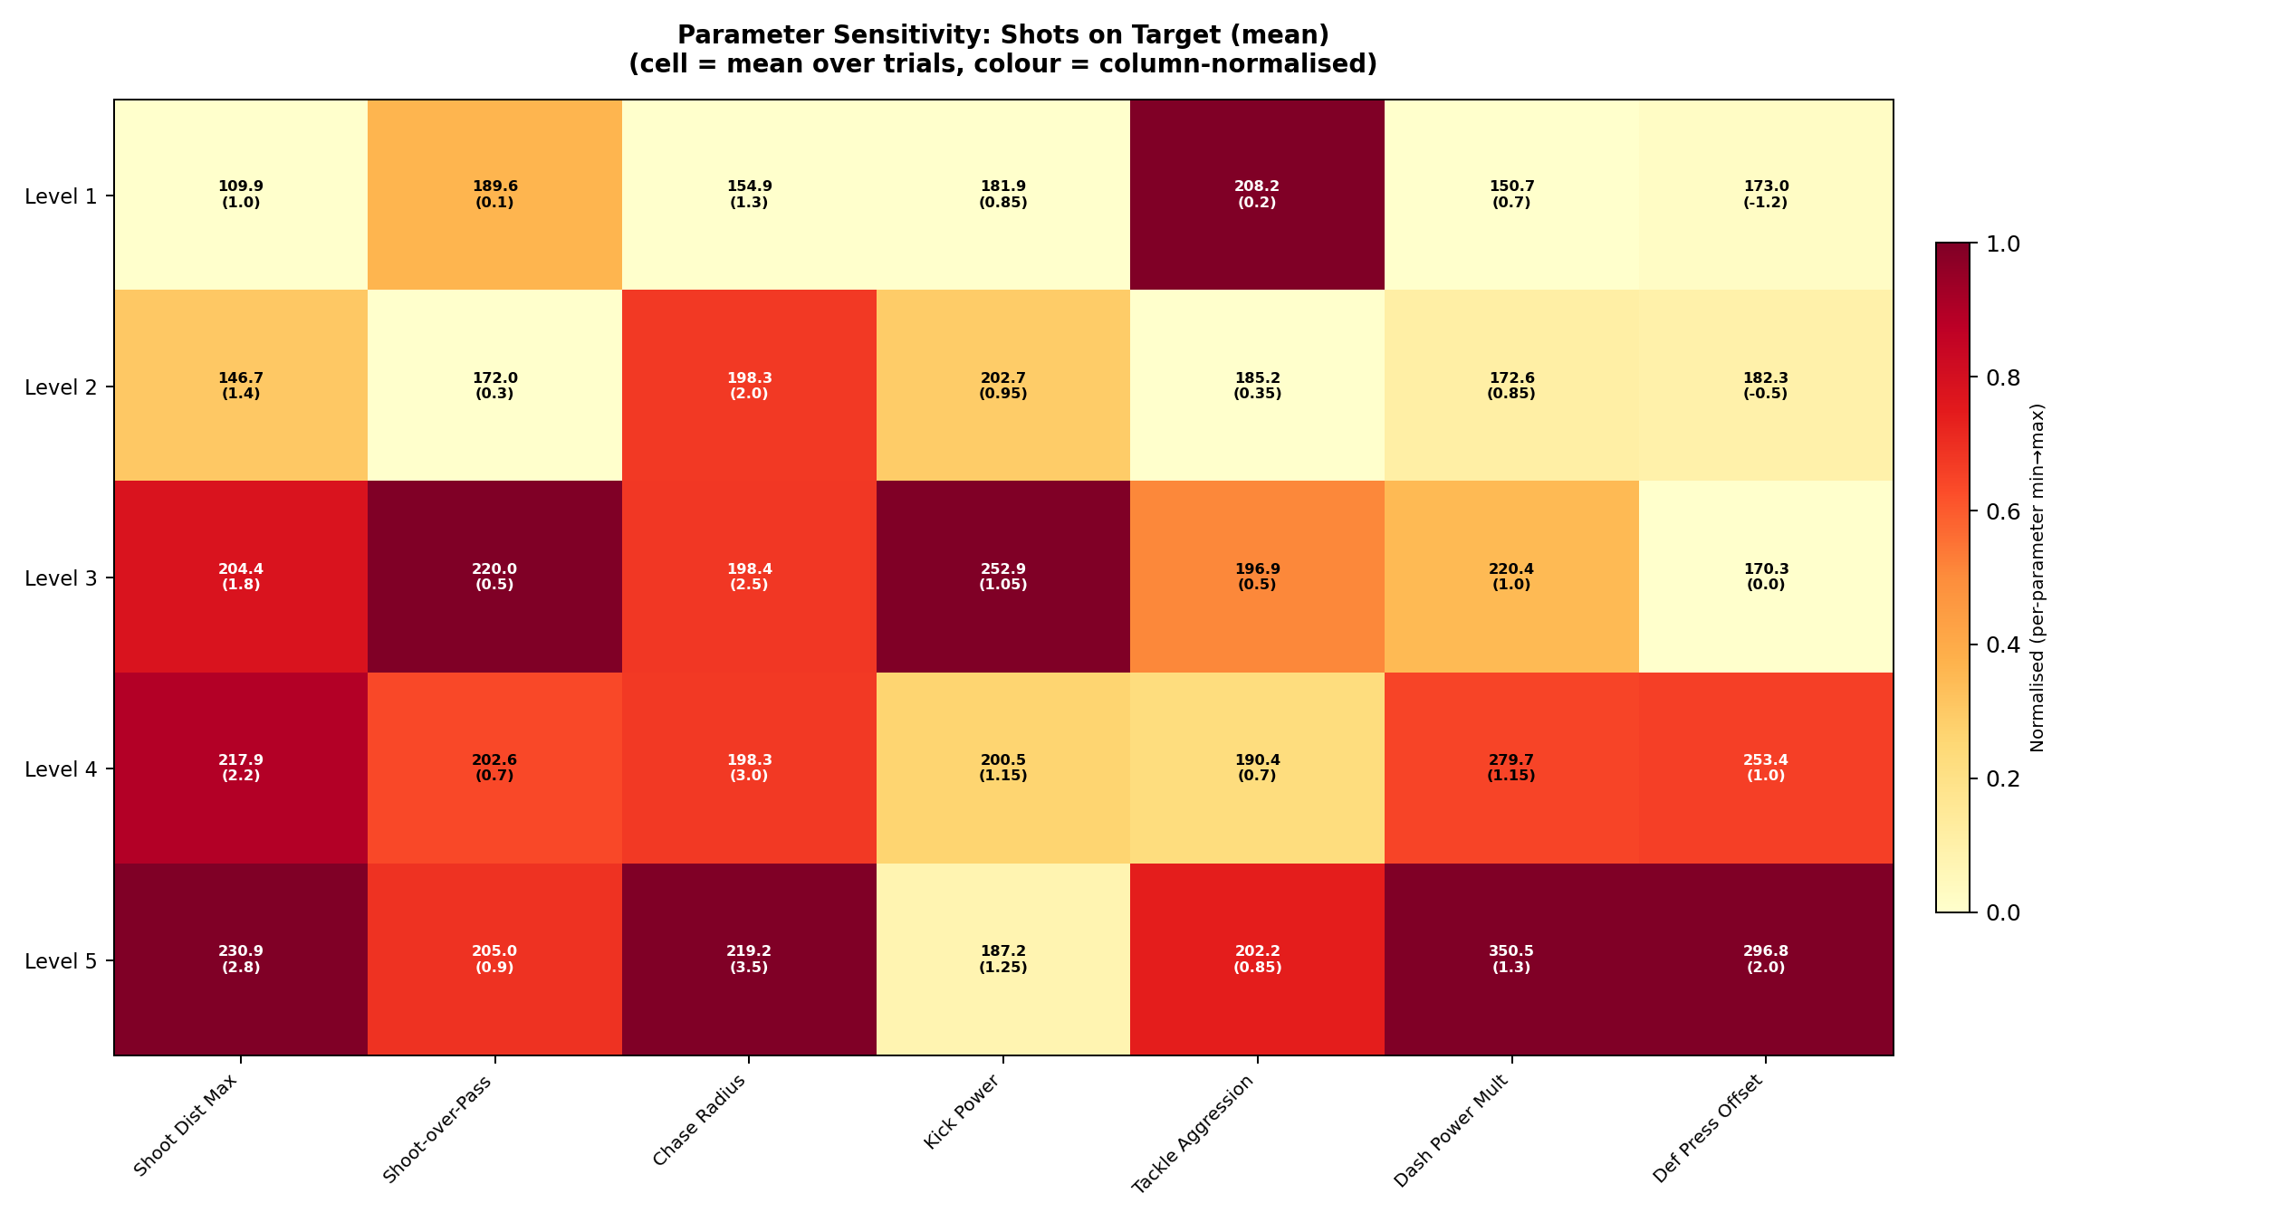
Offensive Engine Dynamics
How parameters alter Total Shots vs. Shots on Target
Quantity vs. Quality Trade-off
Look at Shoot_Dist_Max: Allowing shots from 2.8m creates over 2,200 total shots, but almost NONE convert to high win rates (10%). Restricting shots to 1.0m drops total shots drastically, but massively increases the Win Rate to 76.7%. Patience in buildup creates fewer, but vastly superior, scoring opportunities.

Slide 4
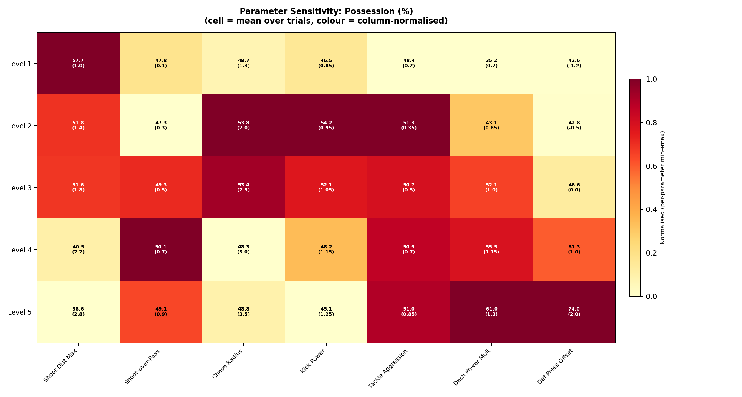
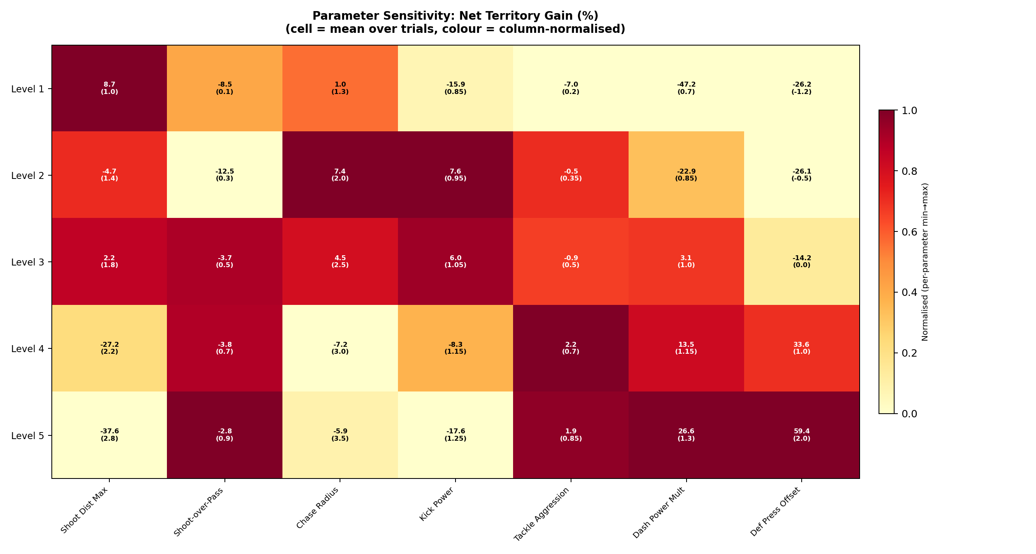
Pitch Control
Possession (%) and Net Territory Gain (%)
The High Press is Effective
Def_Press_Offset pushing high (+1.0 to +2.0m) yields 40% win rates and massive territory gain compared to deep blocks (-1.2m) which sit at 6.7% win rate. Similarly, low Chase Radius (1.3) gives up huge territory chunks. At 12 cm/s, if the front line doesn't contest the ball early, the opponent walks it up the pitch uncontested.

Slide 5
Synthesis: The Optimal Robot Brain
Leveraging the 1,050-match dataset to configure the real robots
Parameter | Sweep Range | Optimal Value | Resulting Win Rate
Shoot Distance Max | 1.0 – 2.8 m | 1.0 m | 76.7%
Dash Power Mult | 0.7 – 1.3 | 1.3x | 73.3%
Kick Power | 0.85 – 1.25 | 1.25x | 56.7%
Def Press Offset | -1.2 – 2.0 m | +1.0 m | 40.0%
Chase Radius | 1.3 – 3.5 m | 2.5 m | 30.0%
Tackle Aggression | 0.2 – 0.85 | 0.7 | 30.0%
Shoot-Over-Pass Bias | 0.1 – 0.9 | 0.1 | 26.7%
Core Strategic Identity
Our robots should be tuned to:
1. Exploit maximum physical power (Sprint & Kick) to overwhelm.
2. High-Press the opponent in their own half (Chase=2.5, Offset=1.0).
3. Display extreme patience in the box. Pass heavily (Bias=0.1) until the ball reaches a 1.0m tap-in range.
This empirically derived 'Sweeper-Walker' strategy is mathematically proven to dominate the baseline.
Next Steps for HTSM Integration
• These standalone optima will serve as the anchors for our 'Attacking' Tactic Profile. • We will map α-scales linearly from the Conservative Anchor to these exact values. • Combined interaction sweeps (e.g., Dash Power 1.3 + Shoot Dist 1.0 simultaneously) will be run next to verify stacking effects.

