Slide 1

Robotics TDP: Team 1 Final Presentation

Slide 2
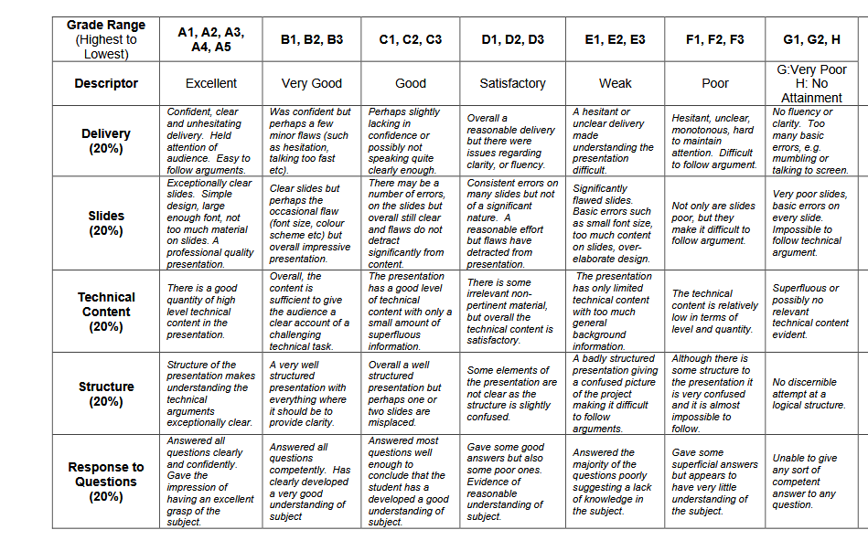
General Guidelines
Should aim for ~20 slides total. You should be able to present your slides in 2.5 mins
Font size = 20
Use bullet points and avoid long paragraphs
Marking scheme is on right
In particular note:
"Clear slides. Simple design, large enough font, not too much material on slides"
80% of marks on non-technical work.

Slide 3
Introduction

Slide 4
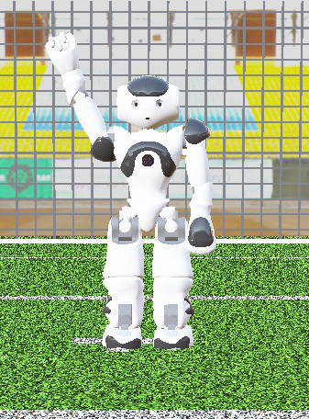
Introduction: Presentation Structure
Presenting today:
1. Introduction – Ciarán Breen (Project Manager)
2. Methodology
3D – Jie Shu (WP 2 Lead)
2D – Chengjie Hao (WP 5 Lead)
3. Results and Analysis – Bonolo Masima (WP 3 Lead)
4. Team Performance – Wang Jinghao (WP6 Lead)
5. Conclusions – Wang Zefu (WP 4 Lead)

Slide 5
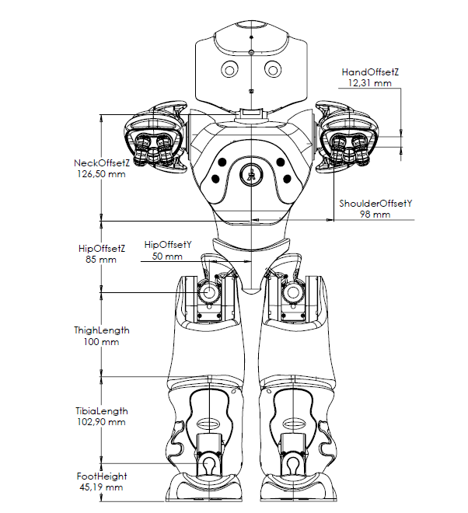
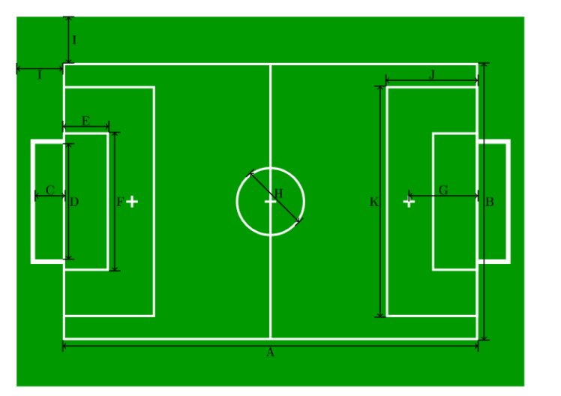
Introduction: Project Requirements
Project Goal:
Develop a simulation of 2 Robocup teams and their playing environment, and use this simulation to design, develop, and optimise the behavioural algorithms for those teams
Test the optimised behavioural algorithms we developed on hardware.
Requirements Summary:
2 teams of 4 NAO6 robots each with 3 behaviours: Goalkeeper, Defender, Striker
Follow the general rules of soccer as outlined by RoboCup
Totally autonomous with ability to react to state of play

Slide 6
Introduction: Project Structure
Six individual work packages (WPs): Full Project, Simulation Phase, Hardware Phase
Project management and Specification
Simulation Environment
Development
Guidance and Control
Behavioural
Algorithms
Integration
Testing
Lead:
Ciaran Breen
Jie Shu
Bonolo Masima
Wang Zefu
Chengjie Hao
Wang Jinghao
Project Manager handles non-technical project tasks
All team members lead one WP and will assist with others
Each workpackage has tasks and deliverables assigned at beginning of project which fed project plan
Project did not advance into hardware phase
Notes:
Six work packages across the whole lifecycle of the project
Project Manager, which is me, handles non-technical project tasks
Everyone else leads a technical workpackage with others assisting
Teams + github

Slide 7
Methodology (3D)

Slide 8
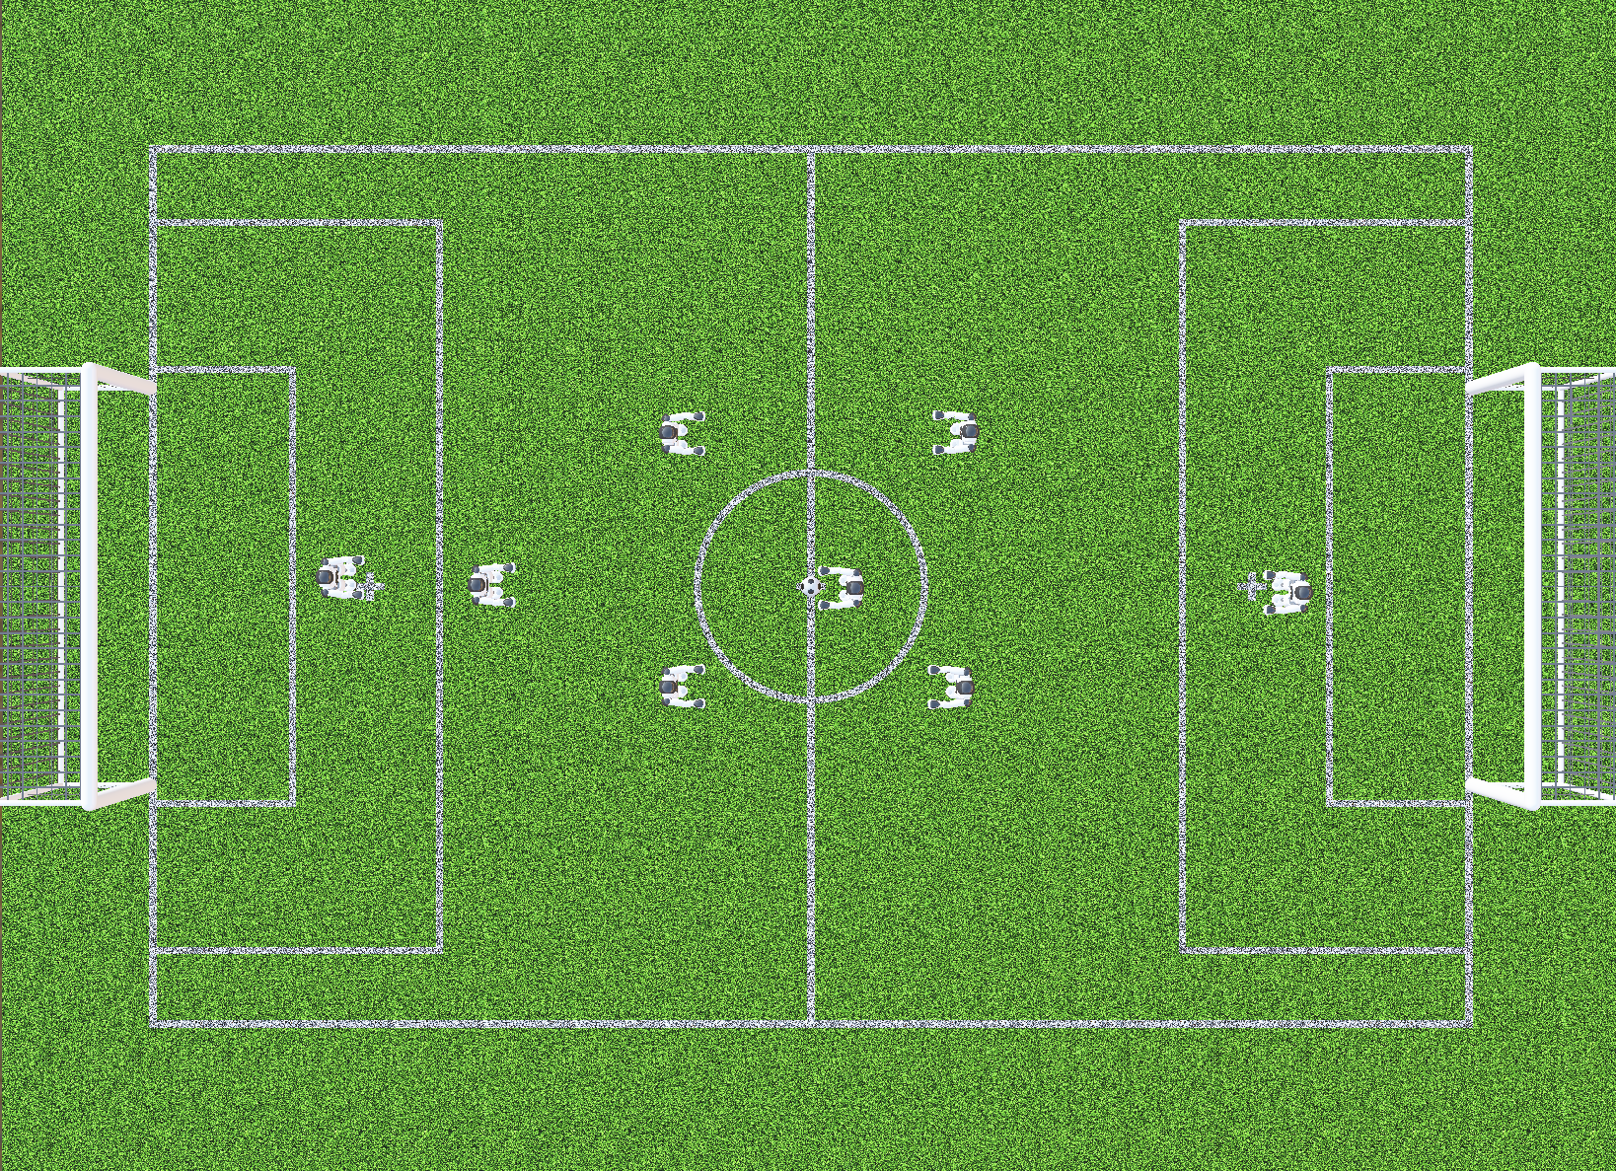
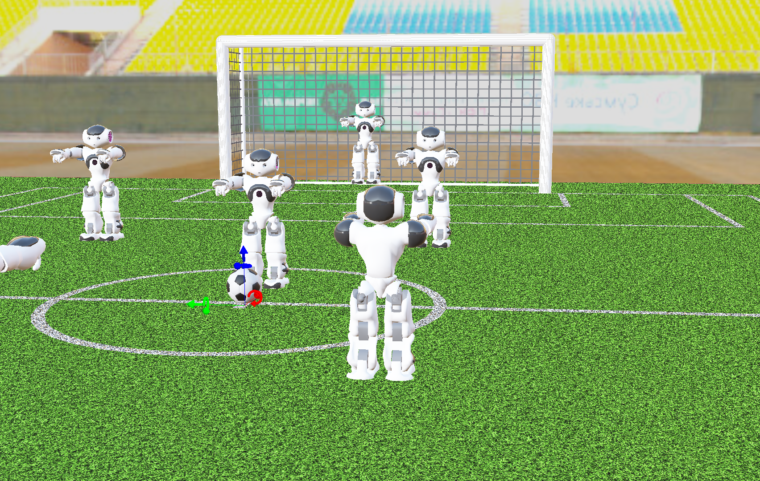
Model Creation And Validation
Model Creation
Built the NAO6 robot model in the Webots 3D environment
Configured the simulation scene with robot, ball, and pitch
Used the Webots physics engine to represent realistic motion constraints
Model Validation
Verified robot motion behaviours in Webots (walking, turning, approaching the ball, kicking)
Observed that motion is physically consistent but slow (due to stability and simulation constraints)
Identified limitations for high-level behaviour testing (e.g., long execution time, reduced responsiveness)

Slide 9
Controller Design And Testing Results
Detect Ball
Walking:
Max Stable Frequency: 1.4 steps/s
Max Velocity: 12 cm/s
Average Drift: ~0.8 cm/m (@ max velocity)
Turning (with PID balance control):
Average Yaw Speed: 0.424 rad/s
Max Yaw Speed: 0.831 rad/s
Kicking:
Kick Distance: ~1.3m
Recovery from fall:
Recovery Time: ~26s (from lying on back)
Turn to Target
Walk Forward
Stop & Align
Kick

Slide 10
Methodology (2D)

Slide 11
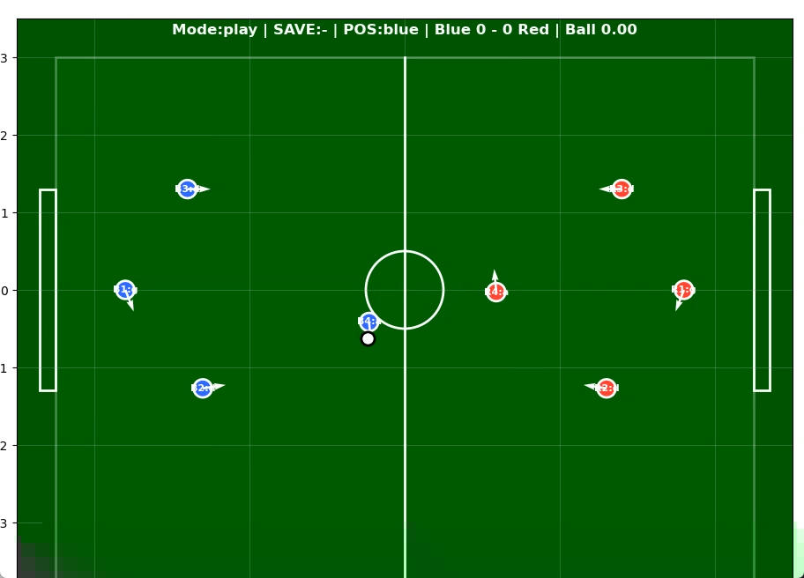
How we develop a 2D model
Solution for the bottleneck we've met:
2D Simulation for behavioral development
Much quicker to run simulations
Start behavioral development while continually updating with kinematic parameters from 3D

Slide 12
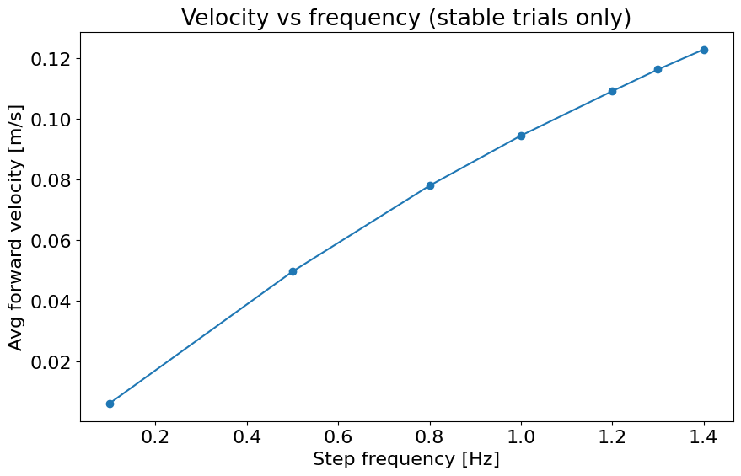
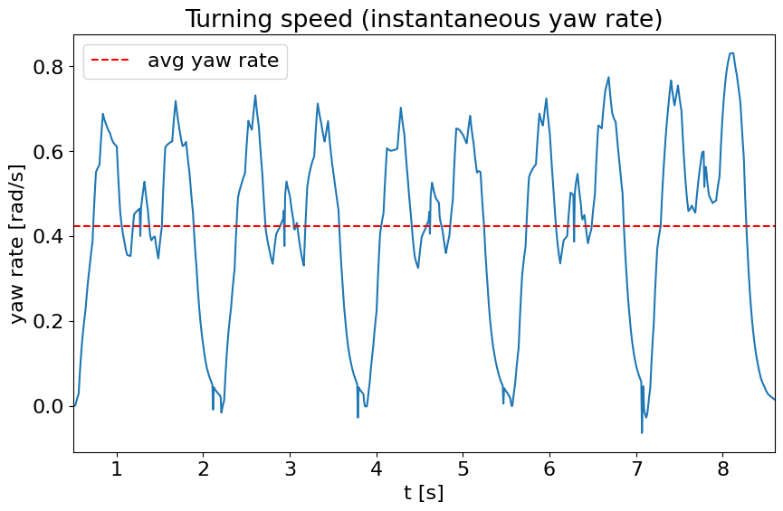
How we made the model realistic:
Category | Metric | Value
Walking | Stable Frequency | 1.4 steps/s
 | Max Velocity | 12 cm/s
 | Average Drift | ~0.8 cm/m (@ max velocity)
Turning | Average Yaw Speed | 0.424 rad/s
 | Max Yaw Speed | 0.831 rad/s
Kicking | Kick Distance | ~1.3m
Recovery | Recovery Time | ~26s (from lying on back)
... | ... | ...
2X
2X

Slide 13
Behaviour Model & Test
FSM Implementation
Behaviour Pipeline
State-based control (move, kick, defend, recover)
Condition-based transitions (distance, possession, context)
Role-specific behaviours (attacker / defender / goalkeeper)
World state
Decision Function
Finite State Machine
Testing method
Action Output
One-variable-at-a-time testing
Measure performance (goals, possession, stability)
Enables clear and reproducible tuning
Robot Motion

Slide 14
Results and Analysis

Slide 15
Suggested Structure
From guidelines: Required results to illustrate completion of each stage and discussion of the analysis of these results. (Just focus on behavior I think)
Description of metrics being analysed – why are they important
Results of parameter optimisation tests
Final simulation of games. Baseline vs Optimized (static), Optimised (static) vs Optimised (Dynamic)
Analysis – which parameters are significant to performance? Does dynamic behavior help?

Slide 16
Team Performance Analysis

Slide 17
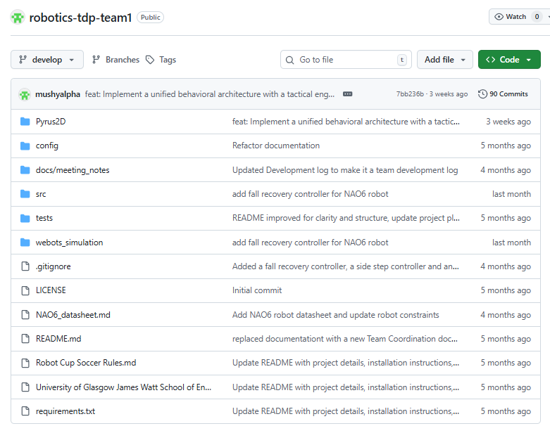
Assign tasks according to WPs
Weekly Meetings
Sync progress to GitHub
Fill in the TARs
Our GitHub
Workflow

Slide 18
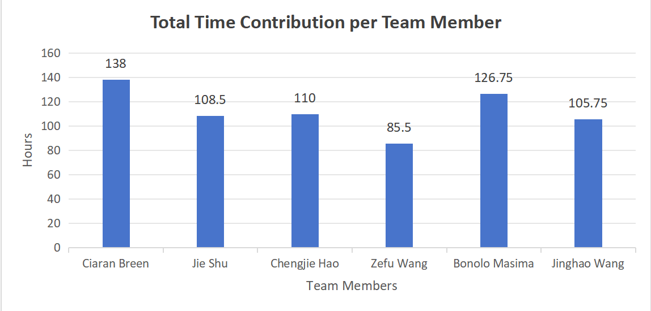

Slide 20
Suggested Structure
From guidelines: Evaluation of the performance of your team, including a comparison of your estimated and actual time/costs.
Explanation of how we worked as a team: Breaking project into workpackages, weekly team meetings (admin and technical), use of github for collavorative coding.
Analysis of time contributions from TARs
Comparison of estimated cost vs. Actual cost (I've attached our estimate from week 1 in next slide)

Slide 21
Cost Estimate
Project runs for a total of 19 weeks during term:
Week 3 (not incl. kickoff) – Week 10 in Semester 1 (8 weeks)
Week 1 – Week 11 in Semester 2 (11 weeks)
We estimate 10 hrs per person per week (2hrs meetings + 8hrs technical).
Team Staff Costs = £250/hr * 10hrs * 6 team members * 19 weeks
= £285,000
We estimate 20hrs expert help: ~ 1hr per week
Expert Staff Costs = £1250/hr * 20 hrs = £25,000
Total Cost = £285000 + £25000 = £310,000
Actually we estimate 674.5 hrs totally and the total cost is £250/hr * 674.5 = £168625

Slide 22
Conclusions and Future Work

Slide 23
Suggested Structure
From guidelines: Findings from the study as a bullet point list. Overall assessment of the project outcomes
Summarise our findings and performance. What went well? What didn't go well and why? I think we need to address why we didn't make it past behavioral stage
Future work – what would we do if we had more time? How would we have moved onto hardware.

Slide 24




Thank you for listening! Any questions?
#UofGWorldChangers
@UofGlasgow

Slide 25
Results & Analysis: Methodology
Behavioural Parameter Sensitivity | 1,050 Match Sweep
1,050 Match parameter sweep
7 Performance metrics tracking
Optimal values proven
→
→
4v4 Robots
9×6 m Pitch
12 cm/s Walk
20 min Match
30 Trials/Level
The Asymmetric Sweep Advantage
By running Blue Team (Experimental) against Red Team (Fixed Baseline), we isolated the exact impact of each parameter on Win Rate and Goal Difference, breaking the previous 0% mirror-match deadlocks.

Slide 26
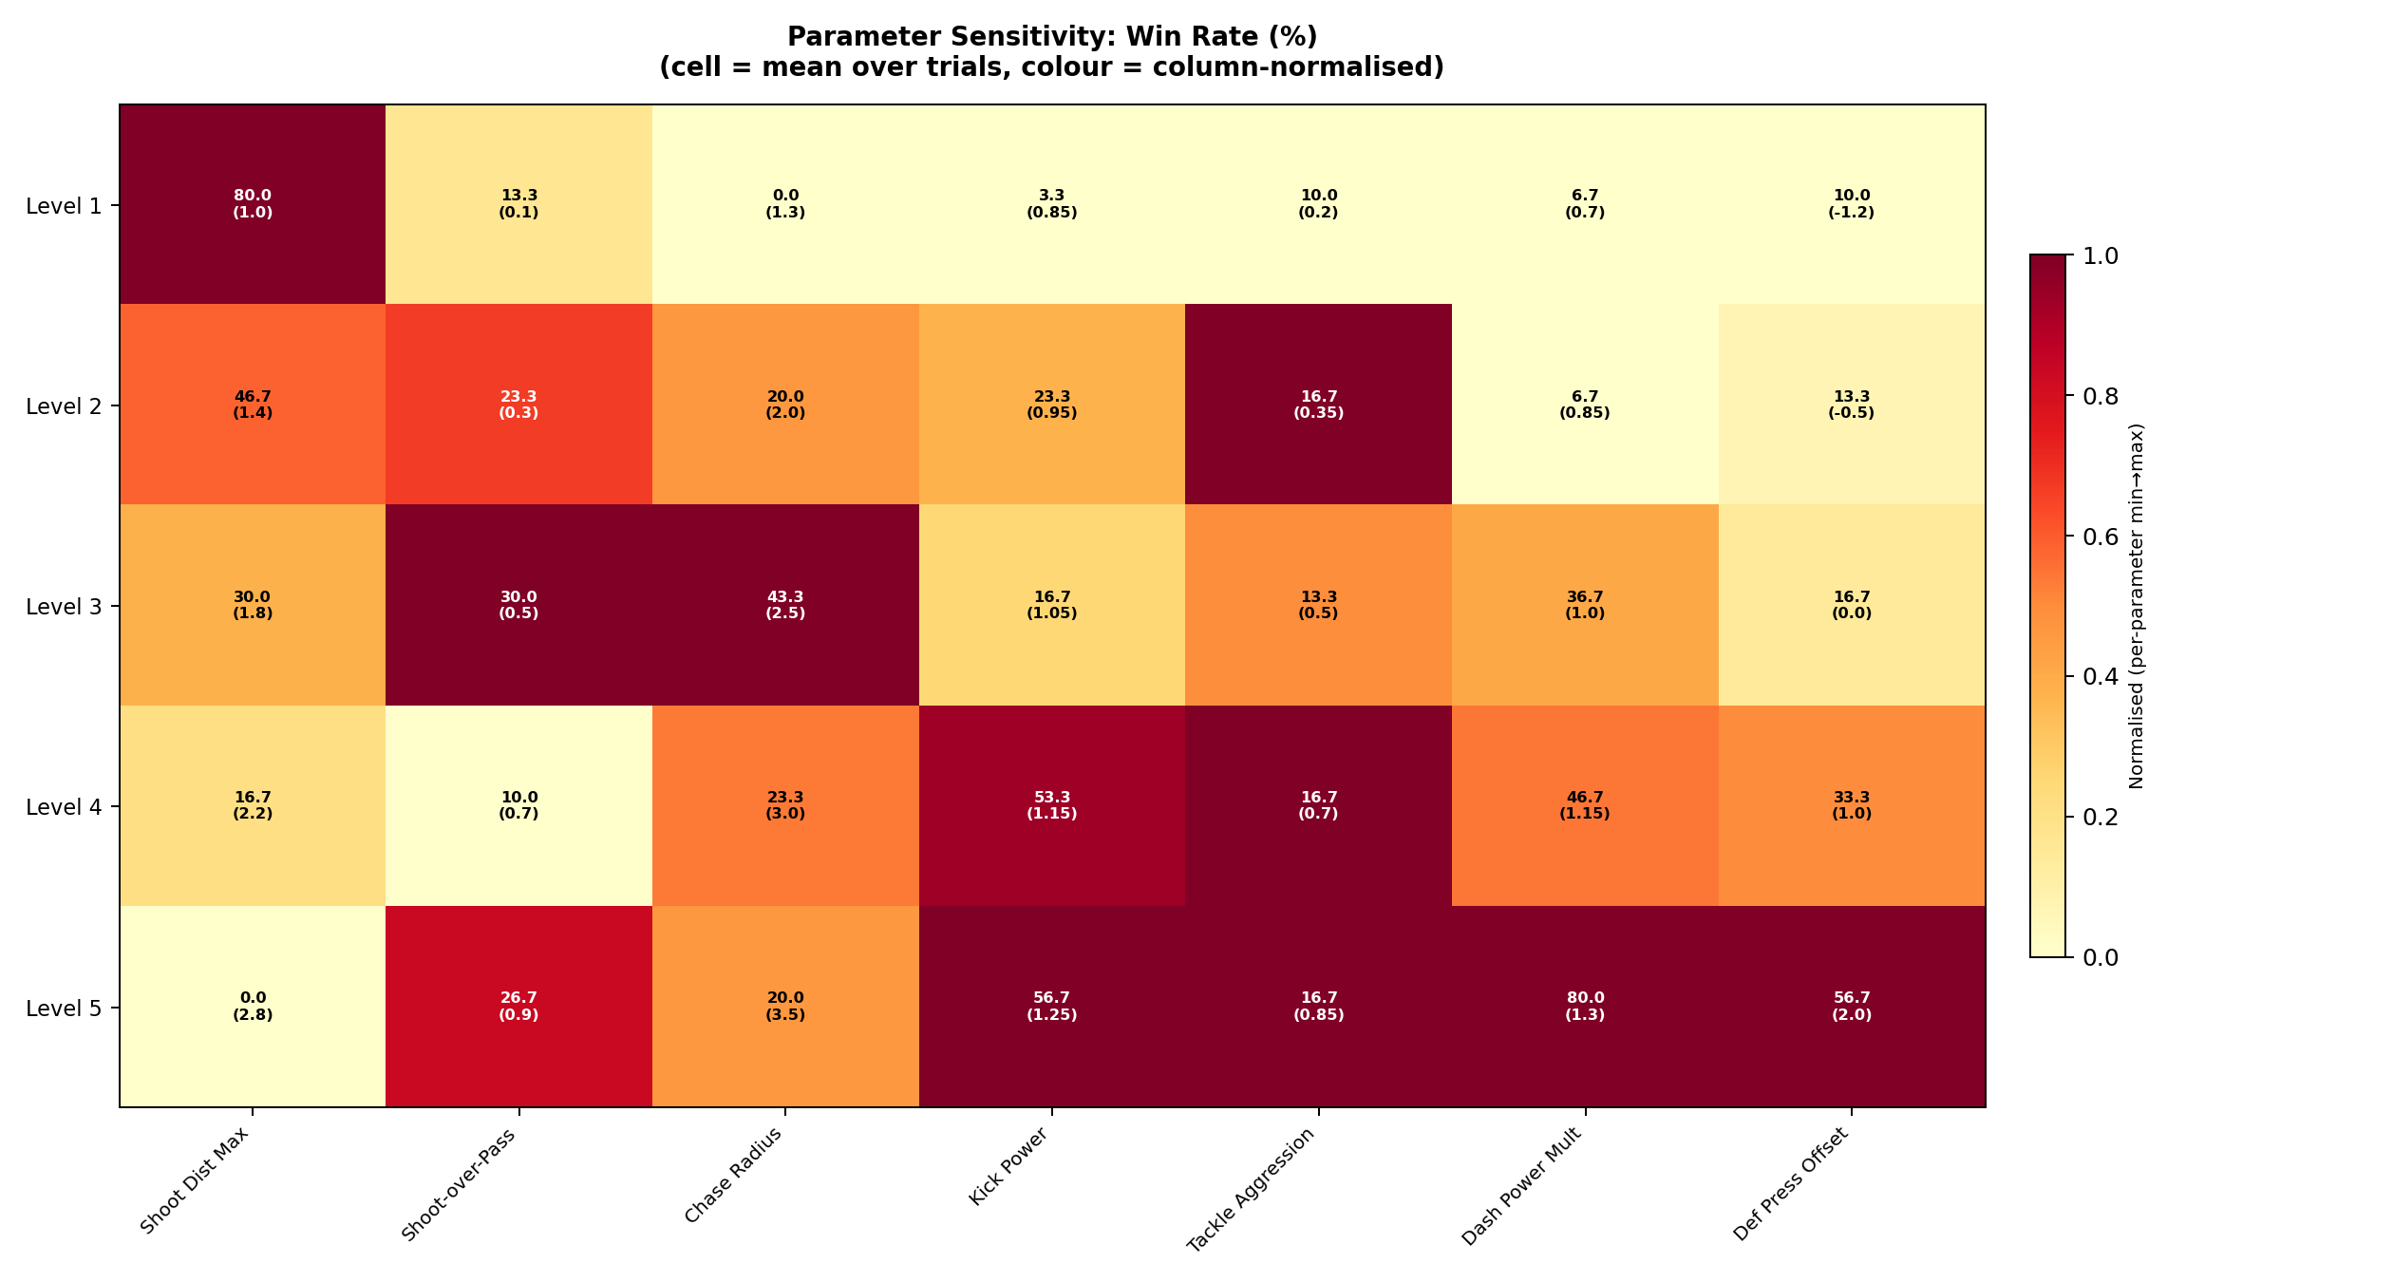
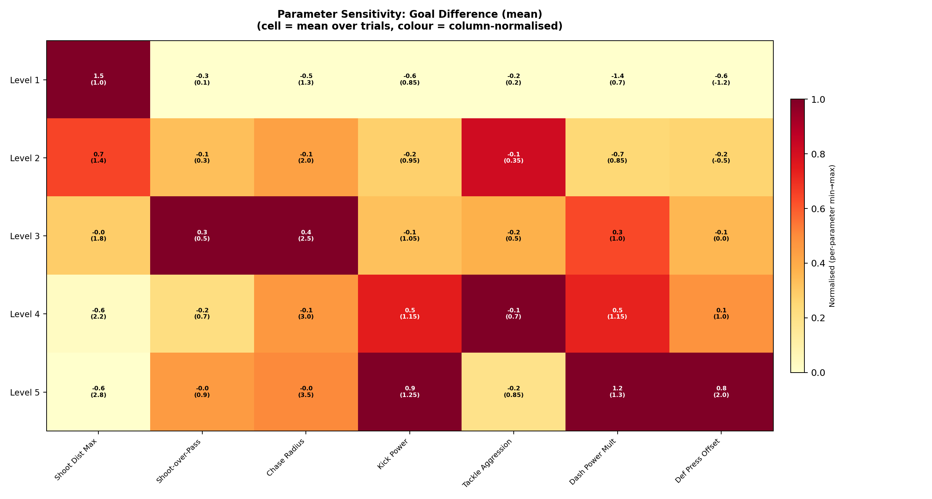
Performance Impact
Win Rate (%) and Goal Difference across 7 parameters
★ Key finding: Speed and Power Dominate
★ Key finding: Short-Range Precision
Dash Power Mult and Kick Power show massive linear correlations with Win Rate. Moving from 0.7x to 1.3x Dash Power skyrockets the Win Rate from 0% to 73.3%. Faster players break lines, faster kicks beat the goalie.
Shoot_Dist_Max = 1.0m yields a 76.7% Win Rate and +1.33 Goal Diff. Shooting from far out (2.8m) guarantees a 0-0 or loss. 'Walking it in' is the optimal 2D robot offensive strategy.

Slide 27
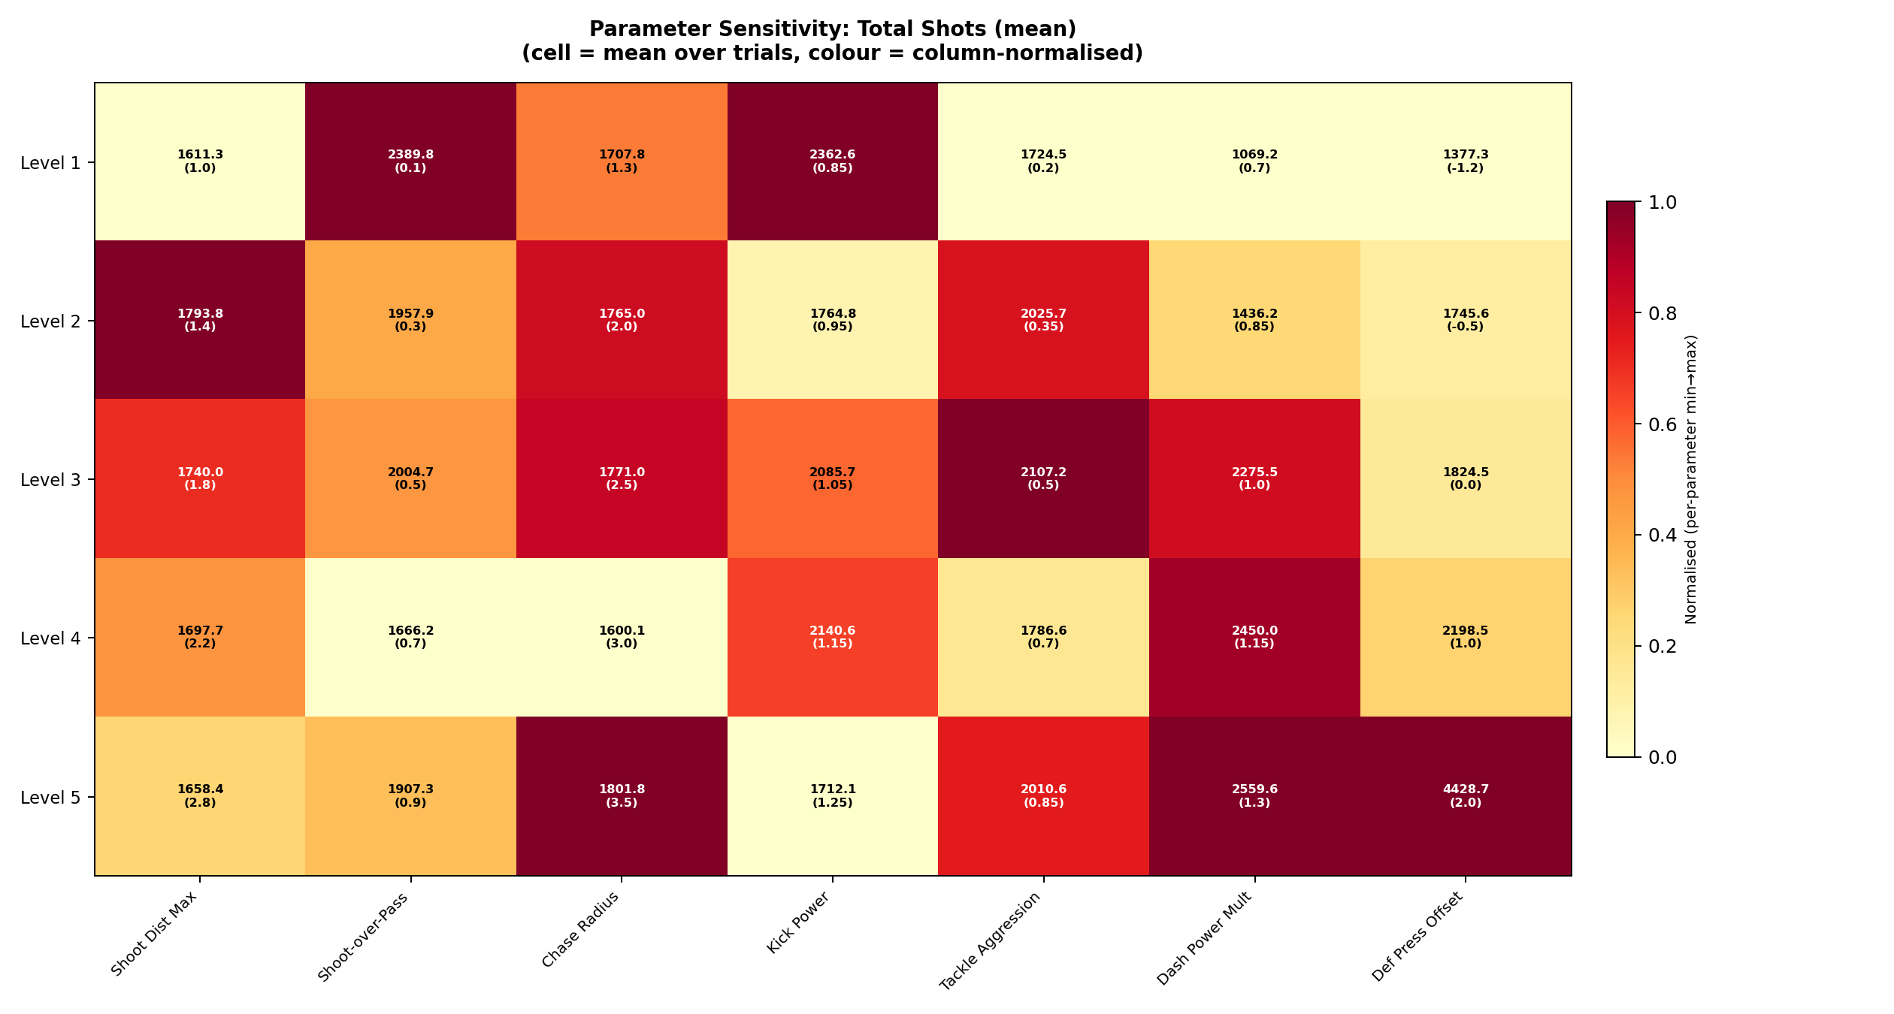
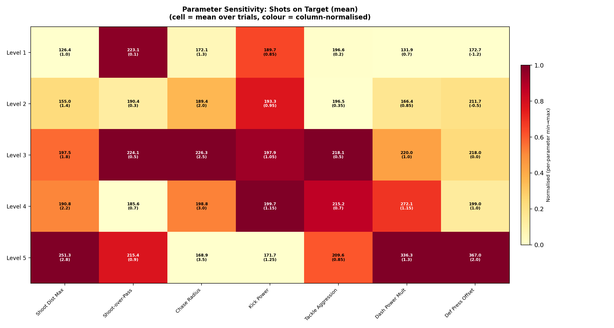
Offensive Engine Dynamics
How parameters alter Total Shots vs. Shots on Target
Quantity vs. Quality Trade-off
Look at Shoot_Dist_Max: Allowing shots from 2.8m creates over 2,200 total shots, but almost NONE convert to high win rates (10%). Restricting shots to 1.0m drops total shots drastically, but massively increases the Win Rate to 76.7%. Patience in buildup creates fewer, but vastly superior, scoring opportunities.

Slide 28
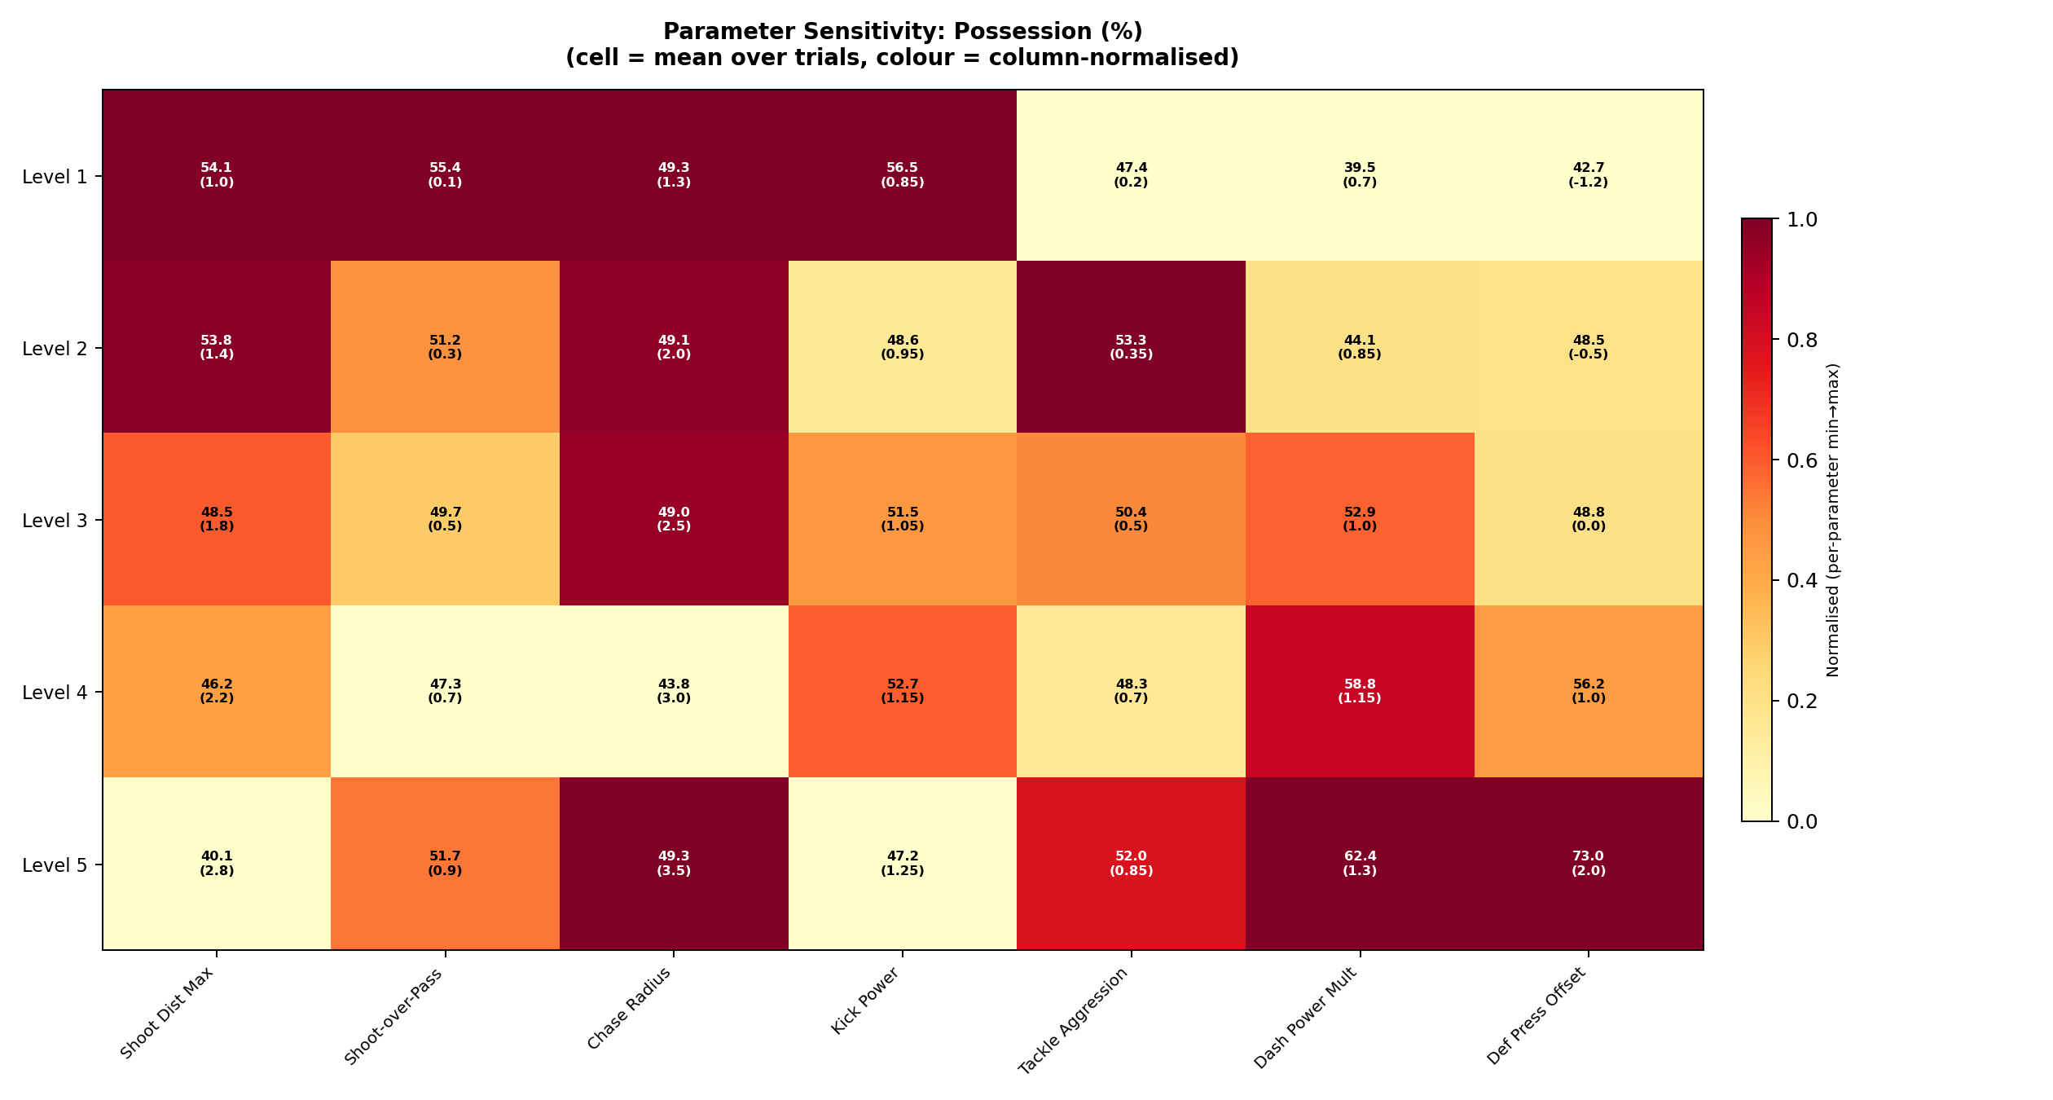
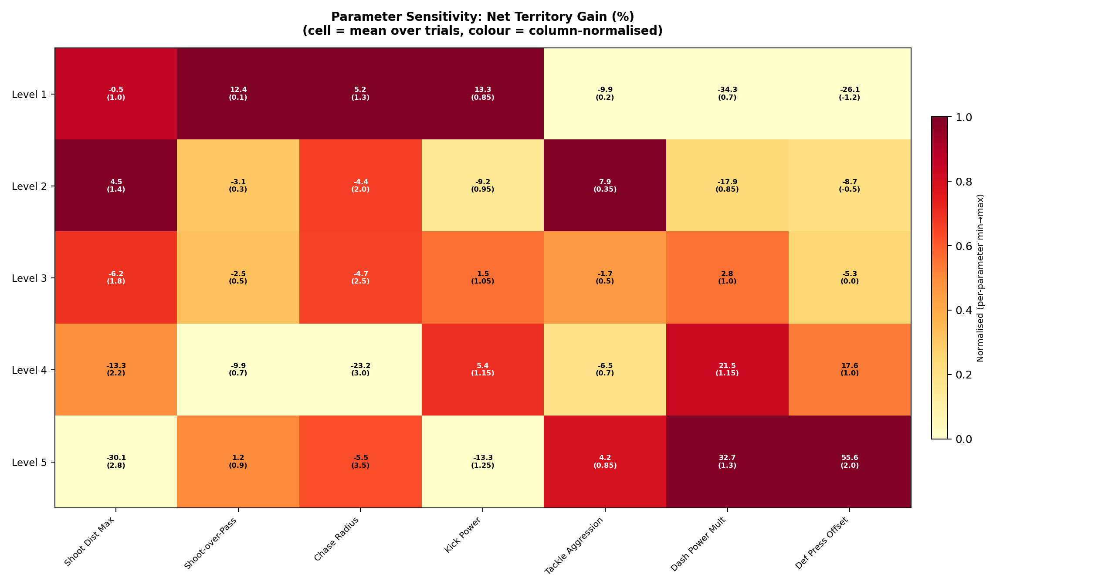
Pitch Control
Possession (%) and Net Territory Gain (%)
The High Press is Effective
Def_Press_Offset pushing high (+1.0 to +2.0m) yields 40% win rates and massive territory gain compared to deep blocks (-1.2m) which sit at 6.7% win rate. Similarly, low Chase Radius (1.3) gives up huge territory chunks. At 12 cm/s, if the front line doesn't contest the ball early, the opponent walks it up the pitch uncontested.

Slide 29
Synthesis: The Optimal Robot Brain
Leveraging the 1,050-match dataset to configure the real robots
Parameter | Sweep Range | Optimal Value | Win Rate
Shoot Distance Max | 1.0 – 2.8 m | 1.0 m | 76.7%
Dash Power Mult | 0.7 – 1.3 | 1.3x | 73.3%
Kick Power | 0.85 – 1.25 | 1.25x | 56.7%
Def Press Offset | -1.2 – 2.0 m | +1.0 m | 40.0%
Chase Radius | 1.3 – 3.5 m | 2.5 m | 30.0%
Tackle Aggression | 0.2 – 0.85 | 0.7 | 30.0%
Shoot-Over-Pass Bias | 0.1 – 0.9 | 0.1 | 26.7%
Core Strategic Identity
Our robots should be tuned to:
1. Exploit max physical power (Sprint & Kick) to overwhelm.
2. High-Press the opponent in their own half (Chase=2.5, Offset=1).
3. Display extreme patience in the box. Pass heavily (Bias=0.1) until the ball reaches a 1.0m tap-in range.
This empirically derived 'Sweeper-Walker' strategy is mathematically proven to dominate the baseline.
Next Steps for HTSM Integration
• These standalone optima will serve as the anchors for our 'Attacking' Tactic Profile. • We will map α-scales linearly from the Conservative Anchor to these exact values. • Combined interaction sweeps (e.g., Dash Power 1.3 + Shoot Dist 1.0 simultaneously) will be run next to verify stacking effects.

Slide 30
HTSM Tactical Integration
Mapping Empirical Optima to Dynamic Game States
Grounding in 3D Webots Physics
Anchoring the Profiles
The simulation engine constraints align with measured 3D physical parameters: • Walk Velocity: Max 12 cm/s (1.4 steps/s) • Kick Distance: ~1.3m max range • Turn Speed: 0.42 to 0.83 rad/s • Fall Recovery: 26s (from back) This ensures that tactical behaviours developed in 2D are perfectly constrained for transfer to the physical robots.
The optimal parameters from our 1,050-match sweep form the anchor for our 'All Out Attack' profile (α = 1.0). From there, values scale dynamically towards a conservative 'Park the Bus' profile (α = 0.0) based on real-time game states (Score Difference and Time Remaining).
Tactic Profile | α value | Shoot Dist Max | Chase Radius | Def Press Offset | Shoot Bias
Park the Bus | 0.10 | 1.0 m | 1.3 m | −3.2 m (Deep) | 0.1
Balanced | 0.50 | 1.0 m | 2.0 m | −1.0 m | 0.5
Counter Attack | 0.70 | 1.0 m | 2.5 m | 0.0 m | 0.7
All Out Attack | 0.95 | 1.0 m | 2.5 m | +1.0 m (High) | 0.9
Fluid Formation Shifting
Rather than snapping between rigid formations (like 1-2-1), the alpha parameter dictates continuous positional offsets. As tactcs shift securely from Defense to Attack, defenders dynamically press up into midfield (+1.0m) and attackers physically shift wide and forward to overwhelm.

