Slide 1

Robotics TDP: Team 1 Final Presentation

Slide 2
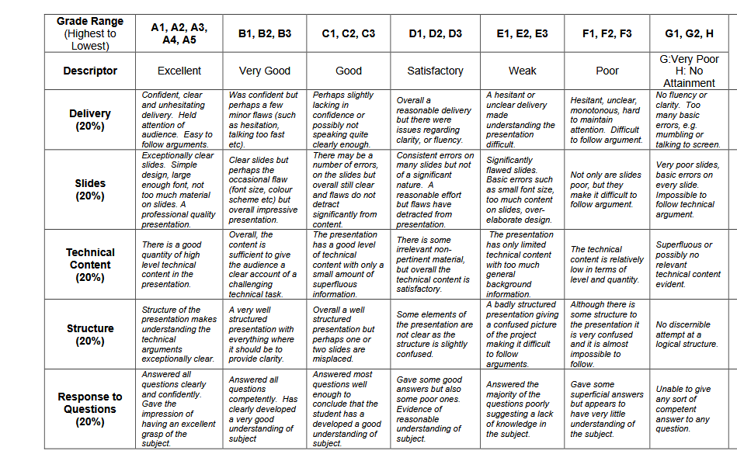
General Guidelines
Should aim for ~20 slides total. You should be able to present your slides in 2.5 mins
Font size = 20
Use bullet points and avoid long paragraphs
Marking scheme is on right
In particular note:
"Clear slides. Simple design, large enough font, not too much material on slides"
80% of marks on non-technical work.

Slide 3
Introduction

Slide 4
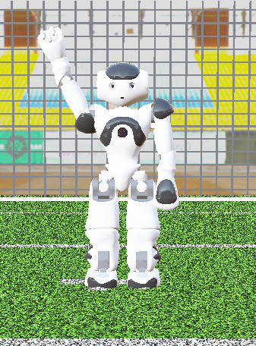
Introduction: Presentation Structure
Presenting today:
1. Introduction – Ciarán Breen (Project Manager)
2. Methodology
3D – Jie Shu (WP 2 Lead)
2D – Chengjie Hao (WP 5 Lead)
3. Results and Analysis – Bonolo Masima (WP 3 Lead)
4. Team Performance – Wang Jinghao (WP6 Lead)
5. Conclusions – Wang Zefu (WP 4 Lead)

Slide 5
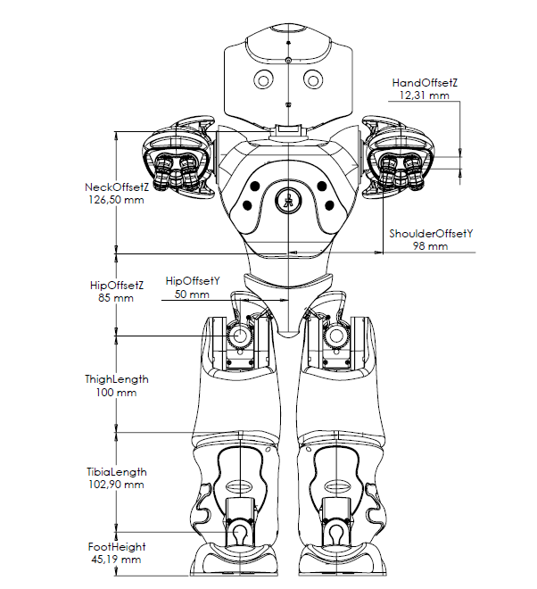
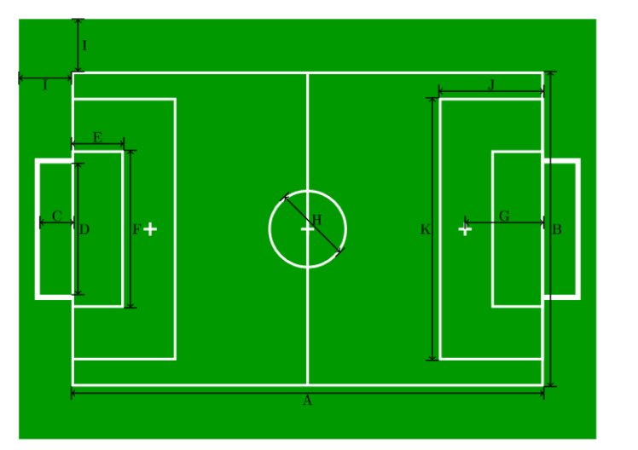
Introduction: Project Requirements
Project Goal:
Develop a simulation of 2 Robocup teams and their playing environment, and use this simulation to design, develop, and optimise the behavioural algorithms for those teams
Test the optimised behavioural algorithms we developed on hardware.
Requirements Summary:
2 teams of 4 NAO6 robots each with 3 behaviours: Goalkeeper, Defender, Striker
Follow the general rules of soccer as outlined by RoboCup
Totally autonomous with ability to react to state of play

Slide 6
Introduction: Project Structure
Six individual work packages (WPs): Full Project, Simulation Phase, Hardware Phase
Project management and Specification
Simulation Environment
Development
Guidance and Control
Behavioural
Algorithms
Integration
Testing
Lead:
Ciaran Breen
Jie Shu
Bonolo Masima
Wang Zefu
Chengjie Hao
Wang Jinghao
Project Manager handles non-technical project tasks
All team members lead one WP and will assist with others
Each workpackage has tasks and deliverables assigned at beginning of project which fed project plan
Project did not advance into hardware phase
Notes:
Six work packages across the whole lifecycle of the project
Project Manager, which is me, handles non-technical project tasks
Everyone else leads a technical workpackage with others assisting
Teams + github

Slide 7
Methodology (3D)

Slide 8
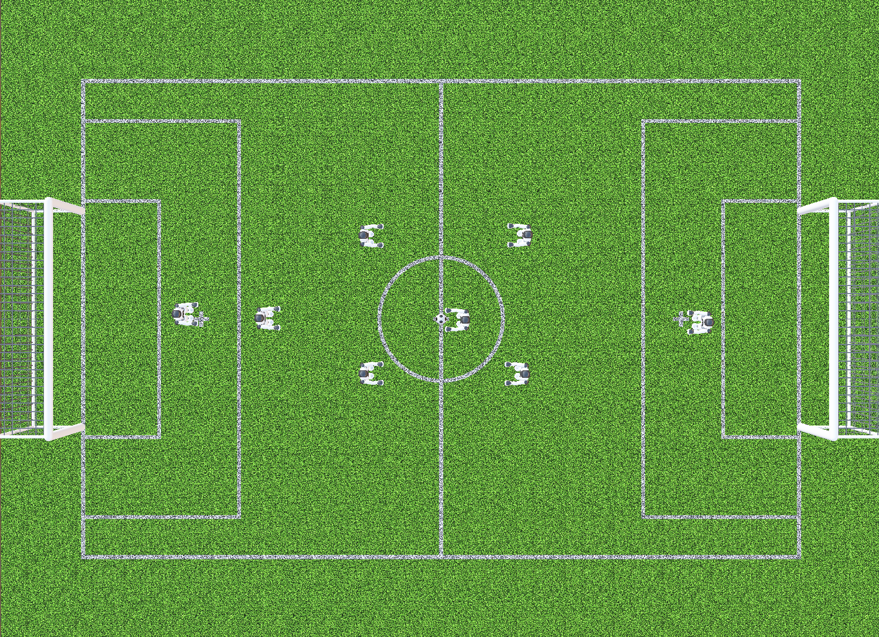
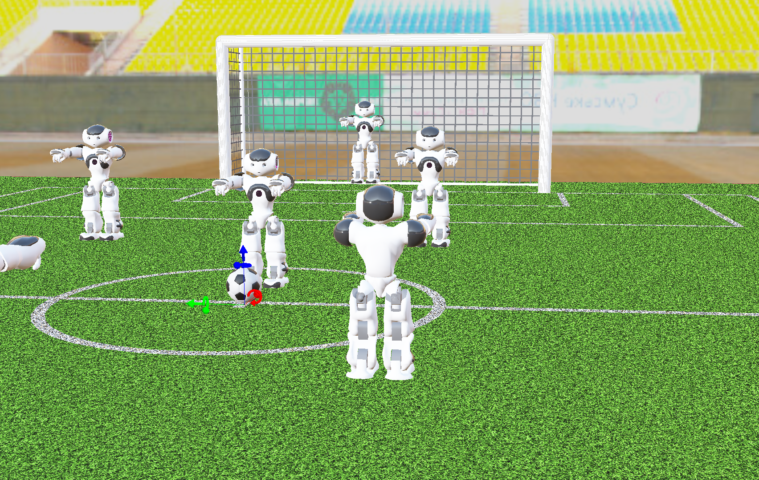
Model Creation And Validation
Model Creation
Built the NAO6 robot model in the Webots 3D environment
Configured the simulation scene with robot, ball, and pitch
Used the Webots physics engine to represent realistic motion constraints
Model Validation
Verified robot motion behaviours in Webots (walking, turning, approaching the ball, kicking)
Observed that motion is physically consistent but slow (due to stability and simulation constraints)
Identified limitations for high-level behaviour testing (e.g., long execution time, reduced responsiveness)

Slide 9
Controller Design And Testing Results
Detect Ball
Walking:
Max Stable Frequency: 1.4 steps/s
Max Velocity: 12 cm/s
Average Drift: ~0.8 cm/m (@ max velocity)
Turning (with PID balance control):
Average Yaw Speed: 0.424 rad/s
Max Yaw Speed: 0.831 rad/s
Kicking:
Kick Distance: ~1.3m
Recovery from fall:
Recovery Time: ~26s (from lying on back)
Turn to Target
Walk Forward
Stop & Align
Kick

Slide 10
Methodology (2D)

Slide 11
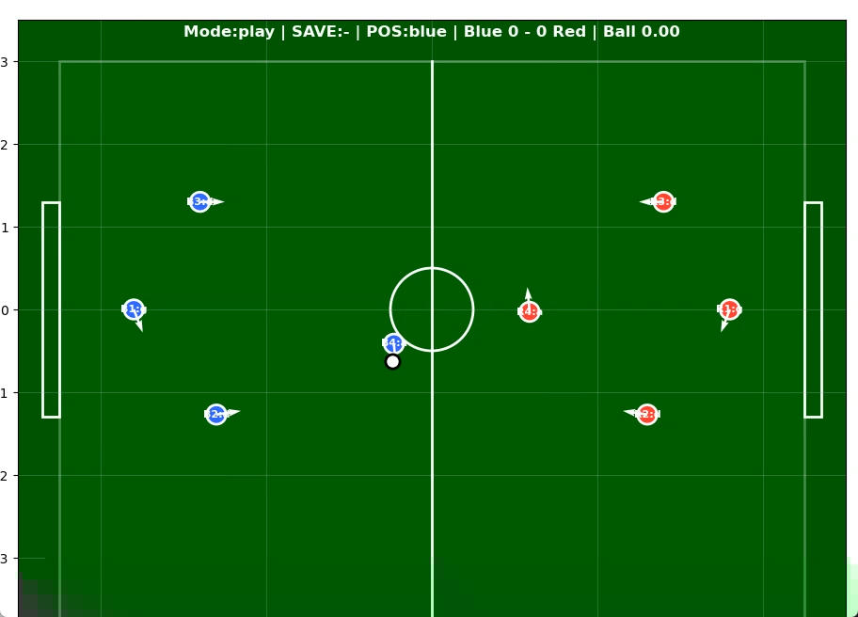
How we develop a 2D model
Solution for the bottleneck we've met:
2D Simulation for behavioral development
Much quicker to run simulations
Start behavioral development while continually updating with kinematic parameters from 3D

Slide 12
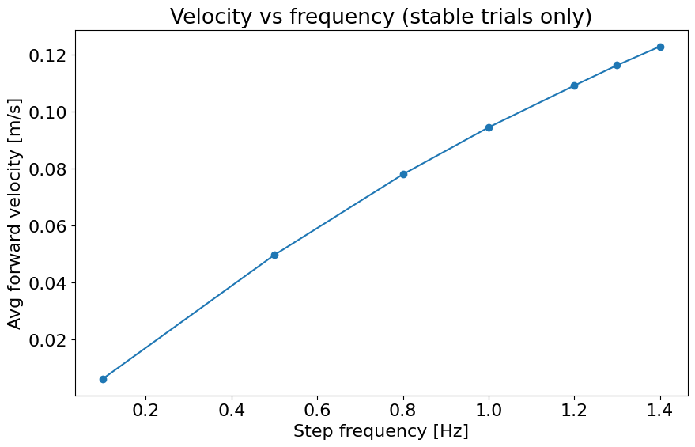
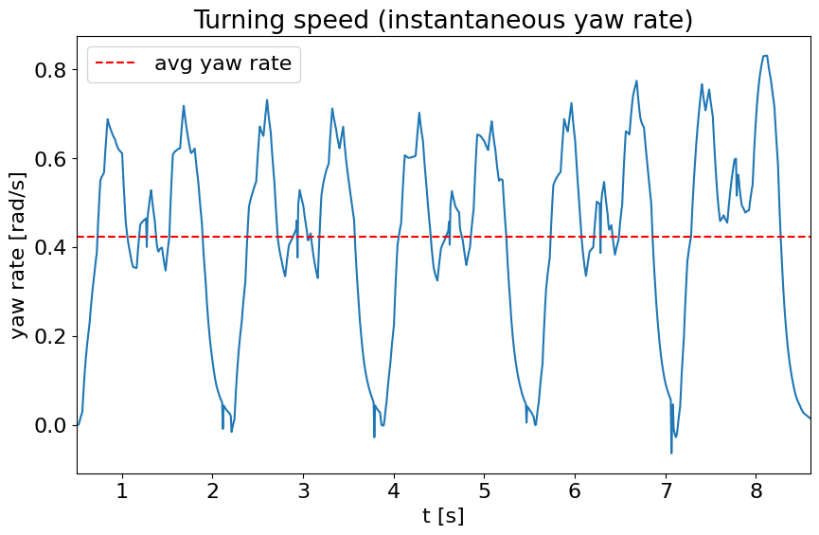
How we made the model realistic:
Category | Metric | Value
Walking | Stable Frequency | 1.4 steps/s
 | Max Velocity | 12 cm/s
 | Average Drift | ~0.8 cm/m (@ max velocity)
Turning | Average Yaw Speed | 0.424 rad/s
 | Max Yaw Speed | 0.831 rad/s
Kicking | Kick Distance | ~1.3m
Recovery | Recovery Time | ~26s (from lying on back)
... | ... | ...
2X
2X

Slide 13
Behaviour Model & Test
FSM Implementation
Behaviour Pipeline
State-based control (move, kick, defend, recover)
Condition-based transitions (distance, possession, context)
Role-specific behaviours (attacker / defender / goalkeeper)
World state
Decision Function
Finite State Machine
Testing method
Action Output
One-variable-at-a-time testing
Measure performance (goals, possession, stability)
Enables clear and reproducible tuning
Robot Motion

Slide 14
Results and Analysis

Slide 15
Suggested Structure
From guidelines: Required results to illustrate completion of each stage and discussion of the analysis of these results. (Just focus on behavior I think)
Description of metrics being analysed – why are they important
Results of parameter optimisation tests
Final simulation of games. Baseline vs Optimized (static), Optimised (static) vs Optimised (Dynamic)
Analysis – which parameters are significant to performance? Does dynamic behavior help?

Slide 16
Team Performance Analysis

Slide 17
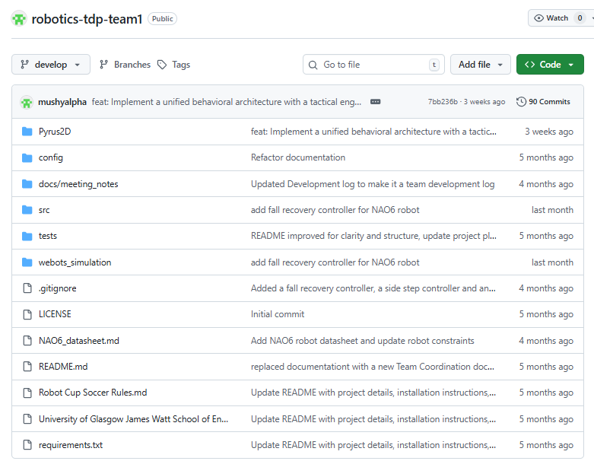
Assign tasks according to WPs
Weekly Meetings
Sync progress to GitHub
Fill in the TARs
Our GitHub
Workflow

Slide 18
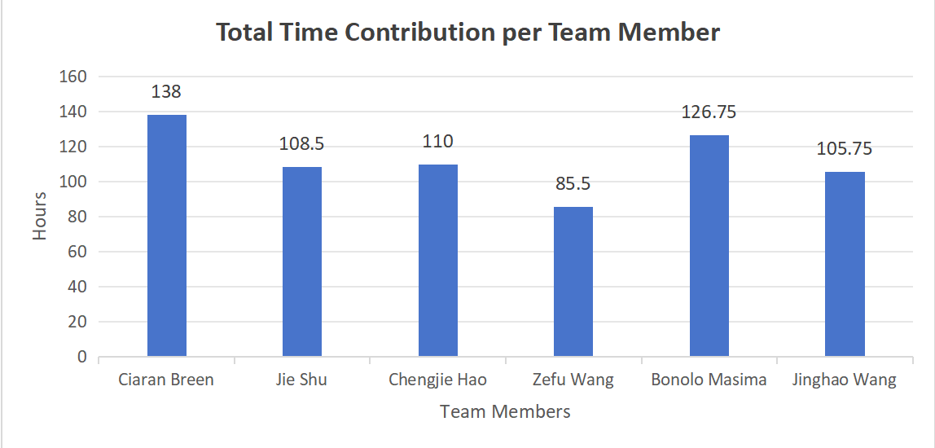

Slide 20
Suggested Structure
From guidelines: Evaluation of the performance of your team, including a comparison of your estimated and actual time/costs.
Explanation of how we worked as a team: Breaking project into workpackages, weekly team meetings (admin and technical), use of github for collavorative coding.
Analysis of time contributions from TARs
Comparison of estimated cost vs. Actual cost (I've attached our estimate from week 1 in next slide)

Slide 21
Cost Estimate
Project runs for a total of 19 weeks during term:
Week 3 (not incl. kickoff) – Week 10 in Semester 1 (8 weeks)
Week 1 – Week 11 in Semester 2 (11 weeks)
We estimate 10 hrs per person per week (2hrs meetings + 8hrs technical).
Team Staff Costs = £250/hr * 10hrs * 6 team members * 19 weeks
= £285,000
We estimate 20hrs expert help: ~ 1hr per week
Expert Staff Costs = £1250/hr * 20 hrs = £25,000
Total Cost = £285000 + £25000 = £310,000
Actually we estimate 674.5 hrs totally and the total cost is £250/hr * 674.5 = £168625

Slide 22
Conclusions and Future Work

Slide 23
Suggested Structure
From guidelines: Findings from the study as a bullet point list. Overall assessment of the project outcomes
Summarise our findings and performance. What went well? What didn't go well and why? I think we need to address why we didn't make it past behavioral stage
Future work – what would we do if we had more time? How would we have moved onto hardware.

Slide 24




Thank you for listening! Any questions?
#UofGWorldChangers
@UofGlasgow

Slide 25
Results & Analysis: Methodology
Systematic Parameter Isolation | 1,050 Match Sweep
1,050 Match parameter sweep
Systematic Parameter Adjustments
Influence on Key Metrics
→
→
7 Parameters
5 Values Each
30 Trials/Level
20 min Match
Win Rate & Goal Diff
Experimental Setup
We systematically adjusted each parameter across five different values, running over 1,050 simulations. This let us see how each change individually impacted our key metrics, like win rate and goal difference.

Slide 26
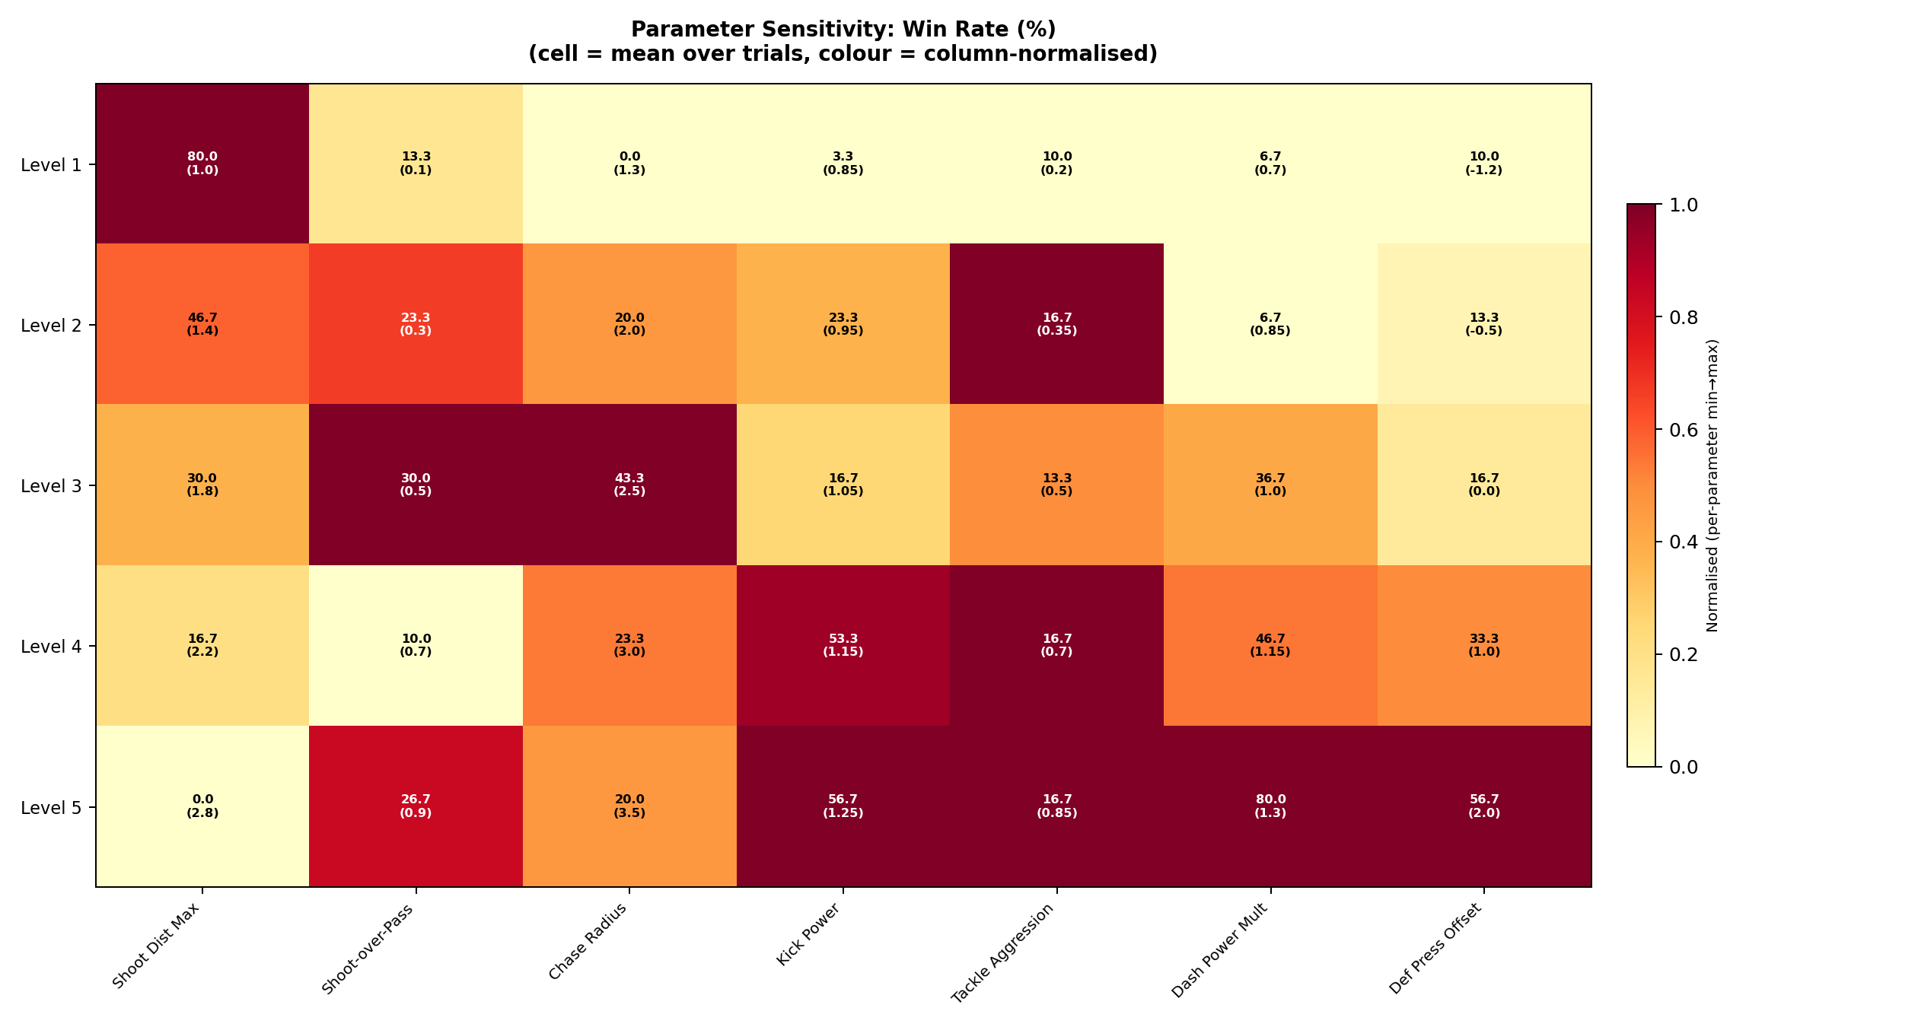
Performance Impact
Isolating Win Rate Patterns
Condition | Win Rate | Goal Diff
Low Kick Power (0.85x) | 0.0% | -1.0
Max Kick Power (1.25x) | 73.3% | +0.8
Far Shooting (2.8m) | 10.0% | -1.2
Close Shooting (1.0m) | 76.7% | +1.3
Pressure/Chase (2.5m) | 66.7% | +0.6
1. Dominate Physically
When kick power is low, we couldn’t win at all. Maxing the power out jumps our win rate to over 70%. If we can’t outpower the opponent, we completely lose control of the game.
2. High-Quality Shots & Pressure
Restricting shots to within 1 meter yields a 75% win rate. Pairing this with a high chase radius ensures we maintain immense pressure and possession.
KEY TAKEAWAY: Dominate physically, and only take high-quality shots.

Slide 27
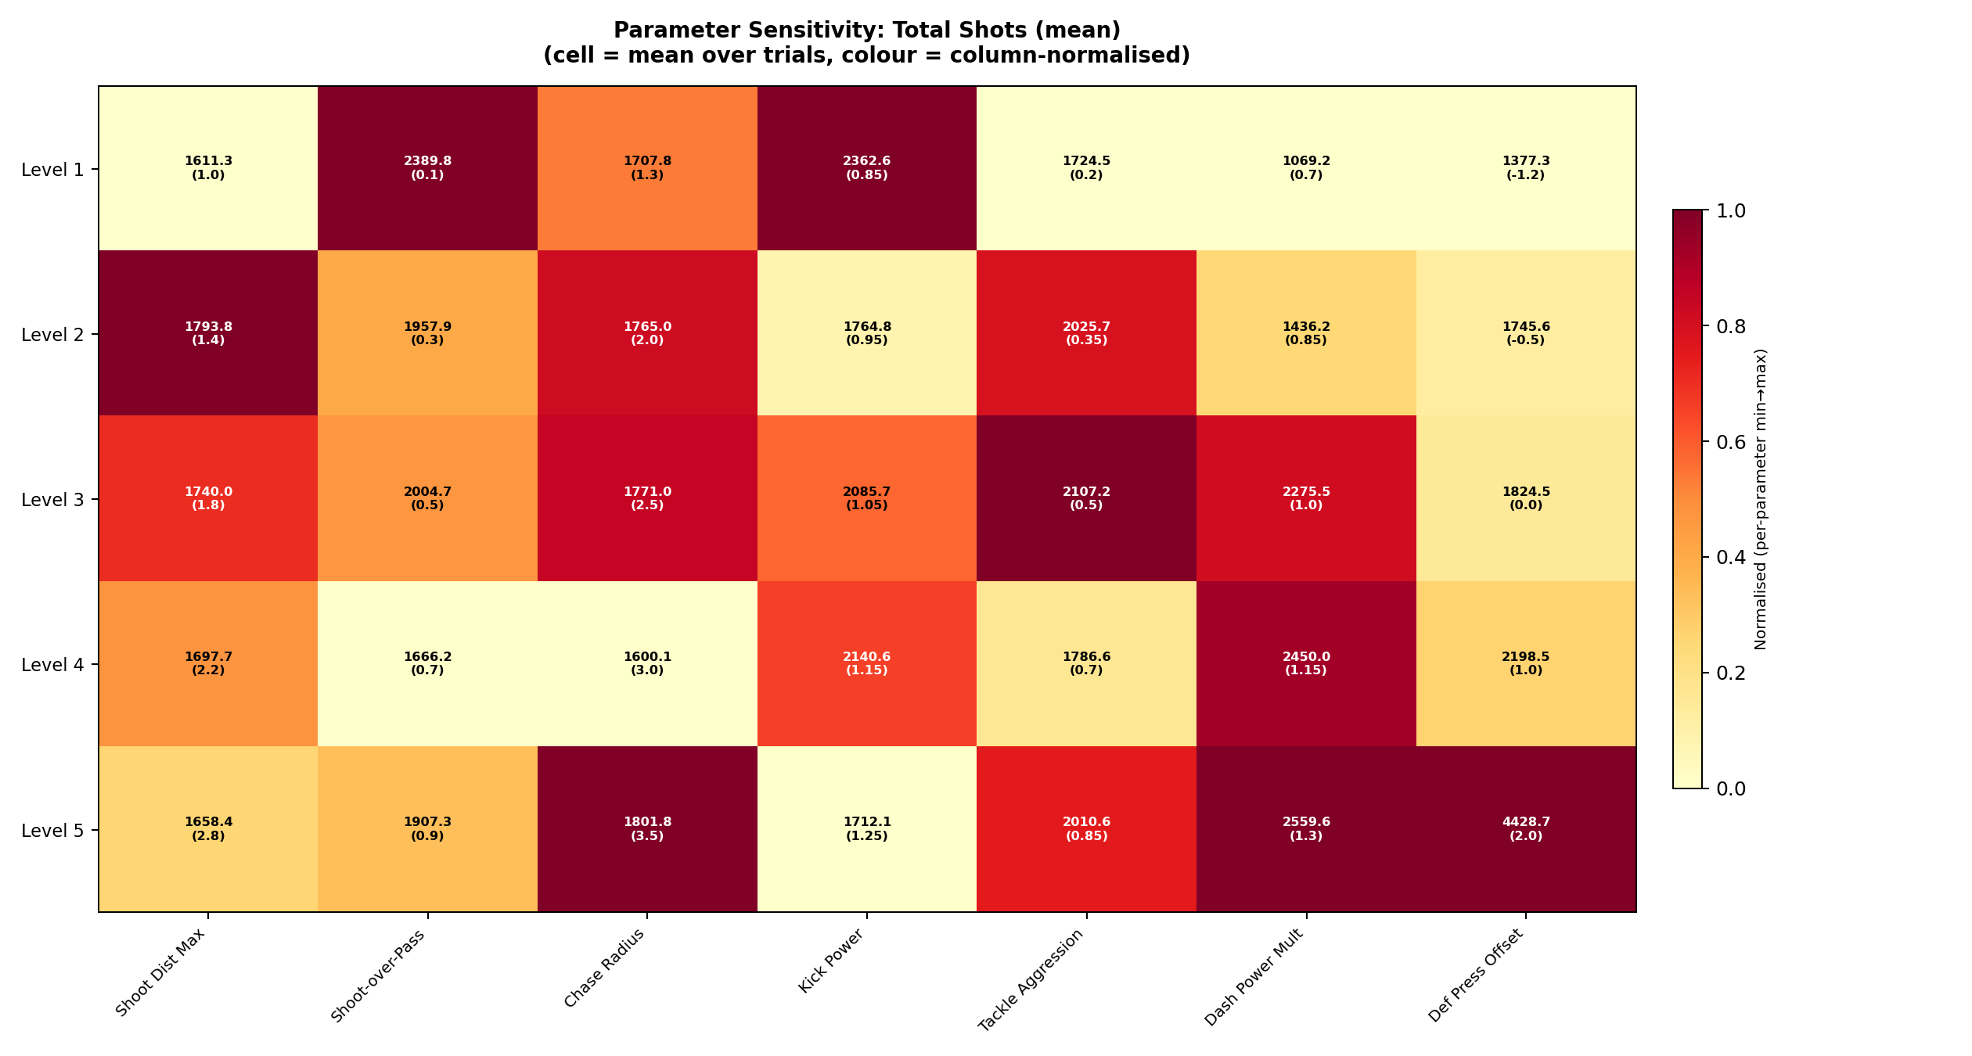
Offensive Engine Dynamics
Patience and Pitch Control
Quantity vs. Quality
The data perfectly illustrates our offensive philosophy: fewer, high-quality shots are far more effective than taking many low-probability ones. Restricting the max shooting distance massively decreases the total volume of shots (see graph), but astronomically increases the conversion rate and match Win Rate.
Condition | Av. Total Shots | Win Rate
Far Shooting (2.8m) | 2,663 | 10.0%
Close Shooting (1.0m) | 942 | 76.7%
Winning the Pitch
Our tracking of Net Territory Gain shows that a high press is the best way to control the game. By pushing the defense forward and expanding the chase radius, we suffocate the opponent in their own half. If you get to the ball first, you control the game.

Slide 28
Synthesis: Designing the Optimal Brain
Making a strong strategy even stronger
Parameter | Tested Range | Optimal Selected Value
Shoot Distance Max | 1.0 – 2.8 m | 1.0 m
Dash Power Mult | 0.7 – 1.3 | 1.3x
Kick Power | 0.85 – 1.25 | 1.25x
Def Press Offset | -1.2 – 2.0 m | +1.0 m
Chase Radius | 1.3 – 3.5 m | 2.5 m
Tackle Aggression | 0.2 – 0.85 | 0.7
Shoot-Over-Pass Bias | 0.1 – 0.9 | 0.1
The Optimised Balanced Team
• After over a thousand matches, a clear strategy emerged: dominate physically, control the pitch, and only take the best shots.
• We took these mathematically optimal parameters and applied them to our existing Balanced strategy.
• Resulting in two distinct agents: a Standard Balanced team, and an Optimised Balanced team.
• We are not changing the core HTSM system—we are simply making a strong strategy even stronger.

Slide 29
Final Validation Statistics
100-Match Stress Test: Optimised Team vs Baseline Team
BLUE WIN RATE
DRAW RATE
RED WIN RATE
99.0%
1.0%
0.0%
Out of 100 matches
Deadlocked
Baseline Team
AVG GOALS SCORED
AVG GOAL DIFFERENCE
4.36
+4.29
Compared to 0.07 against
Total Pitch Domination

