Slide 1
Results & Analysis
Behavioural Parameter Sensitivity | ENG5326 Robotics M | Team 1
LEVEL 1 Parameter Sweep
OPTIMAL VALUES Identified
LEVEL 2 HTSM Tactic Profiles
→
→
4v4 Robots
9×6 m Pitch
12 cm/s Walk
20 min Match
5 Trials/Level
Parameters Swept
Metrics Recorded
• shoot_distance_max (1.0 – 2.8 m)
Win Rate • Goal Difference • Shots on Target
• shoot_over_pass_bias (0.1 – 0.9)
Total Shots • Possession % • Territory Gain
• chase_radius (1.3 – 3.5 m)
Centroid X (team average field position)
⚡ Critical fix: Added dribble mechanic → ball went from never reaching opponent half to scoring. Passes ↓ 14,400 → 239 | Shots ↑ 0 → 76

Slide 2
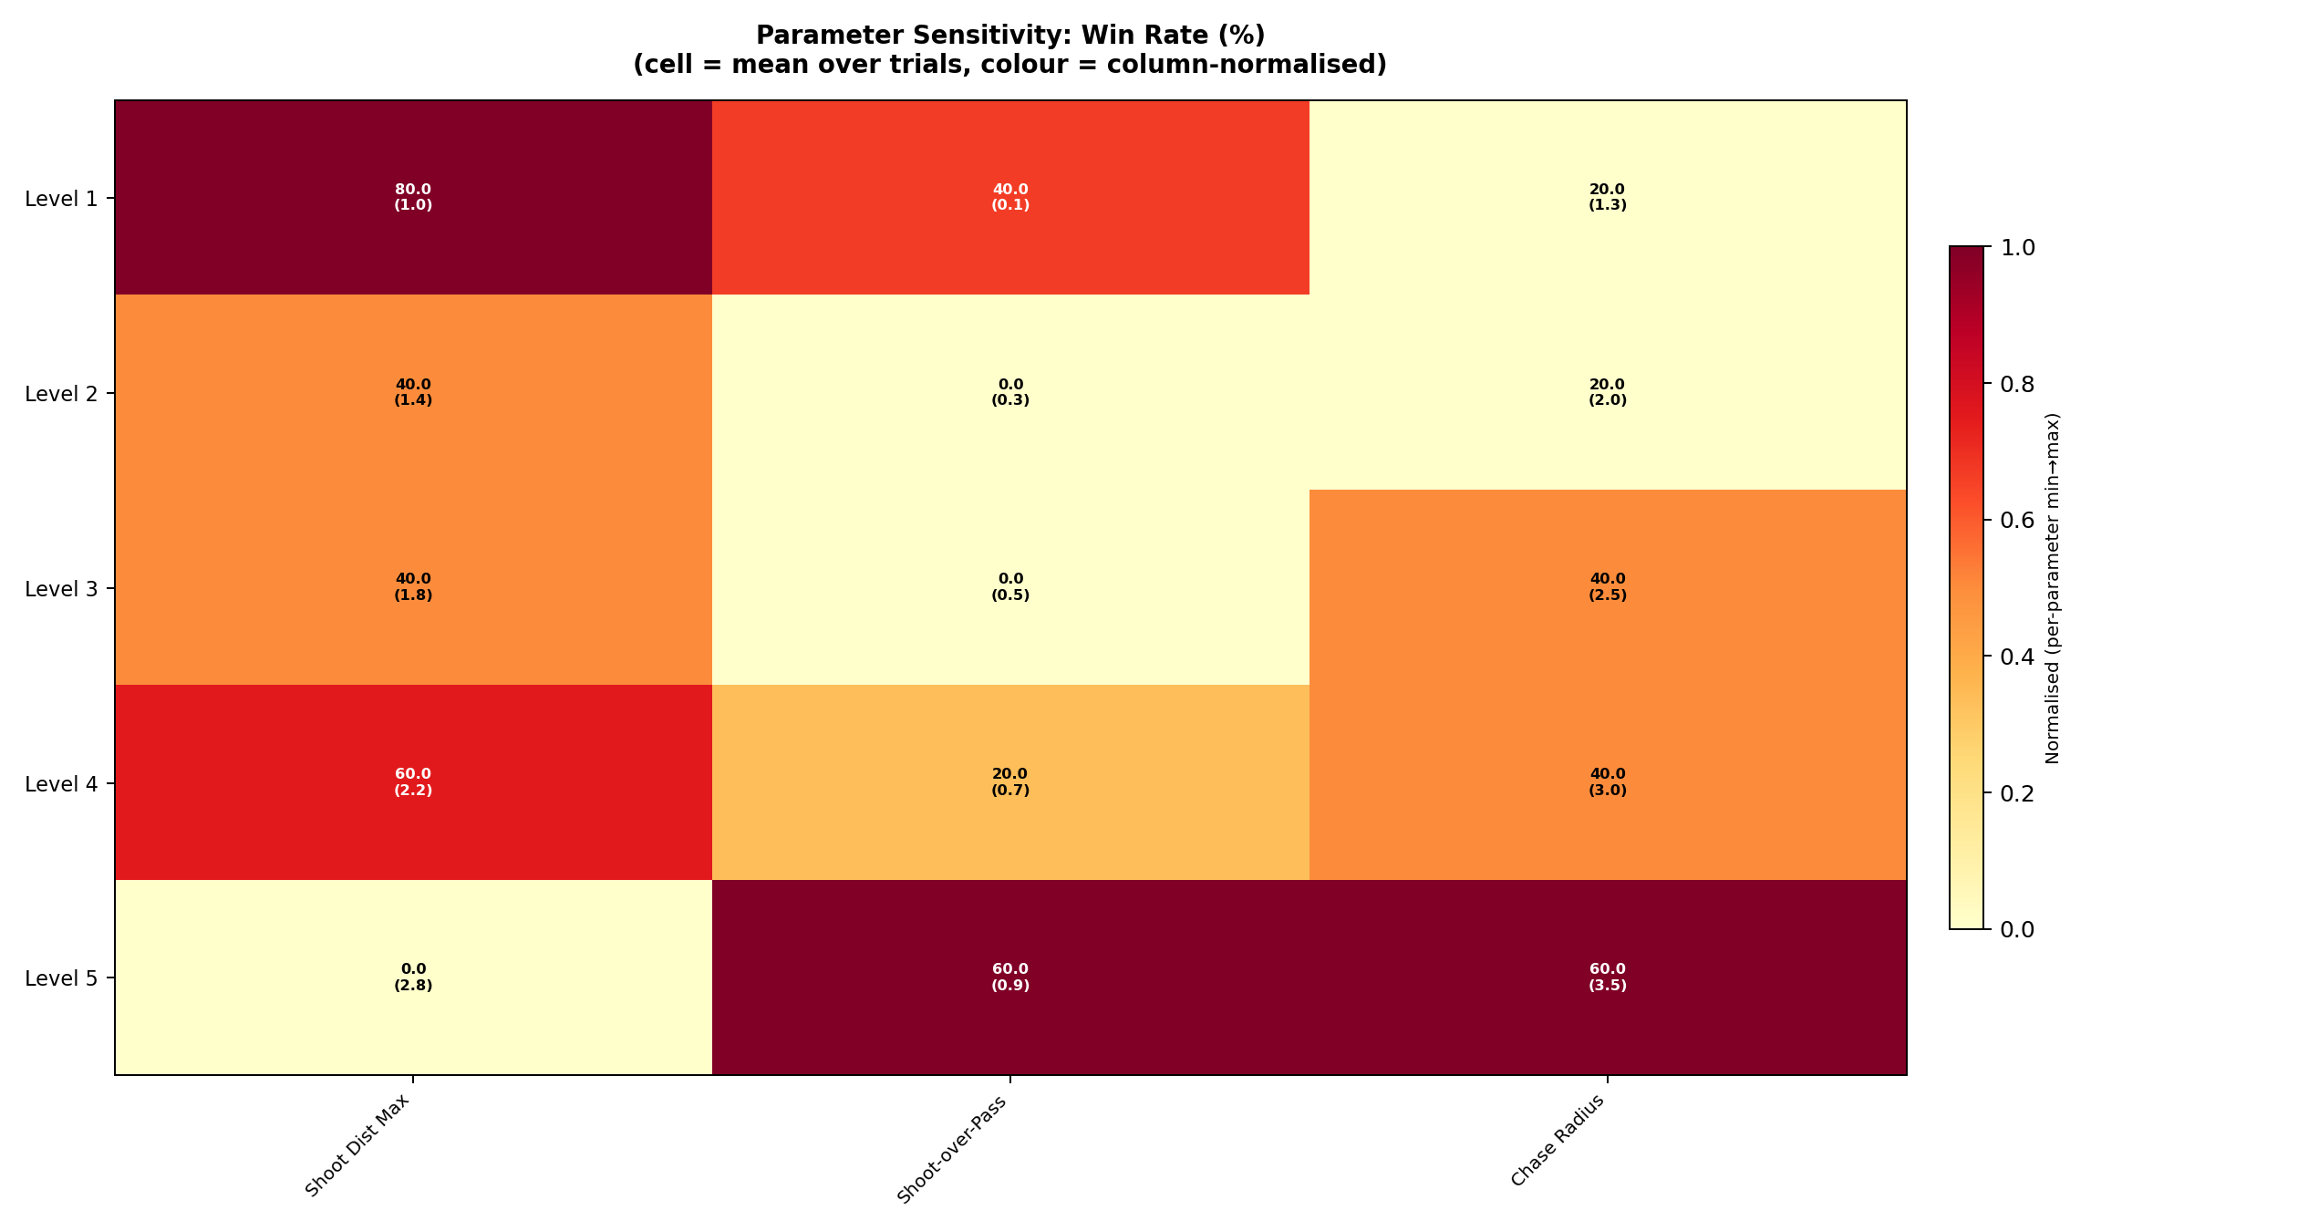
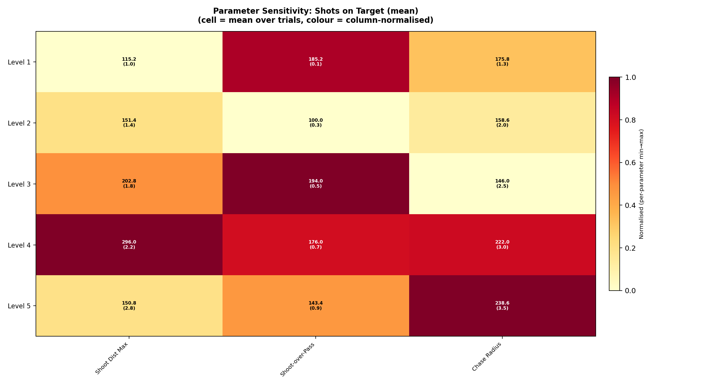
Shoot Distance Max
How far a robot attempts a shot from goal | Sweep: 1.0 – 2.8 m
Win Rate by Parameter & Level
Shots on Target by Parameter & Level
Distance (m) | Win Rate | Goal Diff | Shots on Target
1.0 m | 80% | +1.4 | 115
1.4 m | 40% | +0.4 | 151
1.8 m (base) | 40% | +0.6 | 203
2.2 m | 60% | +0.4 | 296
2.8 m | 0% | −0.8 | 151
★ Optimal: 1.0 m — 80% win rate | Short-range precision beats long-range volume at 12 cm/s kick speed
⚠ 2.8 m loses every match — robot wastes possession on low-probability shots

Slide 3
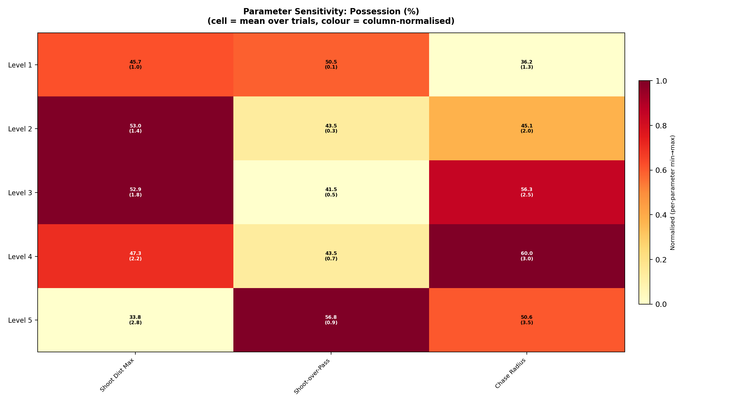
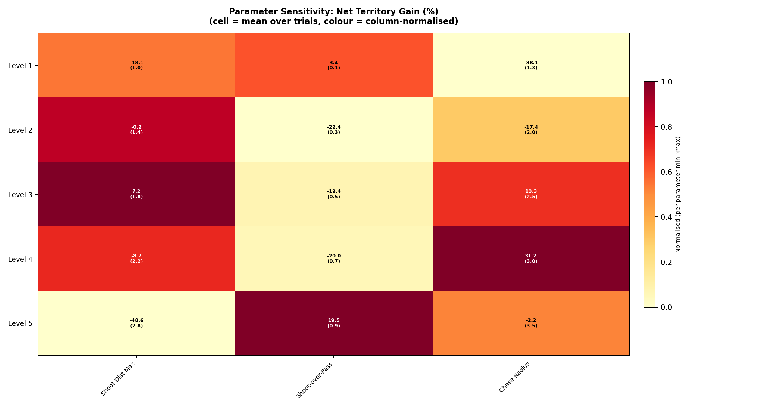
Shoot-Over-Pass Bias
Probability of shooting vs. passing when in range | Sweep: 0.1 – 0.9
Possession % by Parameter & Level
Territory Gain by Parameter & Level
Bias | Win Rate | Goal Diff | Possession % | Territory Gain
0.1 | 40% | +0.2 | 50.5% | +3.4
0.3 | 0% | −1.0 | 43.5% | −22.4
0.5 (base) | 0% | −0.2 | 41.5% | −19.4
0.7 | 20% | +0.2 | 43.5% | −20.0
0.9 | 60% | +0.8 | 56.8% | +19.5
★ Optimal: 0.9 — 60% win rate | "Lukewarm" middle (0.3–0.7) loses or draws every time
⚠ 0.5 BASELINE: 0% win rate — decisive robots always beat hesitant ones

Slide 4
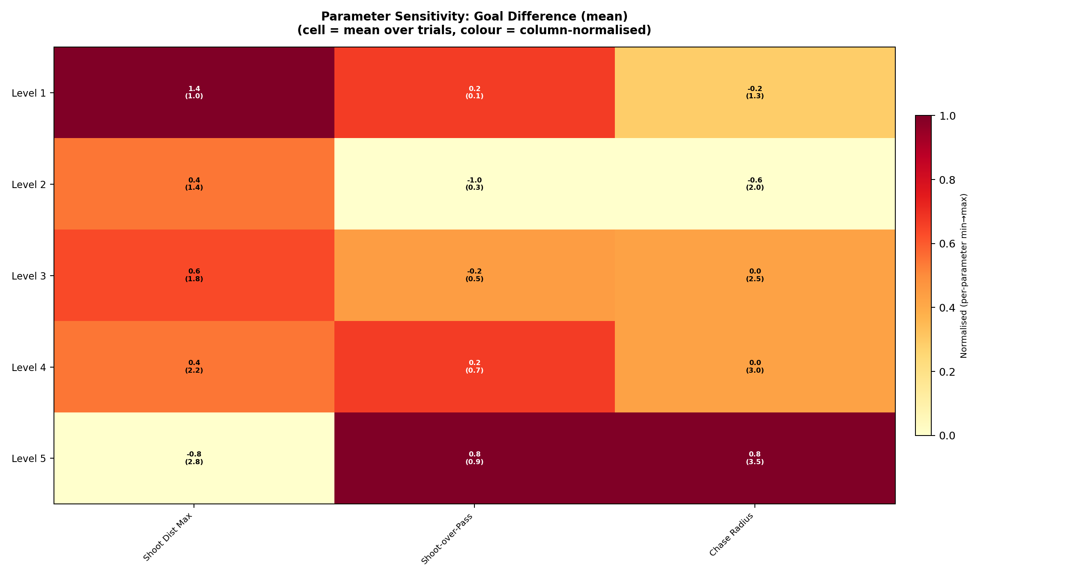
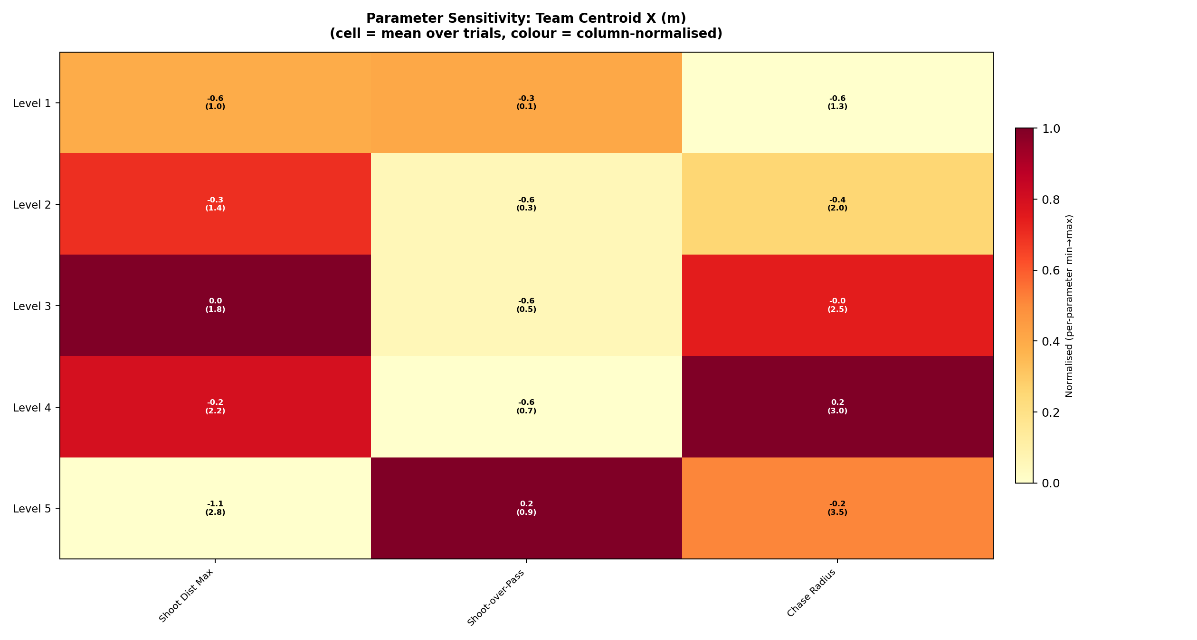
Chase Radius
Max distance at which a robot actively pursues the ball | Sweep: 1.3 – 3.5 m
Goal Difference by Parameter & Level
Team Centroid X by Parameter & Level
Radius (m) | Win Rate | Goal Diff | Possession % | Territory
1.3 | 20% | −0.2 | 36.2% | −38.1
2.0 (base) | 20% | −0.6 | 45.1% | −17.4
2.5 | 40% | 0.0 | 56.3% | +10.3
3.0 | 40% | 0.0 | 60.0% | +31.2
3.5 | 60% | +0.8 | 50.6% | −2.2
★ Optimal: 3.5 m — 60% win rate | At 12 cm/s walk speed, first to the ball wins
⚠ 1.3 m: loses 38% of territory — under-pressing is catastrophic at slow speeds

Slide 5
Synthesis: Optimal Parameters → HTSM Tactic Profiles
Level 1 findings directly configure Level 2 tactic engine
Parameter | BASELINE | Optimal | Win Rate Gain | Key Insight
shoot_distance_max | 1.8 m | 1.0 m | +40 pp | Short-range accuracy dominates
shoot_over_pass_bias | 0.5 | 0.9 | +60 pp | Decisive > hesitant in front of goal
chase_radius | 2.0 m | 3.5 m | +40 pp | First to ball wins at 12 cm/s
Optimal Values in HTSM Tactic Profiles (α-mapped)
Limitations & Next Steps
Tactic | α range | shoot_dist | bias | chase_r
Park the Bus | 0.00–0.15 | 1.0 m | 0.15 | 1.3 m
Possession | 0.35 | 1.0 m | 0.30 | 2.0 m
Balanced | 0.50 | 1.0 m | 0.50 | 2.5 m
Counter Attack | 0.70 | 1.0 m | 0.80 | 3.5 m
All Out Attack | 0.95–1.00 | 1.0 m | 0.9 | 3.5 m
• 5 trials/level — wide confidence intervals
• 30-trial sweep currently running
• 4 parameters not yet swept (kick_power,
position_x_offset, dash_power_mult,
min_passes_before_shot)
• Parameter interactions not captured
• Falls disabled — may shift optimal chase_r

