Slide 1
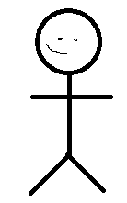
ChangeGold
AdjustHealth
ChangeGold
RollDice
UseAbility
DnD Player
UseHealingSurge
Abilities are regained
Changing stats affects abilities
NewEncounter/NewDay
ChangeStats
= GUI intereaction and feedback
Changes made in stored data

