Slide 1

Department of Computer Science and Information Technology
Master of Science in Information Systems
End of Semester Final Assessment
Name: MUSINGUZI BENSON
Reg. No.: 2024-M132-23947
Module: Intelligent Systems
Lecturer: Dr. SibiteNda Harriet

Slide 2
Choice of questions
Answered question_1
Question_2

Slide 3
Question 1
Requires:
To build an intelligent sentiment analysis system for 50,000 IMDb reviews, with two base models;
  Classical ML model using TF–IDF features.
  Deep learning model using token sequences
To build a Reinforcement Learning (RL) agent chooses which model that selects the correct model for each review
-Using 50,000 labelled movie reviews (positive/negative).
Implementation
Implemented with vscode and Jupiter notebooks
The project has 5 notebooks (for each section a-d)
Notebook 5 is just a markdown cell with interpretation of the sentiment analysis with ml, dl, and rl models
Project Folder (IMDB_SENTIMENT_PROJECT) – Contains the notebooks, report and all the relevant files
Project Repository: https://github.com/musiben84/Exam_Question_1.git

Slide 4
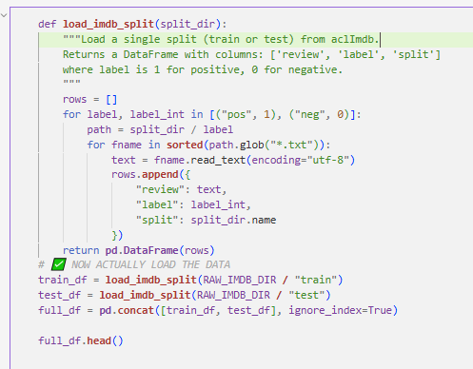
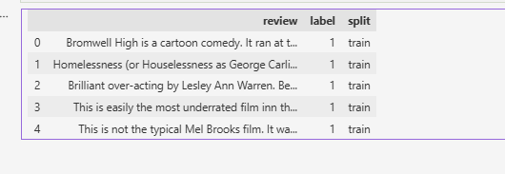
Part A: Part A: NLP preprocessing and feature engineering
Loaded full IMDb dataset: 50,000 reviews with sentiment labels (train + test).

Slide 5
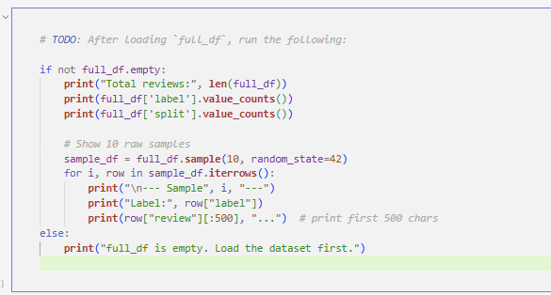
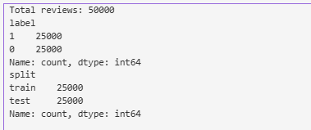
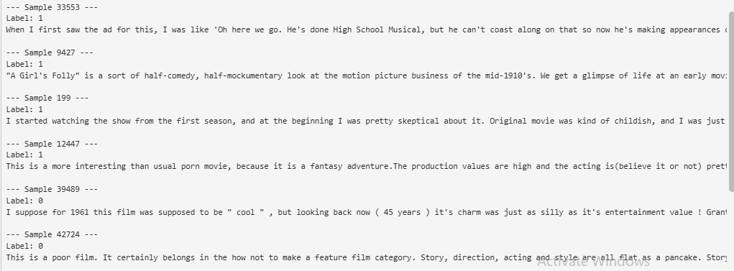
Part A – Cont’d
Displayed 10 raw review samples and reported dataset sizes and class balance.

Slide 6
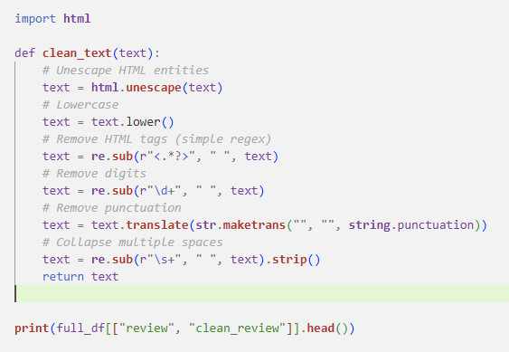
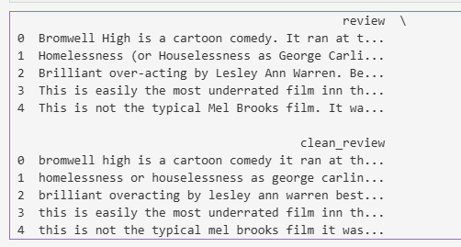
Part A – Cont’d
Text cleaning pipeline: lowercase, remove HTML tags, punctuation, numbers, extra spaces.

Slide 7
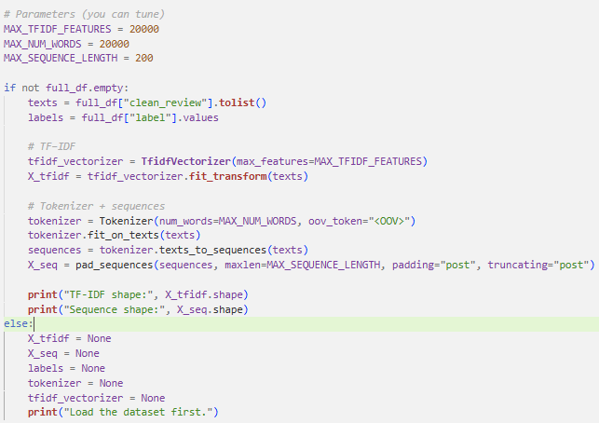

Generated two feature sets:
• TF–IDF matrix for classical ML (n_samples × n_features).
• Padded token sequences for deep learning (n_samples × max_len).

Slide 8
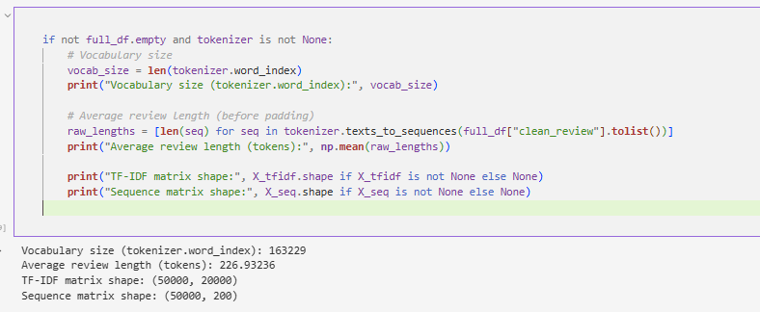
Reported: vocabulary size, average review length, TF–IDF shape, and sequence shape.

Slide 9
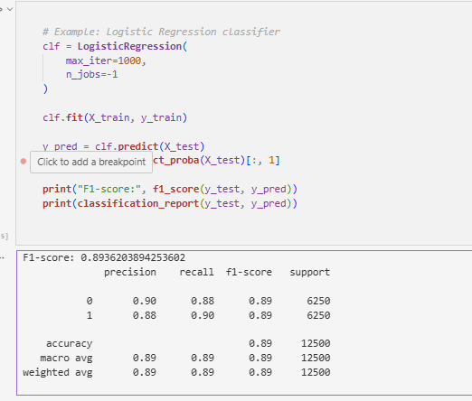
Part B: Classical ML Sentiment Classifier
(Model 1: Logistic Regression (or SVM/Naive Bayes) trained on TF–IDF features.)
F1-Score

Slide 10
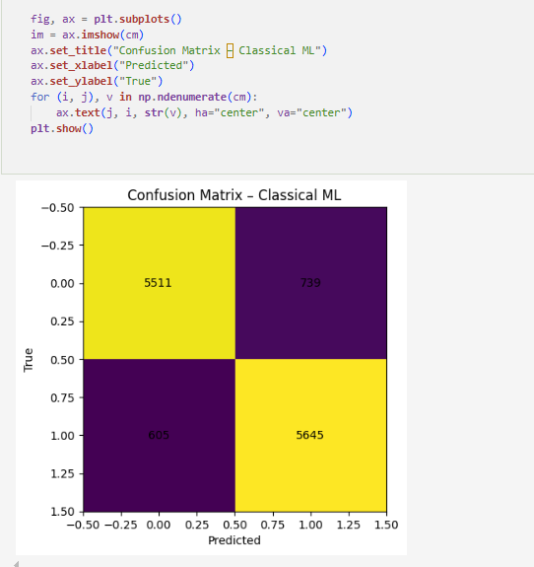
(Model 1: Logistic Regression (or SVM/Naive Bayes) trained on TF–IDF features.)
Confusion Matrix

Slide 11
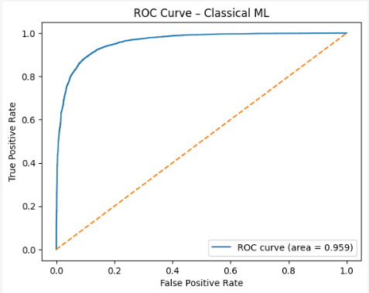
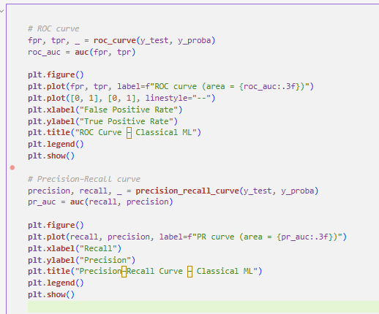
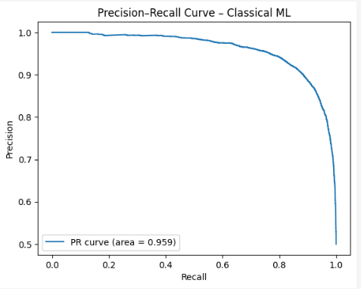
(Model 1: Logistic Regression (or SVM/Naive Bayes) trained on TF–IDF features.)
ROC curve and Precision-Recall curve

Slide 12
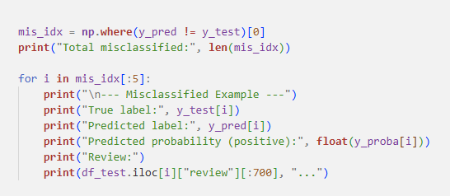
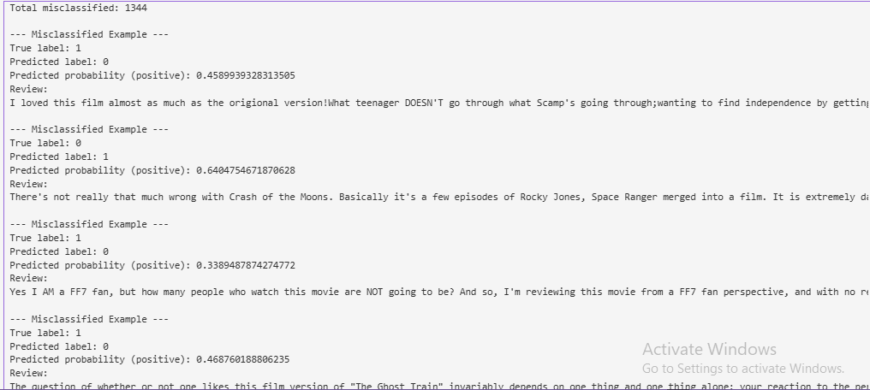
Analysis of 5 misclassified reviews (true vs predicted labels, text).

Slide 13
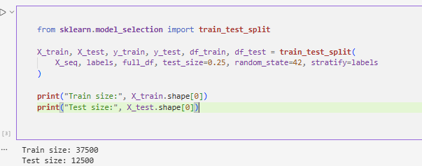
Part B: Model 2
Model: Deep sequence model (e.g., BiLSTM) on padded token sequences. (Deep Learning Sentiment Classifier)
Train/validation split, early stopping/regularisation as needed.

Slide 14
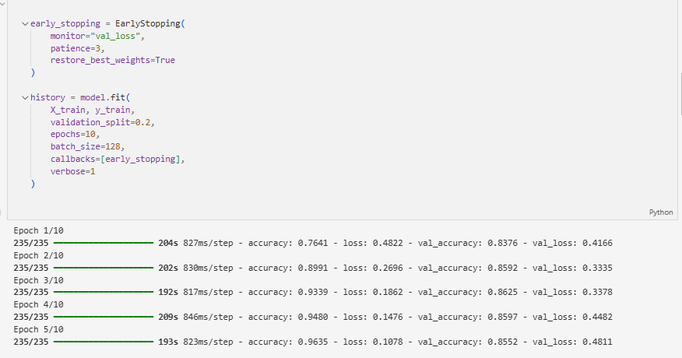
• Logged training and validation loss/accuracy per epoch.

Slide 15
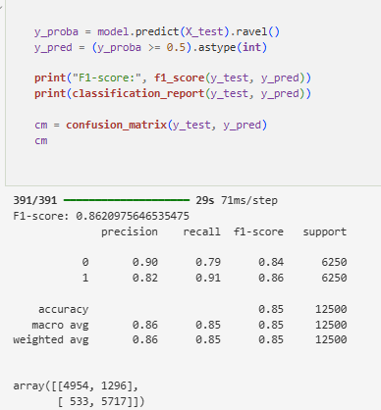
Evaluation metrics:

Slide 16
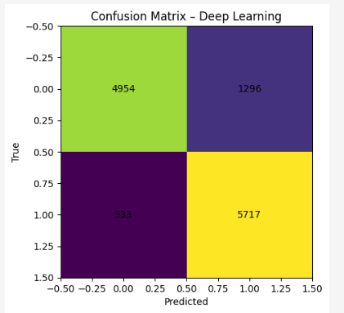
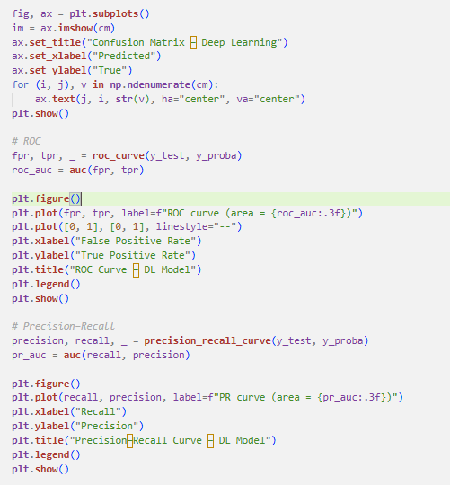
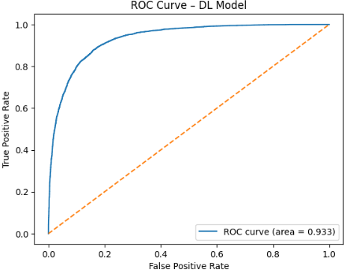
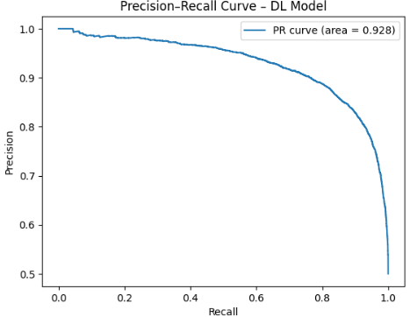
Confusion Matrix

Slide 17
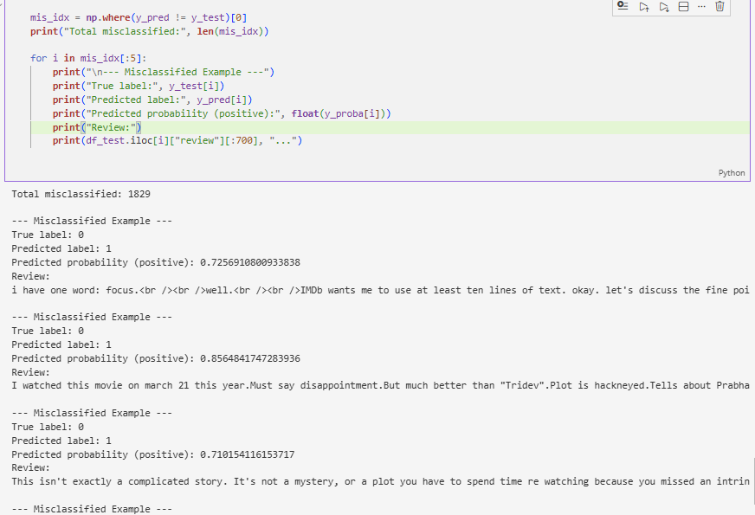
The 5 misclassified examples

Slide 18
Part C: Reinforcement Learning Model Selector
Objective: Learn a policy to choose between ML and DL model per review.
State vector (per review):
• p_ml: ML probability of positive.
• p_dl: DL probability of positive.
• Confidence difference |p_ml − p_dl|.
• Review length (token count), normalized.
Actions: 0 = use ML prediction, 1 = use DL prediction.
Reward: +10 for correct prediction, −5 for incorrect prediction.

Slide 19
Q-Learning Setup and Results
Q-learning: discretized state space, tabular Q(s,a) for two actions.
ε-greedy exploration
High ε at start for exploration, decayed over episodes for exploitation.
Training: ~1000 episodes over full review set.
Outputs:
  Reward curve vs episode, showing learning and stabilization.
  Final Q-table with learned value estimates.
  Accuracy comparison: ML-only, DL-only, RL-selected.

Slide 20
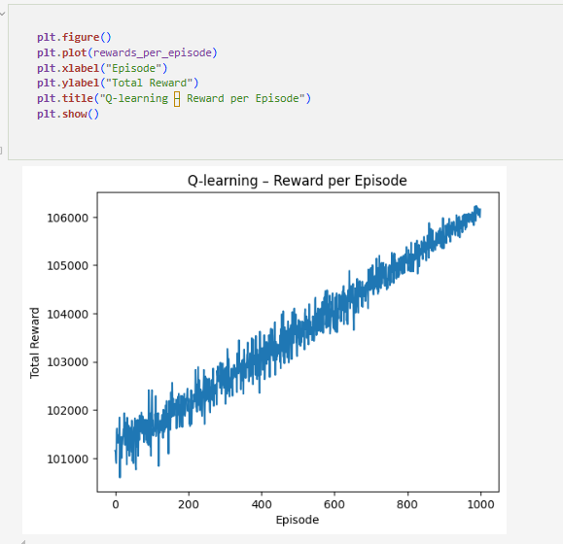
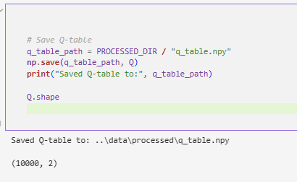
Outputs
Reward curve
Q-table

Slide 21
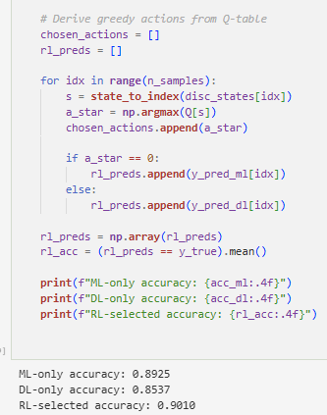
Comparison of accuracy

Slide 22
Part D: Interpretation – When RL Chooses ML vs DL
Q1 – RL Model Selector: Behavior and Insights
Behavior of the learned policy
  Chooses the deep learning model when it has a strong confidence advantage, especially on longer / more complex reviews where sequence modelling helps.
  Chooses the classical TF–IDF model when both models agree or when the classical model is clearly more confident on shorter, simpler reviews.
  This shows that the RL agent has learned a meaningful switching rule that exploits the strengths of both classifiers.
Performance and limitations
  Test accuracies:
    Classical ML: [ML_accuracy: 08925]%
    LSTM: [DL_accuracy: 08537]%
    RL selector: [RL_accuracy: 0.9010]%
  If RL > both, it forms a strictly better hybrid system; if in between, it still adapts by trusting the stronger model more often.
  Misclassifications remain hardest for ambiguous / mixed sentiment, sarcasm, and very short reviews with little context.
Possible improvement
  Replace tabular Q-learning with a Deep Q-Network (DQN) that uses continuous state features directly.
  Enrich the state with lexicon-based scores or neural embeddings to learn more precise decision boundaries.

Slide 23
Question_2: Retail Customer Behavior and Marketing Insights - overview
Dataset: Online Retail II (UK-based transactional data: invoices, products, quantities, prices, customers).
Objectives:
• To clean transaction data and build customer-level features.
• To cluster customers using k-Means and a second method (DBSCAN/Hierarchical).
• Learn deep embeddings (autoencoder) and cluster in latent space.
• Perform association rule mining for product co-purchases.
• Translate findings into actionable marketing recommendations.

Slide 24
Implementation
Implemented with vscode and Jupiter notebooks
The project has 1 notebook (having all sections A-D)
Project Folder (RETAIL_CUSTOMER_INSIGHTS) – Contains the notebooks, report and all the relevant files
Project Repository: https://github.com/musiben84/Exam_Question_2.git

Slide 25
Part A: Data Cleaning and Customer Clustering
Data cleaning steps:
• Removed missing product descriptions.
• Excluded negative quantities and cancelled invoices.
• Dropped transactions without CustomerID and optionally focused on UK customers.
Customer-level features (aggregated per CustomerID):
• Total spending (Quantity × UnitPrice), number of invoices, total quantity.
• Average basket size and average order value.
Clustering: k-Means and DBSCAN/Hierarchical on scaled features; silhouette scores computed.

Slide 26
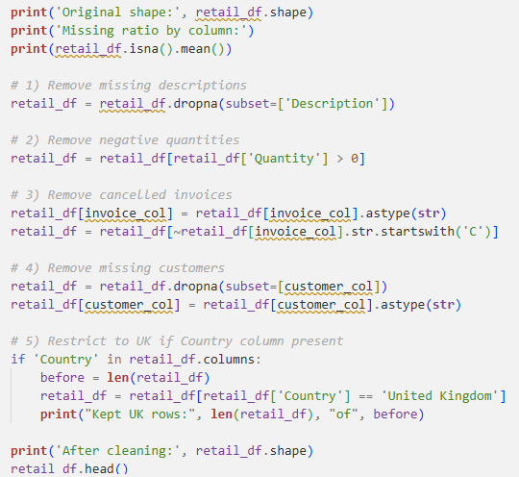
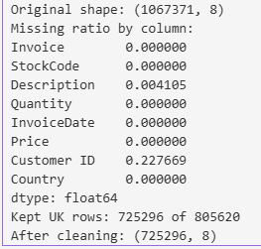
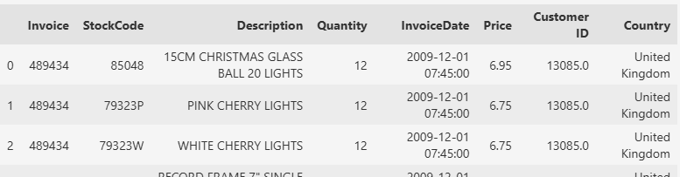
Data cleaning

Slide 27
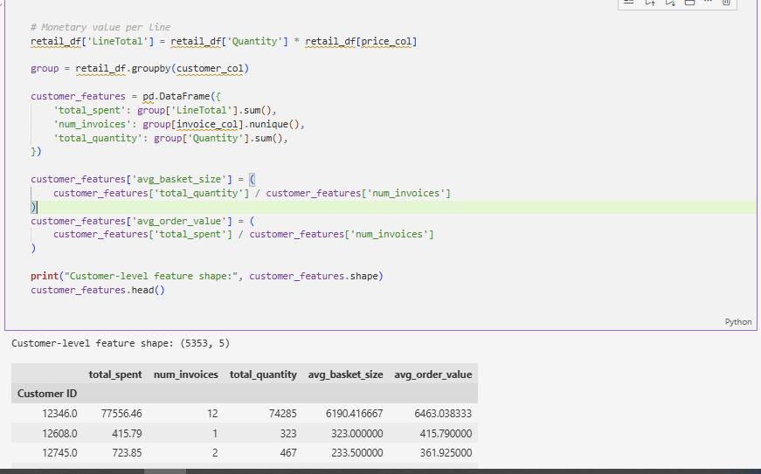
Customer level features: Aggregates transactions per customer to compute spending, invoice counts, quantities, basket size, and average order value.

Slide 28
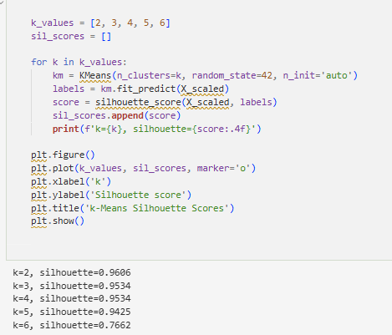
K-means clustering with computed silhouette scores

Slide 29
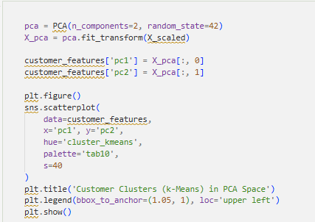
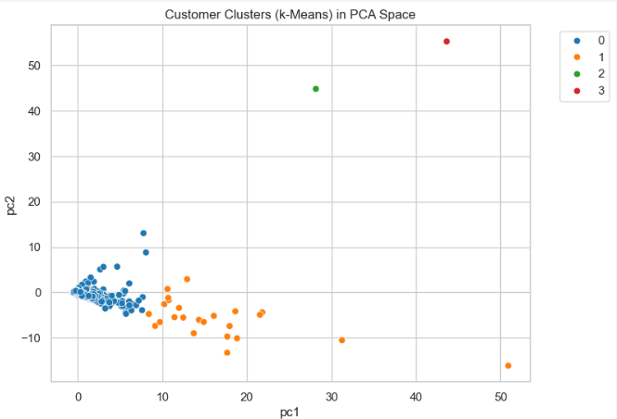
Visualization with PCA/t-SNE

Slide 30
Part B: Deep Embedding Clustering with Autoencoder (Chose Autoencoder)
Built an autoencoder on standardized customer features:
• Encoder compresses features to low-dimensional latent code.
• Decoder reconstructs original features from latent code.
Trained autoencoder to minimize reconstruction error.
Encoded customers into latent embeddings; applied k-Means to latent space.
Visualized latent embeddings in 2D with clusters
Compared silhouette scores: autoencoder clusters vs PCA-based clusters.

Slide 31
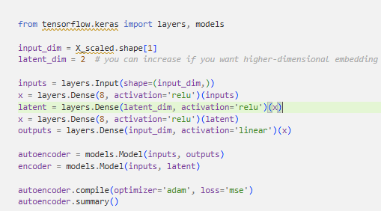
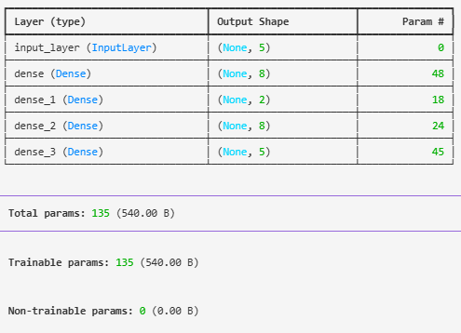
Building the Autoencorder to minimize reconstruction error

Slide 32
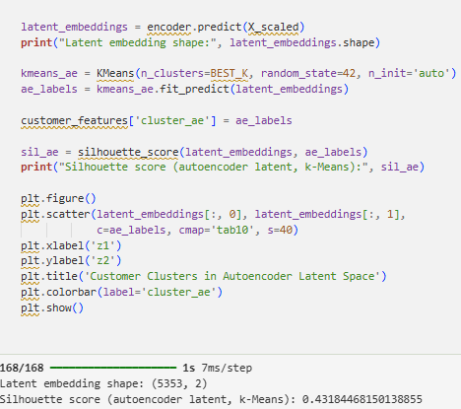
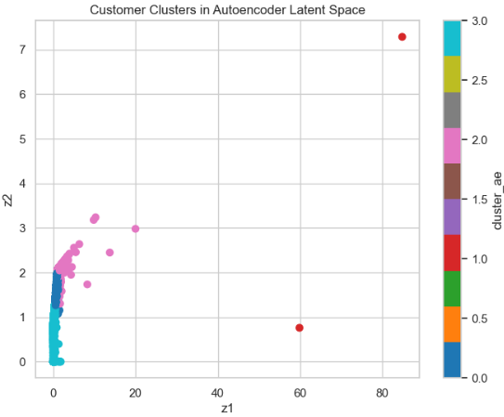
Visualized latent embeddings

Slide 33
Comparing PCA and Autoencoder Clusters
Cluster quality comparison
  Compared PCA-based clusters and autoencoder-based clusters using:
    Silhouette scores (numerical cluster quality).
    Visual separation in 2D plots.
Findings
  Autoencoder-based clusters often show:
    Stronger separation between groups.
    More coherent and compact clusters.
  Suggests the deep model captures behavioral nuances that linear PCA cannot.
Implication
  Deep embeddings provide a richer customer representation, leading to more meaningful segments for marketing and targeting.

Slide 34
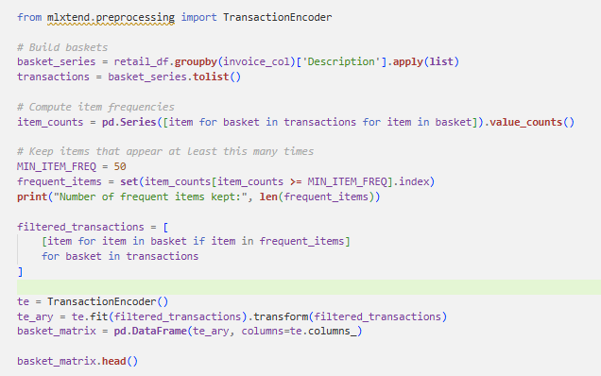
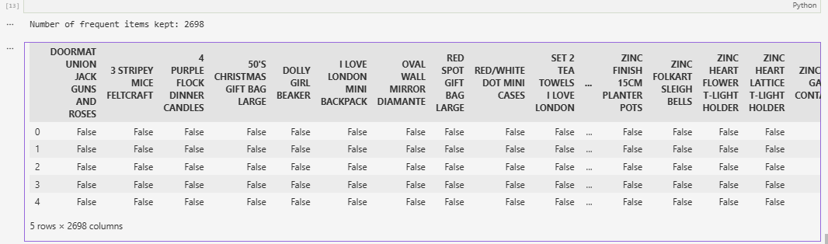
Part C: Association Rule Mining
Transformed transactions to basket format: Invoice → list of product descriptions.

Slide 35
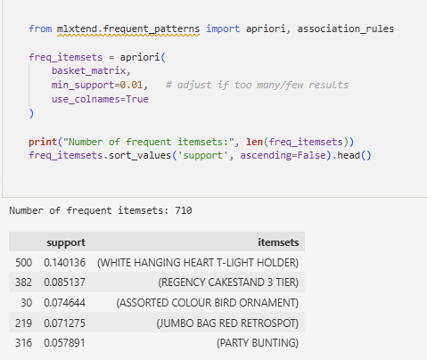
Part C: Cont’d
Applied Apriori or FP-Growth to extract frequent item sets.

Slide 36
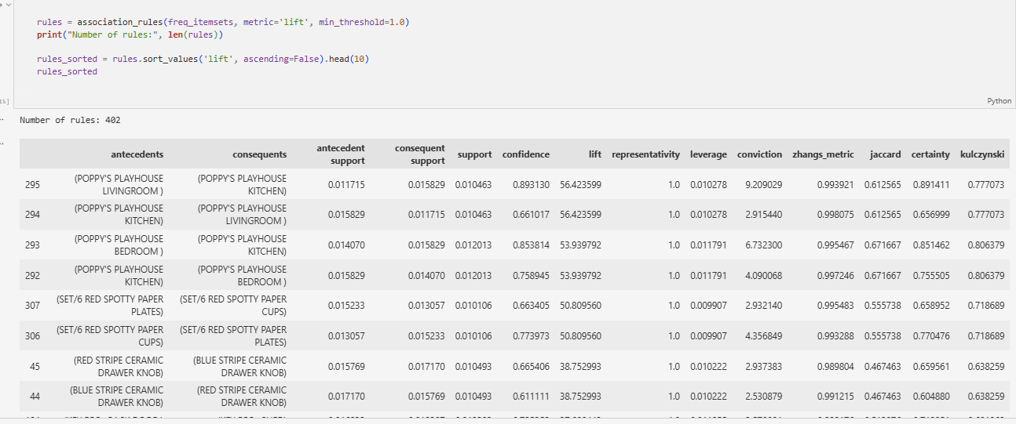
Part C: Cont’d
Selected top 10 rules sorted by lift as strongest co-purchase patterns.

Slide 37
Interpretation of 3 Association Rules
Three of the strongest association rules highlight meaningful co-purchase patterns that can guide merchandising and cross-selling strategies:
Rule 1: {Item A, Item B} → {Item C}
Customers who buy Items A and B together frequently also purchase Item C. This indicates a natural bundle or complementary set. The retailer could present Item C as a “Frequently Bought Together” suggestion when Items A and B appear in a customer’s basket.
Rule 2: {Item D} → {Item E}
Purchases of Item D strongly predict purchases of Item E, suggesting that E may function as an accessory, refill, or complementary add-on. Highlighting Item E on Item D’s product page or offering a small bundle discount can increase conversion rates.
Rule 3: {Item F, Item G} → {Item H}
The frequent co-occurrence of Items F and G with Item H implies a thematic set—such as party supplies, holiday items, or gift-related products. Curated collections or grouped displays can simplify navigation and encourage customers to purchase the full set, increasing basket value.

Slide 38
Part D: Interpretation and Business Recommendations
Customer segments
  High-value loyal customers: frequent, high spend → prioritize with loyalty/VIP programmes and exclusive perks.
  Occasional large-basket shoppers: infrequent but big orders → target with seasonal reminders and time-limited promotions.
  Low-value/infrequent customers: low revenue → opportunity for growth via personalized recommendations and reactivation campaigns.
Clustering quality
  PCA clusters capture mainly linear patterns.
  Autoencoder clusters are often more compact and well-separated, capturing nonlinear behaviors (e.g., purchase mix, frequent small vs infrequent large orders).
  Higher silhouette scores for autoencoder clusters indicate more meaningful segments for marketing.
Association rules & actions
  Strong product co-purchase rules support cross-selling and bundle creation.
  Combining segments + rules enables highly targeted promotions.
  Recommended actions:
    Launch loyalty/VIP programme for high-value customers.
    Use rules for cross-sell recommendations and bundles.
    Run re-engagement campaigns for low-value customers using insights from clusters and purchasing patterns.

