Slide 1

Seasonal Agriculture Performance Analysis
By-Aniket Dey Dhara
Techno Main Salt Lake
AICTE STUDENT ID: STU65ffc365db25e1711260517

Slide 2

Problem Statement
Agricultural activities are influenced by seasonal variations in environmental conditions, farming practices, resource availability and market conditions. As a result, agricultural performance may differ from one season to another. However, raw agricultural data does not clearly explain how agricultural performance changes across seasons or what patterns can be observed in different seasonal conditions. The problem is to analyze the given agricultural dataset and investigate seasonal differences in agricultural performance by identifying meaningful patterns, trends, relationships and variations within the available data.

Slide 3
This project analyzes a seasonal agriculture dataset covering multiple Indian states, crops and farming conditions. It examines how farming practices, environmental factors, resource usage and economic performance vary across the Kharif, Rabi and Zaid seasons. Using Python-based data cleaning, exploratory analysis and visualization, the project identifies seasonal patterns, trends and relationships in agricultural performance, and develops evidence-based insights and recommendations to support seasonal agricultural planning.
Project Description

Slide 4

Who are the end users?
Farmers and agricultural producers planning crop selection and resource allocation by season
Agricultural policymakers designing subsidies, irrigation and regional development programs
Agribusinesses and market analysts studying seasonal crop and pricing trends
Researchers and students studying seasonal patterns in agricultural performance

Slide 5





Technologies Used
  Python
  GitHub
  Git
  Google Colab
  Pandas
  NumPy
  Matplotlib
  Seaborn

Slide 6
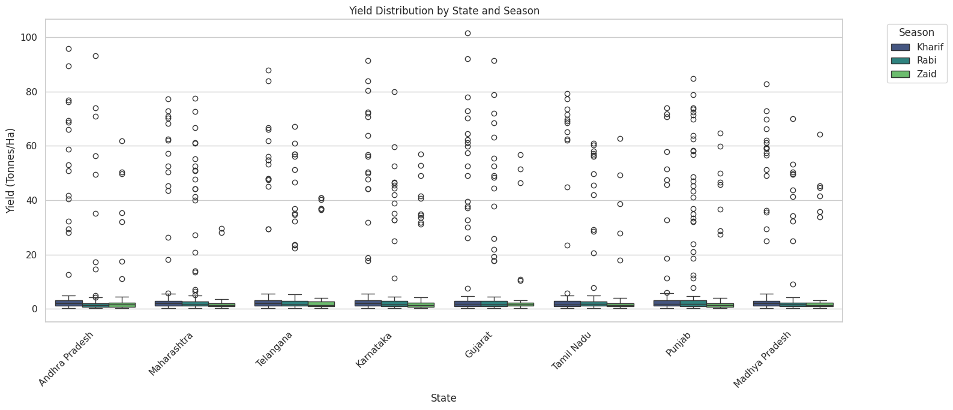
RESULTS
Regional Differences in Yield per Season
This analysis investigates how Yield_Tonnes_Ha varies across different State for each Season. Understanding regional performance is crucial for identifying areas that excel in certain seasons or crops, and can inform regional agricultural strategies. It's relevant to the project goal of investigating how agricultural performance varies across seasons and identifying meaningful patterns, as regional variations are a significant factor.

Slide 7
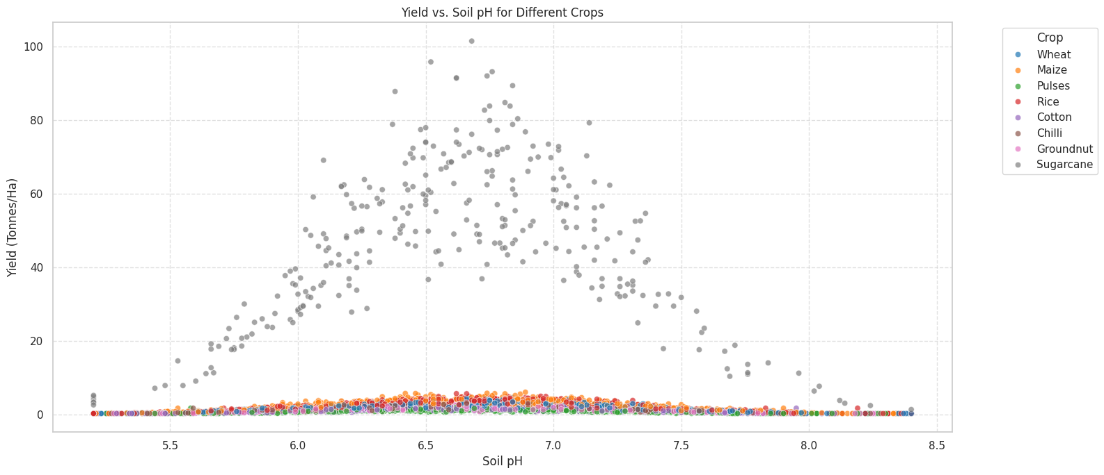
RESULTS
Impact of Soil pH on Yield per Crop
This analysis explores the relationship between soil pH and yield for different crop types. Soil pH is a critical environmental factor affecting nutrient availability and crop growth. Understanding its impact across different crops can help optimize farming practices and improve yield, directly addressing the project objective of investigating relationships among relevant variables and identifying patterns in agricultural performance.

Slide 8
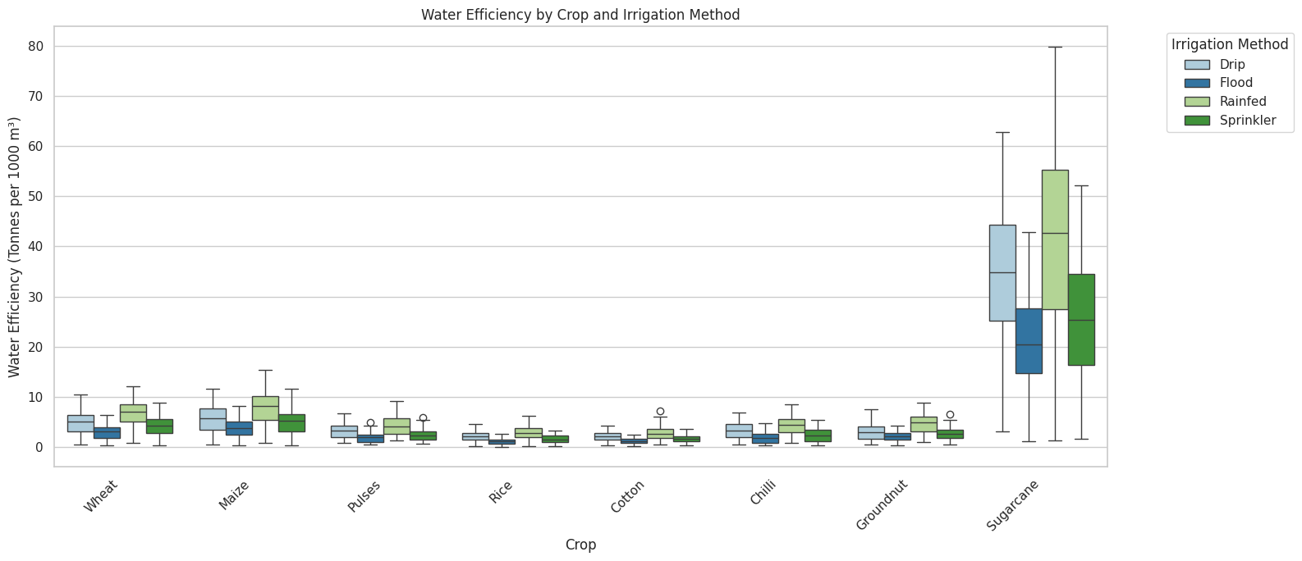
RESULTS
Water Efficiency by Irrigation Method and Crop
This analysis focuses on Water_Efficiency_t_per_1000m3 across different Irrigation_Method for each Crop. Water usage and efficiency are crucial for sustainable agriculture, especially given seasonal variations in water availability. This analysis directly addresses resource usage, helping to identify efficient practices that can lead to better performance and resource management, aligning with the project's focus on understanding agricultural performance and resource usage.

Slide 9
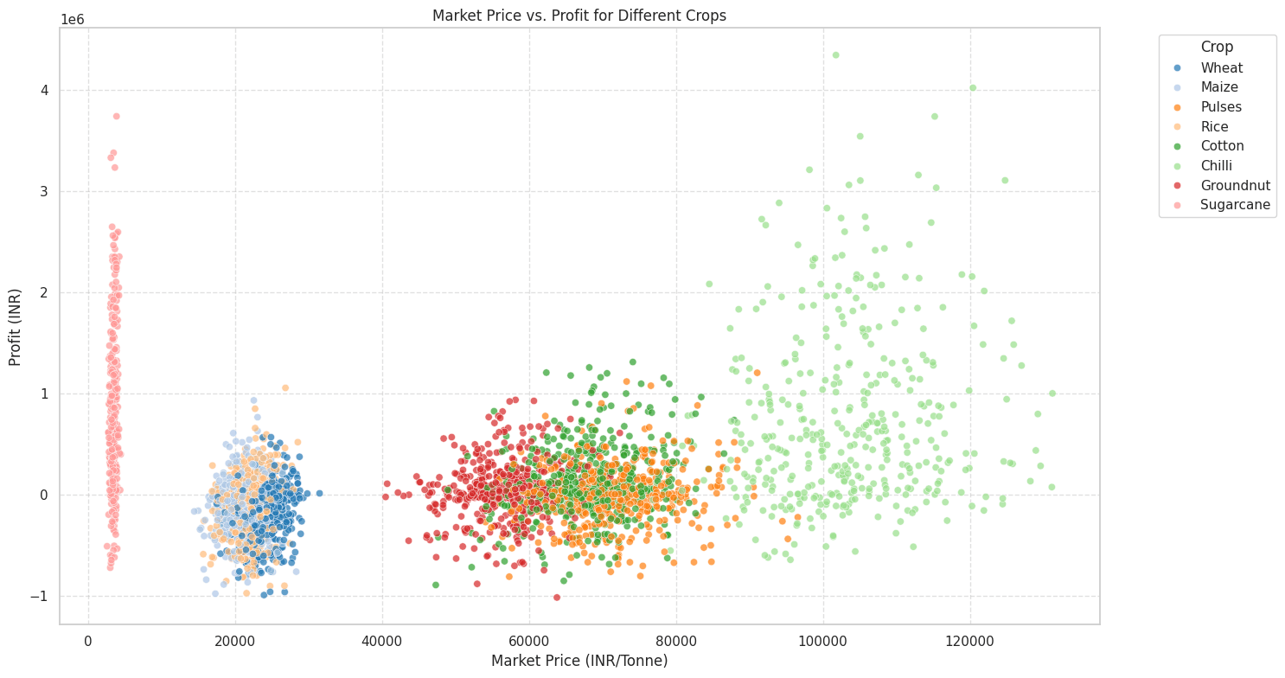
RESULTS
Market Price vs. Profit for Different Crops
Question: How does the market price per tonne affect the profit margin for different crops?
Analysis: This analysis investigates the relationship between Market_Price_INR_Tonne and Profit_INR, segmented by Crop, to help farmers make informed decisions about which crops to grow and when to sell. A higher market price per tonne generally correlates with higher profit margins, but the slope and spread of this relationship differ significantly by crop. Some crops show a wide range of profits even at similar prices, suggesting that cost of production, yield and farm area also strongly influence the final profit. Certain high-value crops consistently yield higher profits, while others are more volatile — showing that market price alone is not sufficient, and a holistic view including costs is essential for maximizing profitability.

Slide 10
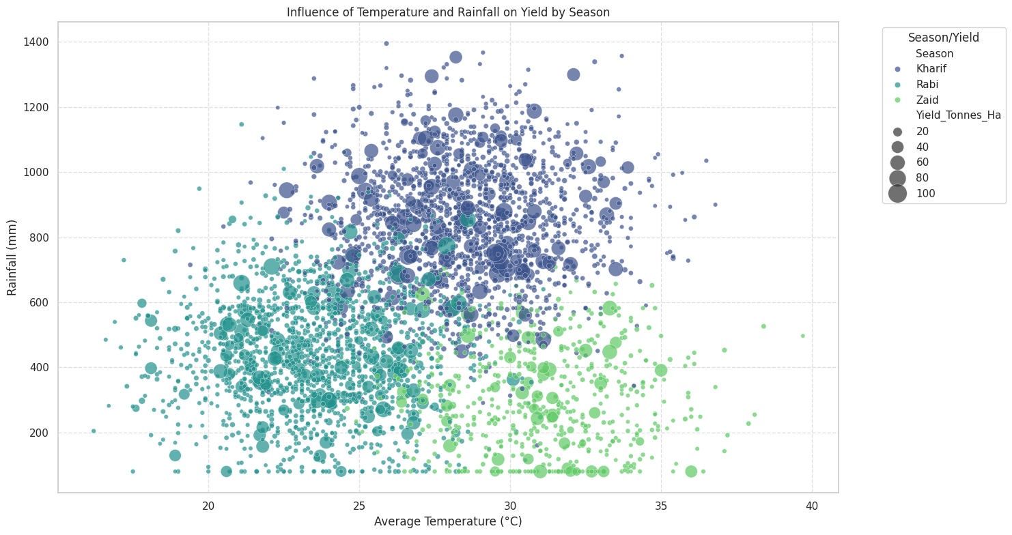
RESULTS
Influence of Temperature and Rainfall on Yield by Season
Interpretation: We can observe clusters of high yield (larger points) occurring within specific temperature and rainfall ranges, which vary by season. Kharif often shows higher rainfall and moderate-to-high temperatures, supporting higher yields for many crops, while Rabi and Zaid, with lower rainfall and different temperature profiles, favor crops adapted to those conditions or need more irrigation for comparable yields. This helps identify the ideal climatic envelope for maximizing yield in each season.

Slide 11
Future scope
How the Analysis Could Support Future Investigation or Decision-Making?
This analysis provides a strong foundation for strategic decision-making in agriculture. It can support:
Policy Formulation: Inform policies related to crop subsidies, irrigation infrastructure development, and regional agricultural development programs.
Farm Management: Guide farmers in optimizing crop selection, irrigation methods, and resource allocation based on seasonal conditions and regional best practices.
Further Research: Identify specific areas for deeper scientific inquiry, such as detailed studies on soil-nutrient interactions, climate-resilient crop varieties, or the economic impact of specific farming innovations.
Risk Management: Help stakeholders understand seasonal vulnerabilities and develop strategies to mitigate risks associated with environmental variability and market fluctuations.

Slide 12


GitHub Link
https://github.com/musicaldeveloper/Seasonal-Agriculture-Data-Analysis.git

Slide 13

VOIS Course completion certificate -
Course name- Data Visualization

Slide 14
Thank you
.
.

