Slide 1
Lunch and learn Introduction to Docker/Kubernetes

Slide 2
Docker Benefits
Small packaged container - easily reproducible across environments.
Rapid deployment - can be managed with Kubernetes/ECS.
Secure – applications are completely segregated and isolated from each other.
Simple and fast configuration – Infrastructure defined as code within the Dockerfile.
Continuous Integration – Docker works well with tools such as Gitlab, Travis, and Jenkins.

Slide 3
Kubernetes/ECS Benefits
Control and automate deployments and updates.
Save money by optimizing infrastructural resources thanks to the more efficient use of hardware.
Orchestrate containers on multiple hosts.
Self-monitoring/health checks.
Horizontal scaling – can add more pods easily if needed.

Slide 4
Docker engine components
Server: docker daemon called dockerd. It can create and manage docker images, containers, etc.
Rest API – used to instruct docker daemon what to do.
Command Line Interface (CLI) – client which is used to enter docker commands

Slide 5
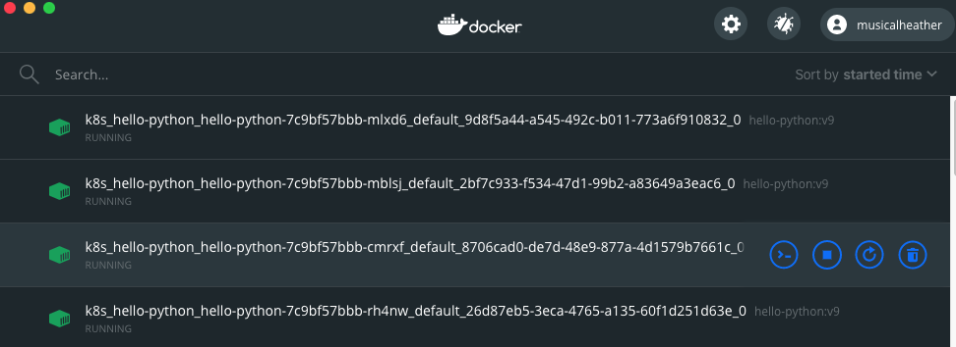
Docker For Desktop
This is a nifty GUI for development purposes. It shows you the running pods and allows you to restart or connect to them.

Slide 6
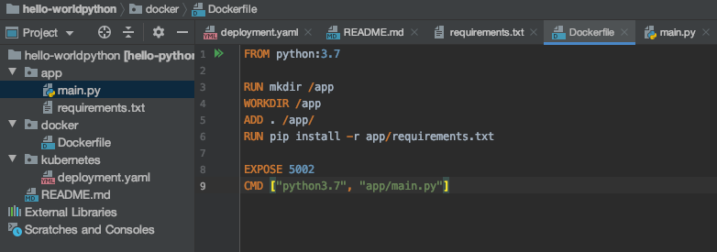
Introducing the Dockerfile

Slide 7
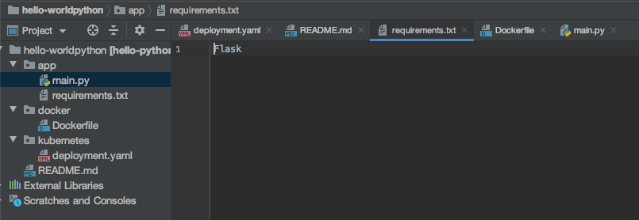
Requirements file
This file contains any packages that your application needs to have installed

Slide 8
When to Build/Deploy
Docker - when anything changes in your code short of the Kubernetes deployment itself.
Kubernetes – when the cluster definition changes, you’ll need to delete the deployment and apply the changes.

Slide 9
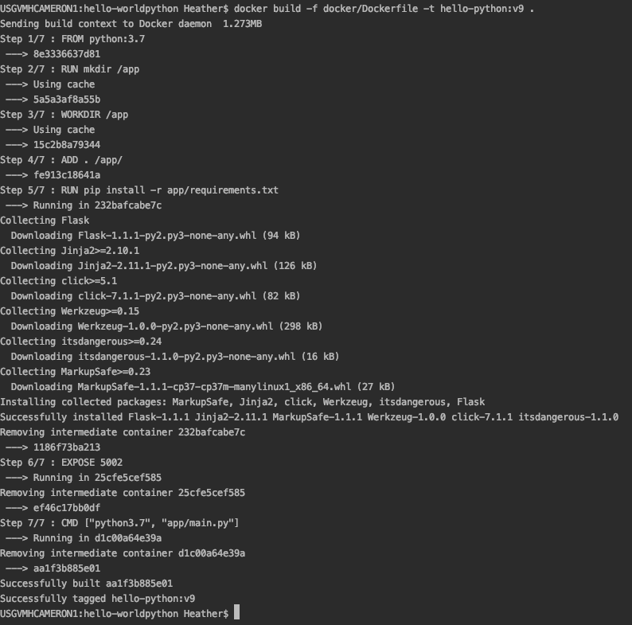
Docker Build Process

Slide 10
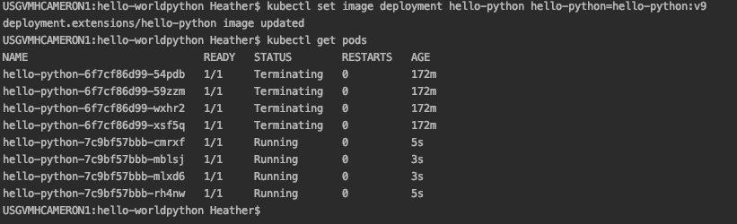
Kubernetes Update Process

Slide 11

After Deployment
Check to make sure your application has the expected changes. Because Kubernetes/ECS does rolling updates, there is zero downtime. It typically takes 2-3 minutes for all the pods to terminate and deploy in order.

