Slide 1
Basic information of photography
How to exposure properly

Slide 2
Background
Why would people do this?
Photography is one of famous hobbies for people. They start photography as their hobbies, but they tend to start to study more deeply. However, they have lack of knowledge of photography and how to set up the camera properly. What they see from eyes is different from what camera takes through the viewfinder.
This tutorial is useful because…
This tutorial site contains basic information of photography for beginners. They can learn basic theory or principle of camera. This information will help them set up an exposure properly. Furthermore, they also can get newest information of gears.

Slide 3
Design objectives & strategy
The goal of the design is to…
Give them simple information and let them know that camera system is not hard. After they read this page, they won’t hesitate to use camera to outside and won’t afraid to use manual mode instead of automatic mode.

Slide 4
Site audience
This tutorial site will help people who…
Have interested in photography and willing to learn photography. Moreover, it is sad if their images turn out bad quality when they go travel around. They won’t make any mistake.
Visitors include…
Student, couple, traveler, photography hobby group, kids

Slide 5
Competitors
Lifehacker
http://lifehacker.com/5815742/basics-of-photography-the-complete-guide
Camerasim
http://camerasim.com/apps/original-camerasim/web/
Strobist
http://strobist.blogspot.com/
Fstoppers
https://fstoppers.com/

Slide 6
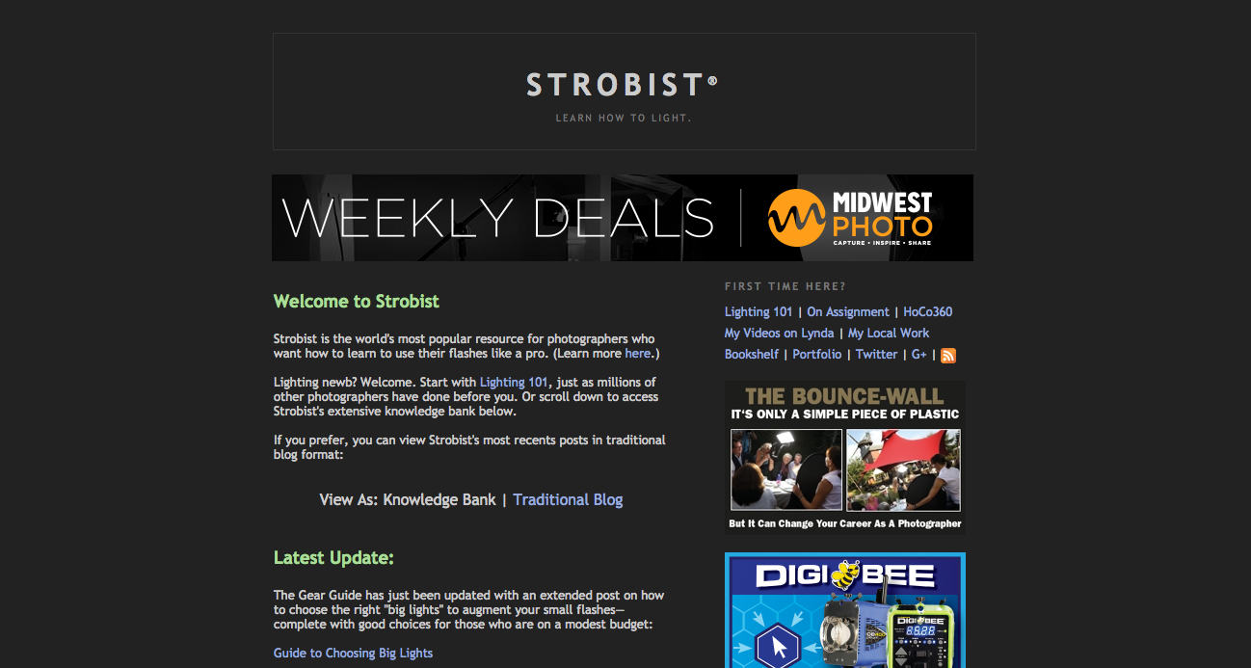
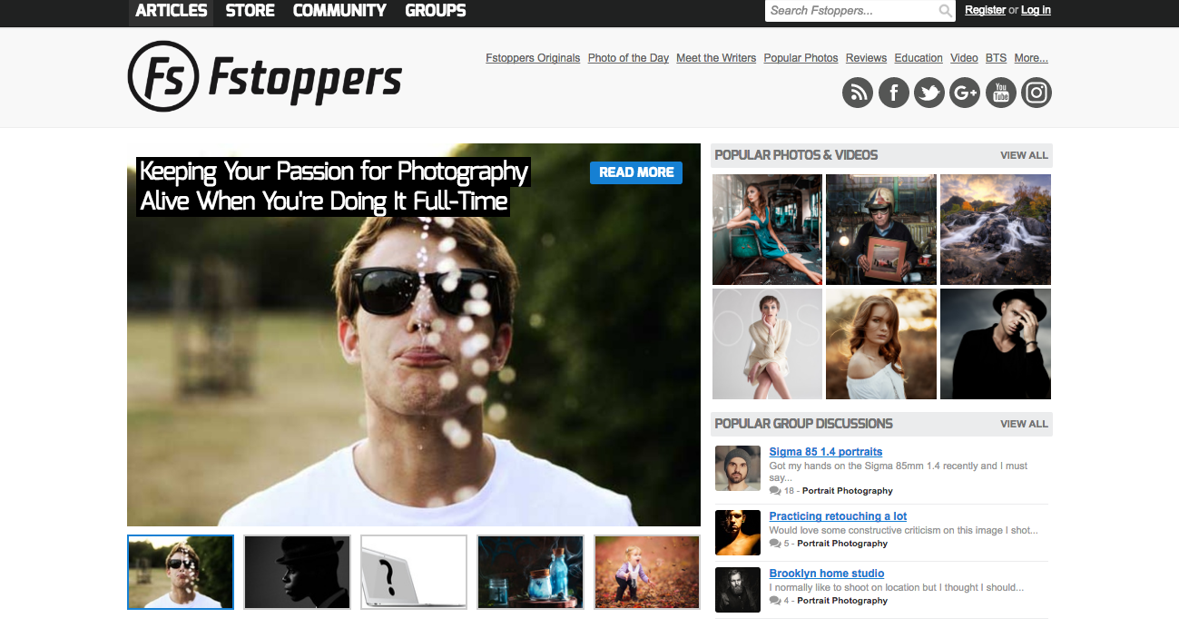
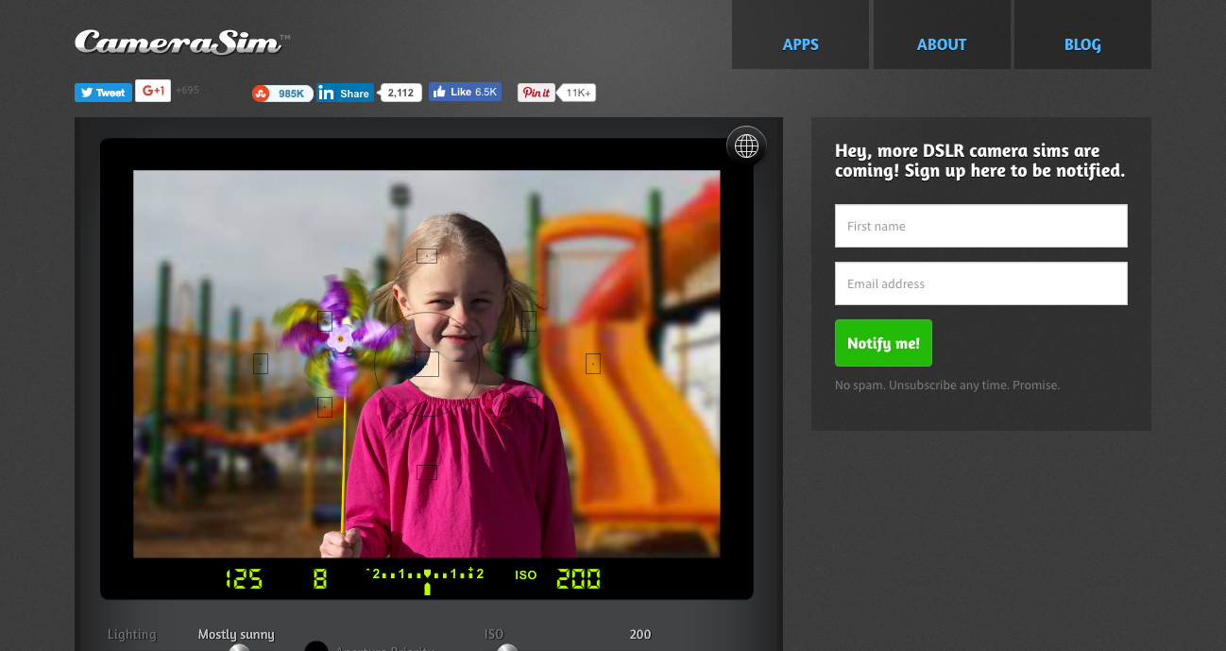
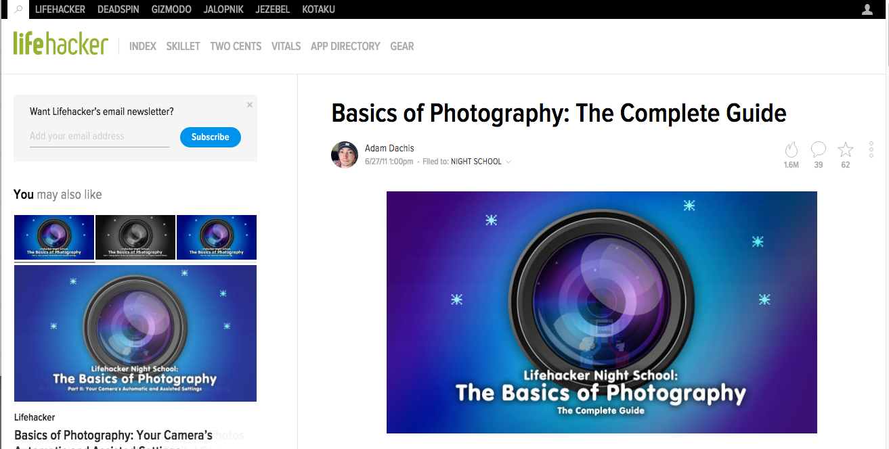
Competitors

Slide 7
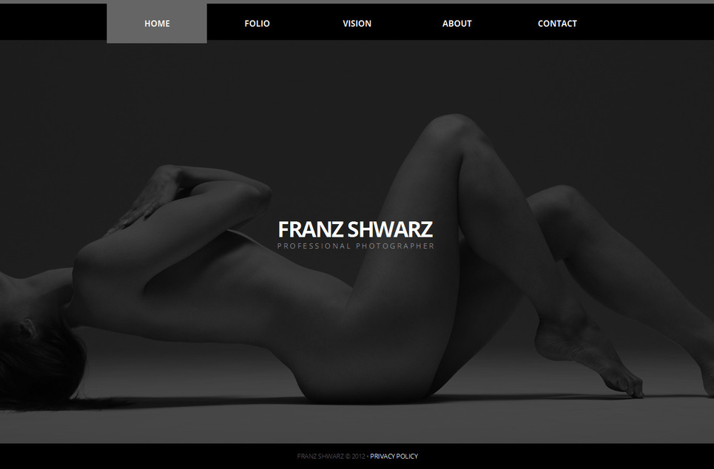
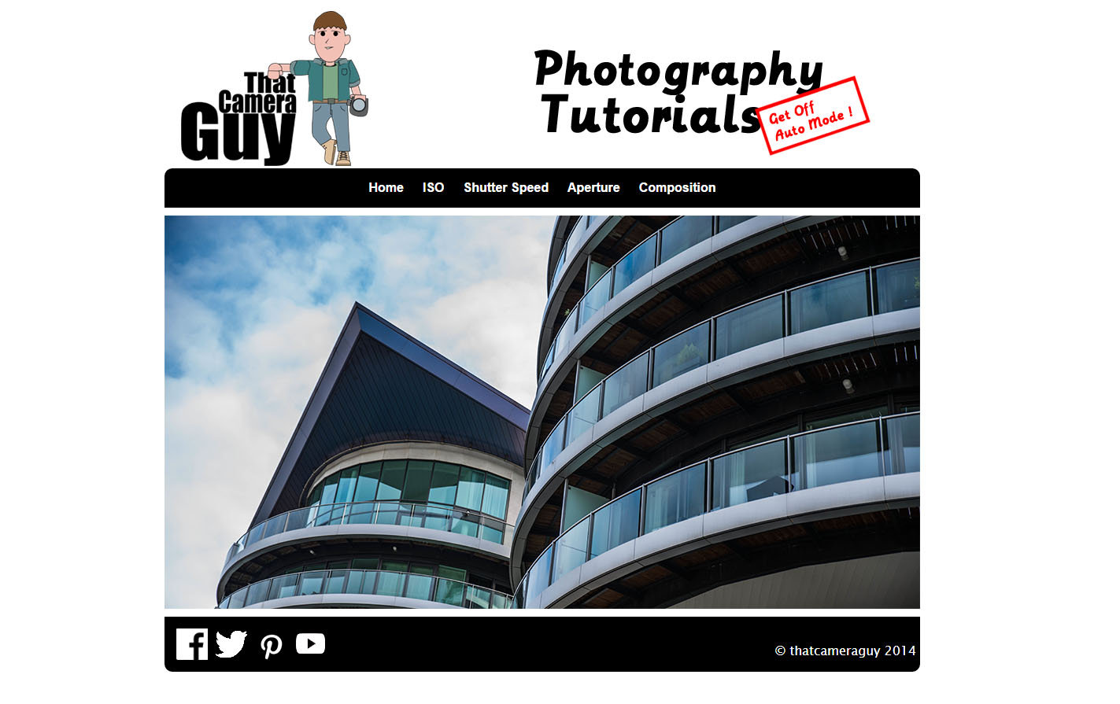
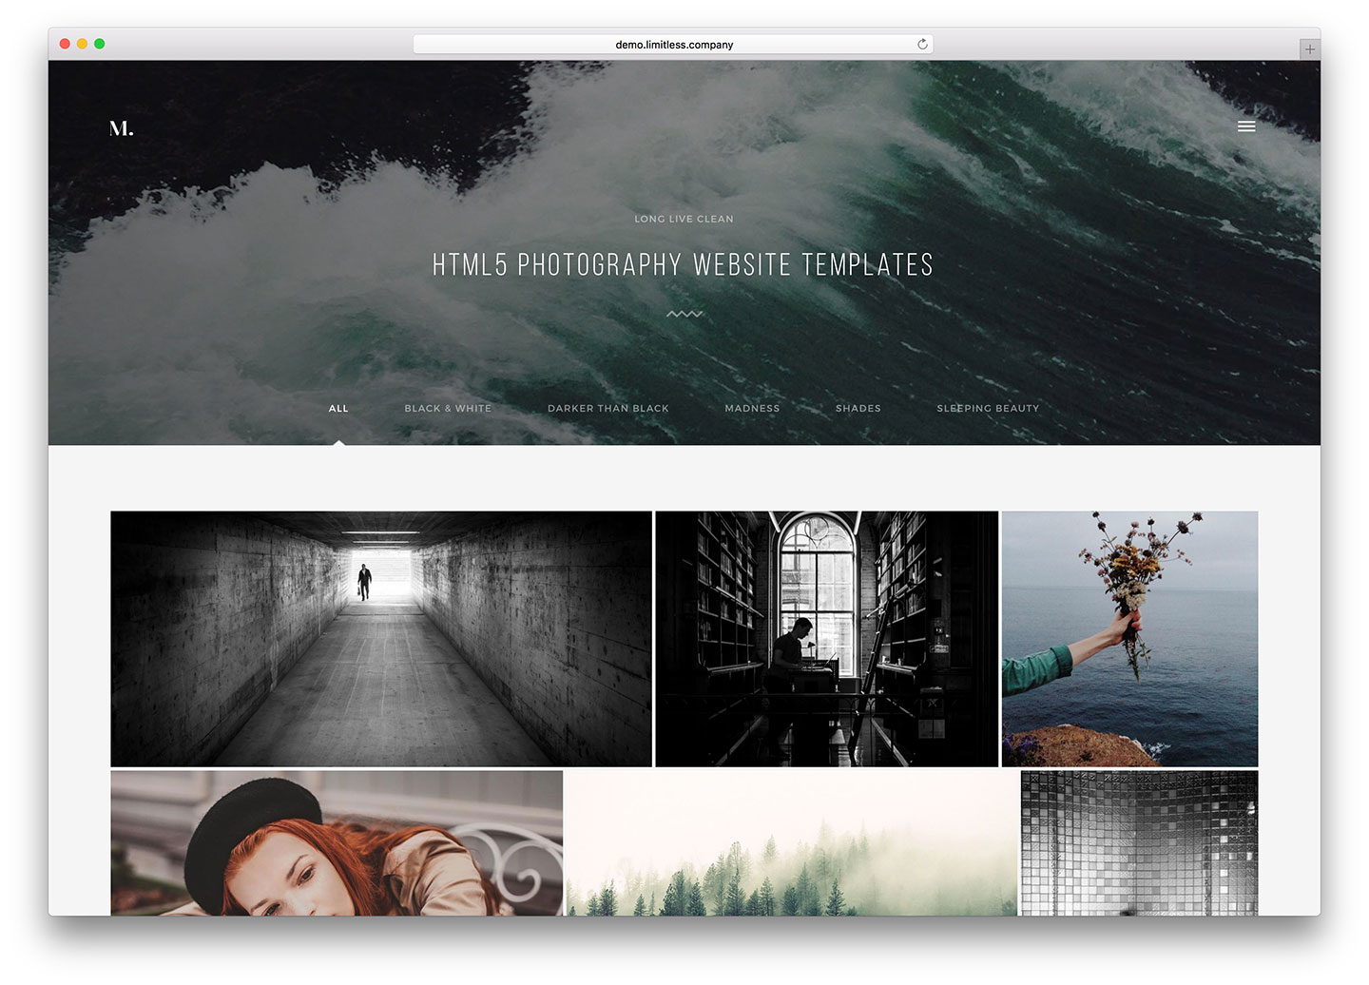
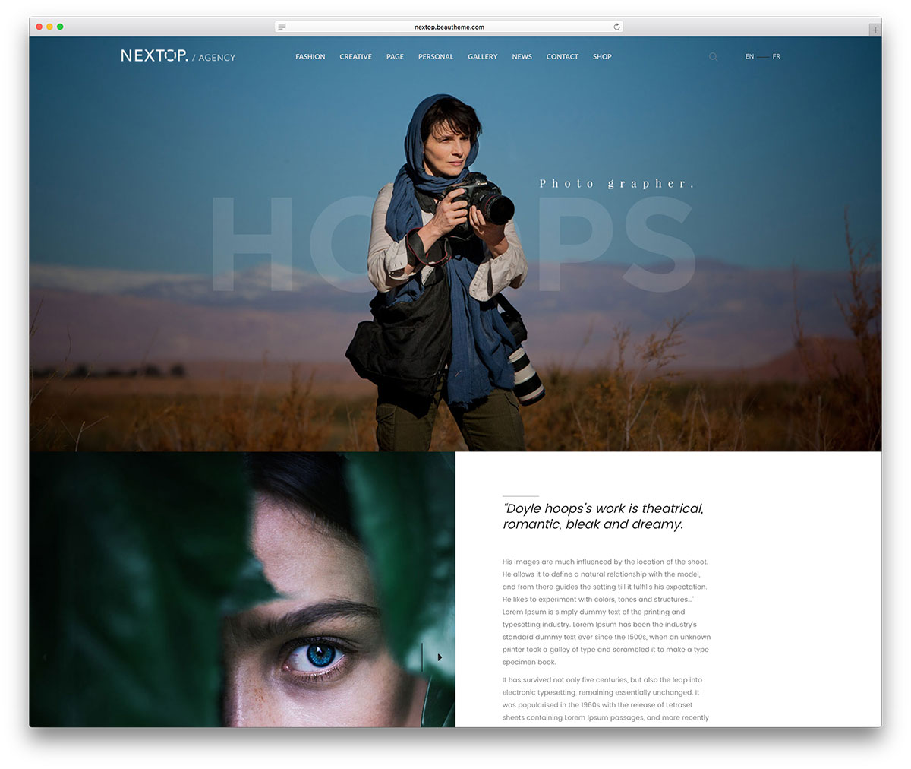

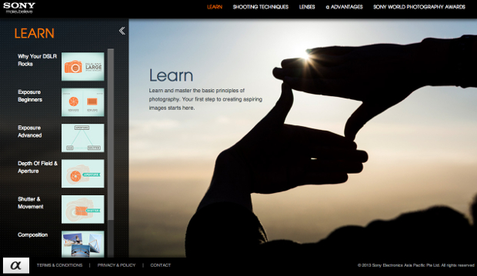
Colors and textures

Slide 8
Keywords
Site should be
Site shouldn’t be
Simple
Modern
Minimalist
B&W
Informative
Educational
Organized
Too much colorful
Chaotic
Humorous

Slide 9
Content for the site
Home
About / Contact
How-to
Gears
Other resources (other useful websites)

