Slide 1
Detecting Heavy Drinking Episodes using Accelerometer Data
Deep Learning 2470 Final Project
Amrit Singh Rana
Muskaan Patel
Sarah Prakriti Peters

Slide 2
We are proposing a smartphone-based system to address the problem of excessive alcohol consumption.
Heavy alcohol use is especially prevalent on college campuses, and real-time measurement of blood alcohol content or transdermal alcohol content is challenging.
Our system uses accelerometer signals to track a user's level of intoxication in real-time, enabling the delivery of just-in-time adaptive interventions during heavy drinking events.
Our project will focus on developing novel features using deep learning techniques to improve the accuracy and usability of the heavy drinking classifier.
Project Summary

Slide 3
Dataset
14,057,567
The dataset used in the project is Bar Crawl: Detecting Heavy Drinking Data Set, available on the UCI Machine Learning Repository.
The dataset includes accelerometer data collected from 13 participants during a bar crawl event at a sampling frequency of 50 Hz.
The dataset contains data samples with features extracted from both the time and frequency domain
Data was collected from smartphones at a sampling rate of 40 Hz. It was collected from 11 iPhones and 2 Android phones.
TAC data was collected using SCRAM ankle bracelets at 30-minute intervals, with raw readings and cleaned readings.
Accelerometer Readings
715
TAC Readings
13
Participants

Slide 4

Binarized TAC Data
Upsampled TAC Data
Data Preprocessing
Merged TAC Data with Accelerometer Data
Evenly Sampled Accelerometer Data

Slide 5
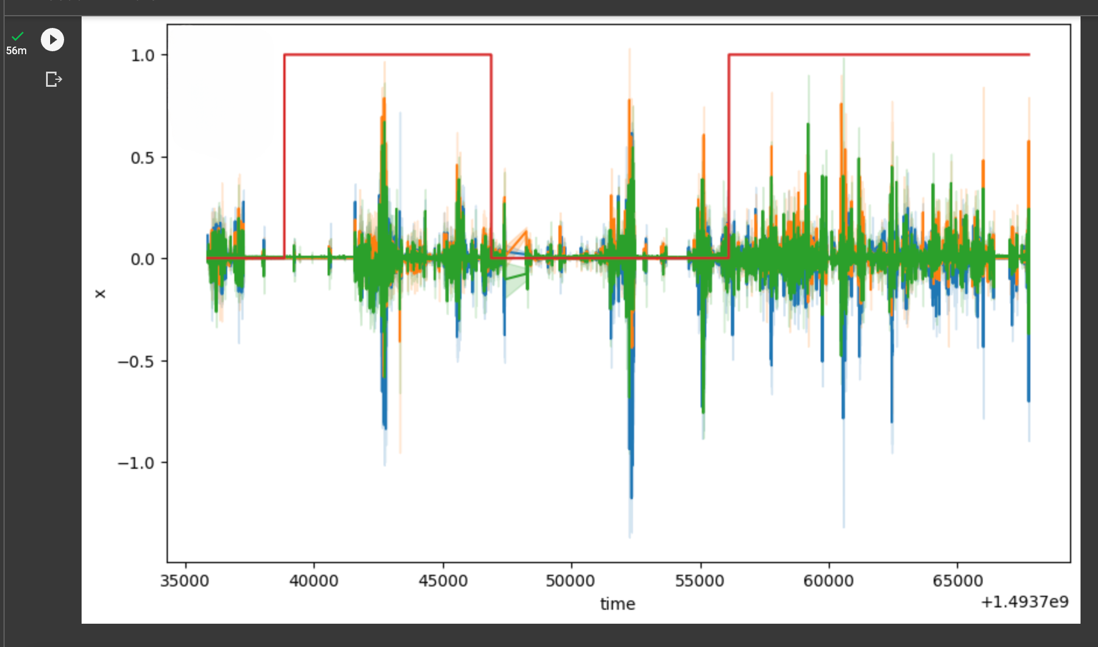
Legend:
Red - TAC Value (0 or 1)
Blue - x-axis values
Green - y-axis values
Orange - z-axis values

Slide 6
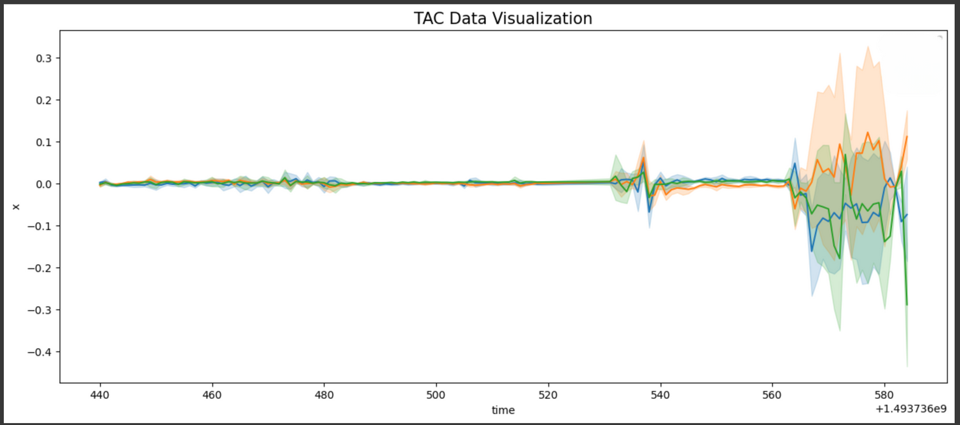

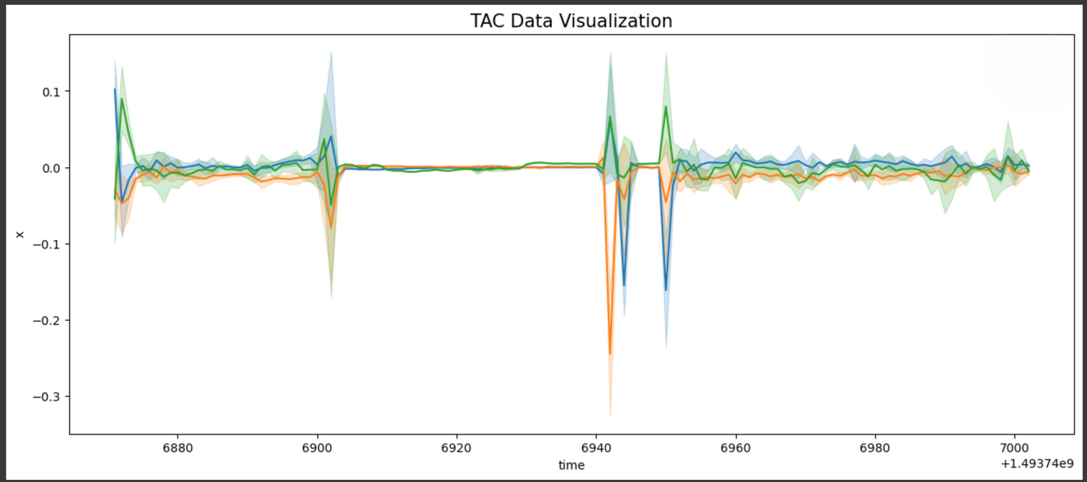
Data Visualization when TAC value is 0
Legend:
Blue - x-axis values
Green - y-axis values
Orange - z-axis values
Data Visualization when TAC value is 1
Legend:
Blue - x-axis values
Green - y-axis values
Orange - z-axis values

Slide 7
The raw time-series data must be transformed using a windowing technique before applying standard classification algorithms.
In stage 1, we built 16 simple statistical features like mean, standard deviation, min-max values, skew, kurtosis, etc.
In stage 2, we added 13 new fast-Fourier transform features such as FFT Mean, FFT standard deviation, FFT Interquartile range, etc.
In stage 3, we added index values of the underlying data as potential features.
At the end of all the feature engineering steps, we have a data frame with 107 columns to work with!
Feature Engineering

Slide 8

Feature Engineering
Basic Features
Statistical Features
Fast Fourier Transform Features
X-Axis
Y-Axis
Z-Axis
X,Y,Z Mean
X,Y,Z Standard Deviation
X,Y,Z Average Absolute Difference
X,Y,Z Min Values
X,Y,Z Max Values
X,Y,Z Max-Min Differences
X,Y,Z Median Values
X,Y,Z Median Absolute Deviation
X,Y,Z InterQuartile Ranges
X,Y,Z Negativa Positive Counts
X,Y,Z Values above Mean
X,Y,Z Skewness
X,Y,Z Kurtosis
X,Y,Z Energy
Average Resultant
Signal Magnitude Area
X,Y,Z FFT Mean
X,Y,Z FFT Standard Deviation
X,Y,Z FFT Average Absolute Difference
X,Y,Z FFT Min Values
X,Y,Z FFT Max Values
X,Y,Z FFT Max-Min Differences
X,Y,Z FFT Median Values
X,Y,Z FFT Median Absolute Deviation
X,Y,Z FFT InterQuartile Ranges
X,Y,Z FFT Values above Mean
X,Y,Z FFT Skewness
X,Y,Z FFT Kurtosis
X,Y,Z FFT Energy
FFT Average Resultant
FFT Signal Magnitude Area
Notes:
x_IQR_fft
y_IQR_fft
z_IQR_fft
x_above_mean_fft
y_above_mean_fft
z_above_mean_fft
x_skewness_fft
y_skewness_fft
z_skewness_fft
x_kurtosis_fft
y_kurtosis_fft
z_kurtosis_fft
x_energy_fft
y_energy_fft
z_energy_fft
avg_result_accl_fft
sma_fft

Slide 9
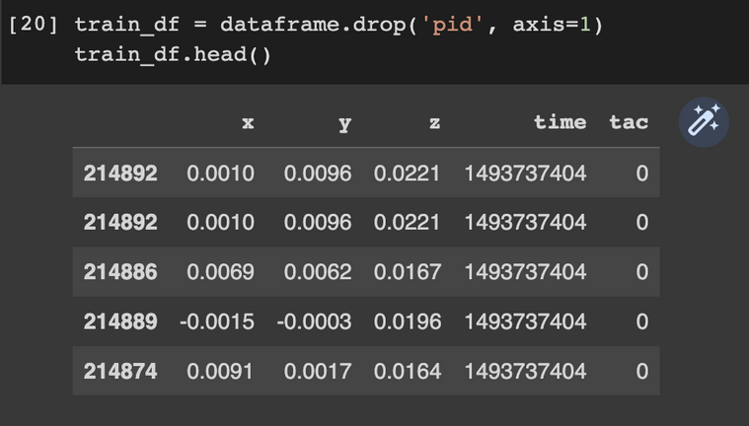
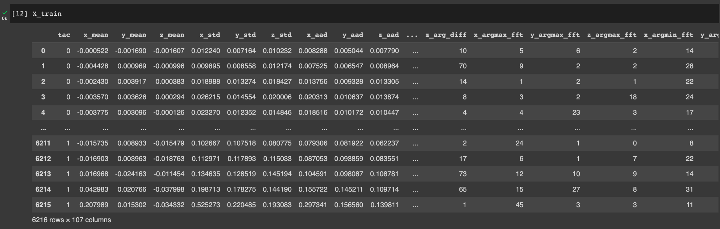

Slide 10
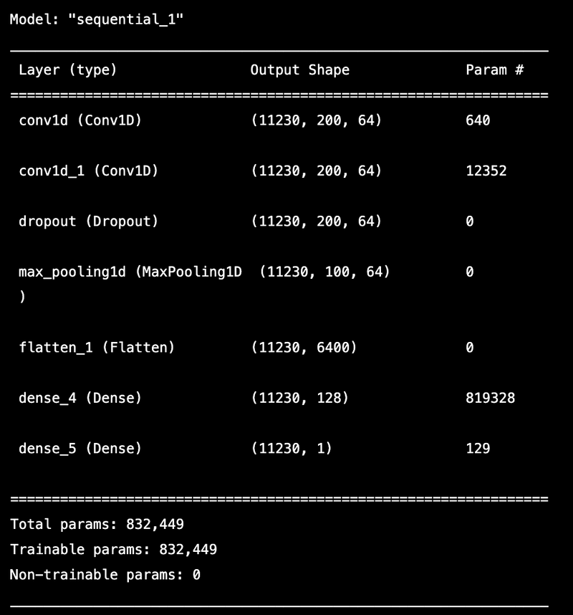
Models Used
Convolutional Neural Network
CNN was chosen as it eliminates the need for feature extraction, simplifying the model architecture and reducing the risk of losing important information.
Accelerometer data resembles image data as x, y, z axes are like colour channels, making it suitable for CNNs to learn patterns and classify activities.
However, CNN performed extremely poorly.
Accuracy - 28%

Slide 11
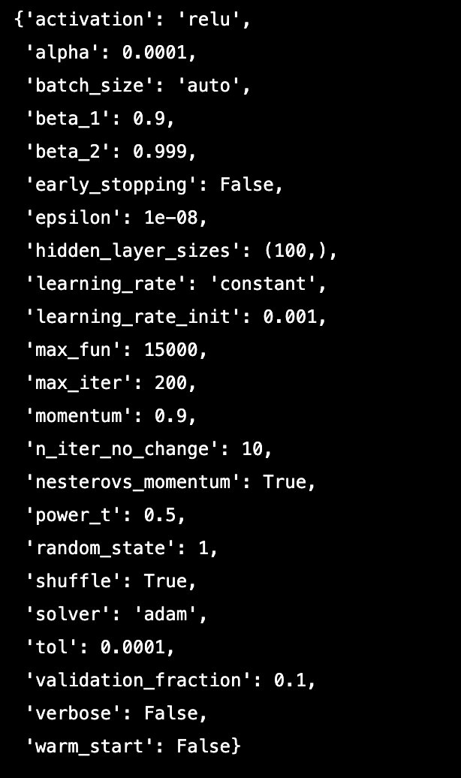
Models Used
Multi-Layer Perceptron
Next, after receiving bad results from the CNN, we switched to a simpler network for our baseline model.
MLP is a type of feedforward neural network commonly used for classification tasks.
The MLP model achieved an accuracy of approximately 68% in classifying the transformed accelerometer data for detecting heavy drinking episodes.

Slide 12
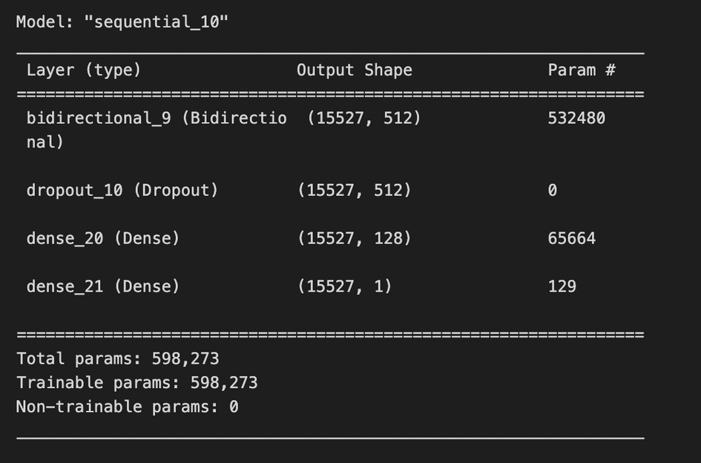
Models Used
Long Short-Term Memory Networks (LSTM)
Bidirectional LSTM is a type of recurrent neural network that is adept at capturing long-term dependencies in sequential data.
The LSTM model was found to be effective in analysing accelerometer data and achieved a high accuracy of approximately 71% in classifying the data into two categories.
This highlights the suitability of LSTM for this type of data and suggests that the approach can be used to address the problem of excessive alcohol consumption effectively.

Slide 13
Result Summary
Model | Test Accuracy
CNN | 28%
Multi-Layered Perceptron | 68%
Long Short-Term Memory Networks (LSTM) | 71%

Slide 14

Future Work
Refine feature engineering: Develop novel features to improve accuracy and usability by exploring new techniques for extracting relevant information from accelerometer data.
Address bugs and challenges: Identify and address bugs or challenges during model development
Collect more data: Collect additional accelerometer data to enhance the generalisability of models
Additional Features: Consider incorporating other sensors like GPS or heart rate sensors to improve prediction accuracy.
Develop app: Convert the system into an app for easy usability and accessibility.

Slide 15
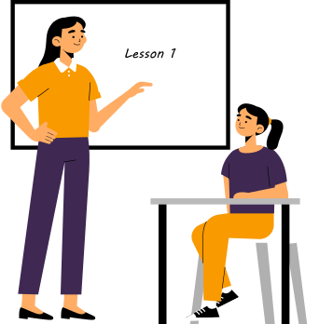
Lessons Learnt!
Never pick weird datasets which have no good research paper publications!
Pre-processing time-series data with 14 MILLION instances is not a good idea!
Never underestimate the power of a common man (a basic Multi-Layered Perceptron Network in our case).
Special thanks to our project mentor Nange, for always being there for us (on gloomy weekdays and sunny weekends)

Slide 16
Thank You!
Thanks to Dr. Ritambhara for engaging and informative deep learning lectures, and to all the TAs for their hard work and dedication.

