Slide 1


Object Oriented Programming in C++
Prepared by:
Muskaan Pirani
Devang Patel Institute of Advance Technology and Research

Slide 2

AIRLINE RESERVATION SYSTEM
AIRLINE RESERVATION SYSTEM

Slide 3
OUTLINE
Introduction
Motivation
Header Files
Flowchart
Minimum configuration
Implemented Screenshots
Application of project
Conclusions
Future scope
References
AIRLINE RESERVATION SYSTEM

Slide 4
INTRODUCTION
It is used to store records about the passenger and flight details.
It performs the following operations:-
RESERVATION
Books a ticket
DATA
CANCELLATION
Cancels the ticket
OTHER OPERATIONS
To see various records.
AIRLINE RESERVATION SYSTEM

Slide 5
MOTIVATION
A manual system which mainly involves registering manually.
LARGE PILES OF RECORDS.
MANUAL SYSTEM
TIME CONSUMING.
HIGH CHANCES OF ERROR
BY USING C++
IT BECOMES EASY TO HANDLE.
AIRLINE RESERVATION SYSTEM

Slide 6
HEADER FILES
#include<iostream>
#include<iomanip>
#include<conio.h>
#include<string.h>
#include<stdlib.h>
AIRLINE RESERVATION SYSTEM

Slide 7
FLOWCHART
CLASS MY TIME
CLASS PASSANGER
CLASS SEARCH
CLASS MAIN1
CLASS BOOKING
CLASS LOCAL
CLASS INTERNATIONAL
AIRLINE RESERVATION SYSTEM

Slide 8
MINIMUM CONFIGURATION REQUIRED
Working System having 2GB of RAM.
Code Blocks (Version 16.01).
AIRLINE RESERVATION SYSTEM

Slide 9
APPLICATION
Can be used for educational purposes.
Can be used at airports with further modification.
AIRLINE RESERVATION SYSTEM

Slide 10
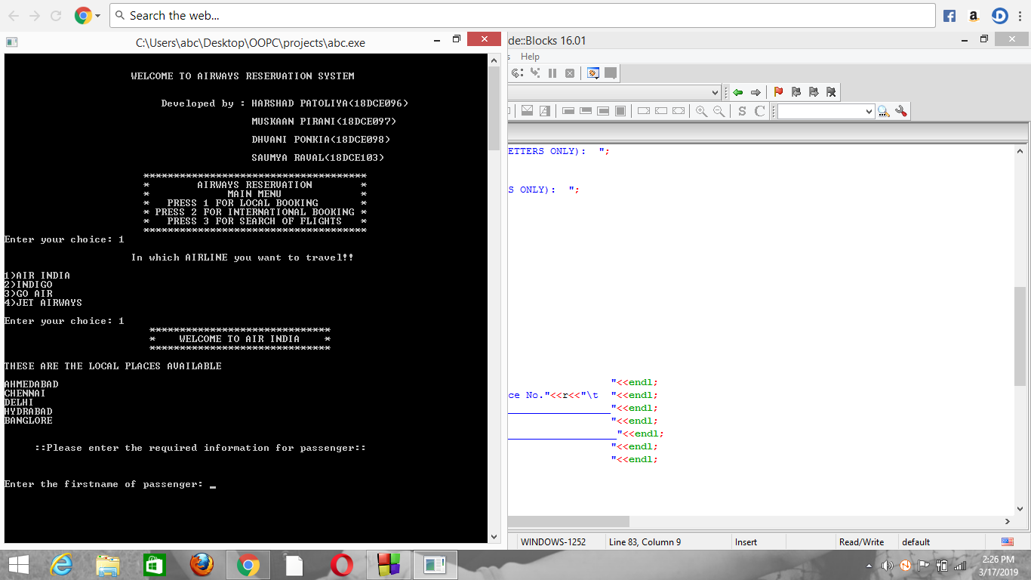
IMPLEMENTED SCREENSHOTS
Main menu:
AIRLINE RESERVATION SYSTEM

Slide 11
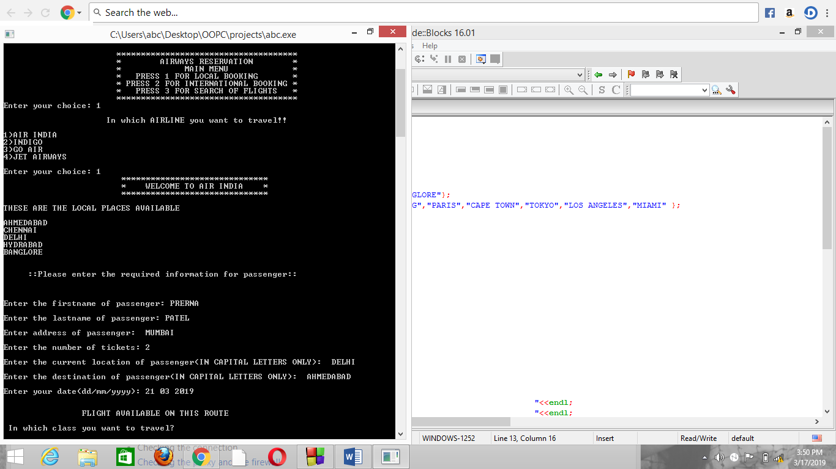
Flight choice and passenger details:
AIRLINE RESERVATION SYSTEM

Slide 12
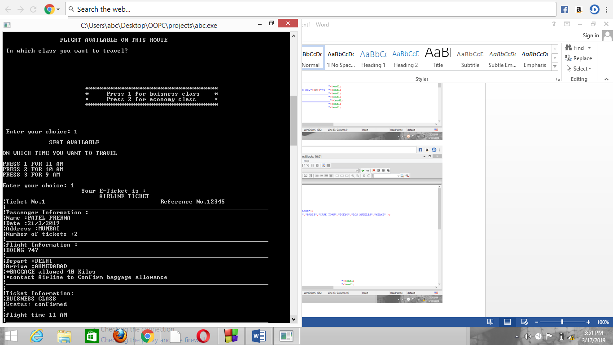
Business/Economic class and Time of flight:
AIRLINE RESERVATION SYSTEM

Slide 13
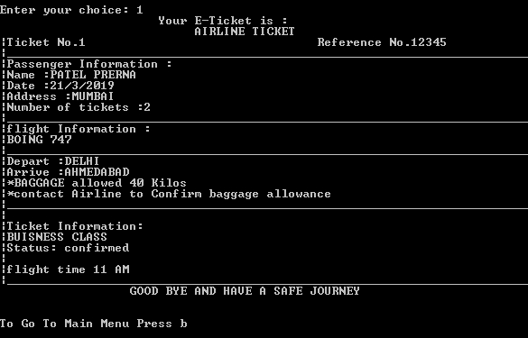
E-Ticket:
AIRLINE RESERVATION SYSTEM

Slide 14
CONCLUSION
This software can be used for systematic storing of data.
Provides instant access of:
Position and availability of flights.
AIRLINE RESERVATION SYSTEM

Slide 15
FUTURE SCOPE
By including concept of file handling we can save more data.
By making it online, we can use it on a larger scale.
AIRLINE RESERVATION SYSTEM

Slide 16
REFERENCES
www.quora.com
www.stackoveflow.com
www.geeksforgeeks.com
http://btechsolutions4u.blogspot.com
AIRLINE RESERVATION SYSTEM

Slide 17
Thank You
AIRLINE RESERVATION SYSTEM

