Slide 1


Stock Market Prediction using Deep Learning Models
TEAM
Muskaan Pirani (18DCE097)
Mihir Vaishnav (18DCE136)
DCE2 Batch-B and C
Devang Patel Institute of Advance Technology and Research

Slide 2
Outline
Introduction
Background Theory and Problem Statement
Current System and Limitations
Proposed System
Project Definition
Team Work
Hardware and Software Requirements
Implementation
Limitations
Future Outcomes
Conclusion
References

Slide 3
Introduction
A time series is a sequence of observations over a certain period.
Forecasting: An essential but challenging part of time series data analysis.
Prediction: The output of an algorithm
Trained on a historical dataset
Applied to new data when forecasting
Notes:
The purpose of Data Analysis is to extract useful information from data and taking the decision based upon the data analysis.
Why prediction? To make highly accurate guess

Slide 4
Background Theory
Conventional time series data analysis techniques often utilize:
Linear regressions for model fitting
Moving average for prediction purpose
ARIMA → RNN → LSTM-based models
Problem Statement
Predicting stock prices accurately.
Using RNN-based models instead of conventional methods.
Notes:
The purpose of Data Analysis is to extract useful information from data and taking the decision based upon the data analysis.
Why prediction? To make highly accurate guess

Slide 5
Current System and Limitations
Readily available data: We have information however, we lack knowledge.
Applications/websites aren’t available for prediction purposes.
Paid Algos for trading purposes.
Notes:
The purpose of Data Analysis is to extract useful information from data and taking the decision based upon the data analysis.
Why prediction? To make highly accurate guess

Slide 6
Proposed System
Using RNN-based Algorithms.
Predicted value = Original value ± RMSE
Algorithms previously used:
ARIMA
Algorithms used to reduce RMSE:
LSTM
BiLSTM
GRU
Prophet
Notes:
The purpose of Data Analysis is to extract useful information from data and taking the decision based upon the data analysis.
Why prediction? To make highly accurate guess

Slide 7
Project Definition
In this project, a selection of certain stocks data listed in the NSE and BSE are used for the prediction of trend.
Our program is aimed to identify the trend of the price of the target stock.
Prediction here refers to the general trend of the specific stock price.
The main goal is to reduce the RMSE values and to compare the algorithms based on error.
Notes:
The purpose of Data Analysis is to extract useful information from data and taking the decision based upon the data analysis.
Why prediction? To make highly accurate guess

Slide 8


Team Work
Muskaan Pirani
Successfully build the models for RMSE as low as 2.08
Algorithms build: Prophet, LSTM, BiLSTM, GRU, ARIMA
Mihir Vaishnav
Successfully deployed the model Prophet on Streamlit.
Implemented whole code in Streamlit syntax from python.
Notes:
The purpose of Data Analysis is to extract useful information from data and taking the decision based upon the data analysis.
Why prediction? To make highly accurate guess

Slide 9
Hardware and Software Requirements
Tools:
Google Colaboratory/Jupyter Notebook
Web Browser
Technology:
ML algorithms
Streamlit for deployment
Notes:
The purpose of Data Analysis is to extract useful information from data and taking the decision based upon the data analysis.
Why prediction? To make highly accurate guess

Slide 10
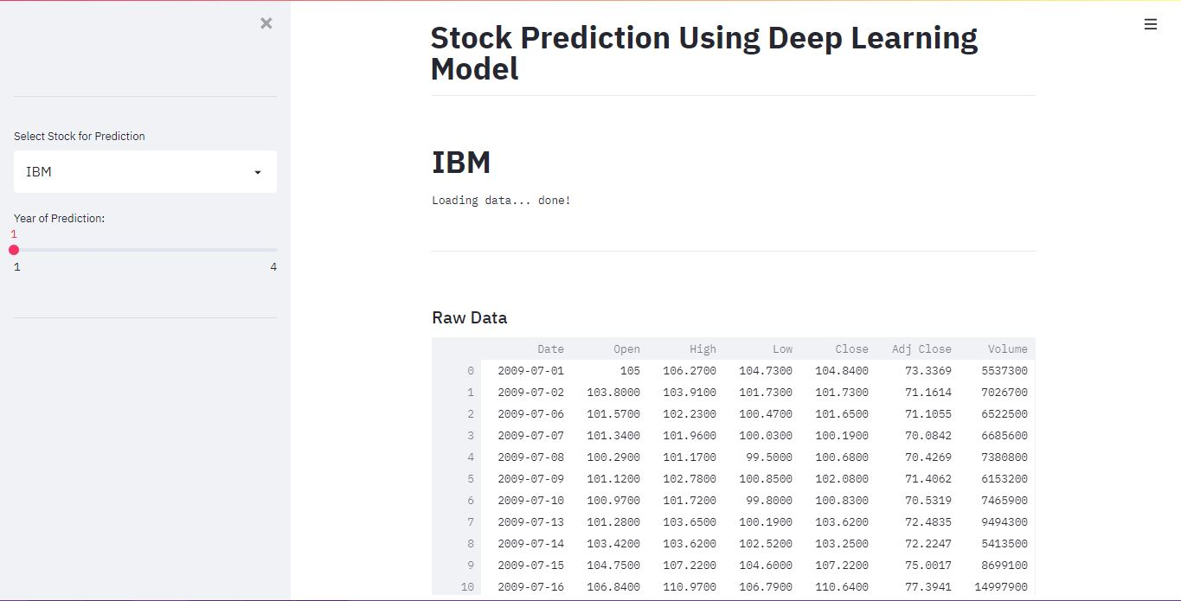
Implementation
Notes:
The purpose of Data Analysis is to extract useful information from data and taking the decision based upon the data analysis.
Why prediction? To make highly accurate guess

Slide 11
Limitations
Static Website.
Deployed Prophet model out of all.
Notes:
The purpose of Data Analysis is to extract useful information from data and taking the decision based upon the data analysis.
Why prediction? To make highly accurate guess

Slide 12
Future Outcomes
Dynamic website.
Inclusion of more stock data.
Increment in functionality which be helpful for traders.
Notes:
The purpose of Data Analysis is to extract useful information from data and taking the decision based upon the data analysis.
Why prediction? To make highly accurate guess

Slide 13
Conclusion
To conclude our project, we have successfully implemented and deployed our algorithms.
We had reduced RMSE score upto 2.08 which was the main aim behind the project.
Notes:
The purpose of Data Analysis is to extract useful information from data and taking the decision based upon the data analysis.
Why prediction? To make highly accurate guess

Slide 14
References
https://www.analyticsvidhya.com/blog/2018/10/predicting-stock-price-machine-learningnd-deep-learning-techniques-python/? https://medium.com/analytics-vidhya/weather-forecasting-with-recurrent-neural-networks-1eaa057d70c3
https://keras.io/examples/timeseries/timeseries_weather_forecasting/
https://towardsdatascience.com/time-series-forecasting-with-lstms-and-prophet-predict-your-email-workload-48bf9cdb1580
https://arxiv.org/abs/1911.09512
Siami Namini, Sima & Tavakoli, Neda & Siami Namin, Akbar. (2019). A Comparative Analysis of Forecasting Financial Time Series Using ARIMA, LSTM, and BiLSTM.
Notes:
The purpose of Data Analysis is to extract useful information from data and taking the decision based upon the data analysis.
Why prediction? To make highly accurate guess

Slide 15
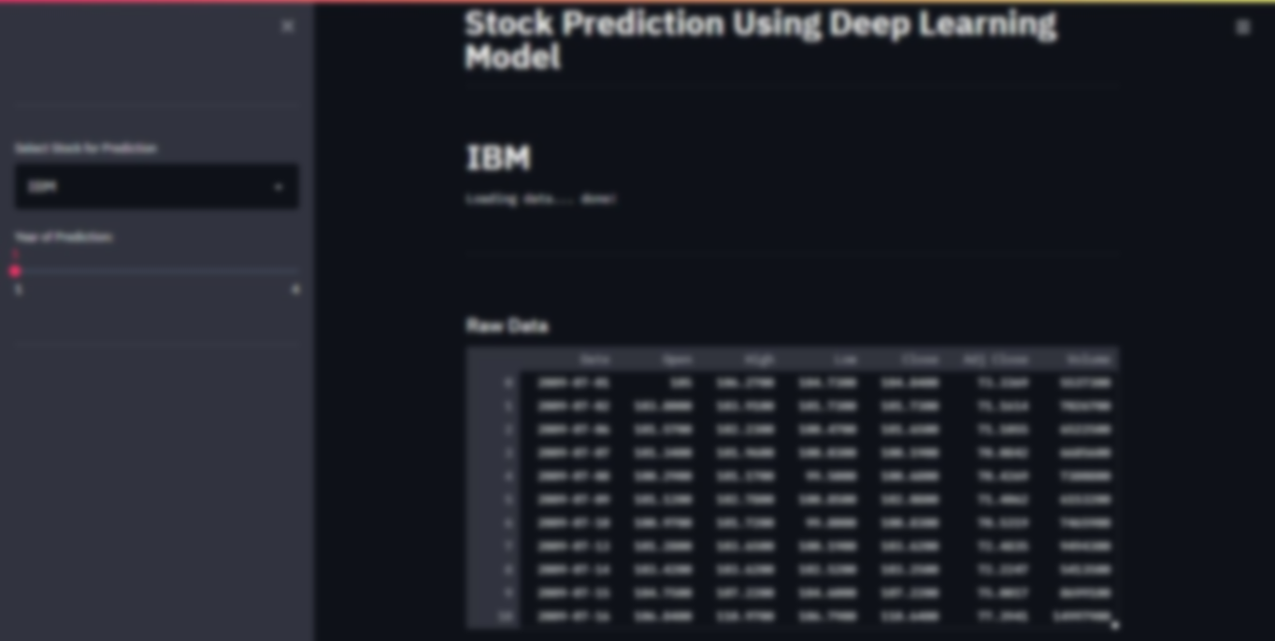
Thank You! Any questions? You can reach us at: Muskaan Pirani: 18dce097@charusat.edu.in Mihir Vaishnav: 18dce136@charusat.edu.in
Notes:
The purpose of Data Analysis is to extract useful information from data and taking the decision based upon the data analysis.
Why prediction? To make highly accurate guess

