Slide 1

DevGuardian
AI-Powered Intelligent CI/CD Guardian
Developer Trust Score + Codebase DNA Fingerprint
Prototype Submission Phase
Microsoft Hackathon — Theme 06
Team: The Hallucinato

Slide 2

Team & Theme
Team name
The Hallucinato
Muskan Sirse
Yogesh Gurjar
THEME 06
AI-Powered Production Function
Co-creator — backend, trust engine & dashboard
Co-creator — AI pipeline, integrations & DevOps
Reinventing Work
One-line pitch: an adaptive, self-learning quality gate that routes AI review depth by developer trust and blocks unsafe merges — automatically and explainably.
Automated quality intelligence between “ready” and “deploy”.
The Hallucinato · Microsoft Hackathon — Theme 06: AI-Powered Production Function: Reinventing Work
2

Slide 3
Problem Statement
2–3 days
1 depth
Generic
typical PR review wait
same scrutiny for every PR, every author
rules flag “best practice”, not YOUR patterns
Modern teams ship through CI/CD, yet the gap between “code is ready” and “code is safe to deploy” is still guarded mostly by humans. Pull requests wait two to three days for review; reviewers are inconsistent and fatigued; and generic AI reviewers treat every change identically — applying the same shallow checks to a senior engineer's one-line fix and a new joiner's authentication rewrite.
The result is twofold waste: trusted developers are slowed by needless friction, while genuinely risky changes slip through without the deep scrutiny they need. Security defects — SQL injection, hardcoded secrets, weak cryptography, disabled TLS — reach production because no automated layer understands WHO wrote the change, HOW risky their recent history is, or whether the code even matches the team's own conventions. Tools rely on generic rule sets that flag violations of “best practice” rather than of THIS team's actual patterns, producing noise teams learn to ignore.
There is no stateful, per-developer intelligence between the pull request and the deploy gate that adapts review depth to risk, learns a codebase's unique “DNA”, and blocks unsafe merges automatically — while staying explainable enough that engineers trust it. DevGuardian targets exactly this gap.
≈ 235 words
The Hallucinato · Microsoft Hackathon — Theme 06: AI-Powered Production Function: Reinventing Work
3

Slide 4
Solution — Approach, Impact & Stack
How it solves the problem
Impact metrics
Developer Trust Score (DTS) routes each PR to the right review depth — trusted devs get an ~8s scan, risky authors get a deep audit, and DTS < 20 is blocked automatically. Codebase DNA Fingerprint learns each repo's real conventions and flags violations of YOUR standards, not generic rules. Actions: inline PR comments + a merge-blocking commit status, Discord alerts, and an explainable dashboard.
PR review turnaround (hours → seconds for trusted devs)
% HIGH/CRITICAL findings caught pre-merge
Reduction in production security defects
Reviewer hours saved per week
DTS trend per developer over time
Deploy-gate Red rate before release
Frameworks · Tools · Technology stack
Backend
Python · FastAPI (single deploy)
AI models (NVIDIA NIM)
Llama 4 Maverick · Qwen3.5-122B · Nemotron-Super-49B
Vector DNA
ChromaDB + nv-embedqa-e5-v5
Data
SQLite (WAL) — trust, reviews, findings
Security scan
Semgrep OSS / built-in OWASP rule pack
Integrations
GitHub webhooks + REST · Discord / Teams
Frontend
Tailwind SPA dashboard (Chart.js)
DevOps
Docker · GitHub Actions + Azure Pipelines · pytest
The Hallucinato · Microsoft Hackathon — Theme 06: AI-Powered Production Function: Reinventing Work
4

Slide 5
Solution — Decisions, Implementation & Scale
Assumptions, constraints & decision points
Ease of implementation & effectiveness
Zero-cost mandate → NVIDIA NIM free models + open-source tooling + GitHub free APIs. SQLite + ChromaDB over Postgres → single deploy, no DB infra to manage. Mock mode → any missing key auto-degrades that integration, so the full pipeline always runs offline and demos anywhere. DTS never shown to managers → ethical by design; used only to route AI depth. HMAC-verified webhooks → refuses requests when no secret is configured. Resilient pipeline → a GitHub write-back failure never discards a completed review.
Connect a repo by adding one webhook (or a GitHub App for an org).
Runs offline in mock mode with zero keys; 28 automated tests pass.
Proven live end-to-end: a real GitHub PR got 3 inline comments + a red merge-gate + Discord alert in ~40s.
Caught real vulnerabilities: SQL injection, hardcoded secret, MD5, disabled TLS.
Scalability & usability
Per-repo DNA profiles + dashboard repo filter → many repos stay cleanly attributed.
GitHub App install model for org-scale onboarding (no per-repo collaborator adds).
Stateless pipeline stages; WAL SQLite handles concurrent webhook + background jobs.
Real-time dashboard (5s auto-refresh) + Microsoft 365 Fluent UI for instant usability.
The Hallucinato · Microsoft Hackathon — Theme 06: AI-Powered Production Function: Reinventing Work
5

Slide 6
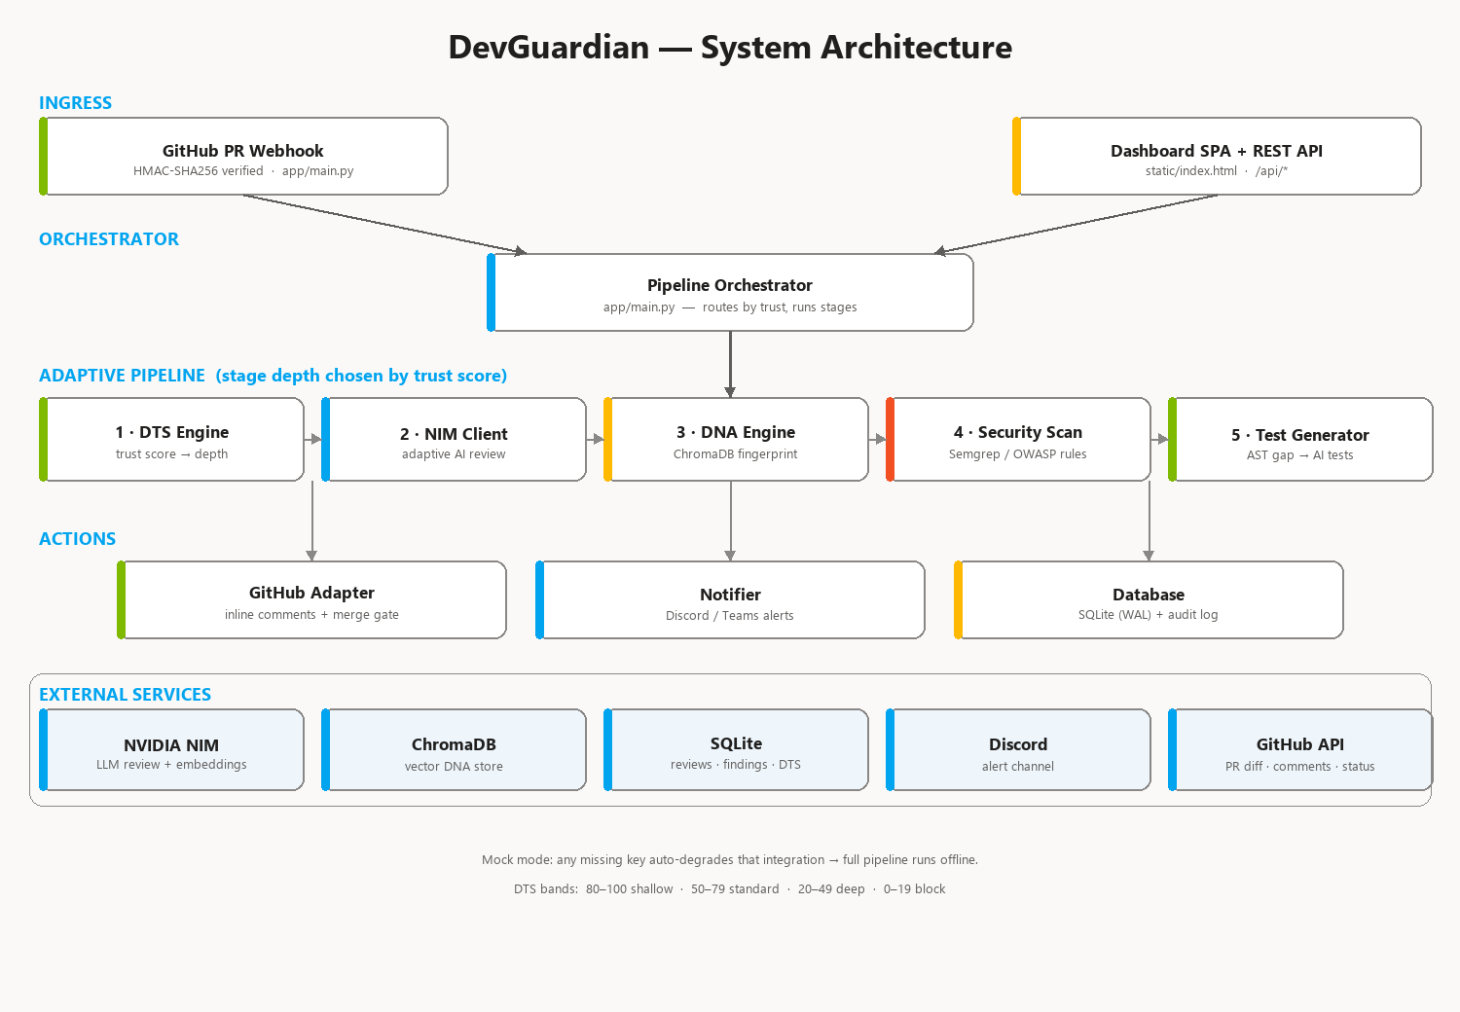
Methodology — Concept & Architecture
Core concept
A three-layer adaptive pipeline that puts stateful, per-developer intelligence between the pull request and the deploy gate.
Design principles
Explainable — every score & finding has a reason. Adaptive — review depth scales with risk. Team-specific — learns YOUR DNA, not generic rules. Graceful — mock mode keeps it always-on.
Components
DTS engine · NIM client · DNA engine · security scanner · test generator · deploy gate · GitHub/Discord/DB actions · dashboard.
The Hallucinato · Microsoft Hackathon — Theme 06: AI-Powered Production Function: Reinventing Work
6

Slide 7
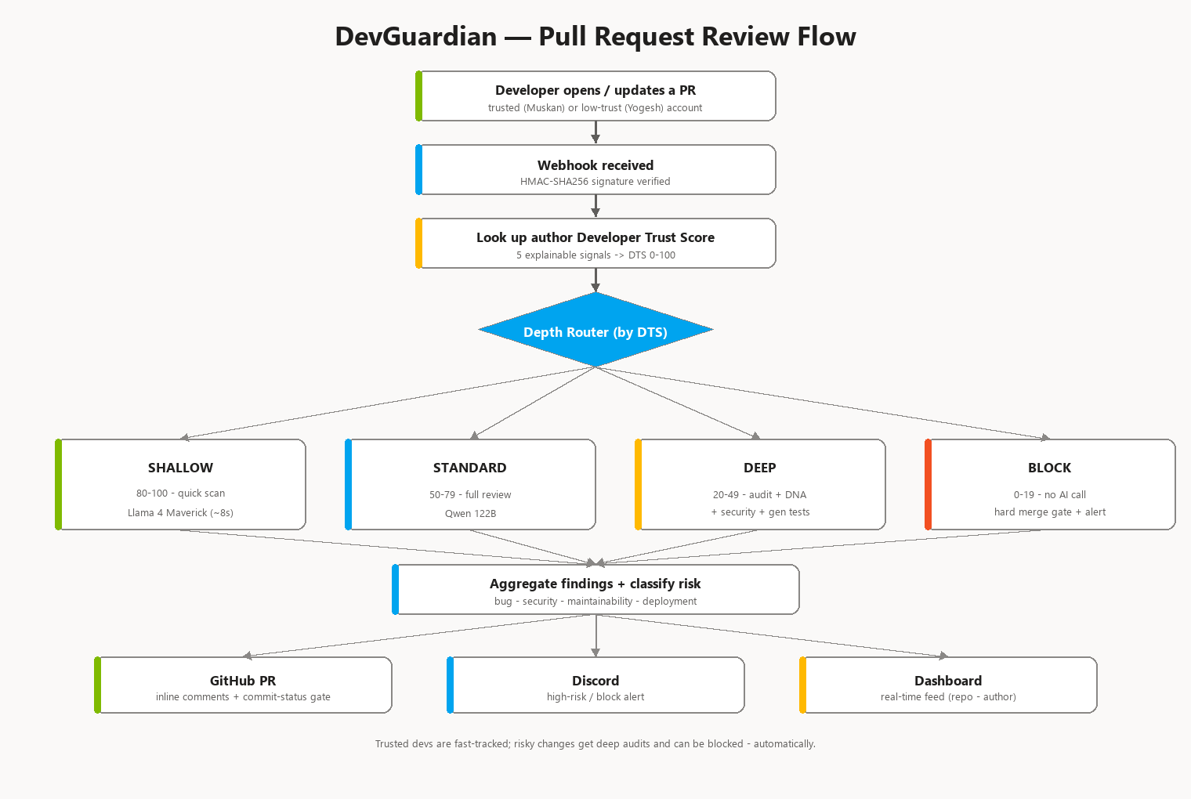
Methodology — Pull Request Review Flow
How a PR moves from webhook to merge decision — routed by Developer Trust Score.
The Hallucinato · Microsoft Hackathon — Theme 06: AI-Powered Production Function: Reinventing Work
7

Slide 8
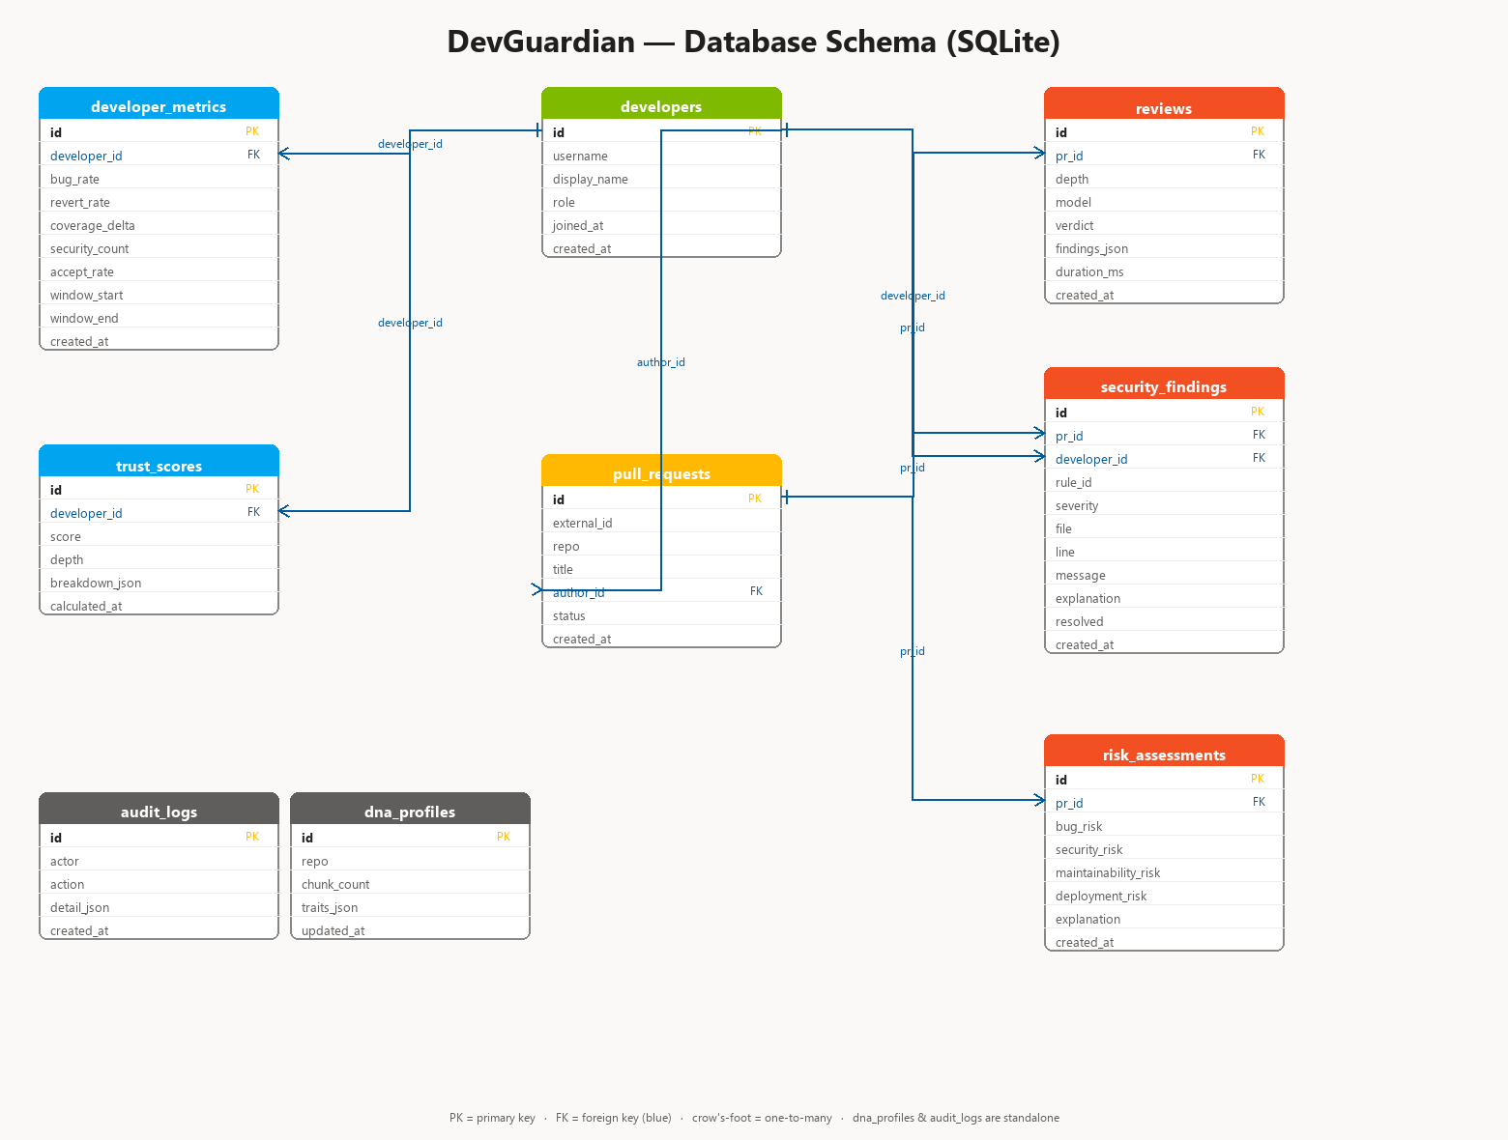
Methodology — Data Model (ER)
SQLite (WAL) — nine tables. FKs link metrics, trust, PRs, reviews, findings & risk; CHECK constraints guard depth, status & resolved.
The Hallucinato · Microsoft Hackathon — Theme 06: AI-Powered Production Function: Reinventing Work
8

Slide 9
Working Prototype
Live, end-to-end — running with real keys
Try it
Single FastAPI service + dashboard, connected to GitHub via an HMAC-verified webhook (ngrok tunnel), live NVIDIA NIM and a Discord channel. Demo flow: Low-trust dev opens a buggy PR → deep review posts 3 inline comments on app/auth.py + a red “devguardian/trust-gate” status (merge blocked) + Discord alert, in ~40s. Trusted dev opens a clean PR → shallow review → approve + green status. Offline “Simulate” runs the full pipeline for all four trust bands without GitHub.
Dashboard: http://localhost:8000/dashboard Public (demo): https://<your-ngrok>.ngrok-free.dev Repo: github.com/muskan-3210/devguardian-demo Run: python -m app.seeder → uvicorn app.main:app
Demo video
Watch the full demo walkthrough (~3.5 min):
▶ https://youtu.be/oSdFeM6pjW8
Live demo: https://devguardian.onrender.com/dashboard
The Hallucinato · Microsoft Hackathon — Theme 06: AI-Powered Production Function: Reinventing Work
9

Slide 10
Attachments
System architecture
PR review flow
Database ER diagram
Documents & links (uploaded on the platform)
docs/DevGuardian_Project_Brief.pdf · docs/DevGuardian_Requirements_Build_Flow.pdf (updated, with diagrams)
docs/ARCHITECTURE.md · DEPLOYMENT.md · DEMO_SCRIPT.md · JUDGE_QA.md
Source repository (FastAPI app/, tests/, Dockerfile, CI) + dashboard screenshots
The Hallucinato · Microsoft Hackathon — Theme 06: AI-Powered Production Function: Reinventing Work
10

