Slide 1



SMART INDIA HACKATHON 2025
TITLE PAGE
Problem Statement ID – SIH25252
Problem Statement Title – Unified Education Interface
Theme- Smart Education
PS Category- Software
Team ID- 64063
Team Name : ASTRA2.0

Slide 2
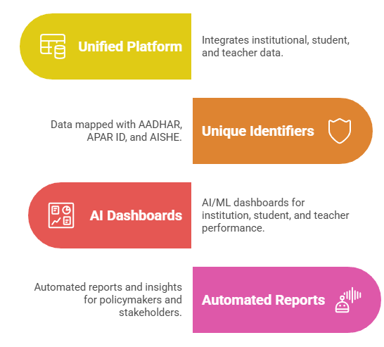
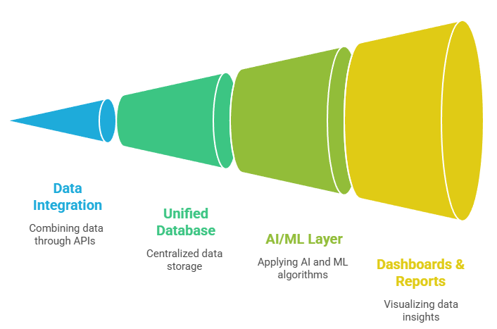

UNIFIED EDUCATION INTERFACE
Current Challenges:
No unified student life cycle tracking.
Fragmented & scattered data across departments.
📉Weak integration with IDs (Aadhar, APAR, AISHE).
⏱️Lack of real-time analytics for decisions.
Difficulty in mapping performance to govt. schemes/policies
Proposed Solution:
360°Stakeholder View 🌐– Single platform for Students, Teachers, Institutions & Govt. bodies.
🎯Unique ID(Aadhar, APAR, AISHE)–based mapping for authenticity.
Gamified Dashboard🏆–Student badges, progress scores & leaderboards to motivate performance.
🤖 Automated, real-time reports for NIRF, schemes, compliance
🔐 Blockchain-enabled Data Security

Slide 3
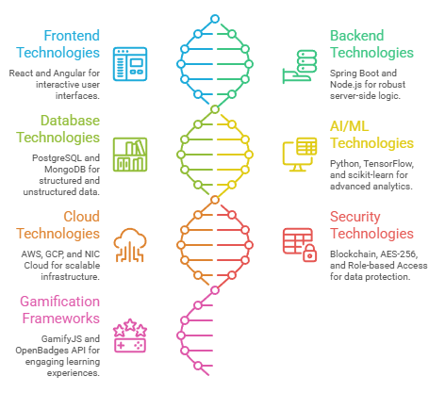
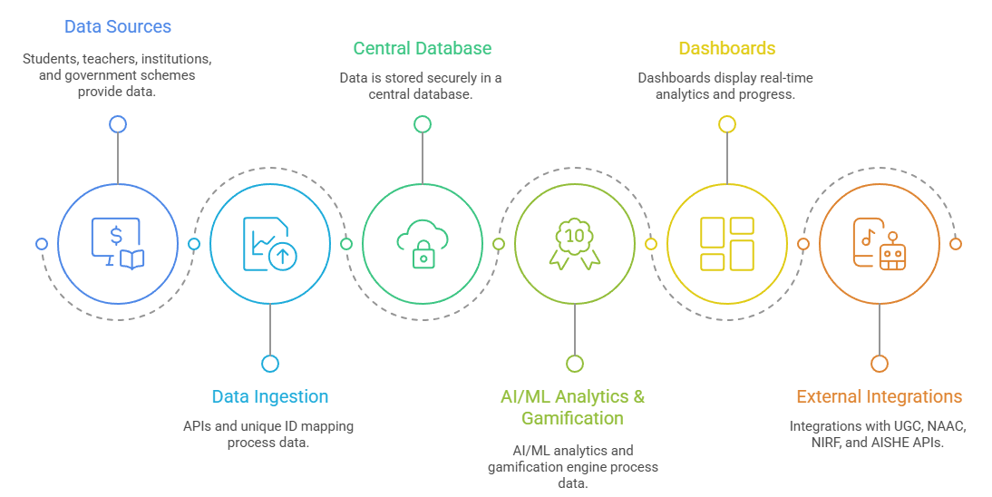
TECHNICAL APPROACH
Process Flow:
Technologies and Tools:
Frontend: React / Angular
Backend: Spring Boot / Node.js
Database: PostgreSQL / MongoDB (structured + unstructured)
🤖 AI/ML: Python, TensorFlow, scikit-learn
🌐Cloud: AWS / GCP / NIC Cloud
Security: Blockchain-enabled audit trail, AES-256 encryption, Role-based Access
🏆Gamification Frameworks/APIs: GamifyJS or OpenBadges API

Slide 4
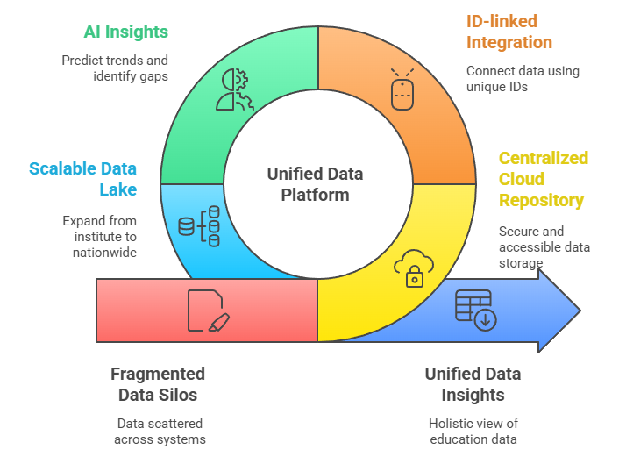
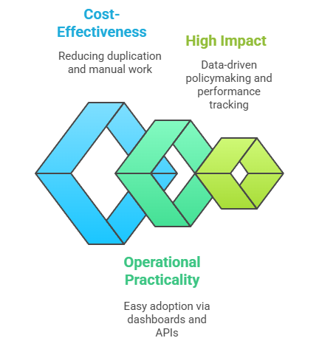
FEASIBILITY AND VIABILITY
Feasibility:
📌 Centralized Repository – Cloud-based secure data storage.
🔐 ID-linked Integration – Uses Aadhar, APAR, AISHE for authentic, smooth adoption
🤖 AI Insights – Predicts trends like dropouts, rankings, skill gaps.
🌍 Scalable Data Lake – Grows from single institute to nationwide system
Viability:
💰 Cost-effective – Reduces duplication and manual reporting efforts.
⚙️ Operationally Practical – Easy adoption via dashboards and APIs.
📈 High Impact – Enables data-driven policymaking and performance tracking.

Slide 5
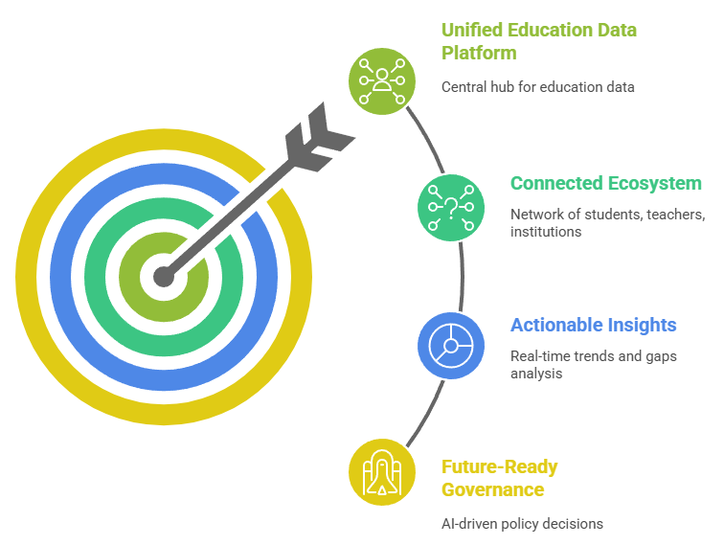
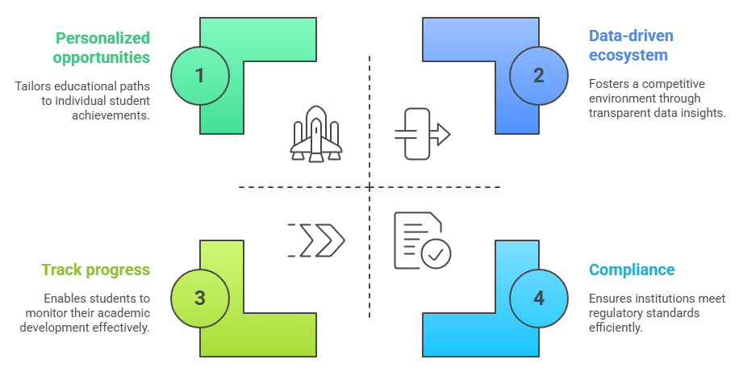
IMPACT AND BENEFITS
IMPACT :
🌐 Connected Ecosystem – Students, teachers, and institutions linked in one platform.
🔍 Actionable Insights – Real-time data highlights trends and gaps.
🚀 Future-Ready Governance – AI-driven decisions for smarter education policies.
BENEFITS :
🎓 For Students – Track progress, achievements & access personalized opportunities.
🏫 For Institutions – Monitor performance, improve rankings & compliance.
🏛️ For Government – Real-time insights for effective policymaking & scheme monitoring.
📈 For Nation – Data-driven education ecosystem boosting transparency & competitiveness.

Slide 6
RESEARCH AND REFERENCES
Research:
NIRF Framework (MHRD, India) – Metrics for institutional ranking and performance evaluation.
AISHE Reports (All India Survey on Higher Education) – Institutional, student, and teacher data standards.
APAR Guidelines (Ministry of Education) – Teacher performance and appraisal metrics.
References:
Ministry of Education. Annual Performance Appraisal Report (APAR) Guidelines.
National Education Policy 2020.
Digital India Initiative – Ministry of Electronics & IT, India.
Research Papers:
“AI and Data Analytics in Higher Education” – Journal of Educational Technology.
“Gamification for Student Engagement and Performance” – International Journal of Learning Analytics.

