Slide 1
Analyzing Customer Feedback For British Airways
Unlocking Insights for Enhanced Customer Experience

Slide 2
Agenda
INTRODUCTION
PROCESS
INSIGHTS
KEY FINDINGS
CONCLUSION

Slide 3

Introduction
British Airways – A Symbol of Excellence
Flagship carrier of the United Kingdom (UK)
A rich history dating back to 2014
Global recognition for world-class service and innovation
Commitment to data-driven decision-making

Slide 4
Process
Understanding data
Data Collection
Data quality
Data analysis
INSIGHTS &
Key findings

Slide 5
INSIGHTS

Slide 6
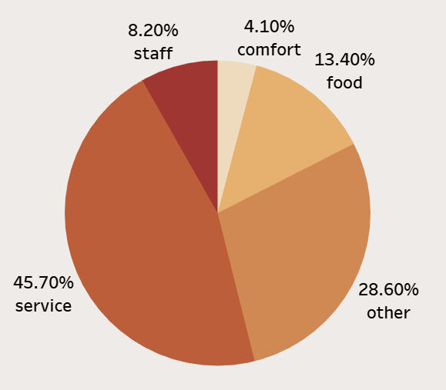
Customer Feedback Analysis
Service category: 45.70% of total reviews, indicating strong customer feedback.
Staff: 8.20% of reviews, suggesting potential for improvement.
Comfort: 4.10% of reviews, highlighting opportunities to enhance the comfort experience.
Service stands out as a strong point for the business.
Consider addressing potential areas for improvement in staff satisfaction.
Explore opportunities to enhance overall comfort for clients.

Slide 7
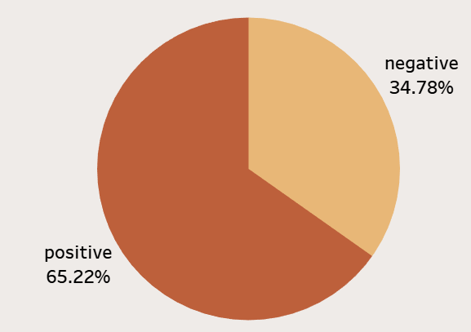
SENTIMENT ANALYSIS
Positive Sentiment: 64.50%
Negative Sentiment: 34.40%
The majority of reviews express positive sentiment towards British Airways, indicating that customers generally have a favorable perception of the airline.

Slide 8
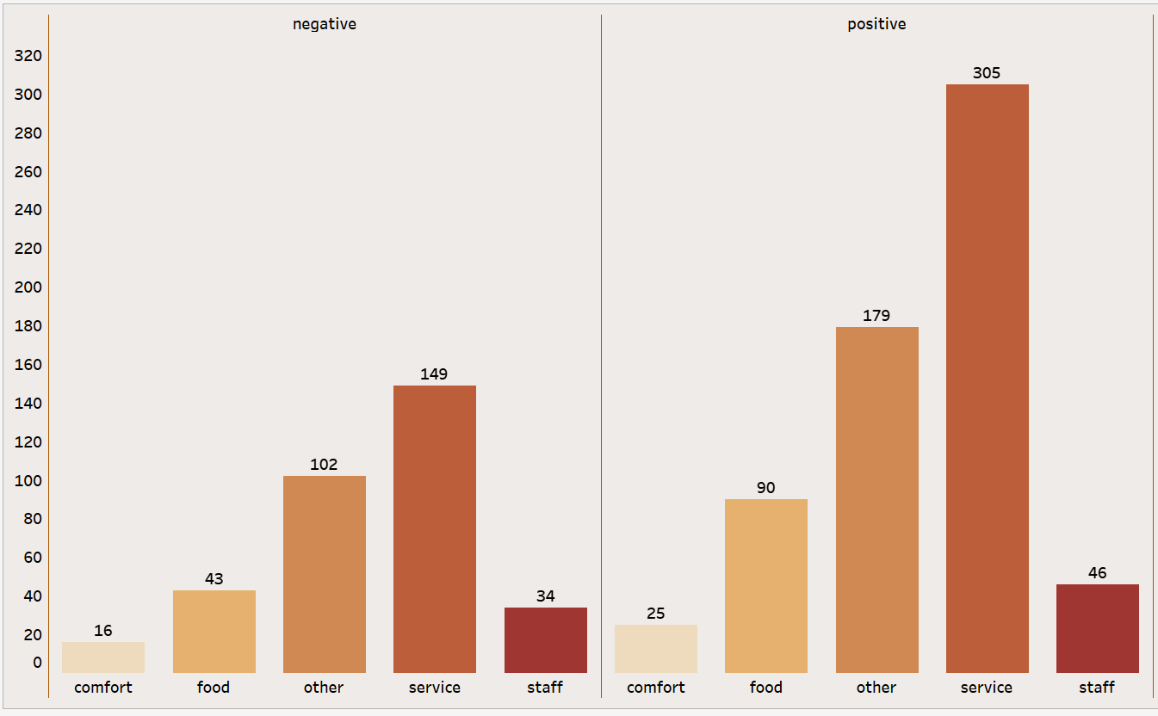
Data Reveals…
Customer Appreciation:
High satisfaction with "Service" category
Positive feedback in "Food" and "Other" categories
Areas for Improvement:
Lower positive reviews in the "Comfort" category
Addressing concerns highlighted in negative reviews

Slide 9
KEY FINDINGS
Customers appreciate the service provided by British Airways the most, with a high number of positive reviews in the "Service" category.
"Food" and "Other" categories also receive a significant number of positive reviews, suggesting overall satisfaction with these aspects.
"Comfort" has fewer positive reviews compared to other categories, indicating potential areas for improvement.
Negative reviews are present in all categories, highlighting areas where British Airways may need to address customer concerns.

Slide 10
Further Analysis & Recommendations
Dive deeper into the content of negative reviews to identify specific pain points and issues mentioned by customers.
Explore trends in sentiment over time to see if there are improvements or declines in customer perception.
Conduct competitor analysis to benchmark British Airways against other airlines in terms of customer satisfaction

Slide 11

Summary
British Airways generally enjoys a positive sentiment among its customers, with the majority expressing satisfaction with various aspects of their service. However, there are areas, such as "Comfort," where improvements could enhance the overall customer experience. Regular monitoring of customer feedback and addressing specific concerns can help BA maintain and further improve its reputation in the airline industry.

Slide 12
Thank you
Muskan Kashyap

