Slide 1
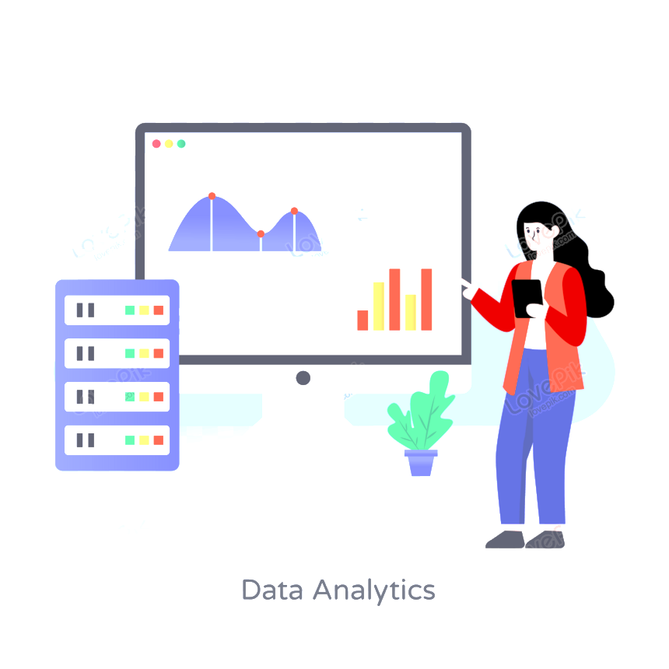
KultureHire
Data Analysis Learnternship
Understanding Career Aspirations of Gen Z
Muskan Kashyap

Slide 2

ROADMAP
1
3
5
7
Dashboards
Data Collection
Analyzing in SQL
Focused PowerBI dashboard
Developed three dashboards on customer service, finance and orders in EXCEL
Created a Google Form with tailored questions to collect data on Gen-Z's career aspirations.
Conducted data analysis using SQL, solving complex questions with the help of Common Table Expressions (CTEs) and joins.
Developed three focused dashboards for each area, incorporating KPIs, Power Query Editor, measures, and groups in Power BI.
2
4
6
8
Problem Statement
Cleaning in SQL
General PowerBI dashboard
Presentation
Developed a problem statement to explore and educate about the career aspirations of Gen-Z, addressing challenges and personal insights.
Loaded data dump into MySQL Workbench, cleaning and exploring high-level information using SQL basics.
Created a Power BI dashboard summarizing Gen-Z's learning aspirations, mission aspirations, and manager aspirations.
Worked on an employer-focused project, creating recommendations and emphasizing the importance of storytelling in data.

Slide 3
STAGE 1:
EXCEL DASHBOARDS

Slide 4
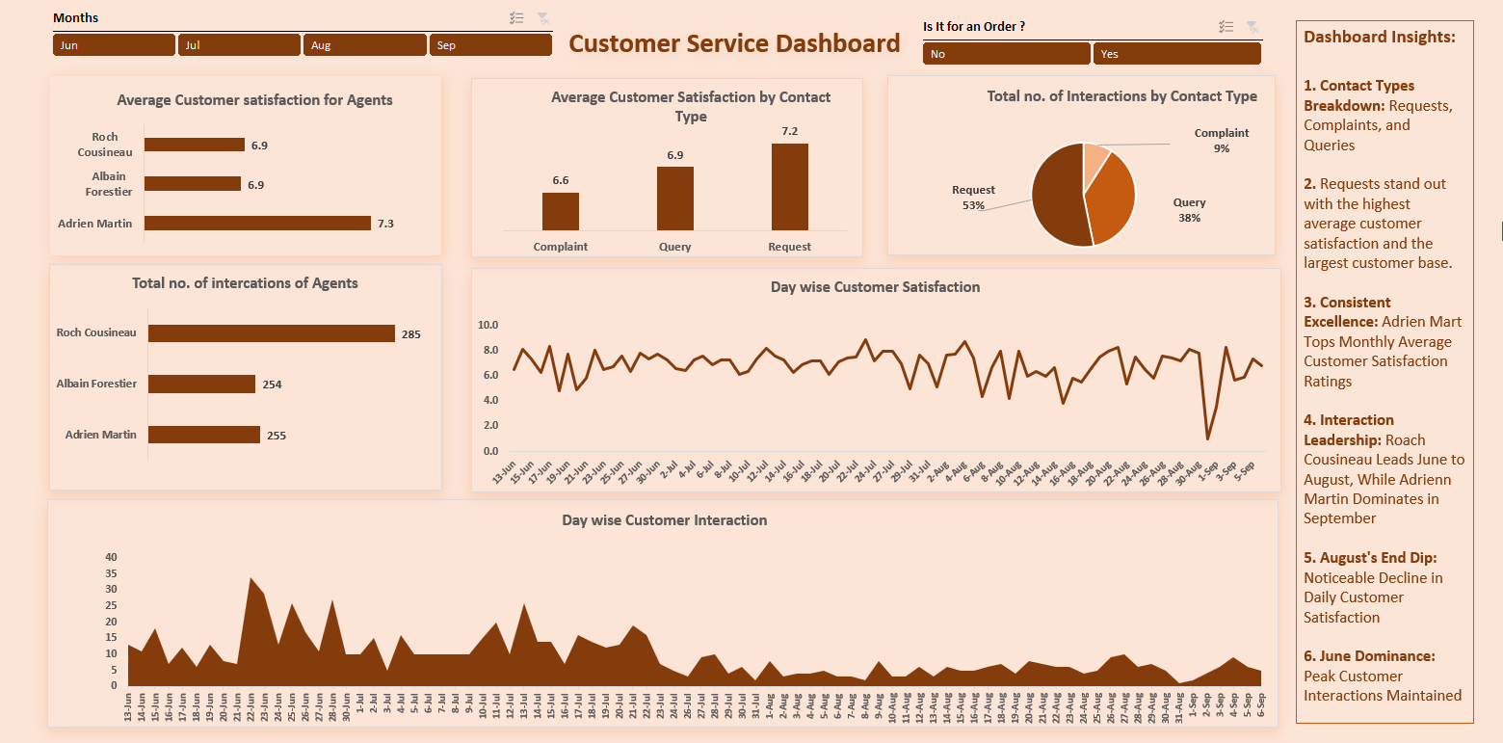

Slide 5
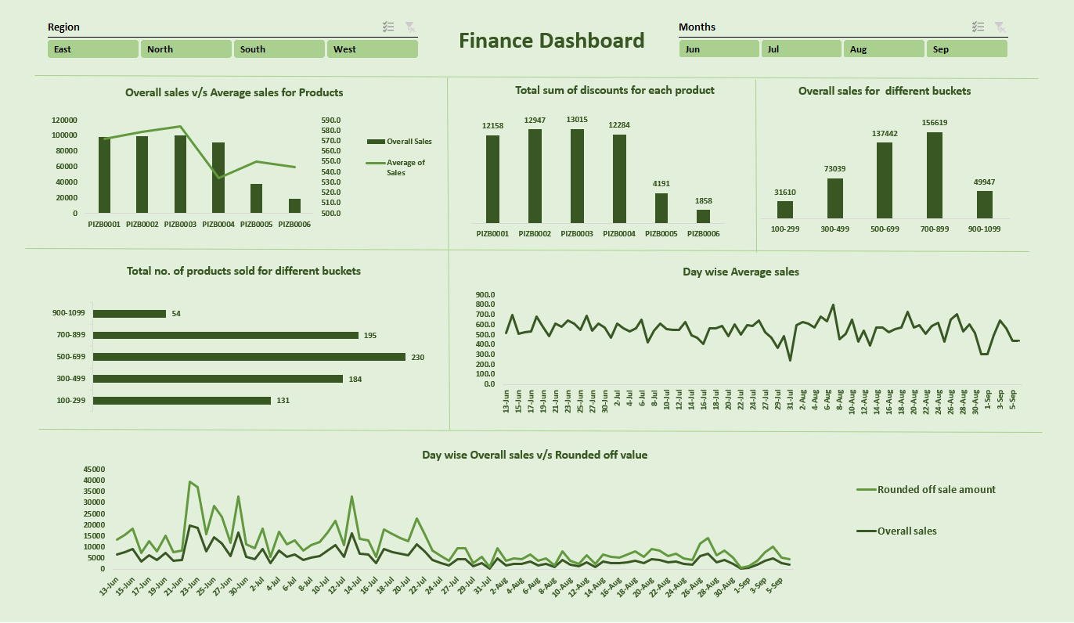

Slide 6
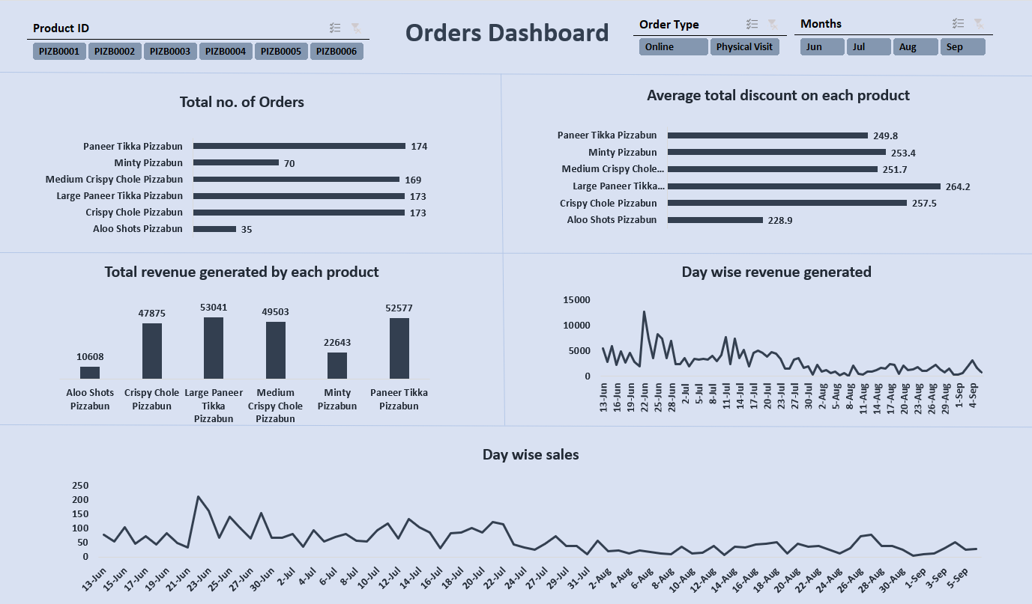

Slide 7
STAGE 2:
PROBLEM STATEMENT

Slide 8
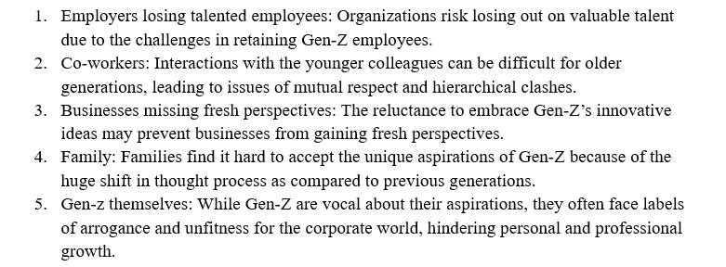
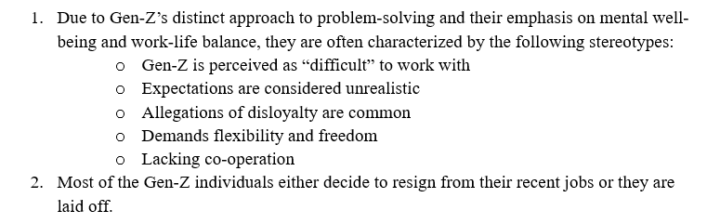
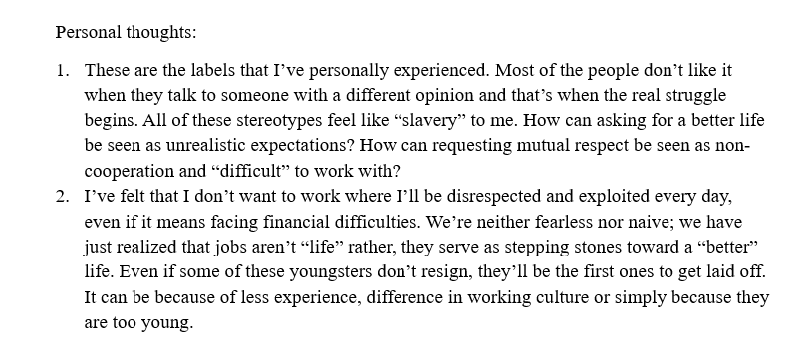
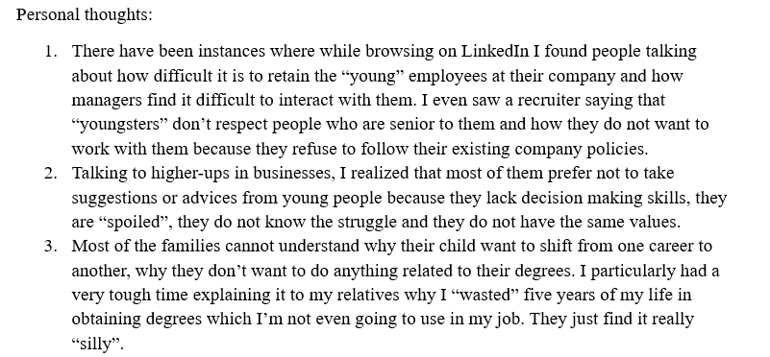
Who is affected?
What is happening?

Slide 9
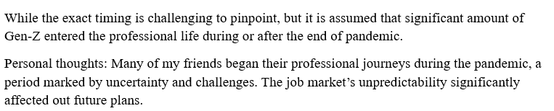
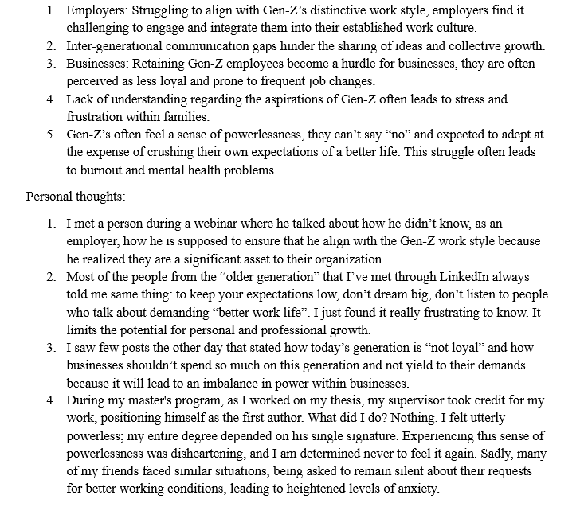
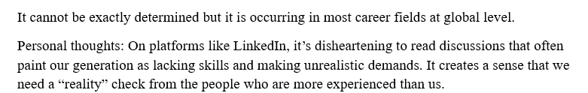
When is this happening?
Why is that happening?
Where is this happening?

Slide 10
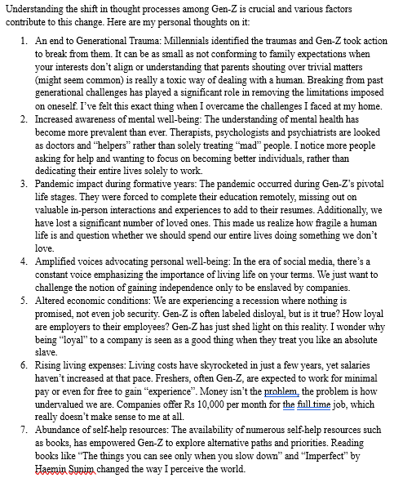
Personal thoughts on various factors contributing to this change in Gen Z
References
Authentically Gen Z: The Values, Aspirations & Drivers That Will Re-Define the Future of Work
Gen Z: The workers who want it all
Sentiments of Indian Gen Z workforce in 2023: Part I
Gen-Z Is Labeled As ‘Difficult’ In The Workplace, But There’s More To The Story
How does Gen Z see its place in the working world? With trepidation
Why Gen Z workers are already so burned out
Aspirations & Wants of Generation Z - A Study on the Work Force of the Future

Slide 11
STAGE 3:
DATA COLLECTION

Slide 12
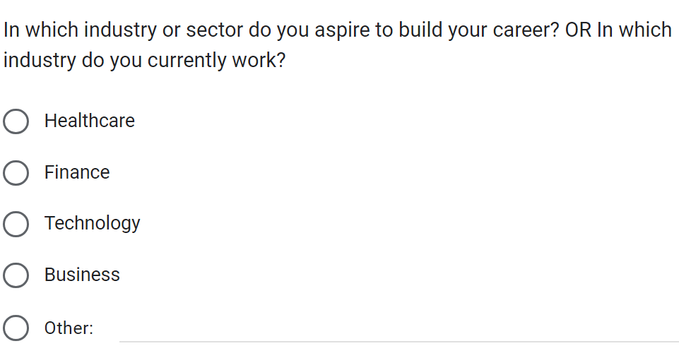
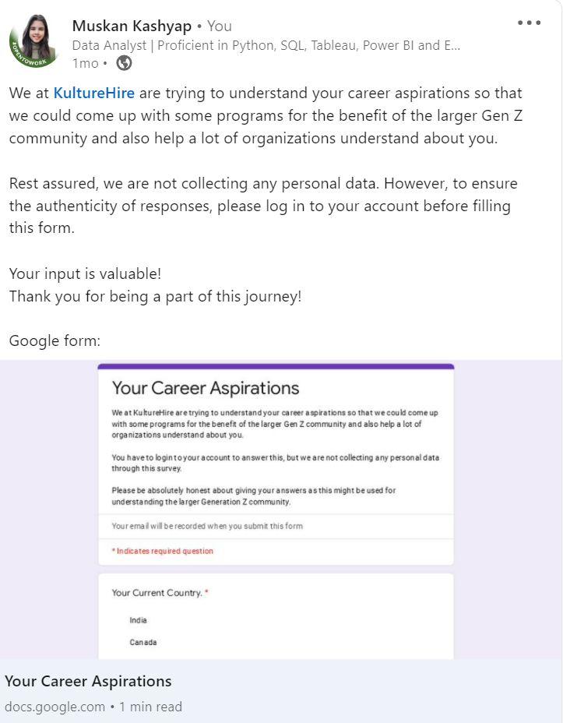
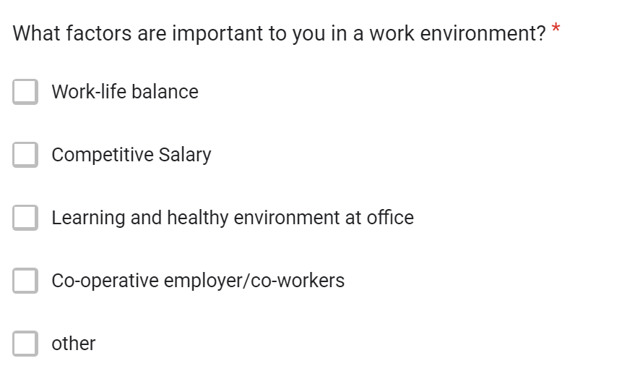
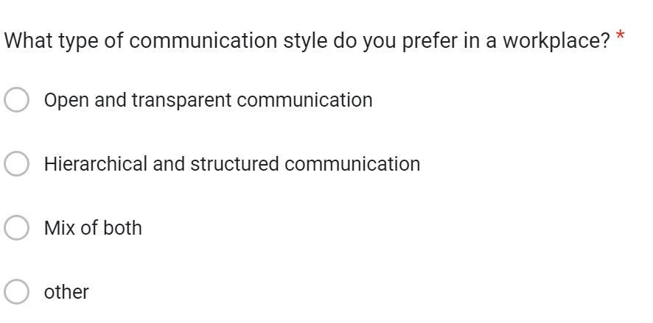

Slide 13
STAGE 4:
CLEANING & STANDARDIZING IN SQL

Slide 14
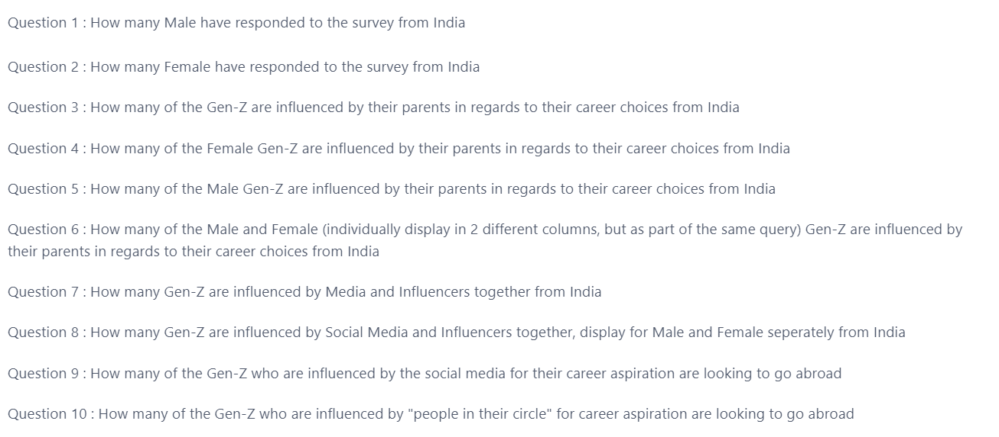

Slide 15
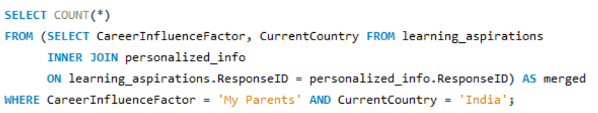
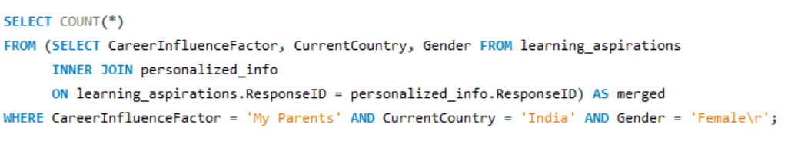
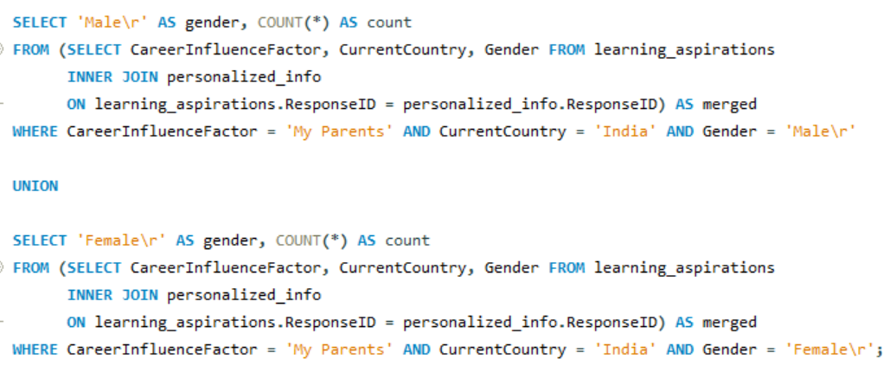
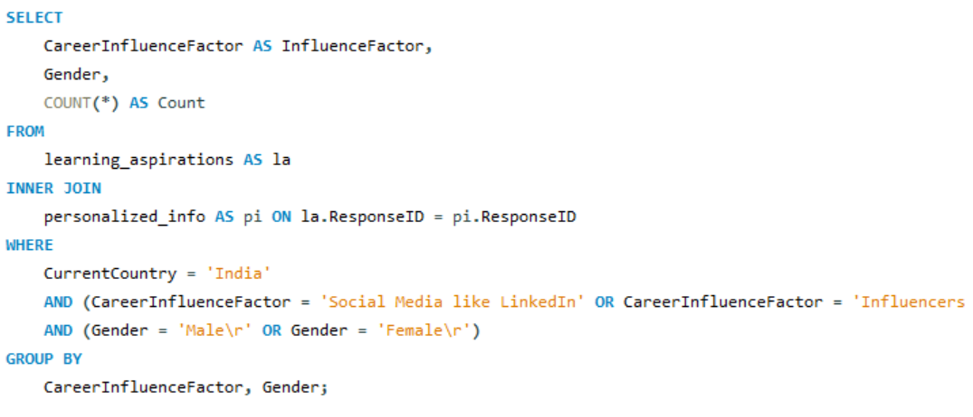

Slide 16
STAGE 5:
ANALYZING
IN SQL

Slide 17
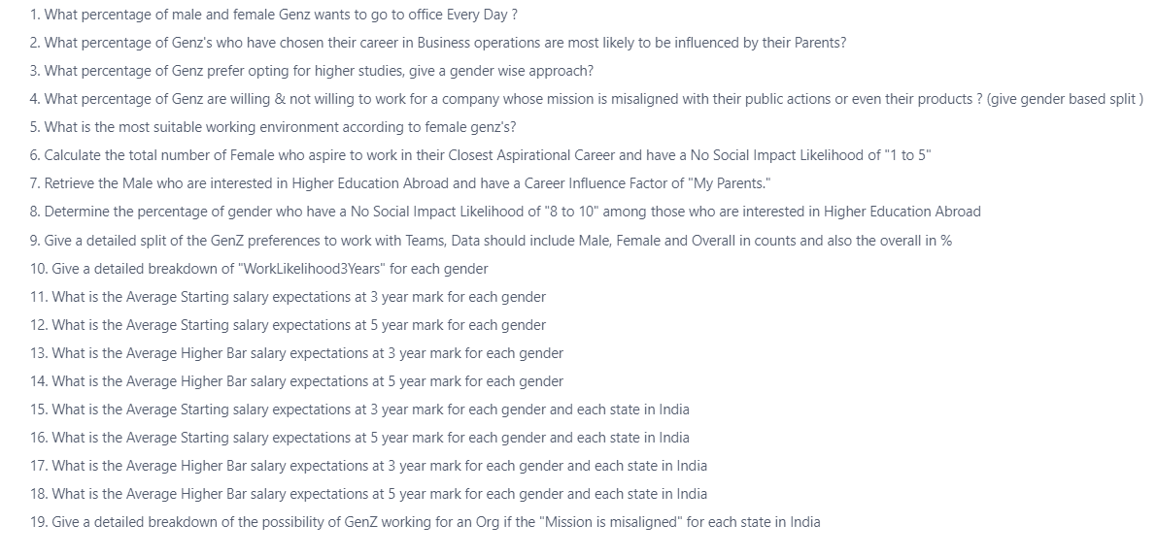

Slide 18
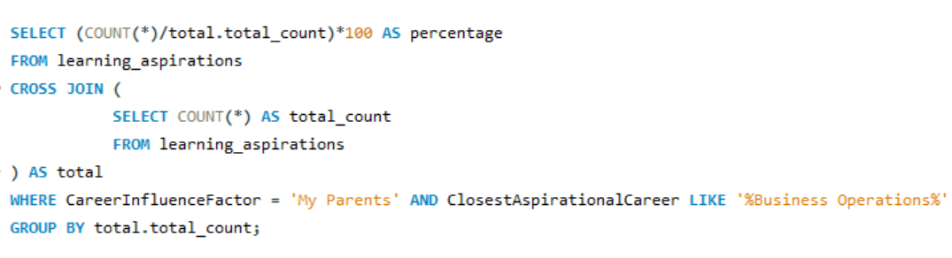
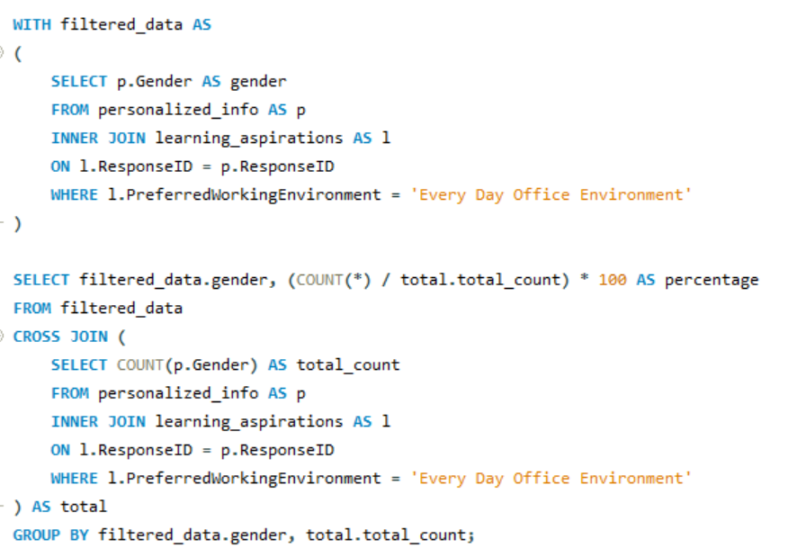
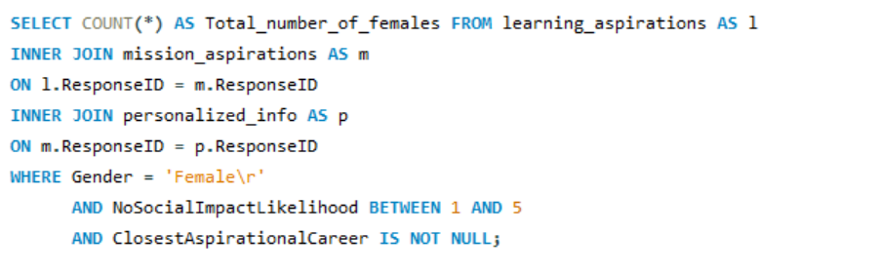

Slide 19
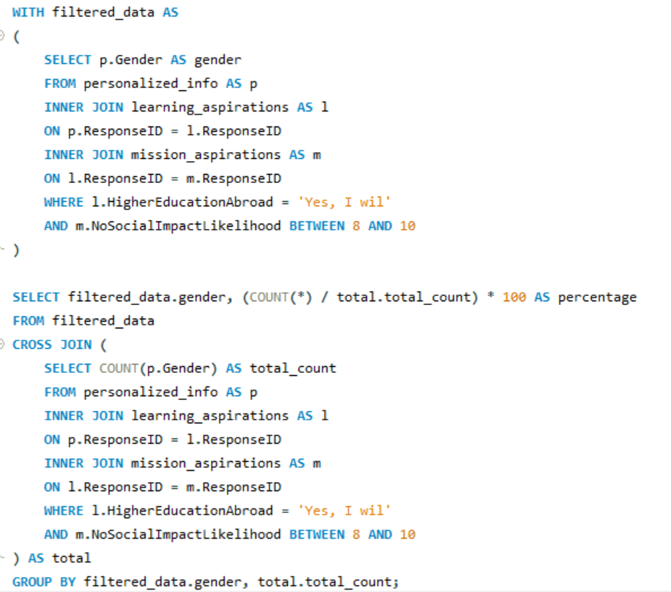
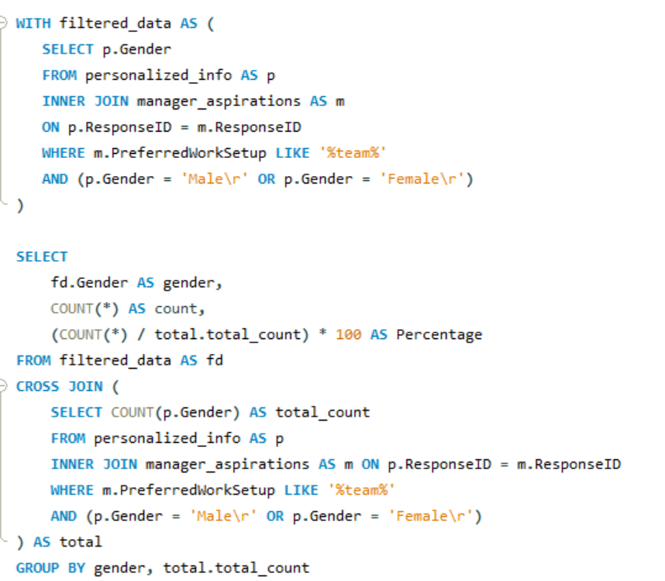
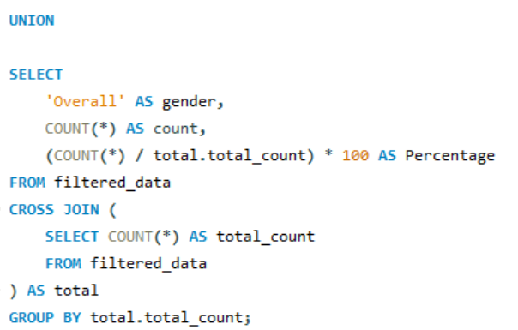

Slide 20
STAGE 6:
GENERAL POWER BI
DASHBOARD

Slide 21
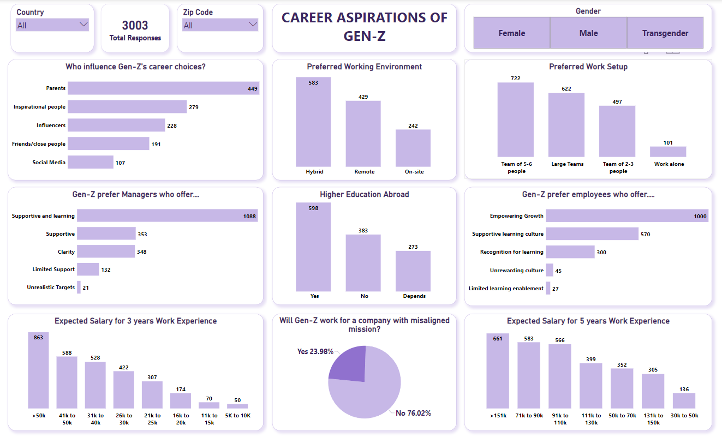

Slide 22
STAGE 7:
FOCUS AREA DRIVEN
POWERBI DASHBOARD

Slide 23
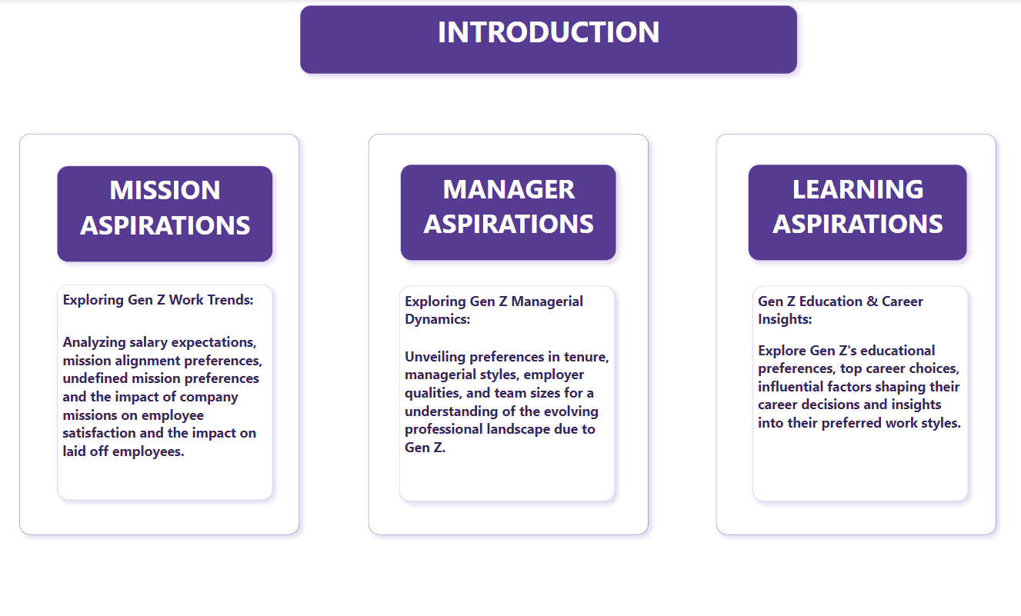

Slide 24
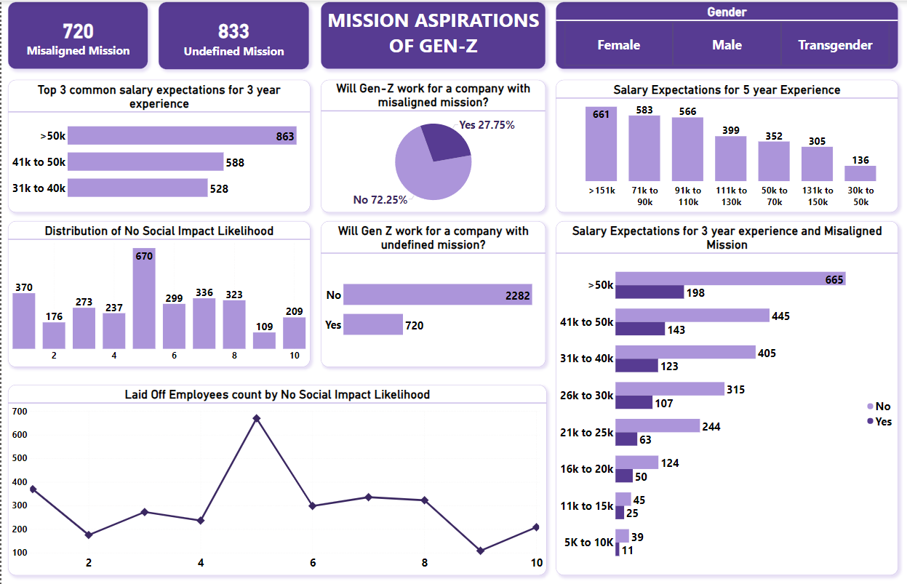

Slide 25
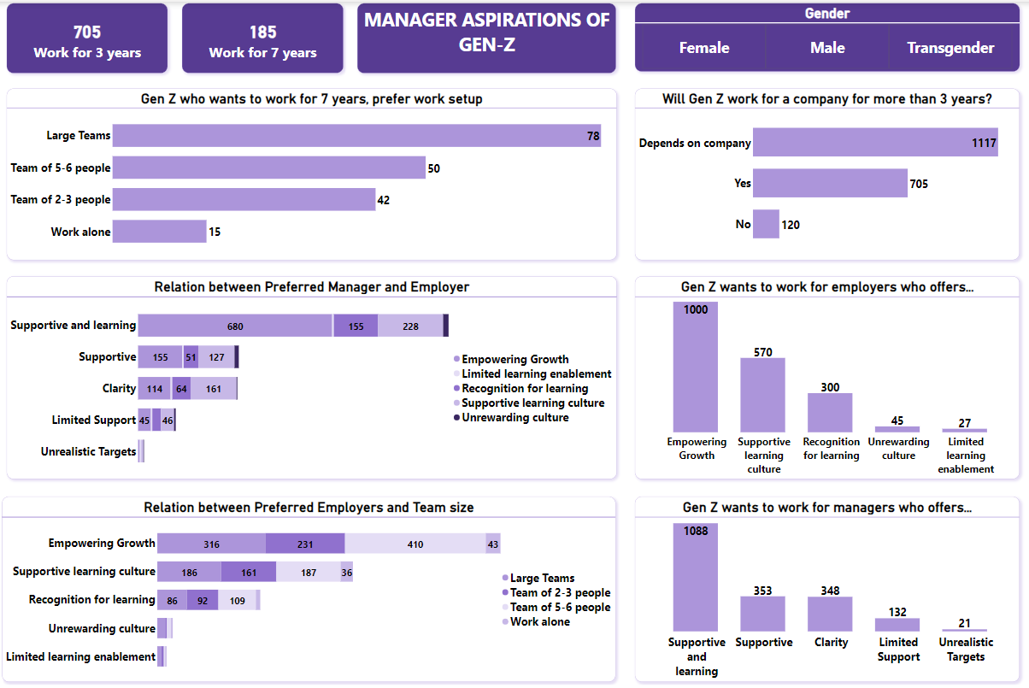

Slide 26
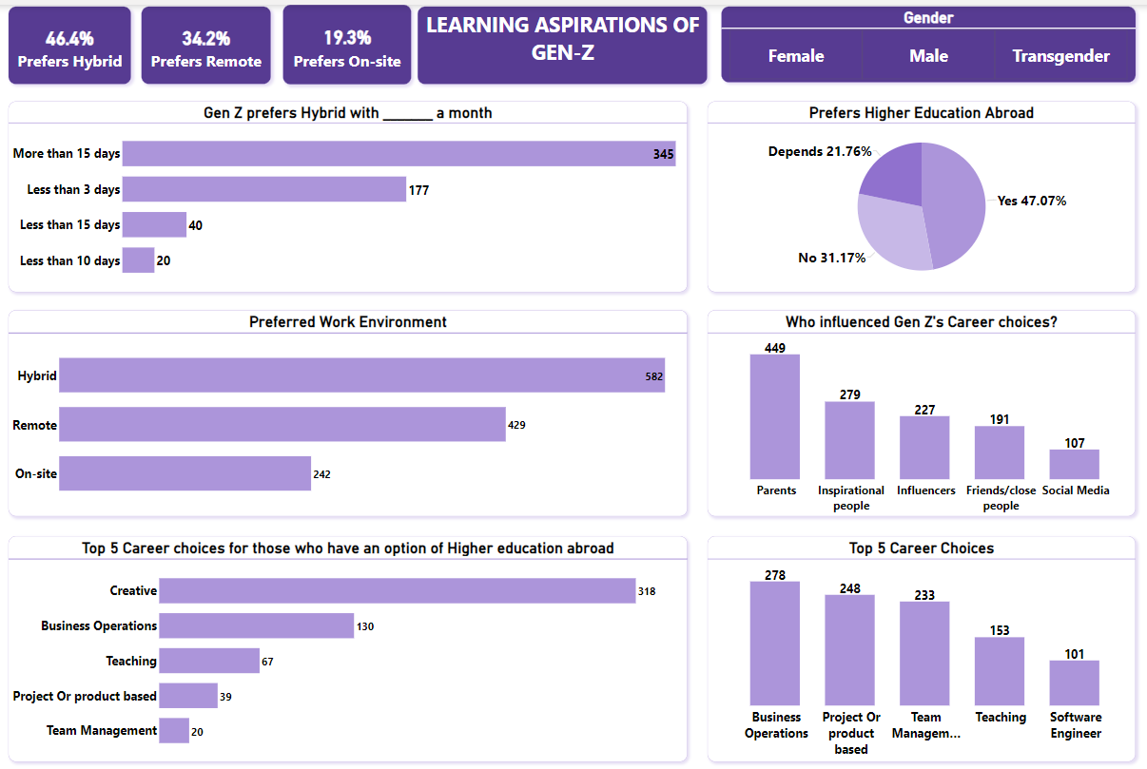

Slide 27
The Walt Disney Company
Disney operates a vast array of businesses, including film studios, television networks, theme parks, and resorts.
Some of its notable divisions and subsidiaries include Walt Disney Studios, Disney Media Networks, Disney Parks, Experiences and Products, and Disney Direct-to-Consumer & International.
The company is renowned for its contributions to the entertainment industry, particularly through the creation of iconic animated characters and films.
Disney's theme parks, including Disneyland and Walt Disney World, are also famous worldwide.
How Disney uses data?
Shorter waiting times: By knowing where people are and what they like, Disney predict crowds and keep lines moving smoothly.
Personalized experiences: Ever feel like Disney knows you better than you know yourself? They suggest rides you'll love, recommend restaurants based on your tastes, or even send birthday greetings in the park! This is all possible because of data!
By understanding what guests like and dislike, Disney continues to improve their parks, shows, and movies.

Slide 28
Average Rating
3.9

Slide 29
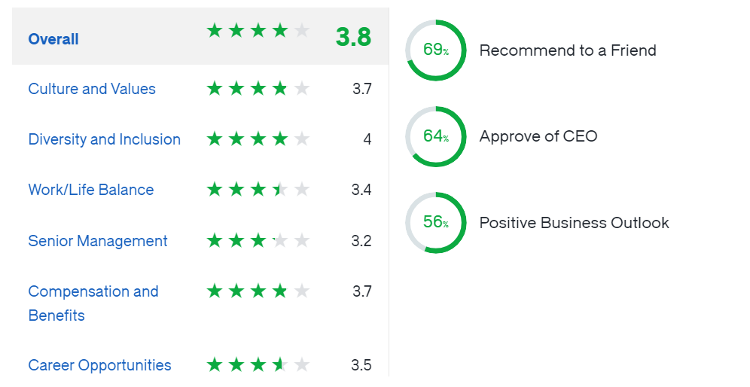
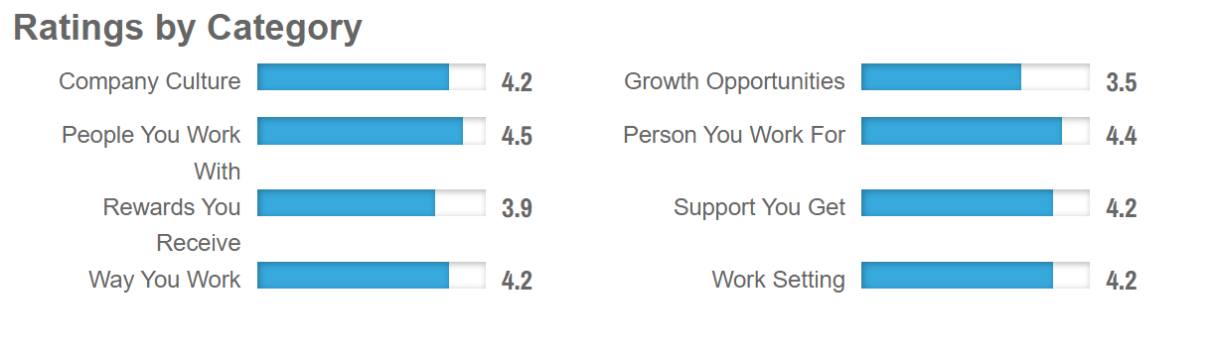
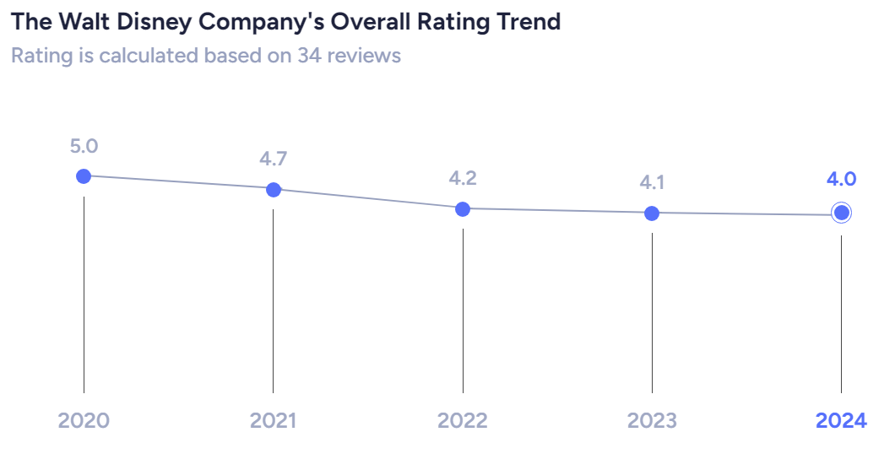
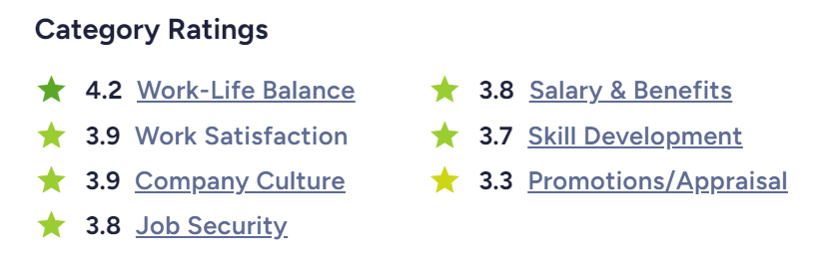
GLASSDOOR
CAREERBLISS
AMBITIONBOX
AMBITIONBOX

Slide 30
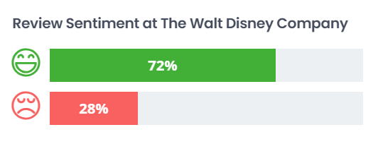
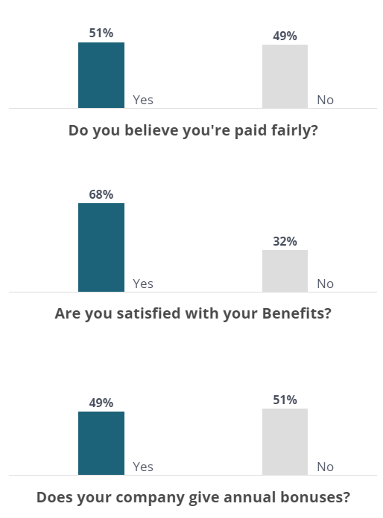
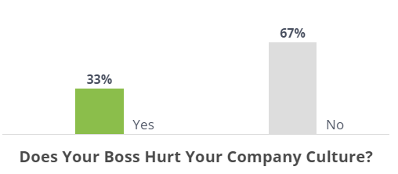
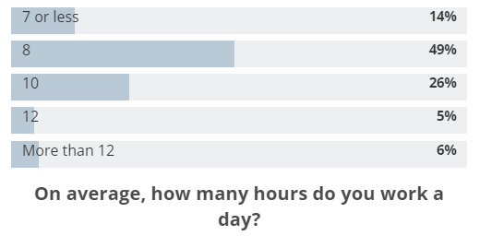
COMPARABLY
COMPARABLY
COMPARABLY

Slide 31
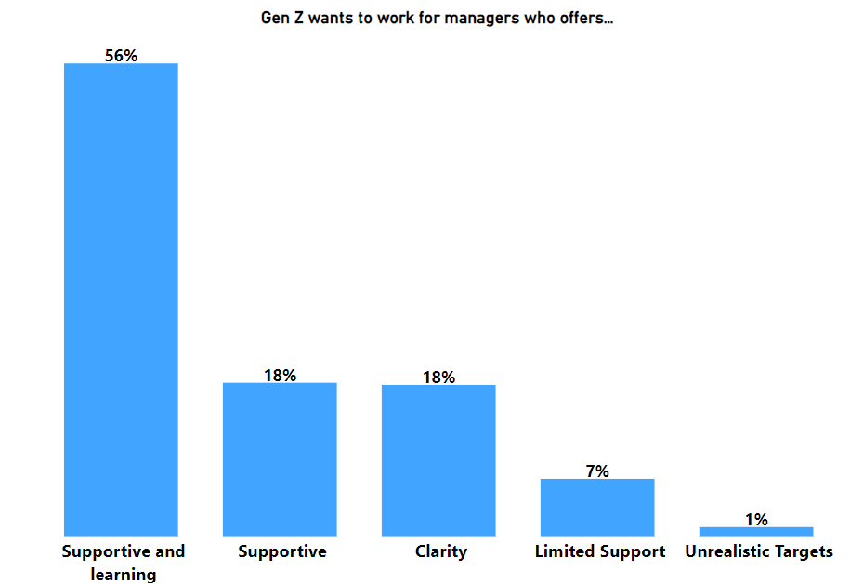
INSIGHTS
PROBLEM
Poor Managers or Leadership
RECOMMENDATIONS
Invest in leadership development programs
Implement a feedback system
Schedule regular meetings with the managers and teams to ensure open communication

Slide 32
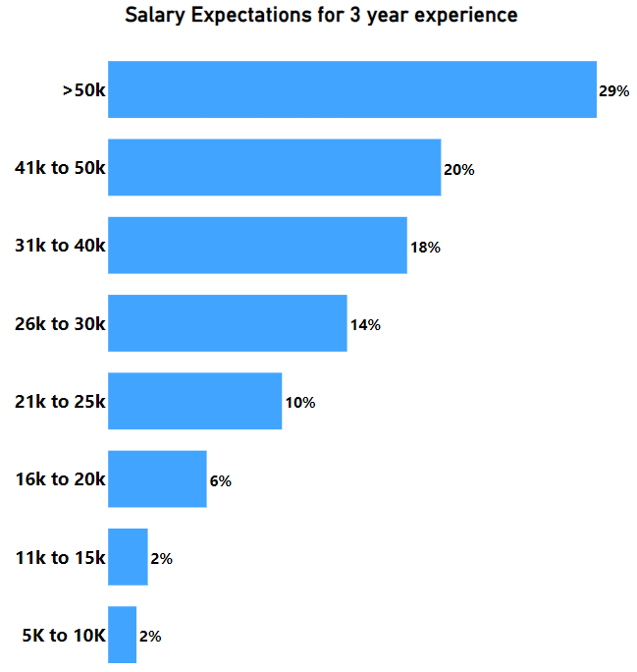
INSIGHTS
PROBLEM
Poor or Low Salaries
RECOMMENDATIONS
Conduct regular market research
Implement performance-based pay
Communicate openly about the company's financial situation
Enhance non-monetary benefits such as health insurance, flexible work hours or professional development opportunities

Slide 33
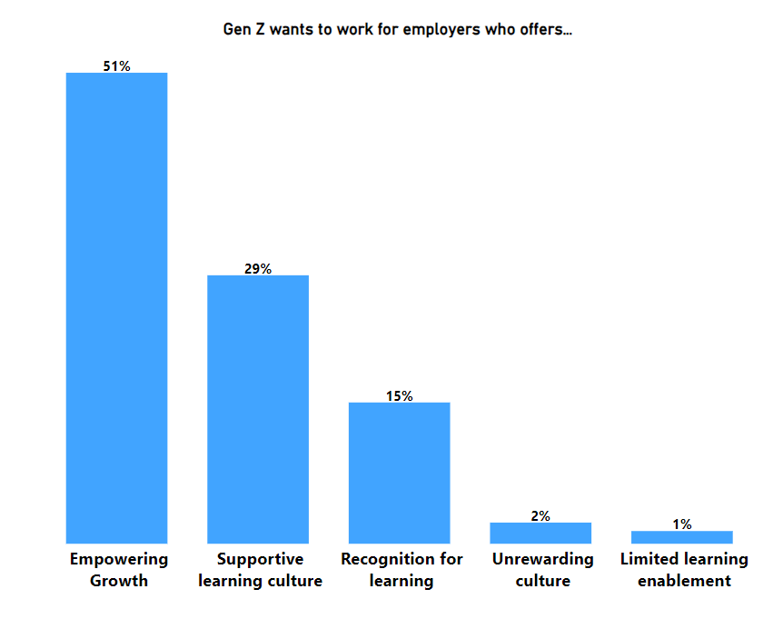
INSIGHTS
PROBLEM
Stagnant Growth
RECOMMENDATIONS
Create personalized career development plans
Provide constructive feedback
Establish clear criteria for promotions
Encourage cross-functional projects
Recognize and celebrate employees’ achievements

Slide 34
THANK YOU!!

