Slide 1

Introduction to International Women's Day
International Women's Day is a global celebration of the social, economic, cultural, and political achievements of women. It's a day to recognize and call for gender equality, celebrate women's achievements, and raise awareness about the challenges they continue to face.
Ma
by Muskan Yadav

Slide 2
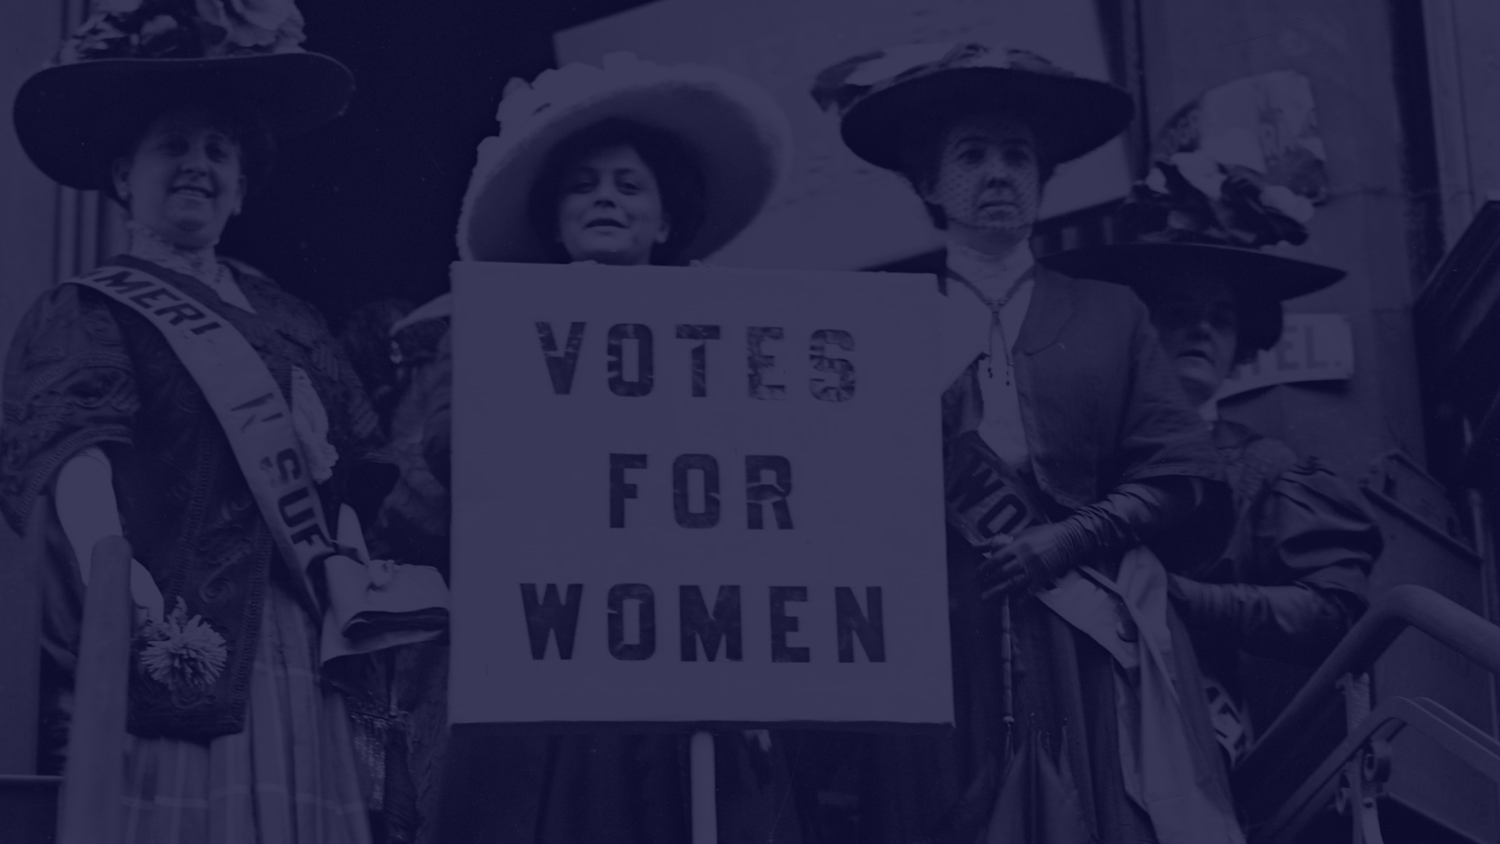
History and Significance of International Women's Day
1
Early Beginnings
First celebrated in 1911, it was initially linked to the labor movement and a push for women's rights.
2
Global Recognition
By the 1970s, it had evolved into a day recognized by the United Nations and observed worldwide.
3
Symbolic Colors
Purple signifies justice and dignity, green symbolizes hope, and white represents purity.

Slide 3
Achievements and Progress Made by Women
Leadership Roles
Advancements in Arts
Scientific Breakthroughs
Women are making significant strides in diverse fields, from politics to business.
Contribution of women in literature, music, and visual arts continue to shape culture and society.
Women are driving innovation and breakthroughs in scientific research and technology.

Slide 4

Challenges and Obstacles Faced by Women
1
Gender Pay Gap
2
Violence Against Women
Women continue to earn less than men for the same work and are underrepresented in higher-paying sectors.
Women face various forms of violence, including domestic abuse and gender-based violence.
3
Discrimination and Stereotypes
Women often encounter bias and discriminatory practices based on gender stereotypes.

Slide 5
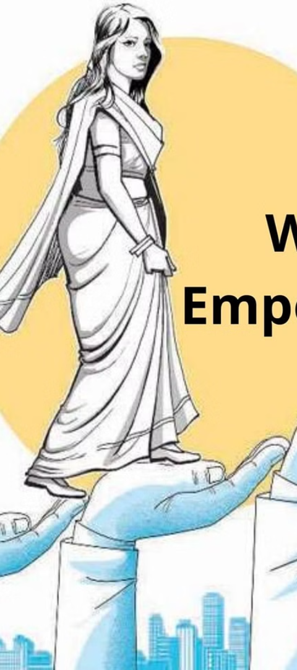
Empowerment and Gender Equality
Equal Opportunities
Legal and Social Reforms
Advocating for policies that provide equal opportunities for women in education and employment.
Campaigning for legal reforms to ensure women's rights are protected and upheld.
Community Support
Strengthening communities to support women's initiatives and gender equality efforts.

Slide 6



Celebrations and Events on International Women's Day
Community Events
Conferences
Marches
Local events, workshops, and cultural performances celebrate the achievements of women.
Gatherings to address women's issues, inspire change, and empower women across various industries.
Peaceful demonstrations advocating for gender equality and women's rights.

Slide 7
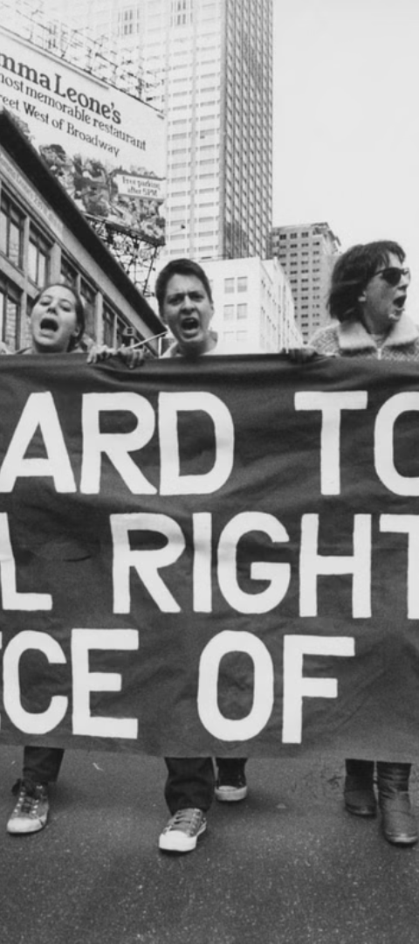



Promoting Women's Rights and Activism
Advocacy Efforts
Collaborating with organizations to advocate for women's rights and gender equality.
Policy Influence
Lobbying for policies that increase protection for women and girls across different sectors.
Impactful Initiatives
Leading and supporting initiatives that empower women and girls to thrive.

Slide 8
Conclusion and Call to Action
131
25M
Countries Participating
Social Media Engagements
In 2020, International Women's Day was celebrated in 131 countries.
Over 25 million conversations took place online during International Women's Day.

