Slide 1
JUNK FOODS VS HEALTHY FOODS

Slide 2
INDEX
TYPES OF JUNK FOODS.
WHAT IS JUNK FOOD?
DISAVANTAGE FOR JUNK FOOD.
TYPES OF HEALTHY FOOD.
WHAT IS HEALTHY FOOD?
BENEFITES FOR HEALTHY FOOD.

Slide 3
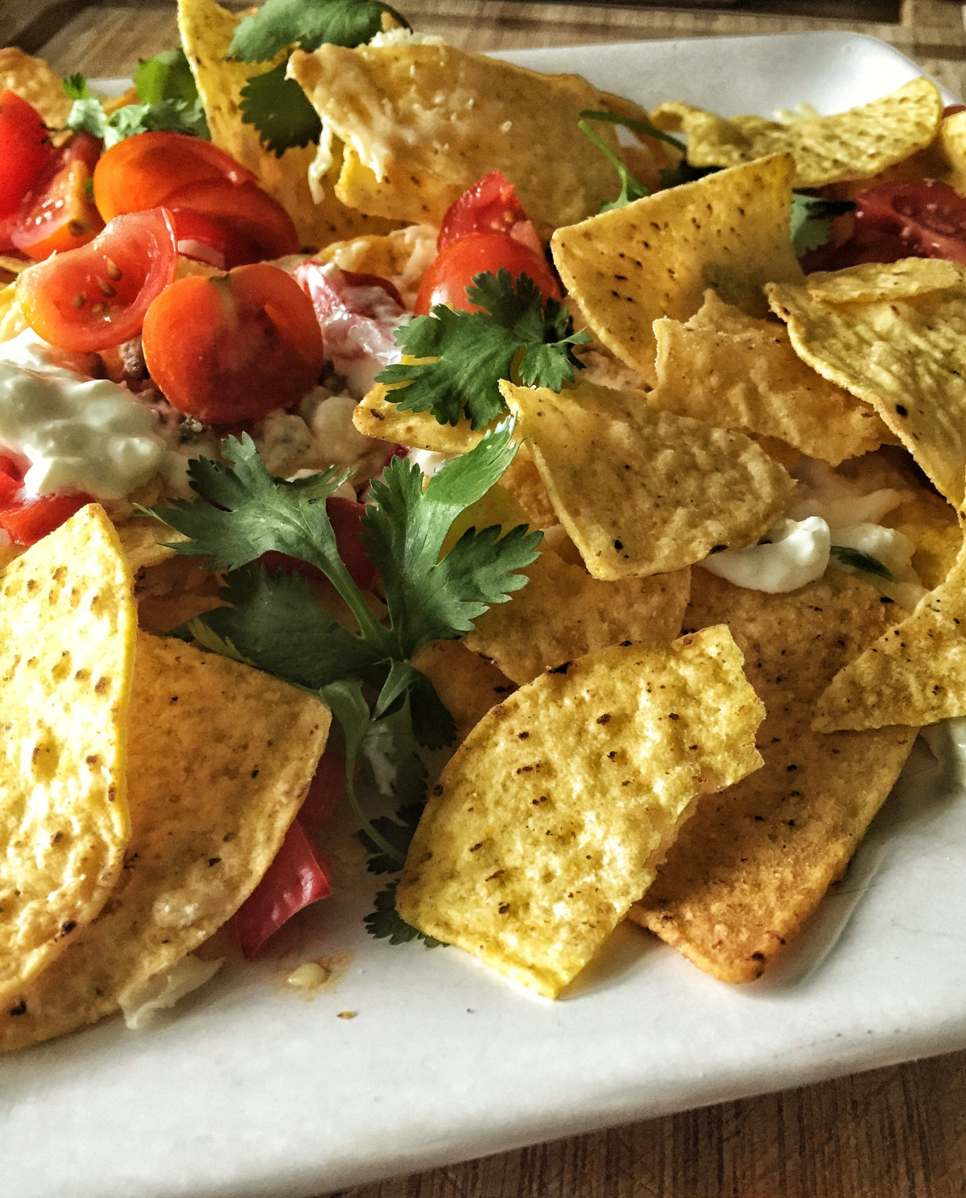
INTRODUCTION
‘Junk food' is food that contains high levels of fats, salt or sugar, and lacks nutrients such as vitamins and minerals. Reading nutritional information labels and following the Health Star Ratings system can help you make healthy food choices.

Slide 4
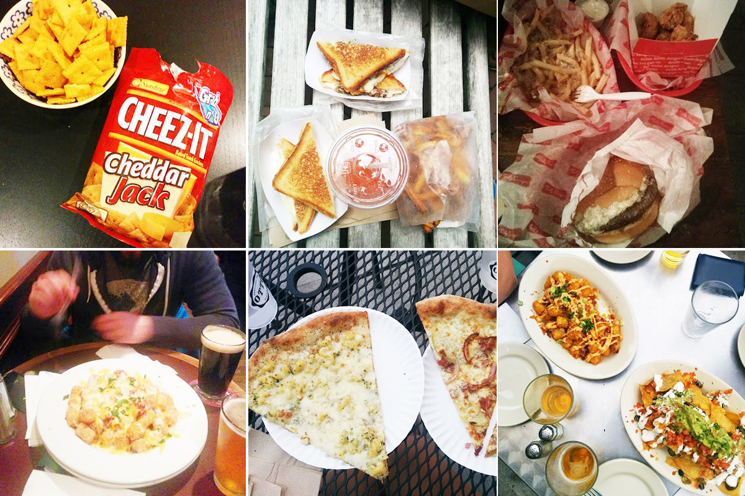
TYPES OF JUNK FOODS:

Slide 5
WHAT IS JUNK FOODS?
Junk foods include foods like burgers, fried chicken, and pizza from fast-food restaurants, as well as packaged foods like chips, biscuits, and ice-cream, sugar-sweetened beverages like soda, fatty meats like bacon, sugary cereals, and frozen ready meals like lasagne.

Slide 6
DISAVANTAGES FOR JUNK FOODS:
Beside having high calories that make junk foods a good diet meal item and the sugar that can maintain blood sugar level, they also contain many nutrients. In this research paper, it will provide detail about the positive benefits of junk food.

Slide 7
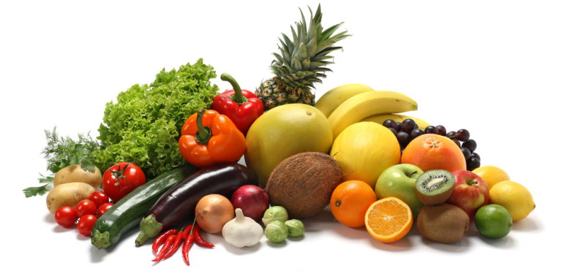
TYPES OF HEALTHY FOODS

Slide 8
WHAT IS HEALTHY FOODS?
A healthy diet provides the body with essential nutrition: fluid, macronutrients such as protein, micronutrients such as vitamins, and adequate fibre and food energy. A healthy diet may contain fruits, vegetables, and whole grains, and may include little to no ultra-processed foods or sweetened beverages.

Slide 9
BENEFITES FOR HEALTHY FOODS:
Following a healthy diet has many benefits, including building strong bones, protecting the heart, preventing disease, and boosting mood.

Slide 10
QUERY

Slide 11
THANK YOU

