Slide 1

Health Determinants & Chronic Disease Analysis Comprehensive Overview of Data, Methods, Results & Insights
Team Data Dynamos
(Muskan Sharma & Hemalikaa Thirumavalavan)

Slide 2

Outline
Project Overview (based on the proposal)
Data Exploration and Visualization
Feature Engineering & Data Preparation
Model Development
Logistic Regression
Random Forest
KNN Classifier
Naive Bayes
Neural Network
Model Evaluation & Comparison
Key Findings & Insights
Recommendations & Conclusions

Slide 3

Introduction & Background & Why this Dataset
Context:
Chronic diseases (diabetes, hypertension, obesity) on the rise worldwide
Lifestyle choices remain key drivers despite medical advances
Aim:
Analyze multi-country data (25 nations) to uncover actionable health insights
Analytical Advantages:
Statistical Power: large sample size supports detection of subtle risk patterns
Model Robustness: rich feature set fuels accurate predictive models and clustering
Policy Impact: multi-country lens highlights both universal and region-specific drivers

Slide 4

Problem Statement
Lifestyle diseases require data-driven solutions to:
Identify key behavioral and population characteristics linked to chronic conditions
Understand relationships between lifestyle choices and biochemical markers
Study health outcome disparities across different countries
Determine population-level factors that produce high risk for cardiovascular disease
Provide evidence-based recommendations for public health interventions

Slide 5

Dataset Description
Source: Kaggle “Heart Attack Risk Predictions”
Scope: 623,028 records × 30 variables from 25 countries
Variable Categories:
Demographics: Country, Age, Gender, Education, Income, Urbanization
Behaviors: Smoking, Alcohol use, Physical activity, Stress, Diabetic behavior
Health Metrics: Cholesterol, Blood Pressure, BMI, Diabetes status, Heart history, Medication adherence
Environment & Access: Air pollution exposure, Healthcare accessibility

Slide 6

Research Questions & Objectives
Research Questions
What demographic characteristics and behavior patterns influence heart attack outcomes?
How do lifestyle behaviors affect key biochemical markers?
What variations exist in chronic disease occurrence between nations?
Which factors most significantly contribute to high cholesterol and blood pressure?
How can we translate findings into effective public health interventions?

Slide 7

Exploratory Data Analysis
Dataset Variables
Features assessed:
Demographic (Age, Gender, Country)
Lifestyle (Alcohol, Smoking, Physical Activity)
Health Metrics (Blood Pressure, Cholesterol, Stress)
Environmental Factors (Air Pollution)
Initial Focus: Heart Attack Outcome (Survived vs. Died)

Slide 8
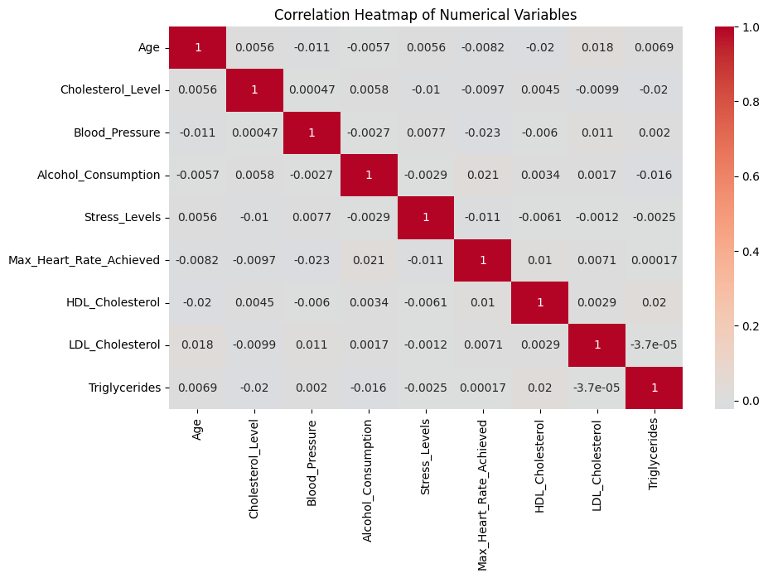
Correlation Analysis
Weak Correlations Overall: Most variables show very low correlation values (close to 0), indicating weak linear relationships.
No Strong Positive/Negative Relationships: No pair of variables shows a correlation significantly higher than ±0.02, which is negligible.
Age: Slight positive correlation with LDL Cholesterol (0.018). Slight negative correlation with HDL Cholesterol (-0.02).
Max Heart Rate Achieved: Slight negative correlation with Blood Pressure (-0.023).
Triglycerides: Slight positive correlation with HDL Cholesterol (0.02).
There are no meaningful linear correlations between these numerical health variables, suggesting that their relationships are either non-linear or weak in this dataset

Slide 9
Data Preprocessing
Handling missing
Feature selection process
Selected features: Stress_Levels, Max_Heart_Rate_Achieved, Smoking_History, Heart_Disease_Risk
Encoding categorical variables
Standardizing numerical features

Slide 10

Logistic Regression Results
Implementation details from notebook
Performance metrics:
Accuracy: 0.51
Precision: 0.50
Recall: 0.49
F1-Score: 0.50
Confusion Matrix visualization
Key strengths/limitations

Slide 11

Random Forest Results
Implementation details
Performance metrics:
Accuracy: 0.50
Precision: 0.50
Recall: 0.51
F1-Score: 0.50

Slide 12
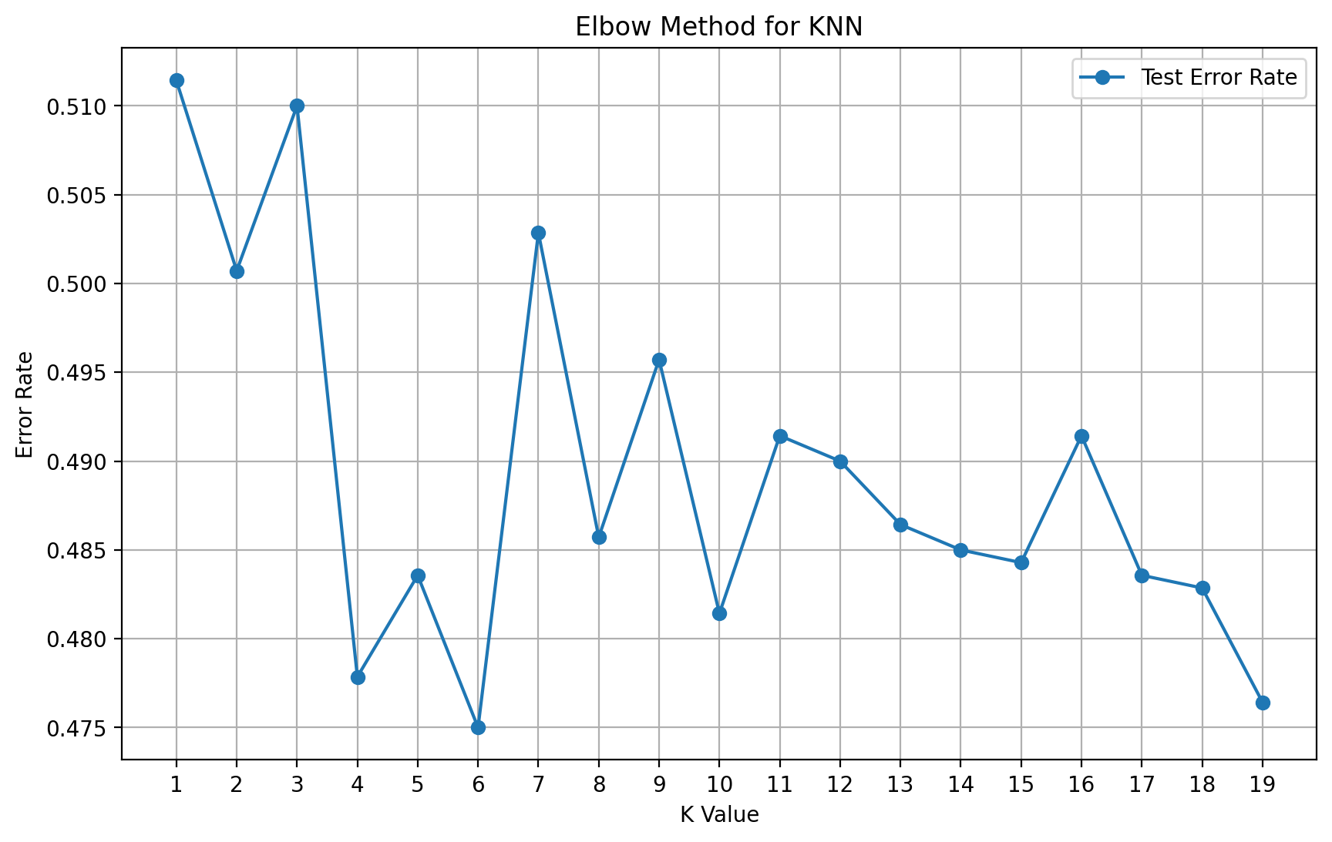
K-Nearest Neighbors Classification
Model Configuration:
Optimal K selection process (k=6 based on error curve)
Distance metric (Euclidean)
Weighting strategy (uniform)
K Selection Analysis:
Error vs. K-value plot showing optimal k determination
Cross-validation error curves
Performance Metrics:
Accuracy: 0.53
Full classification report with precision, recall, F1-score by class
Detailed Confusion Matrix Analysis:
Class-wise performance (493 true positives, 242 true negatives)
Misclassification patterns in feature space
Neighborhood Analysis:
Visualization of decision boundaries for key feature pairs
Effect of different k values on classification boundaries

Slide 13

Naive Bayes Analysis
Model Configuration:
Gaussian Naive Bayes implementation details
Prior probability adjustments
Variance smoothing parameter
Performance Metrics:
Accuracy: 0.52
Precision: 0.52
Recall: 0.47
F1-Score: 0.49
Detailed Confusion Matrix:
True Positives (488), False Positives (456)
False Negatives (553), True Negatives (603)
Probability Distribution Analysis:
Class conditional probability distributions for key features
Log-likelihood ratios for major predictors
Naive Bayes assumption evaluation

Slide 14

Neural Network Implementation
Architecture Design:
Network topology (input layer: 6 nodes, hidden layer: 10 nodes, output layer: 1 node)
Activation functions (Sigmoid for hidden and output layers)
Loss function (Binary cross-entropy)
Training Process:
Learning curve showing loss vs epochs (1000 epochs)
Learning rate optimization (0.01)
Convergence behavior analysis
Performance Results:
Final accuracy: 50.86%
Detailed performance metrics compared to traditional models
Model Interpretability:
Limitations in understanding neural network decisions
Comparison with more interpretable models
Visualization of neuron activations for key samples

Slide 15

Limitations and Future Research
Current Study Limitations:
Data source limitations and potential biases
Cross-sectional nature of data limiting causal inference
Limited social determinants representation
Self-reported data reliability issues
Methodological Considerations:
Alternative modeling approaches to explore
Deeper feature engineering possibilities
Advanced ensemble methods for improved accuracy
Future Research Directions:
Longitudinal studies needed for temporal relationships
Genetic and environmental interaction studies
Intervention effectiveness evaluation studies
Expanded social determinants analysis

Slide 16

Conclusion and Significance
Major Findings Summary:
Primary risk factors ranked by importance
Geographic variation patterns identified
Most effective predictive approaches determined
Public Health Impact:
Potential reduction in heart attack incidence through targeted interventions
Healthcare cost savings potential through prevention
Reduction in healthcare disparities through data-driven approaches
Scientific Contribution:
Analytical framework for chronic disease risk assessment
Cross-country comparative methodology
Integrated machine learning approach for medical risk prediction

