Slide 1

BANASTHALI VIDHYAPITH
GROUP- CSD86
BTECH
III YEAR
IT
SCAMIFY:
A PHISHING SITE DETECTOR
A PHISHING SITE DETECTOR
REAL-TIME PHISHING DETECTION
TEAM MEMBERS-
ROLL NUMBER
Disha Dutta
Kumari Sonam
Mridula Shrivastava
Muskan Atray
Praavinya Chaturvedi
2216826
2216850
2216852
2216853
2216869
PAGE 01

Slide 2
BANASTHALI VIDHYAPITH
GROUP- CSD86
BTECH
III YEAR
IT
Purpose & Goal of Scamify
PURPOSE
GOALS
Develop a machine learning model to detect phishing websites.
Analyze legitimate and phishing websites.
Implement machine learning algorithms for real-time detection.
Provide protection through a user-friendly interface.
PAGE 02

Slide 3
BANASTHALI VIDHYAPITH
GROUP- CSD86
BTECH
III YEAR
IT
Project Scope
Scamify:- A phishing website detection system.
Main Objective: Enhance cybersecurity by detecting malicious websites.
Key Features:
Real-time classification of URLs.
Machine learning algorithms for accurate phishing detection.
PAGE 03

Slide 4
BANASTHALI VIDHYAPITH
GROUP- CSD86
BTECH
III YEAR
IT
System Architecture Overview
Components:
Data Collection: Phishing & legitimate websites.
Data Preprocessing: Cleans and prepares data.
Feature Extraction: Analyzes website features (URL, HTML).
Model Training: Uses neural networks and other algorithms.
Phishing Detection: Classifies new URLs in real-time.
User Interface: For user input and result display.
PAGE 04

Slide 5
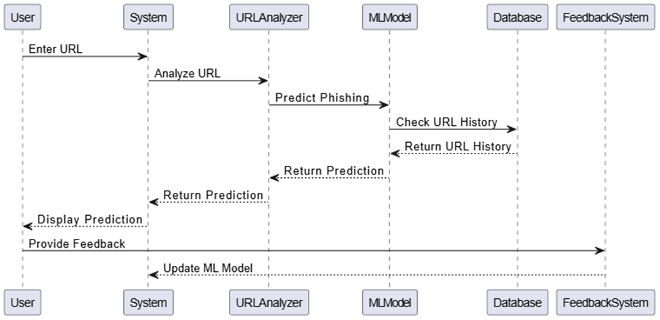
BANASTHALI VIDHYAPITH
GROUP- CSD86
BTECH
III YEAR
IT
System Architecture Overview
PAGE 05

Slide 6
BANASTHALI VIDHYAPITH
GROUP- CSD86
BTECH
III YEAR
IT
Key Features
Phishing Detection:
Classifies URLs as phishing or legitimate.
User-friendly interface for real-time results.
User Feedback:
Collects feedback to improve accuracy​
Security:
Uses SSL/TLS encryption for secure data communication​
PAGE 06

Slide 7
BANASTHALI VIDHYAPITH
GROUP- CSD86
BTECH
III YEAR
IT
Key Features
Phishing Detection Methods
Manual Detection:
Users can enter a URL manually into the system to check if it’s a phishing site.
​
Automatic Detection:
The system will automatically check URLs as users click on them and provide warnings before they access potentially harmful sites.
PAGE 07

Slide 8
BANASTHALI VIDHYAPITH
GROUP- CSD86
BTECH
III YEAR
IT
Machine Learning Model
Algorithms Used:
Neural Networks.
Scikit-learn for model development
Training Data: URLs with labeled phishing and legitimate status.
Evaluation: Metrics include accuracy, precision, recall
PAGE 08

Slide 9


BANASTHALI VIDHYAPITH
GROUP- CSD86
BTECH
III YEAR
IT
User Classes
General Users: Non-technical individuals.
IT Professionals: Security experts monitoring networks.
Developers: Integrators embedding the detection API into applications​
PAGE 09

Slide 10
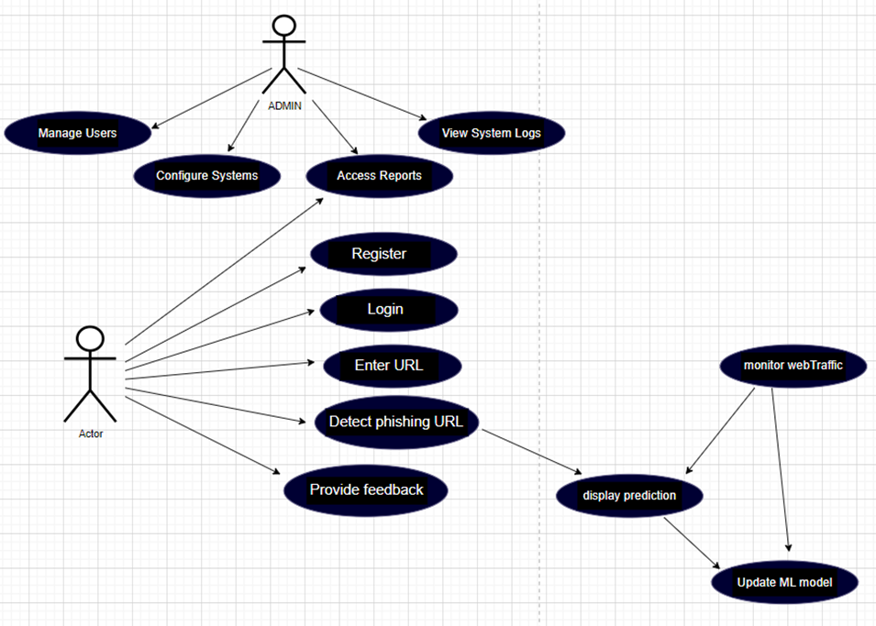
BANASTHALI VIDHYAPITH
GROUP- CSD86
BTECH
III YEAR
IT
User Classes
PAGE 10

Slide 11
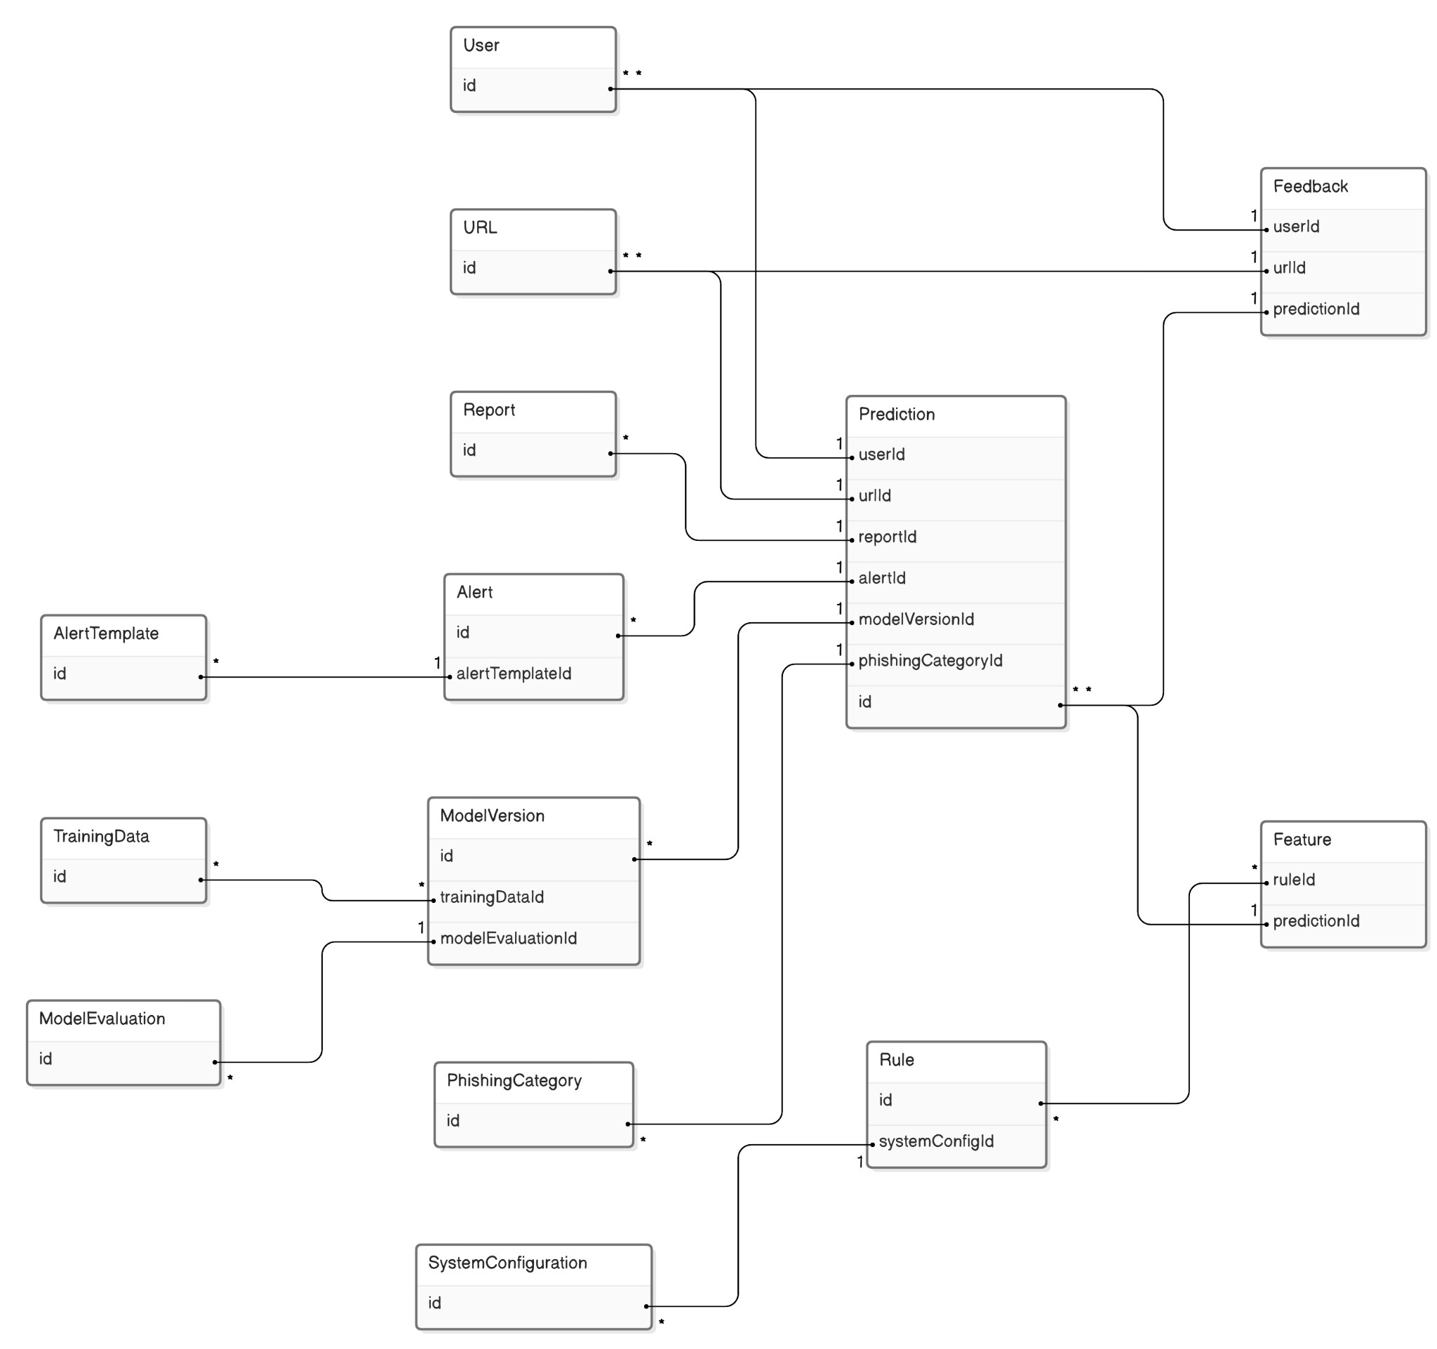
BANASTHALI VIDHYAPITH
GROUP- CSD86
BTECH
III YEAR
IT
E-R diagram
PAGE 07

Slide 12
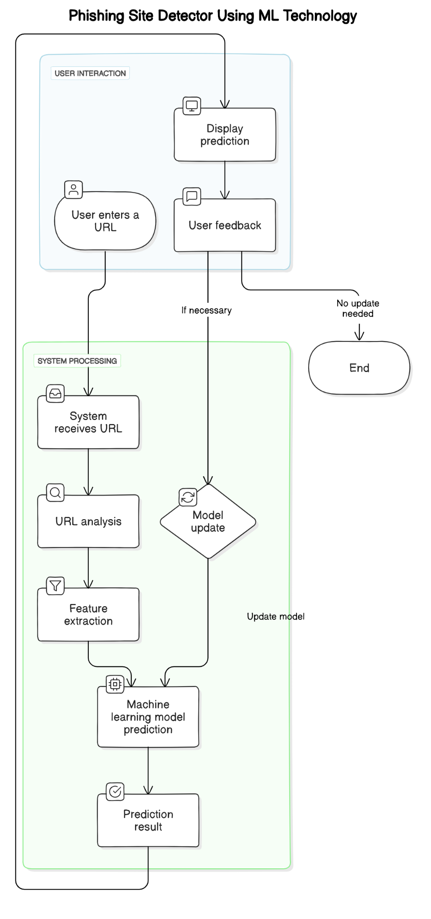
BANASTHALI VIDHYAPITH
GROUP- CSD86
BTECH
III YEAR
IT
Activity Diagram
PAGE 10

Slide 13
BANASTHALI VIDHYAPITH
GROUP- CSD86
BTECH
III YEAR
IT
System Features
Browser Extension:
Real-time phishing detection via browser integration.
Notification system for alerts
API Integration:
Allows developers to embed phishing detection in other tools​
PAGE 11

Slide 14
BANASTHALI VIDHYAPITH
GROUP- CSD86
BTECH
III YEAR
IT
Non-Functional Requirements
Performance:
Real-time detection under 5 seconds
Security:
GDPR compliance, encryption, and secure data handling​
Scalability:
Supports up to 100 concurrent users
PAGE 12

Slide 15
BANASTHALI VIDHYAPITH
GROUP- CSD86
BTECH
III YEAR
IT
Future Improvements
Expand Dataset:
Increase phishing URL database.
Model Updates:
Regular updates for improved accuracy.
User Interface Enhancements:
Increase usability​
PAGE 13

Slide 16
BANASTHALI VIDHYAPITH
GROUP- CSD86
BTECH
III YEAR
IT
Conclusion
Scamify aims to provide effective phishing detection through machine learning.
Scalable, secure, and designed for real-time results.
Future improvements will enhance both accuracy and user experience.
PAGE 14

Slide 17
BANASTHALI VIDHYAPITH
GROUP- CSD86
BTECH
III YEAR
IT
THANK YOU
PAGE 15

