Slide 1
CSE7302 - INTERNSHIP Review-4 Presentation CLIENT SUCCESS INTERN AT TALENTRECRUIT
Student Details
Name | MUSKAN
Roll No | 20221ISE0012
Section | 8ISE03
Under the Supervision of,
Guide: MS. Battula Bhavya,
Reviewer: Mr. Abhishek M
Professor,
Presidency School of CSE
Presidency University
Name of the Program: B.Tech
Name of the HoD: Dr. Gopal Krishna Shyam
Name of the Program Internship Coordinator: Mr. Sreehari T M
Name of the School Internship Coordinator: Dr. Md Ziaur Rahman

Slide 2
Content
About Company or Organization
Working domain or the technology
About your team and reporting Manager
Challenges Faced in Internship
Objectives of the work
Literature Review
Proposed System
Problem Statement
System Requirements
Advantages of Proposed System/Work
Internship Roadmap
Github Link

Slide 3
About Company or Organization
Talent Recruit is an advanced Recruitment and Onboarding platform designed to simplify, automate, and enhance the entire hiring lifecycle. It leverages cutting-edge technologies such as Machine Learning and Artificial Intelligence to help organizations attract, screen, evaluate, and hire the right talent efficiently and accurately.
One of its key highlights is ERIKA – the 24×7 Robotic Recruiter, which automates candidate engagement, interview scheduling, follow-ups, and communication, ensuring a seamless and responsive recruitment experience for both recruiters and candidates. ERIKA reduces manual effort, improves turnaround time, and enhances candidate satisfaction through continuous availability and intelligent interaction.
Talent Recruit enables recruiters to manage job postings, track applications, shortlist candidates, conduct assessments, schedule interviews, and complete onboarding processes within a single integrated platform. Its AI-driven analytics and smart recommendations help recruiters make data-driven hiring decisions, minimize bias, and improve overall hiring quality.

Slide 4
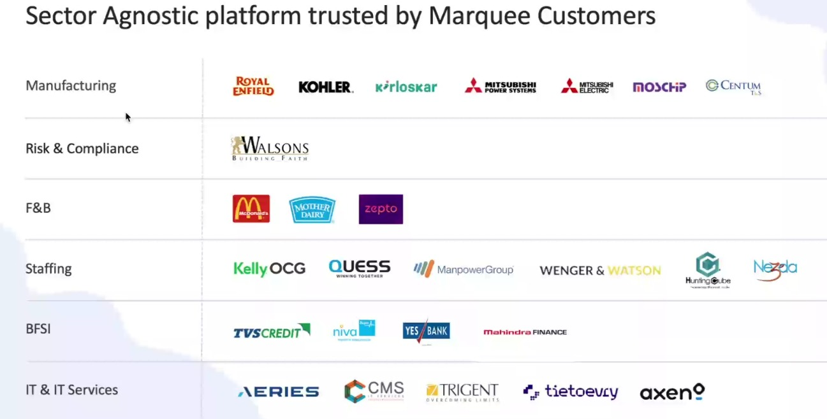
Our Clients

Slide 5
Working domain or the technology
Artificial Intelligence (AI) for intelligent recruitment automation
Machine Learning (ML) for resume screening and candidate ranking
Natural Language Processing (NLP) for chatbot and candidate interaction
Applicant Tracking System (ATS) architecture
SaaS (Software as a Service) cloud-based platform model
Database Management Systems for candidate and job data storage
REST APIs for integration with job portals and communication tools
Chatbot Technology (ERIKA – Robotic Recruiter)
Recruitment Analytics and Reporting Dashboards
Workflow Automation Systems

Slide 6
About your team and reporting Manager
Team Structure, Project, Reporting & Technology Understanding
Our team consists of 9 members, guided by our Reporting Manager, Mr. Ashish Medidata .
Currently, we are in the training phase on the company’s ATS (Applicant Tracking System) product.
We are learning how each technology supports the recruitment process:
Technology Understanding:
AI & ML: Helps in resume screening and candidate ranking.
NLP: Enables chatbot communication and candidate interaction.
ATS Workflow: Helps track candidates across hiring stages.
Databases: Store and manage candidate and job data.
APIs: Integrate job portals and communication tools.
Dashboards & Analytics: Provide recruitment performance insights.
This training helps us understand how technology solves real recruitment challenges.
After training, we will be assigned to live projects for practical client exposure.

Slide 7
Challenges Faced in Internship
I was selected through my college campus placement process. Clearing the interview with the company’s Director was a major challenge, as it involved in-depth technical questions, role-based scenarios, and problem-solving assessments. This experience tested my analytical thinking, technical knowledge, and ability to perform under pressure, helping me gain confidence and clarity about industry expectations.

Slide 8
Objectives of the work
To understand ATS system architecture and recruitment workflows.
To support AI-based resume parsing and candidate shortlisting processes.
To assist in database validation and candidate data management.
To ensure accurate workflow automation across hiring stages.
To support API-based integrations with job portals and communication tools.
To analyze recruitment dashboards and system reports.
To help in identifying and resolving basic system-level issues.
To improve overall system efficiency and data consistency.

Slide 9
Proposed System / Work
AI-powered Applicant Tracking System
Automated resume screening and candidate ranking
Chatbot-based candidate engagement (ERIKA)
Centralized recruitment workflow management

Slide 10
Problem Statement
Understanding the sync and corp environment of Talent Recruit

Slide 11
System Requirements
Web-based ATS platform
Cloud infrastructure
Database for candidate and job data
API integrations with job portals and communication tools

Slide 12
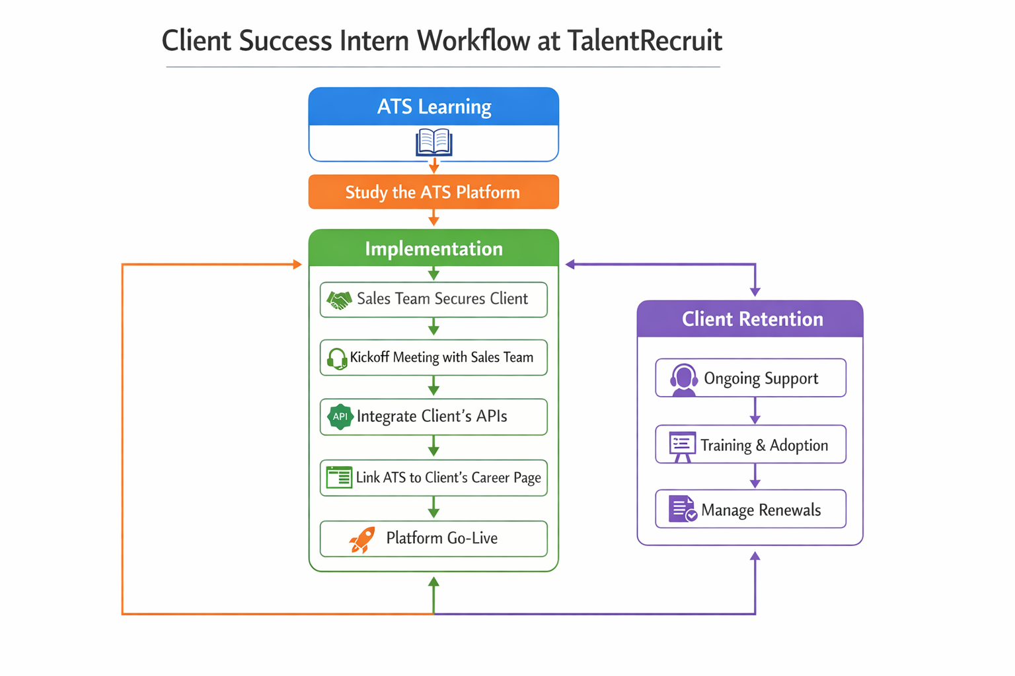

Slide 13
Advantages of Proposed System/Work
Reduces manual effort in recruitment
Improves hiring accuracy and speed
Enhances candidate experience
Supports data-driven hiring decisions

Slide 14
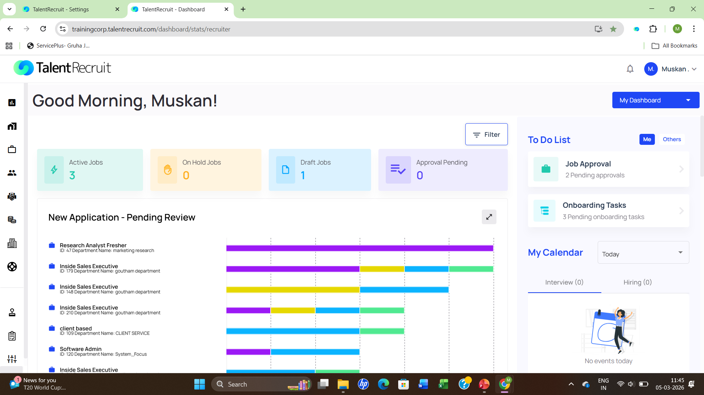
System Design

Slide 15
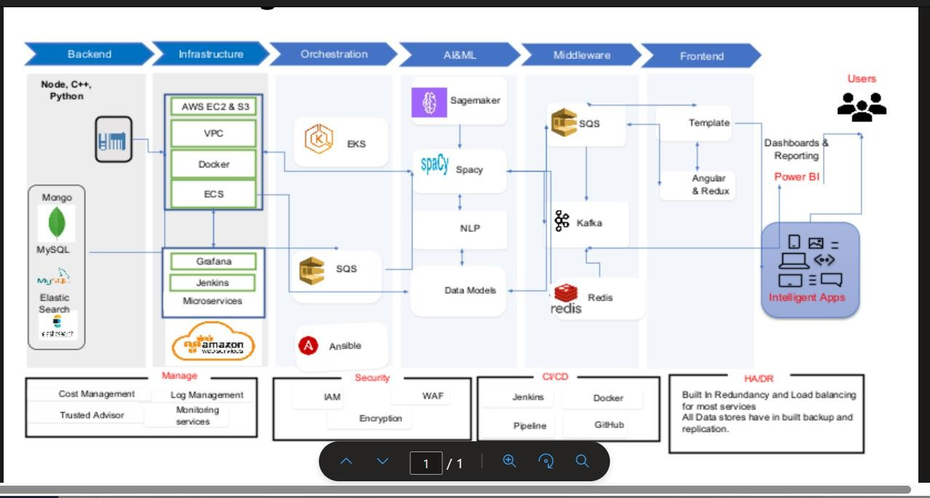

Slide 16
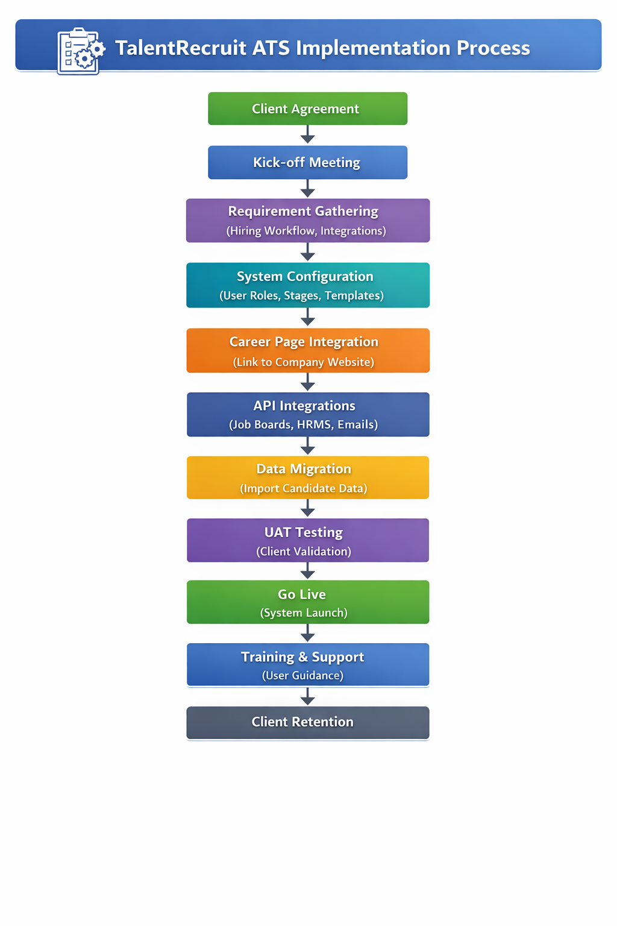
System Implementation

Slide 17
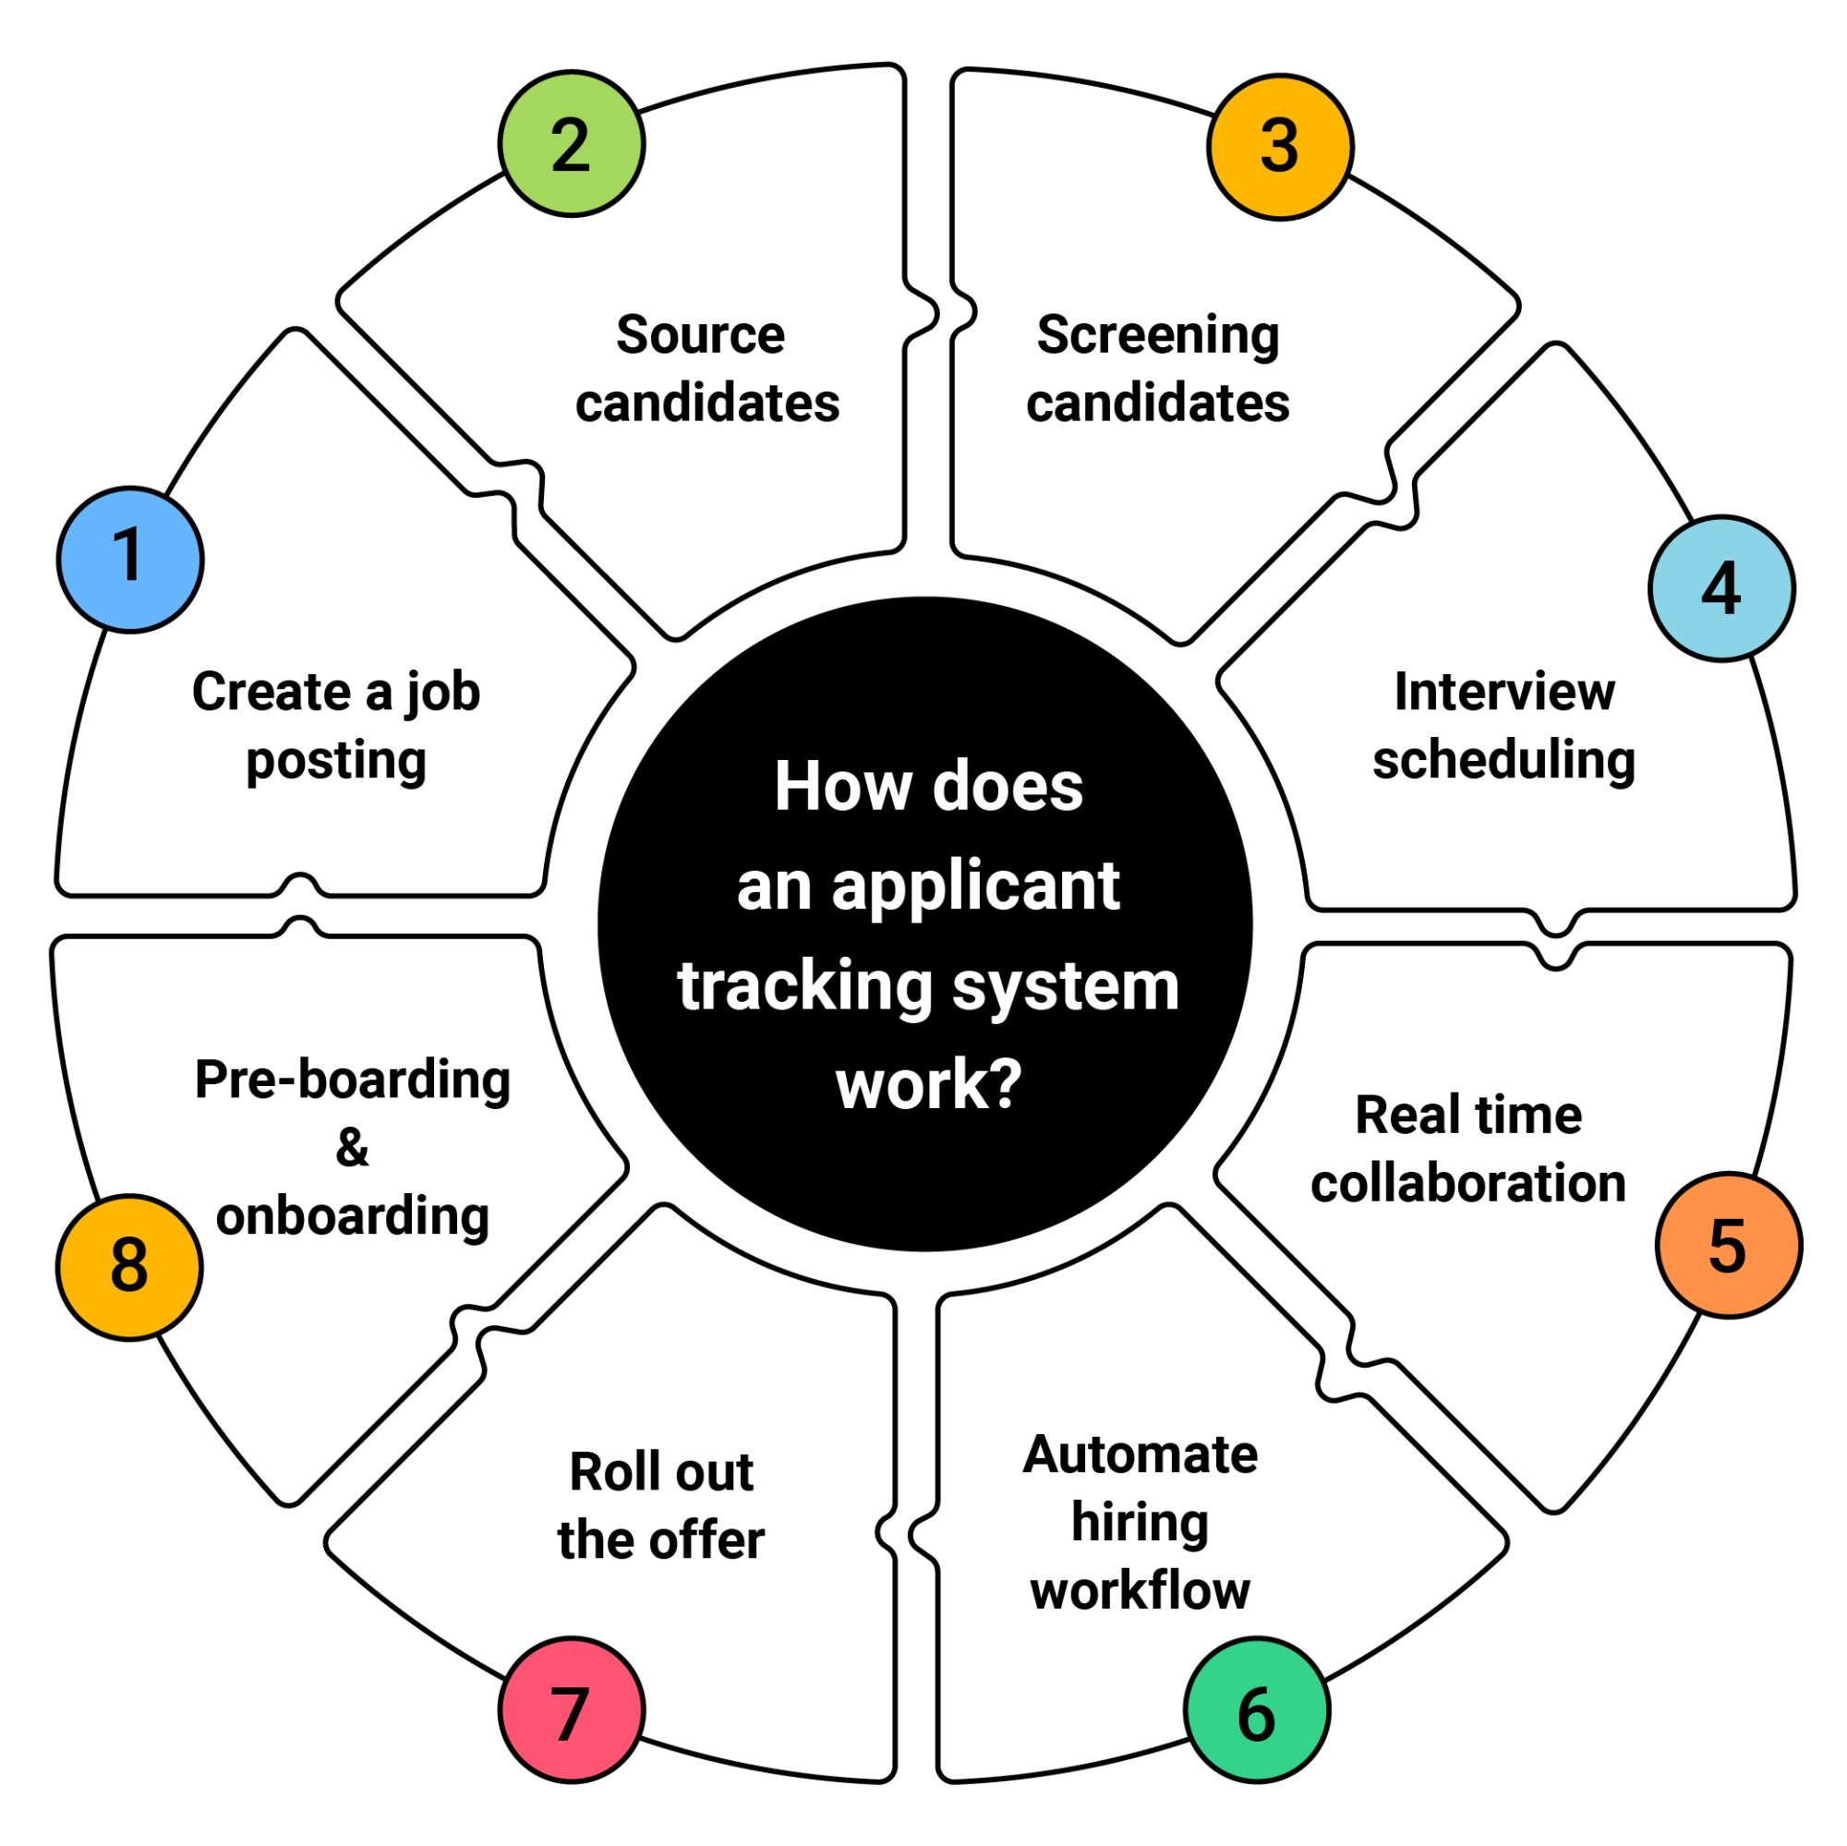
System Testing

Slide 18
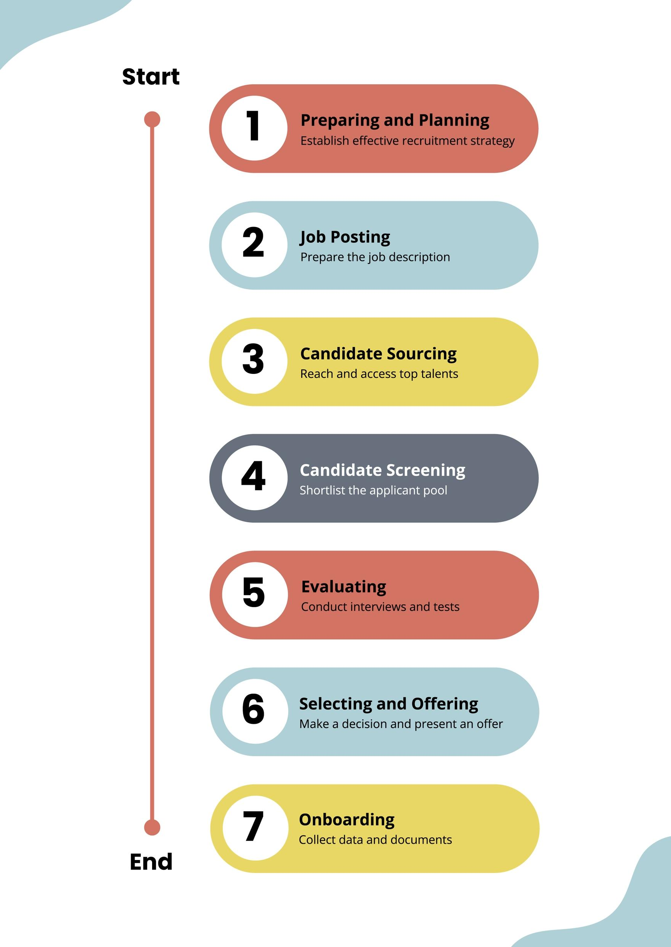
System Testing

Slide 19
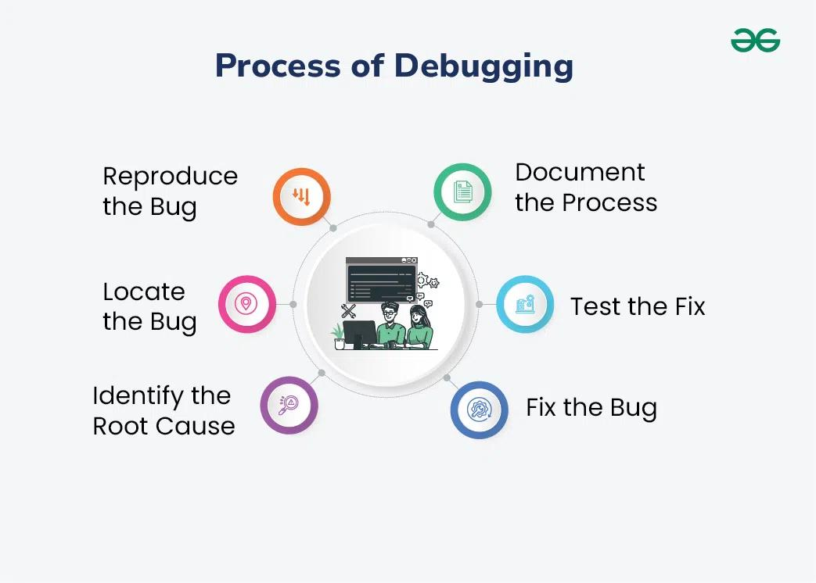
System Testing

Slide 20
Conclusion
The internship helped you gain practical exposure as a Client Success Intern
Got to learn real-world skills like teamwork, communication, and problem-solving.
The system(TalentRecruit) has clear advantages and can be useful in real scenarios.
Challenges faced during the internship helped in personal and professional growth.

Slide 21
Internship Road Map
Note: Write in the below table what u will be achieving in each review
Review 1
Product training and understanding the mechanisms
Review 2
Understanding AI modules and system integration
Review 3
Interactive dashboard development, slicers, drill-through analysis, and recruitment performance
Insights
generation
Review 4
System Testing and bug identification
Final Review

Slide 22
Github Link
https://github.com/muskan200419/INTERNSHIP-TalentRecruit

Slide 23
Q&A

Slide 24
Thank you !!

