Slide 1
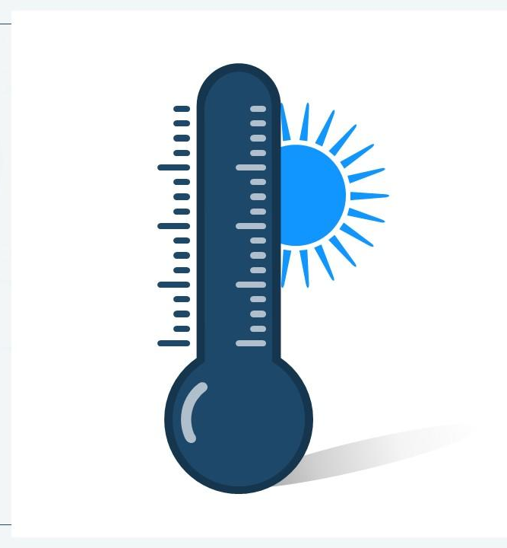
Global Temperature Anomaly Prediction & Analysis Dashboard
Made By- Muskan

Slide 2

Table Of Content
Problem Statement
Objective
Data Description
Data Cleaning and Data Summary
Feature Engineering
Exploratory Data Analysis (EDA)
Machine Learning Model Development
Model Deployment(Streamlit)
Tableau Dashboard
Key Insights and Future Enhancement

Slide 3
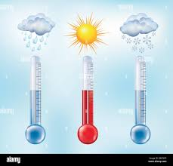
Problem Statement
As a Data Scientist I am developing an end-to-end machine learning pipeline that predicts global temperature anomalies based on historical data. The project will include building a predictive model using Machine Learning (ML), deploying it with Streamlit, and visualizing the results using Tableau.
Global Temperature anomalies have been increasing at an alarming rate due to climate change and human activities. Understanding and predicting these anomalies is crucial.

Slide 4
Objective
This project aims to build a machine learning-based model to predict temperature anomalies and visualize historical and predicted trends using Tableau.
Through this project we will analyse-
Past Trends
Predict Future Temperature Anomalies
Provide Interactive Visualization

Slide 5

Data Description
This dataset provides monthly temperature anomalies from 1880 to the present, with each row representing a different year. The temperature anomalies are compared to a long-term baseline (typically the 20th-century average) and are measured in degrees Celsius.
Columns in the Dataset:
Year: The year of observation.
Month Columns (Jan-Dec): The temperature anomaly for each month (from January to December).
J-D: The annual mean temperature anomaly (based on all 12 months of the year).
D-N: The December to November temperature anomaly.
Seasonal Columns (DJF, MAM, JJA, SON):
DJF: Winter temperature anomaly (December, January, February).
MAM: Spring temperature anomaly (March, April, May).
JJA: Summer temperature anomaly (June, July, August)
SON: Fall temperature anomaly (September, October, November

Slide 6
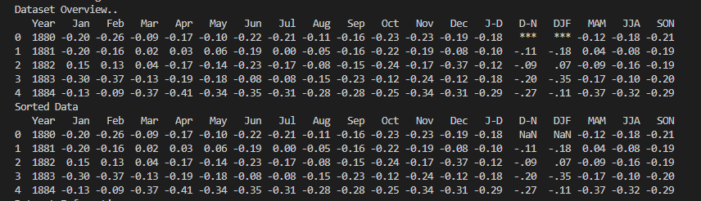
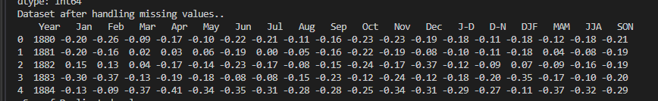
Data Cleaning
Handling Missing Values
Replaced missing values with Forward and Backward fill Technique.

Slide 7
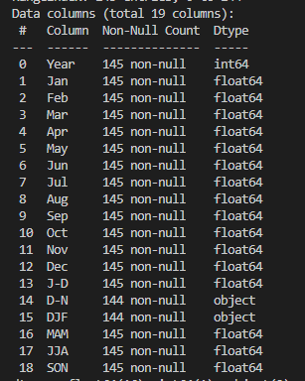
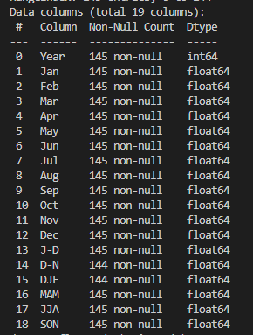
Data Cleaning
Handling Wrong data types of few columns
Converted Object Datatype to float64 as the values were numerical.

Slide 8
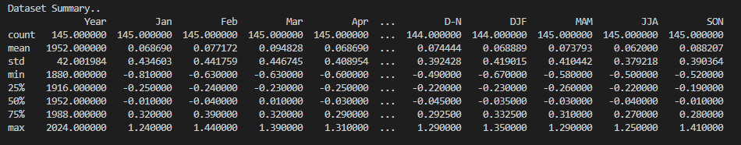
Data Summary
Descriptive Statistics
The dataset contains historical temperature anomalies from 1880 to 2024, covering monthly and seasonal variations. It provides key statistical insights such as mean, standard deviation, and temperature fluctuations across different months and seasons, enabling trend analysis and climate predictions.

Slide 9
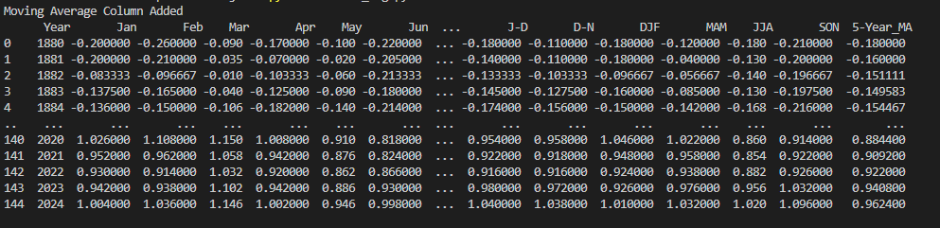
Feature Engineering
Created New Column Yearly Moving Average
Created 5-Year Moving Average column. It helped in capturing Long Term Trends.

Slide 10
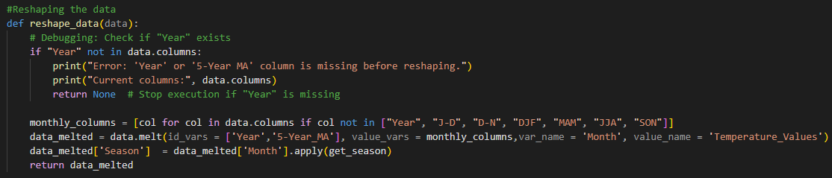
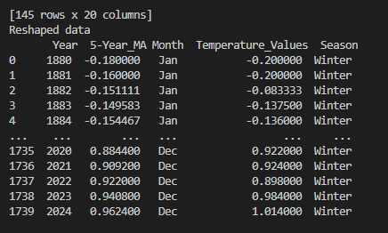
Feature Engineering
Extract time-based features (Year, Month, and Season)
Reshaped the data using data.melt.

Slide 11
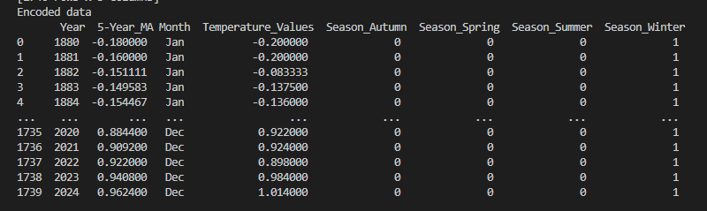
Feature Engineering
Data Encoding
Encoded seasonal information into categorical variables for machine learning models

Slide 12
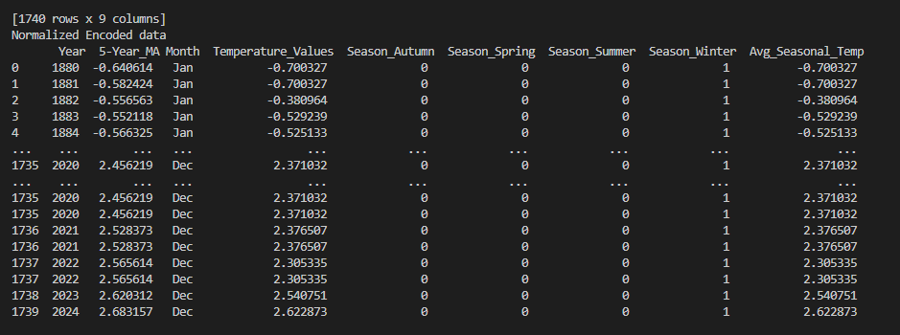
Feature Engineering
Data Normalization
Normalized data using Standardization to prepare it for training phase.

Slide 13
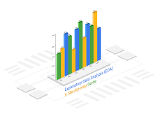
Exploratory Data Analysis

Slide 14
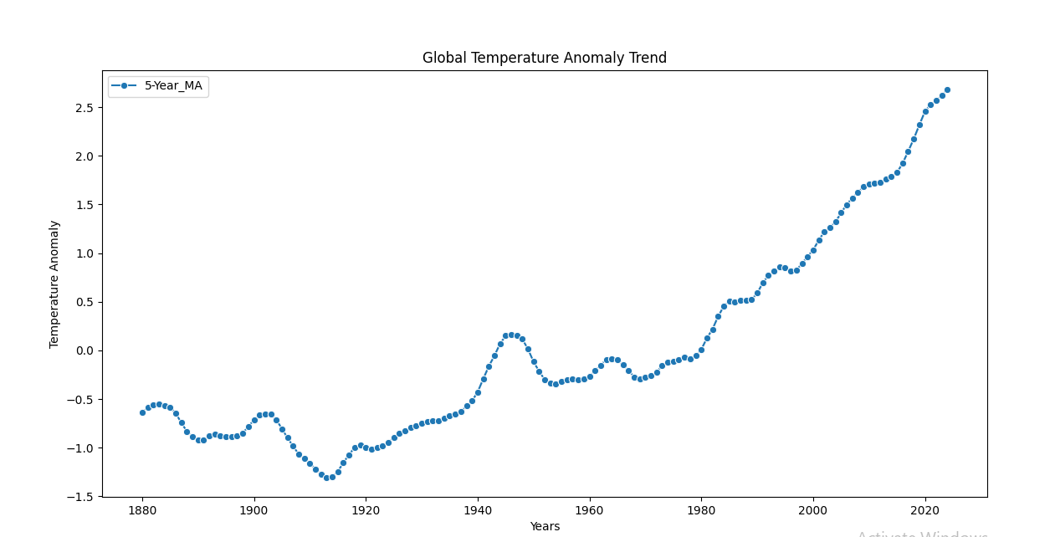
Global Temperature Anomaly Trend
There is a clear Upward Trend in temperature anomalies over time.
Early years (1880–1940) show fluctuating trends, but post-1980, a sharp increase is observed.
This indicates global warming, as temperature anomalies have consistently risen.
This little fall down in temperature might be due to World War

Slide 15
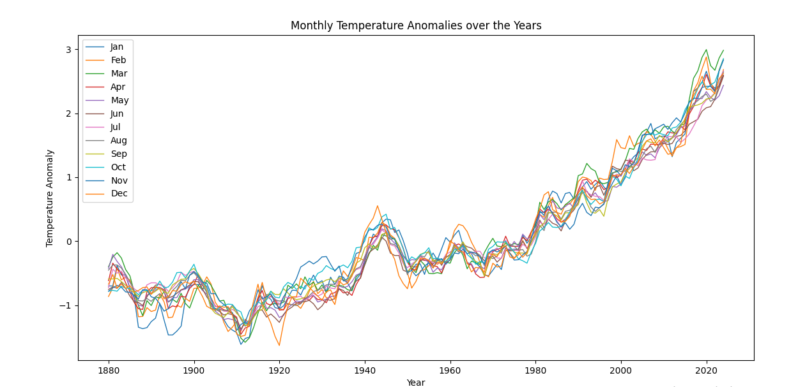
Monthly Temperature Anomalies Over Years
Temperature anomalies vary by month but follow a general Upward Trend.
All months show a warming trend, with higher variations in recent years.
Some months experience more extreme temperature anomalies than others.

Slide 16
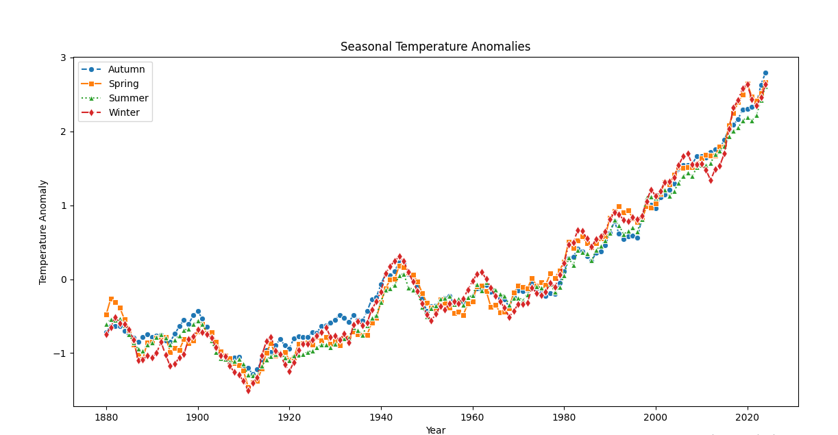
Seasonal Temperature Anomalies
Each season shows a Warming Trend over the decades.
Winters and Summers have more pronounced variations compared to Autumn and Spring.
This suggests that climate change is affecting different seasons at different rates.

Slide 17
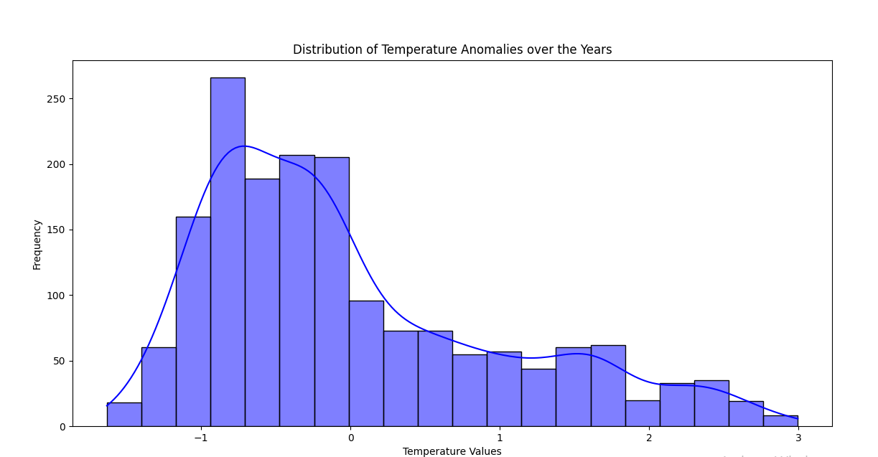
Distribution of Temperature Anomalies Over Years
The distribution is slightly left-skewed, indicating more negative anomalies (cooling events) in historical data.
More recent years have seen higher positive anomalies, contributing to global warming.
The most frequent anomalies are between -1°C and 1°C, but extreme values exist.

Slide 18
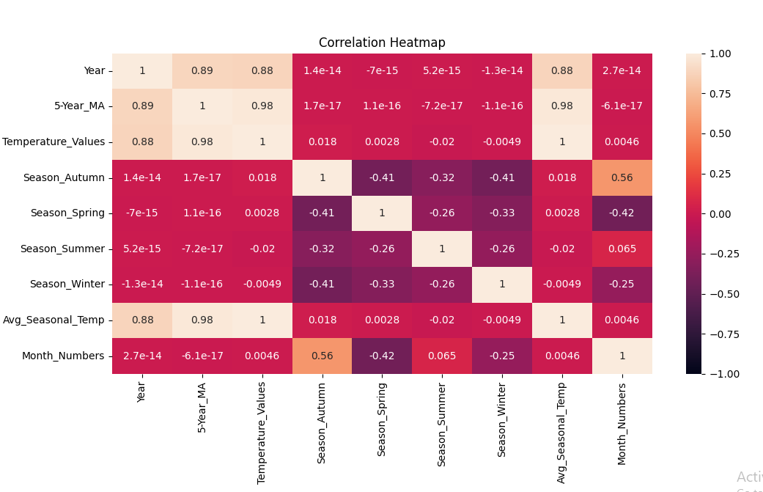
Correlation Heatmap
Strong positive correlation between temperature anomalies and time (Year) → Confirming the long-term warming trend.
High correlation between 5-Year Moving Average and Temperature Anomalies → Indicates that recent years significantly impact moving averages.
Seasonal components (Autumn, Spring, Summer, Winter) show moderate correlations with temperature anomalies.
Month has weak correlation → Suggesting that month alone is not a strong predictor of anomalies.

Slide 19

Machine Learning Model Development

Slide 20
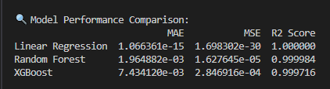

Models Used and Their Performance
Machine Learning Models used -
Linear Regression Model
Random Forest Model
XGBoost Model
Models Performance-
Linear Regression overfitting issue (R² = 1.000).
XGBoost had the lowest error, making it the most accurate.

Slide 21
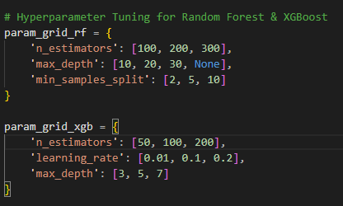
Hyperparameter Tuning (GridSearchCV)
Performed Hyperparameter Tuning to optimize parameters for the best performance.
Hyperparameters(Random Forest)- n_estimators, max_depth, min_samples_split
Hyperparameters (XGBoost)- n_estimators, learning_rate, max_depth

Slide 22

Model Deployment Using Streamlit

Slide 23
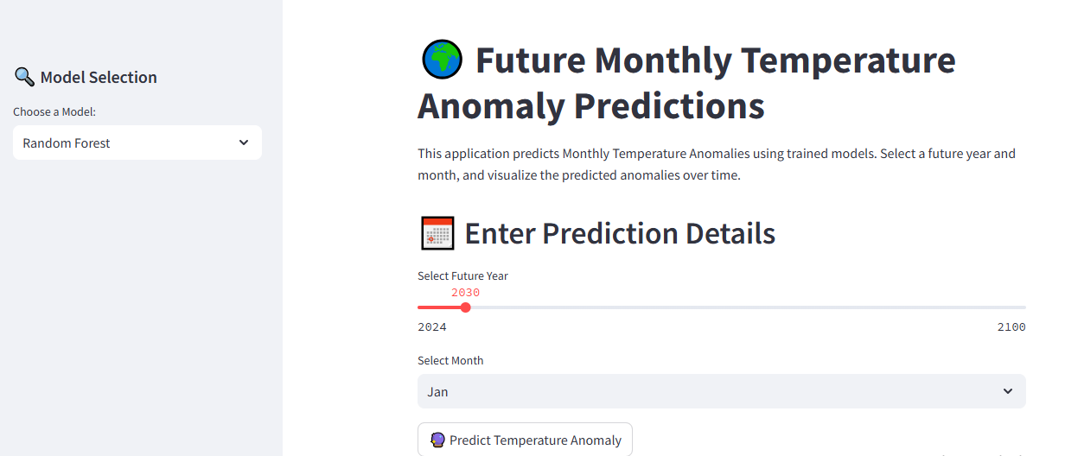
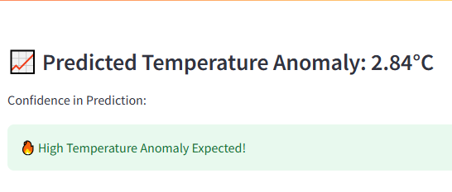
Deployment
Deploy the trained machine learning model as an interactive web application using Streamlit.
Allow users to input a year and month and obtain predicted temperature anomalies.
Provide an intuitive interface to switch between models (Random Forest & XGBoost).

Slide 24
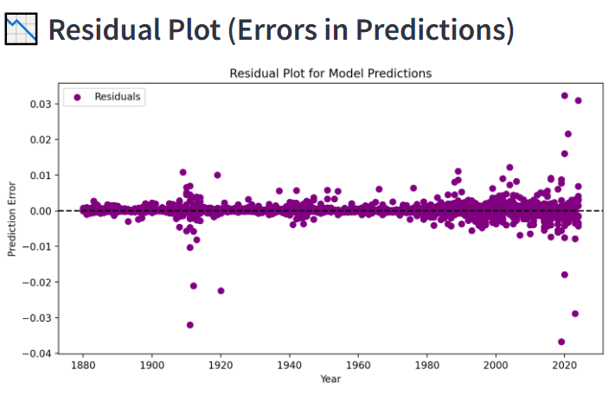
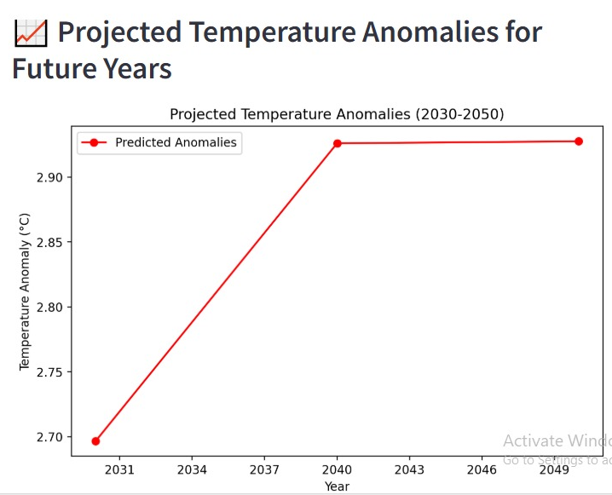
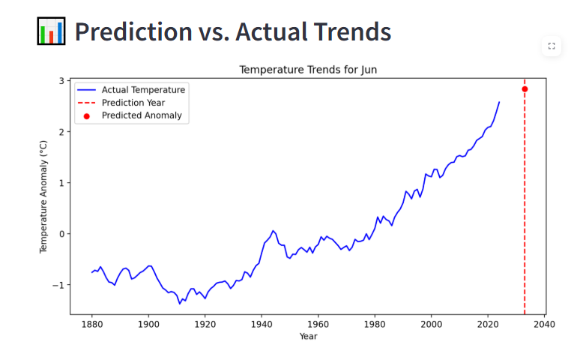
Deployment
With the prediction it also shows you -

Slide 25
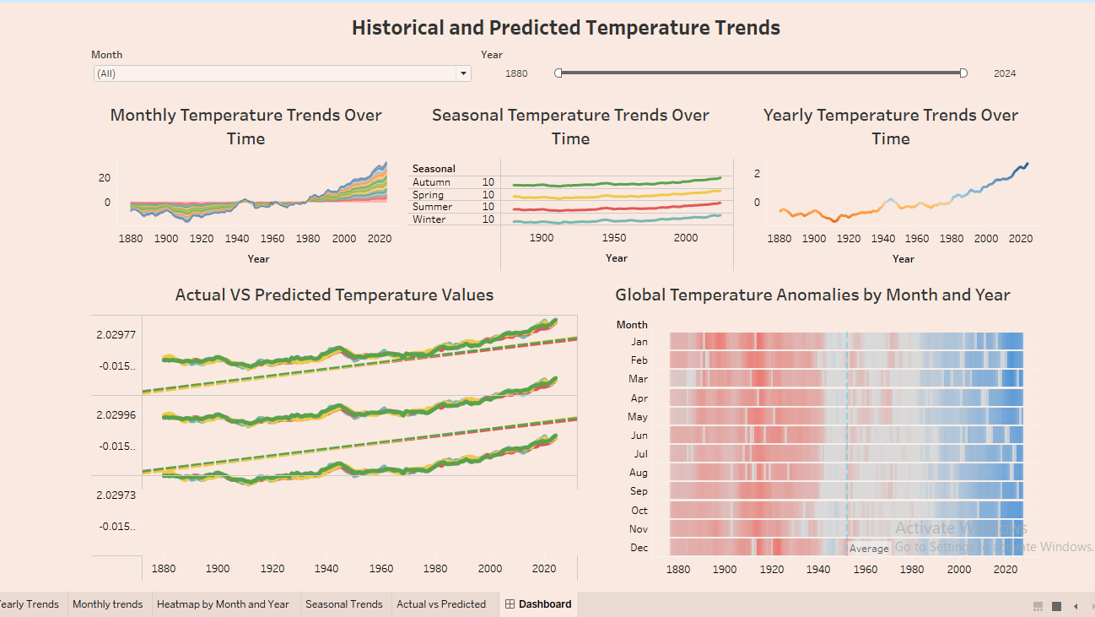
Tableau Dashboard

Slide 26

Tableau Dashboard
Key Insights of Dashboard-
Yearly Trends: Shows the overall trend of temperature anomalies.
Monthly and Seasonal Trends: Identifies seasonal variations.
Predicted vs. Actual Values: Evaluates model accuracy.
Heatmap of Anomalies: Shows warming & cooling patterns globally.
Dashboard Link- https://public.tableau.com/views/TemperatureAnomalyDashboard/Dashboard?:language=en-US&publish=yes&:sid=&:redirect=auth&:display_count=n&:origin=viz_share_link
GitHub Link-
https://github.com/muskan688

Slide 27

Key Insights and Future Scope
Key Takeaways:
Global warming trend is evident.
Temperature anomalies have increased significantly post-1950.
Our model accurately predicts future anomalies.
Future Enhancements:
Incorporate additional climate factors like CO₂ emissions.
Develop an API for real-time predictions.
Expand analysis with geospatial data.

Slide 28


