Slide 1

STATISTICAL ANALYSIS AND VISUALIZATION WITH PYTHON
MADE BY -MUSKAN

Slide 2

TABLE OF
CONTENT
Objective
Generation of Synthetic Data
Insights of Descriptive Statistics
Histograms and KDE Plots
Box Plots Interpretation
Correlation Matrix and Heat Map
Inference Statistics (T-Test)

Slide 3
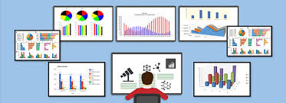
OBJECTIVE
This project aims to perform statistical analysis and data visualization using Python where we will generate a synthetic dataset, perform descriptive and inferential statistics, and visualize the results using Matplotlib and Seaborn.
We will use the following Python libraries:
• Pandas
• Numpy
• Matplotlib
• Seaborn

Slide 4
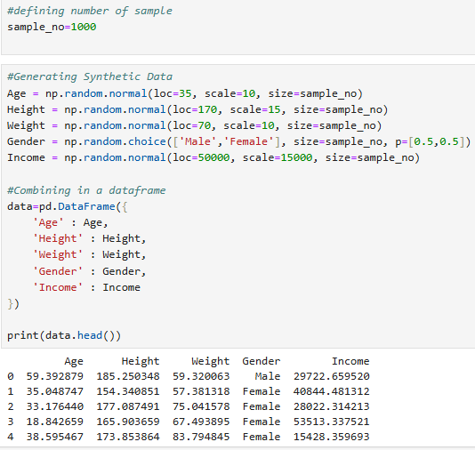
DATA GENERATION
Synthetic Data Generation
Define number of samples
Then generate data using NumPy (np.random.normal)
Then combining it to a data frame
Why are we using Normal Distribution here?
As they allow the simulation of data points with specific statistical properties which helps in closely resembling real-world phenomena.
Also, it works well with Machine Learning and statistical models

Slide 5
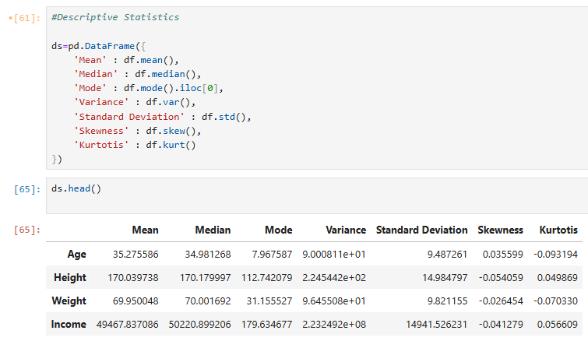
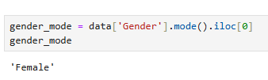
DESCRIPTIVE STATISTICS
As per the near-zero skewness and kurtosis, all variables are almost symmetric.
Income shows high variability than other variables.
Data is normally distributed, as decided while generating the data.
The Output of mode of Gender came out to be ‘Female’.

Slide 6
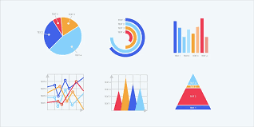
DATA
VISUALIZATION

Slide 7
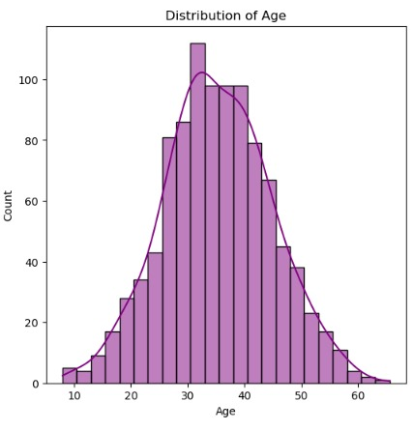
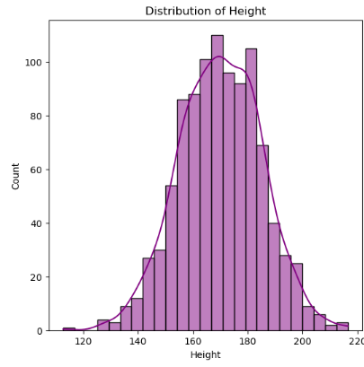
HISTOGRAMS AND KDE PLOTS
As per the skewness and kurtosis, the Age is normally distributed.
The most data is from 30-40 Age group.
As per the skewness and kurtosis, Height is also normally distributed.
The most people are between 160-180 cm height.

Slide 8
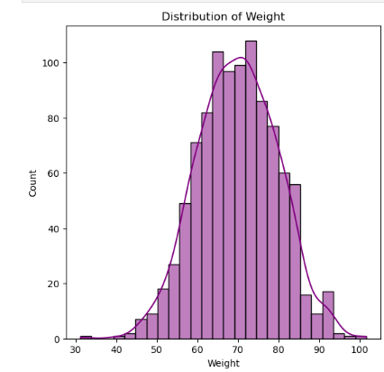
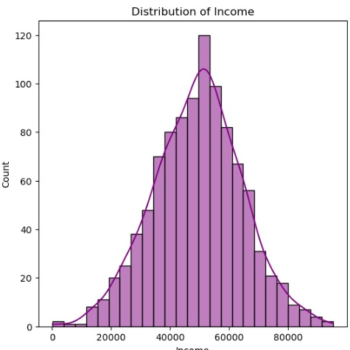
HISTOGRAMS AND KDE PLOTS
As the graph looks little negatively skewed but as per the value of skewness , the skew is negligible. So, it is also normally distributed.
The most people have weight between 60-74kg.
As per the skewness and kurtosis, the Income is also normally distributed
Highest income is between 42000-48000.

Slide 9
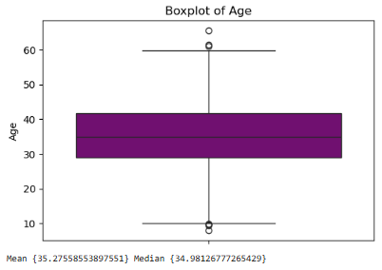
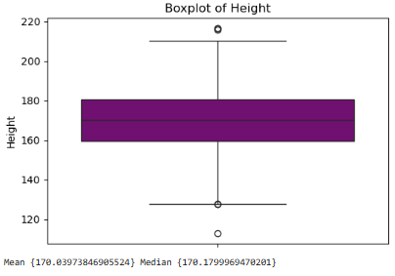
BOX PLOTS
Majority age falls between 10-60 years, with 50 % data between 30-40 years.
Upper outlier are affecting the mean, and pulling it upward.
Lower outliers have less impact on it.
This plot indicates that data is symmetrical.
Majority of the height is between 130cm-210cm.
These outliers are not affecting the mean too much.

Slide 10
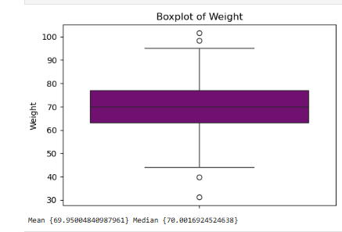
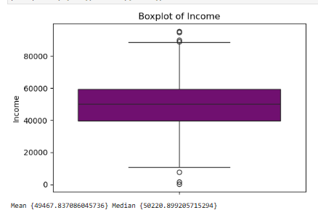
BOX PLOTS
Majority of the income falls between the lower and upper whiskers.
Outliers in both ends suggest some people are getting very high pay while some are getting very low.
Mean is slightly low than median. Maybe because low-income outliers pulling the mean downward.
The majority of weights are between 45kg-95kg.
The outliers on both the sides are not affecting mean much because it is close to median value.

Slide 11
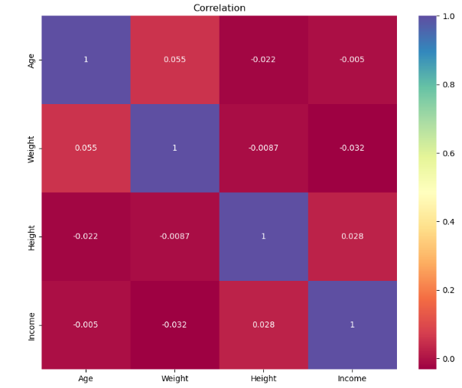
PEARSON COORELATION COEFFICIENT
The correlation values in the heatmap range from -0.032 to 0.055, which all are very close to 0.
A correlation near 0 indicates no linear relationship.
So, there is no significant correlation between any variables.

Slide 12
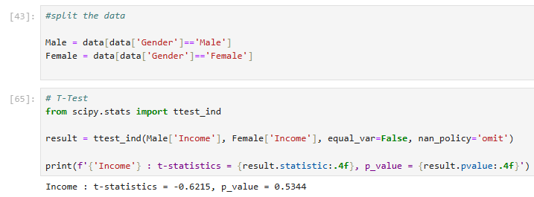
HYPOTHESIS TESTING (T-TEST)
As per the negative t-statistics value, it tells thar mean income of male is less than mean income of female.
As per the p value, it is > than 0.05. So, there is no statistically significant difference in the mean incomes between male and female.

Slide 13
