Slide 1
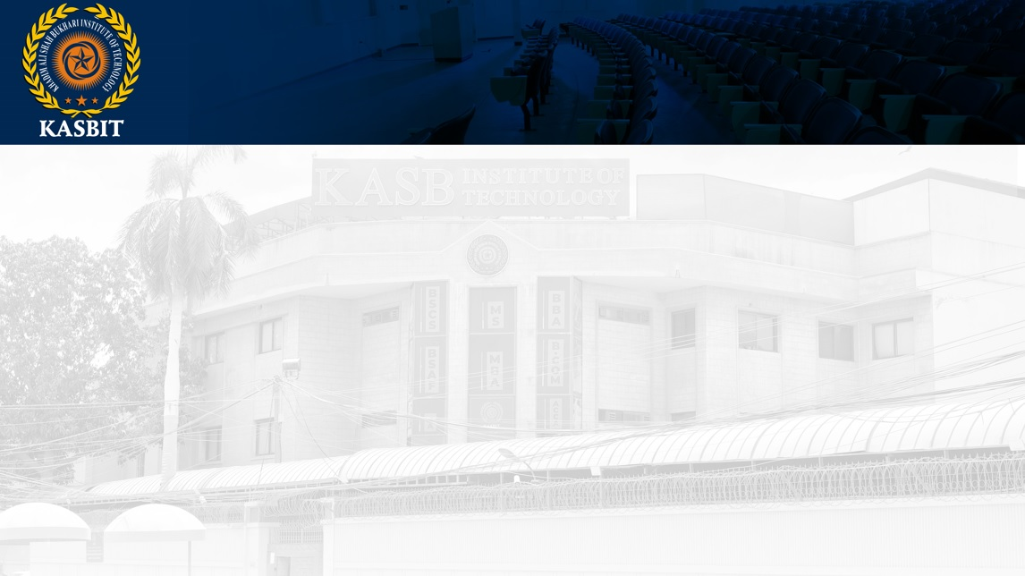
Fundamentals of Management
SESSION 13
BY
Azar Ejaz Ateeq

Slide 2
Chapter 7
CONTROLLING

Slide 3
Leaders
Leaders are people who are able to influence others and who possess managerial authority.
Leadership
Leadership is the art to of influencing and directing people in such a way that will win their obedience, confidence, respect and loyal cooperation in achieving common objectives.
Reference: Management, 14th Edition by Stephen P. Robbins,

Slide 4
Controlling
Controlling is a management function that involves comparing actual performance with planned performance and taking corrective action if needed, to ensure the objectives are achieved.
The Purpose of Control
To ensure that activities are completed in ways that lead to accomplishment of organizational goals.
Reference: Management, 14th Edition by Stephen P. Robbins,

Slide 5
Why Is Control Important?
Control is important in view of the many variables that can put things off track. Because anything involving human is imperfect, Management must use control to monitor progress and to make intelligent adjustments as required.
What Do Managers Measure?
Information
Operations
Finances
People
Reference: Management, 14th Edition by Stephen P. Robbins,

Slide 6
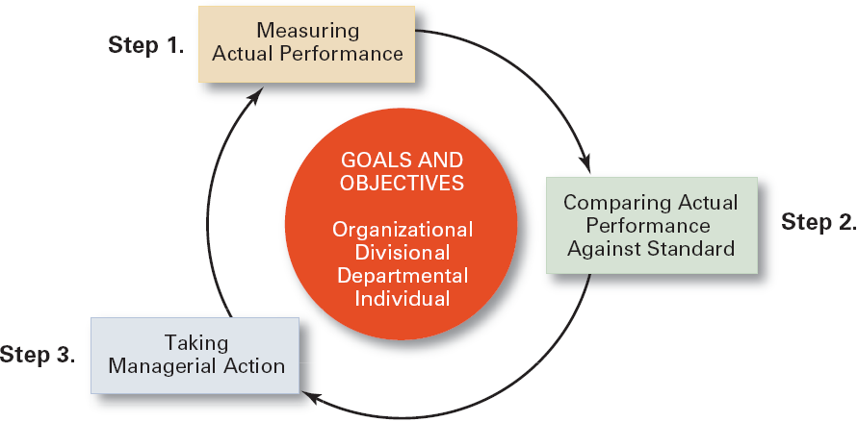
The Control Process
Measuring actual performance.
Comparing actual performance against a standard.
Taking action to correct deviations or inadequate standards.
Reference: Management, 14th Edition by Stephen P. Robbins,

Slide 7
THANK YOU

