Slide 1
BIOLOGY · COMPUTATION · PATTERNS
Introduction to Bioinformatics
How biological questions become data questions.
A first guide for undergraduate biology students

Slide 2
01
Bioinformatics turns biological questions into data questions
THE CORE IDEA
Use computation to store, compare, visualize, and interpret biological information.
It connects biology, computer science, statistics, and data interpretation.
Core idea: biological meaning emerges from patterns in biological data.
Biology becomes more useful when its information can be compared, searched, and interpreted.
2

Slide 3
WHY THE FIELD EXISTS
Biology is generating data faster than we can inspect it
Data at scale
Shared databases
From data to use
Modern genomics produces large, complex datasets that need computational methods.
Public databases make sequences, annotations, and publications searchable across research communities.
Bioinformatics makes biological information usable, not just stored.
3

Slide 4



THE CENTRAL DOGMA
The central dogma gives us the basic data vocabulary
DNA
Stores genetic information.
RNA
Carries and regulates information in cells.
Bioinformatics follows information across these molecules and asks what changes, where, and why.
Proteins
Perform many of the cell’s functions.
4

Slide 5




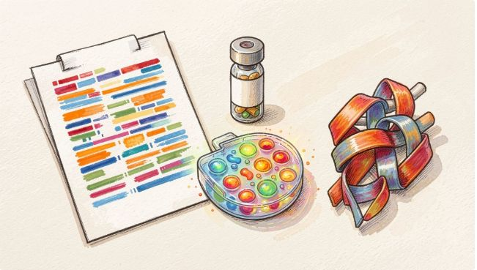
A REPEATING DATA LANDSCAPE
Four biological data types show up again and again
Sequences | DNA, RNA, and protein strings.
Annotations | Labels for genes, variants, functions, and genomic regions.
Expression data | Measurements of which genes are active.
Structures and interactions | The shapes and relationships that help explain function.
5

Slide 6
START WITH THE REPRESENTATION
A sequence is data before it is a story
Before interpretation, a biological sequence is a string over an alphabet.
DNA
Protein
Questions
A · C · G · T
A larger amino-acid alphabet.
Identity · similarity · variation · function
6

Slide 7

CONTEXT MAKES DATA MEANINGFUL
Sequence Record
Common resources include NCBI, Ensembl, and the UCSC Genome Browser. Always ask: what is the source, version, evidence, and meaning of an annotation?
Organism
Gene
Literature
Annotation
Links record to species
Associates sequences to genes
Connects to publications
Functional and metadata tags
Databases add context to biological data
7

Slide 8
COMPARING STRINGS
Alignment asks whether two sequences share a meaningful pattern
SEQUENCE A | A | C | G | T | A | C | G
MATCHES | │ | │ | │ | – | │ | × | │
SEQUENCE B | A | C | G | – | A | T | G
Read it as evidence — Similarity can suggest shared ancestry or related function. Alignment is evidence to interpret, not proof by itself.
Line up sequences to compare matching, missing, or changed positions.
8

Slide 9
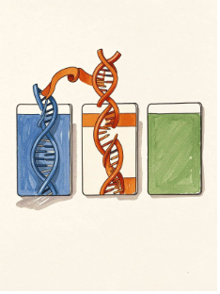
A FIRST LOOKUP
BLAST is a first lookup for an unknown sequence
Paste or upload: a nucleotide or protein sequence.
Search: a reference database for similar sequences.
Inspect: the strongest matches, scores, and biological annotations.
Interpret: return to the original question before drawing a conclusion.
Compare a nucleotide or protein sequence with a reference database to find similar sequences and useful annotations.
Keep asking
Does the match answer the original biological question?
9

Slide 10
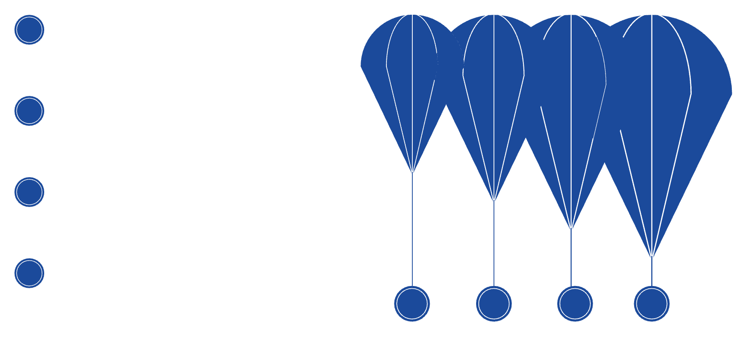
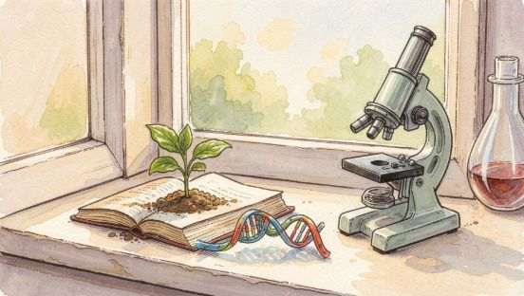
A typical analysis moves from question to interpretation
Define Question
Define the biological question and expected evidence
Collect Data
Collect or retrieve data
Prepare Inputs
Quality-check, clean, and organize inputs
Analyze & Interpret
Run analysis; visualize results and interpret in context.
The mental model: biological questions become data, tools reveal patterns, and interpretation reconnects those patterns to biology.
Examples include alignment, expression analysis, or variant calling; visualize results, test limitations, and interpret with biological context.
10

