Slide 1
JAVA WEB PROJECT / REVIEW 1
QuizNova
Java-Based Online Quiz and
Performance Management System
Student name:
Roll number:
Team:
QUIZNOVA / JAVA PRACTICE STUDIO
01
Notes:
Project title follows the submitted Review 0 screenshot. Student name, roll number and team are intentionally blank because these details were not supplied.

Slide 2
REVIEW 1
Problem and project scope
Java practice needs a reliable timer, useful feedback and controlled publishing.
Participant
Register, take approved quizzes, review answers and track performance.
Quiz creator
Prepare questions and explanations, submit content and review results.
Administrator
Manage accounts and roles, approve content and configure the platform.
QUIZNOVA / JAVA PRACTICE STUDIO
02
Notes:
Scope is four-option Java MCQs. Messages and in-app reminders support participants. Each role is authorized on the server. Requirements source: user-provided project specification and GUVI Review 1 screenshots.

Slide 3
SOLUTION DESIGN
Application architecture
Responsive browser UI
HTML, CSS, JavaScript, Three.js
Embedded Tomcat + Spring Security
Session, CSRF, role checks
REST controller
DispatcherServlet
PerformanceReportServlet
GET /reports/attempts/{id}
PlatformService + scoring policy
Rules, transactions and ownership
JdbcStore → database
H2 locally / PostgreSQL in cloud
QUIZNOVA / JAVA PRACTICE STUDIO
03
Notes:
Source: docs/ARCHITECTURE.md, SecurityConfig.java, ApiController.java, PlatformService.java, ReportWebConfiguration.java. Both request paths use the same authorized service rules.

Slide 4
DATABASE DESIGN
Database relationships
app_users
id PK · email UNIQUE
quizzes
id PK · creator_id FK
questions
id PK · quiz_id FK
messages
sender/recipient FKs
attempts
user/quiz FKs · deadline
answers
attempt + question PK/FKs
system_settings
single settings row
reminders
user/quiz FKs
Parent → referencing table. Reminders link users and quizzes.
QUIZNOVA / JAVA PRACTICE STUDIO
04
Notes:
Source: src/main/resources/schema.sql. Diagram summarizes key relationships; reminders reference app_users and quizzes, not attempts. Additional user references: attempts.participant_id and reviewed_by, messages.sender_id/recipient_id. All relationships and 8 tables are documented in docs/ARCHITECTURE.md.

Slide 5
DATABASE INTEGRATION
Prepared JDBC and transaction boundaries
Bound parameters keep submitted values separate from SQL.
connection.prepareStatement(sql, new String[] {"id"});
statement.setObject(i + 1, args[i]);
SELECT * FROM attempts WHERE id = ? FOR UPDATE
Portable persistence
Generated identities, foreign keys and indexed history queries.
Consistent writes
A transaction and row lock serialize answer saving and submission.
QUIZNOVA / JAVA PRACTICE STUDIO
05
Notes:
Code excerpts: JdbcStore.insert and PlatformService attempt locking. JdbcTemplate manages JDBC connections/resources and bound queries. schema.sql works with H2 and PostgreSQL; the CI postgres job executes the integration suite against PostgreSQL 17.

Slide 6
JAVA IMPLEMENTATION
Core Java concepts in working features
Interfaces and polymorphism
ScoringPolicy → MultipleChoiceScoringPolicy calculates quiz results.
Encapsulation and validation
QuizScore record validates score bounds and computes pass status.
Generics and collections
ReportFormatter<T>, queryForObject<T>, List<Map<String, Object>>.
Inheritance and exceptions
PerformanceReportServlet extends HttpServlet; controlled HTTP errors.
QUIZNOVA / JAVA PRACTICE STUDIO
06
Notes:
Sources: ScoringPolicy.java, MultipleChoiceScoringPolicy.java, QuizScore.java, ReportFormatter.java, TextReportFormatter.java, JdbcStore.java, PerformanceReportServlet.java. These are injected or called by real application paths. Explain exact pass comparison separately from rounded display percentages.

Slide 7
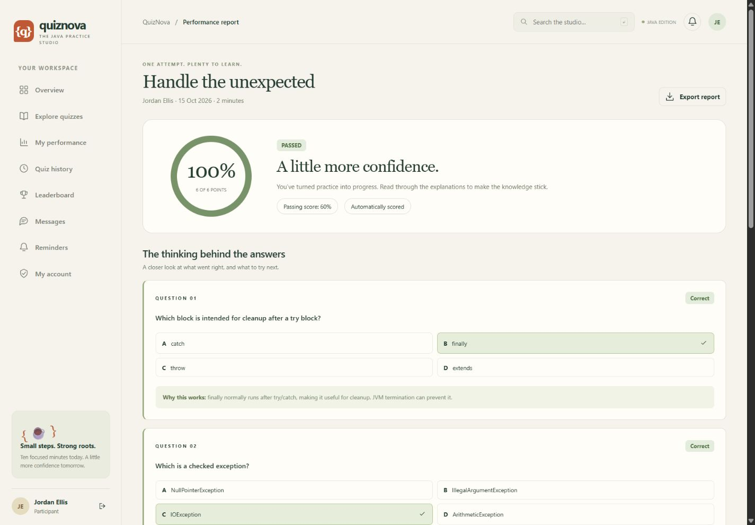
SERVLETS & WEB INTEGRATION
Servlet report export
GET /reports/attempts/{id}
Read authenticated principal
Validate path and ownership
Load a submitted result
Write a UTF-8 attachment
QUIZNOVA / JAVA PRACTICE STUDIO
07
Notes:
Actual application screenshot with local sample data. PerformanceReportServlet.doGet is registered by ReportWebConfiguration. ReportFormatter<Map<String,Object>> produces the text download. Real HTTP tests cover authorized export, anonymous 401, wrong owner 403 and invalid path 404.

Slide 8
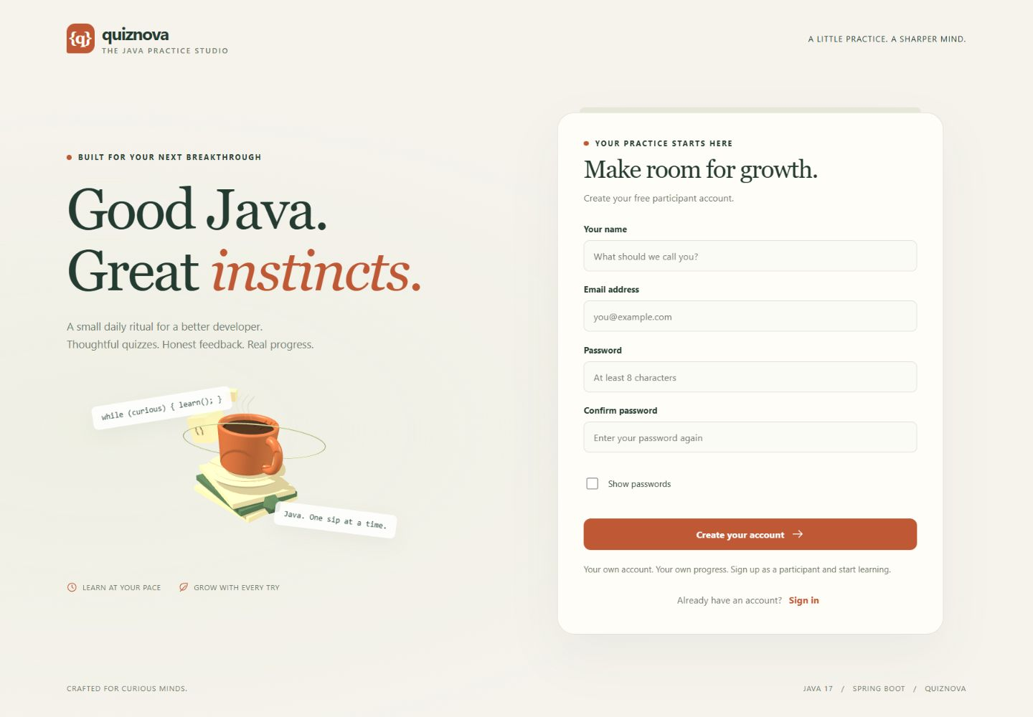
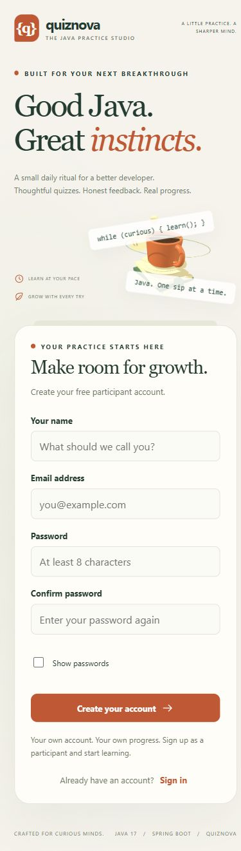
AUTHENTICATION & RESPONSIVE UI
Registration before participation
Participant signup → sign in → own workspace
QUIZNOVA / JAVA PRACTICE STUDIO
08
Notes:
Screenshots captured from the running local app at desktop 1440×1000 and mobile 390×844. Passwords are BCrypt hashed. Public registration always creates a Participant. Creators and other administrators are created by an administrator. Cloud bootstrap uses private environment configuration and disables sample accounts.

Slide 9
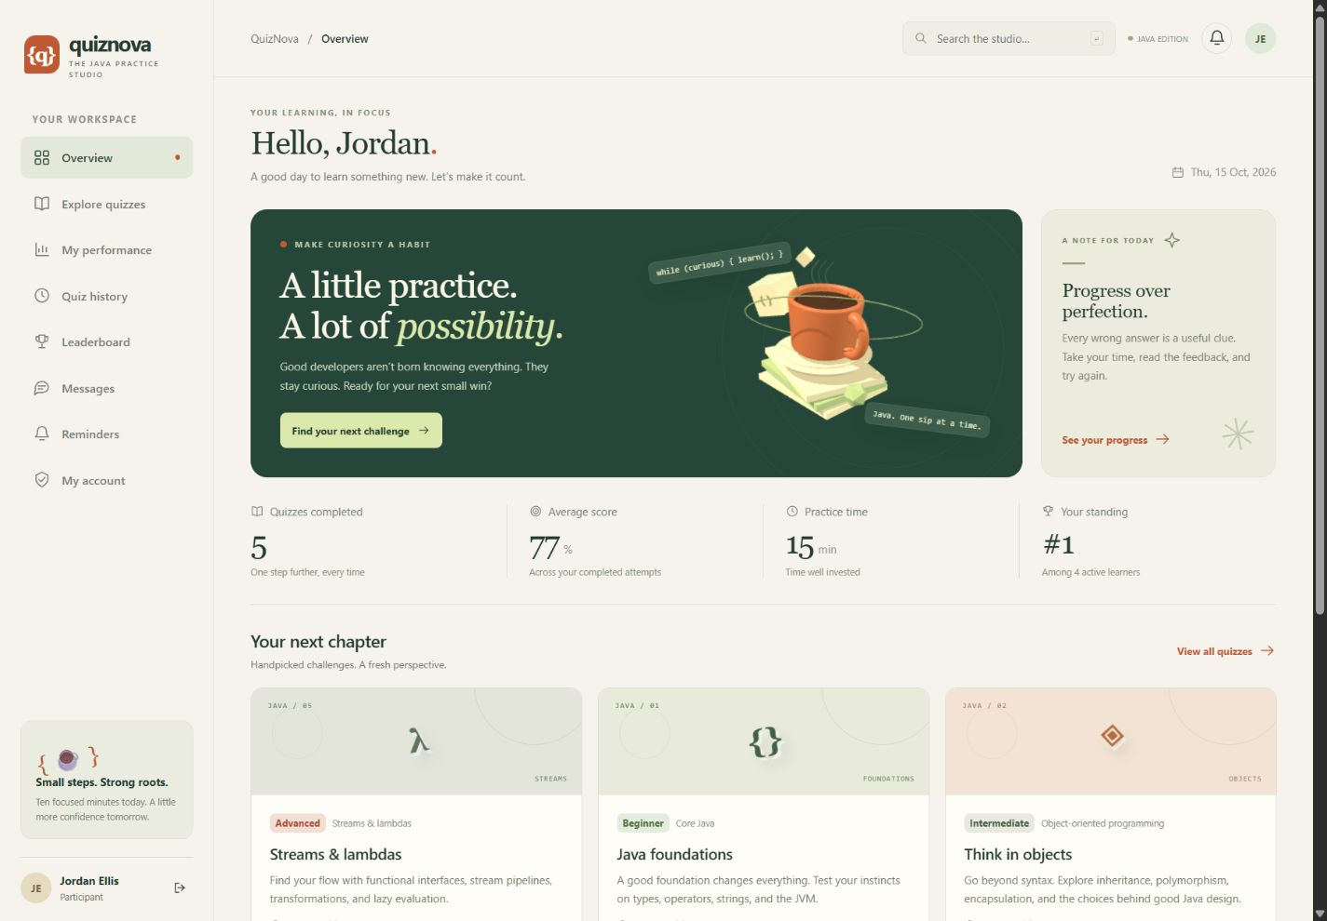
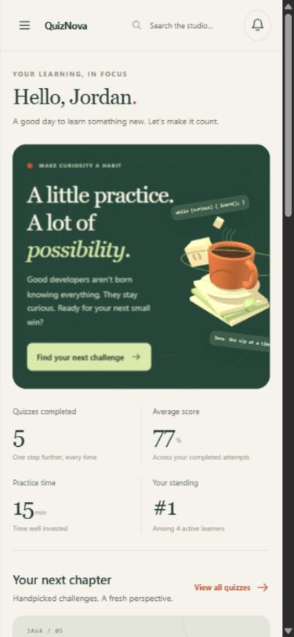
RESPONSIVE INTERFACE
Participant workspace
Approved quizzes, recent attempts and personal standing
QUIZNOVA / JAVA PRACTICE STUDIO
09
Notes:
Actual running app with local sample data. The interface uses ivory, forest and terracotta, editorial typography, and a Three.js cup/books scene. Mobile navigation, touch-sized controls, reduced-motion handling and WebGL fallback are implemented.

Slide 10
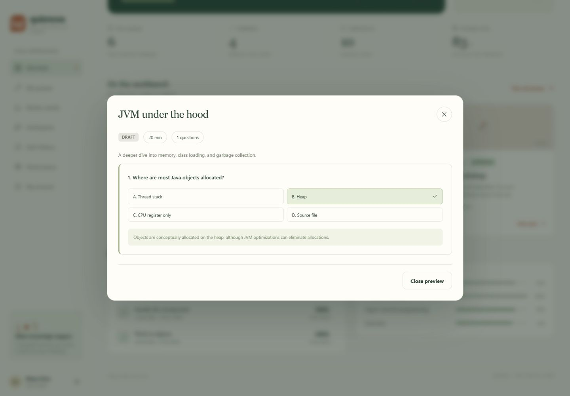
QUIZ CREATOR
Creator content and publication workflow
Draft
↓
Pending review
↓
Approved / rejected
Questions include four choices, an answer key and an explanation.
QUIZNOVA / JAVA PRACTICE STUDIO
10
Notes:
Screenshot: creator preview for the saved JVM draft. Creator can create/edit own content, submit for admin approval, review participant scores and send messages. Content with attempts cannot be rewritten, preserving historical answer meanings. Rejected content can be revised and resubmitted.

Slide 11
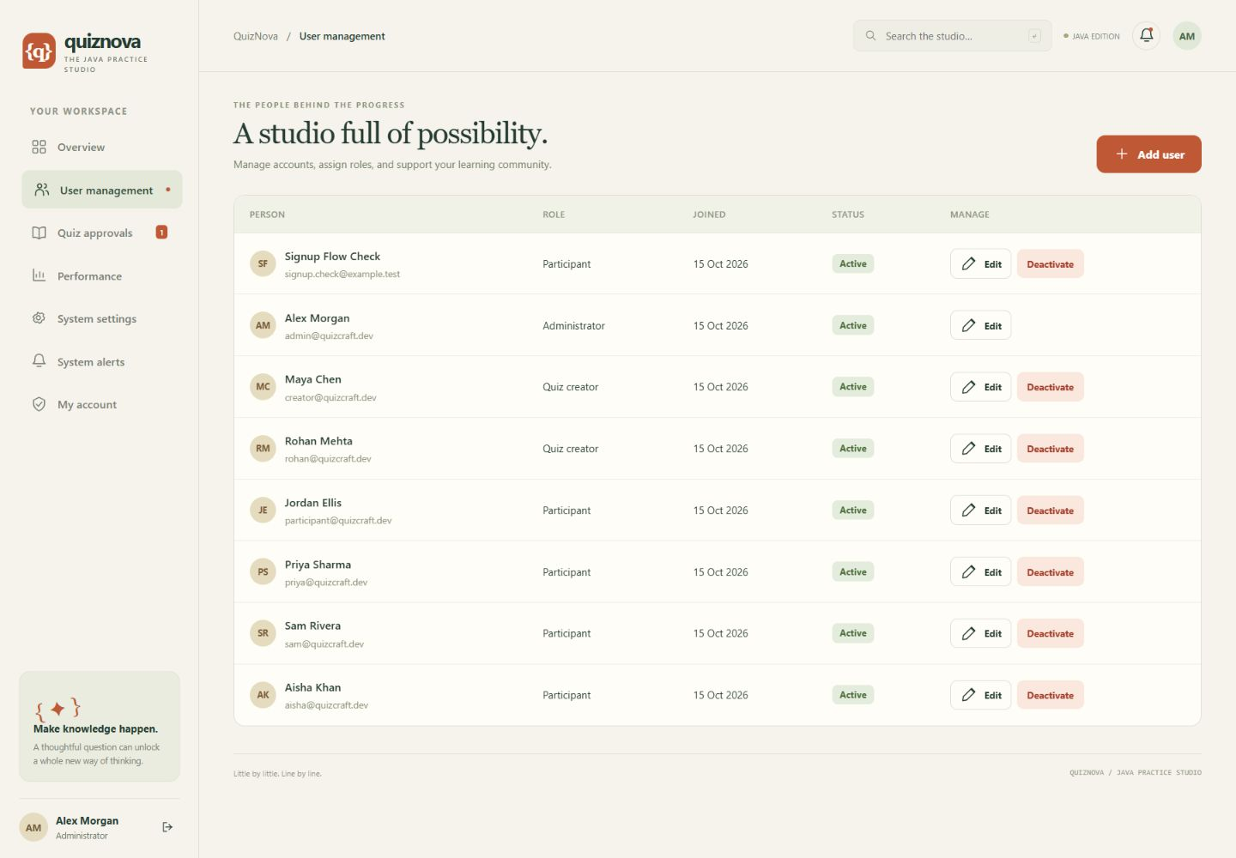
USER MANAGEMENT & MODERATION
Admin controls
Accounts and roles
Create users, assign creators and deactivate access.
Content and settings
Approve or return quizzes; manage pass and attempt settings.
QUIZNOVA / JAVA PRACTICE STUDIO
11
Notes:
Actual local sample accounts, including a signup verification account. User deletion is implemented as deactivation to preserve result history. Security changes invalidate existing sessions after the transaction commits. Admin approval, performance and system-alert views are also implemented.

Slide 12
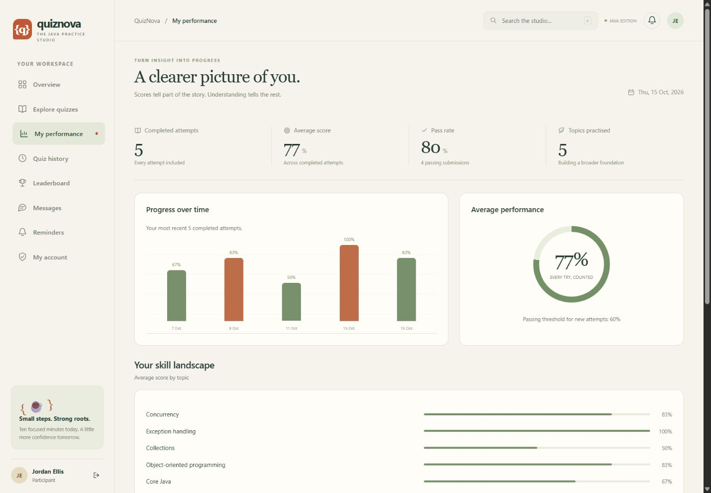
REPORTS & FEEDBACK
Performance across attempts
Scores over time
Topic averages
Pass rate
Answer explanations
Creator review feedback
QUIZNOVA / JAVA PRACTICE STUDIO
12
Notes:
Actual local sample-data screenshot; displayed results are demonstration records and local test attempts, not a student study or measured learning improvement. Automatic score remains available when a creator adds a manual score and feedback. Leaderboard uses the best completed result per quiz.

Slide 13
TEST EVIDENCE
Timing, concurrency and verification
21 tests passed
H2 suite and PostgreSQL CI both passed.
Server owns the deadline
Saved answers survive refresh; late choices cannot change a settled result.
Concurrent requests
Six simultaneous starts resolve to one active attempt using a database lock.
Access and lifecycle checks
Role/ownership, scoring, expiry, bootstrap and real servlet HTTP tests.
QUIZNOVA / JAVA PRACTICE STUDIO
13
Notes:
Verified local mvn test: PlatformIntegrationTest 15, AdminBootstrapTest 2, QuizScoreTest 2, ReportServletIntegrationTest 2; zero failures/errors. CI run: https://github.com/muskanbuilds11/java-online-quiz-platform/actions/runs/38771151801 (H2 and postgres succeeded). Scheduler settles expired attempts every 15 seconds; request-time checks enforce the exact server deadline.

Slide 14
REVIEW COVERAGE
Java web marking rubric
Criterion | Maximum | Evidence in this project
Problem understanding & design | 8 | Roles, architecture and database design
Core Java concepts | 10 | Interfaces, record, generics, exceptions
Database integration (JDBC) | 8 | Prepared JDBC, constraints, transactions
Servlets & web integration | 7 | REST routes and native report servlet
Total available | 33 | Reviewer awards the final score
This is the web rubric. The separate GUI rubric is a different category.
QUIZNOVA / JAVA PRACTICE STUDIO
14
Notes:
Source: user-provided GUVI marking rubric screenshot (codex-clipboard-d167d5dd-661d-44c3-a671-510c4ceb896e.png), Java Web Based Projects section. Maximum = 8 + 10 + 8 + 7 = 33. These are maximum available marks, not awarded or guaranteed marks.

Slide 15
DEMO & REPOSITORY
Run and review the project
Local requirements
Java 17 and Maven 3.9+; run mvn spring-boot:run.
Demo walkthrough
Register → sign in → take quiz → report → creator → admin approval.
Repository documentation
README, architecture, Review 1 evidence, deployment guide and viva notes.
github.com/muskanbuilds11/
java-online-quiz-platform
QUIZNOVA / JAVA PRACTICE STUDIO
15
Notes:
Public repository: https://github.com/muskanbuilds11/java-online-quiz-platform . Local directory D:/Java-Based-Online-Quiz-Platform. README gives sample account details for local review, run commands and configuration. These credentials are disabled by default in the cloud profile. Presentation and repository must be submitted through the review portal by the student; no portal submission is claimed.

Slide 16
DEMONSTRATION ACCESS
Local demo login credentials
Role | Email address
Administrator | admin@quizcraft.dev
Quiz creator | creator@quizcraft.dev
Participant | participant@quizcraft.dev
Password for all three: JavaLab@123
Normal users create an account first. Admin creates creator accounts.
QUIZNOVA / JAVA PRACTICE STUDIO
16
Notes:
These are optional local sample accounts only. Open http://127.0.0.1:8080/ and use Sign in. Sample credentials are documented in README and are disabled by default in the cloud profile. Real deployment credentials must be privately configured; do not reuse these demo passwords for a public deployment.

Slide 17
HOSTING
Cloud deployment
Render Free + Neon PostgreSQL
Java Docker service and a persistent PostgreSQL database in Singapore.
Private administrator access
Use the configured admin email and private password. Local demo logins stay local.
Free hosting behavior
The service sleeps after inactivity. Allow 50 seconds or more for a cold start.
https://quiznova-muskanbuilds11.onrender.com
QUIZNOVA / JAVA PRACTICE STUDIO
17
Notes:
Live deployment verified on 15 October 2026: https://quiznova-muskanbuilds11.onrender.com . Secrets stay in Render environment variables. Cloud demo accounts are disabled. Free hosting sources: https://render.com/docs/free and https://neon.com/pricing . Render free web services can sleep after inactivity and have ephemeral local storage; use external PostgreSQL instead of H2 files. Free services have usage limits and are suitable for a project demonstration. See docs/DEPLOYMENT.md.

