Slide 1
SECURE AI OFFICE
Plan, procure & operate
SMB networks — end to end.
An AI-native platform that turns business requirements into a working network — from sizing and BOM to topology, ordering, deployment and live monitoring.
Pitch Deck • 2026
Confidential

Slide 2
THE PROBLEM
SMB networks are still
planned in spreadsheets.
Most small and mid-sized businesses still rely on consultants, MSPs, or trial-and-error to design their office network. The result is slow procurement, mismatched gear, and operational blind spots after deployment.
73%
6 wks
62%
of SMBs delay network upgrades because they don't know what to buy
average lead time from initial quote to a deployed, working network
of SMB IT budgets get spent on hardware that's over- or under-sized
SECURE AI OFFICE
02 / 15

Slide 3
THE SOLUTION
One platform. Four guided steps.
From a 5-minute business intake to a live network you can monitor — Secure AI Office automates every link in the chain.
01
02
03
04
Business Intake
AI Sizing
BOM + Diagram
Order & Monitor
Capture industry, headcount, sites, security needs in 5 minutes.
Deterministic formulas + AI advisor recommend AP, switch & router counts.
Auto-generated bill of materials and customer-friendly topology.
One-click cart, vendor fulfillment, and Zabbix-powered live monitoring.
SECURE AI OFFICE
03 / 15

Slide 4
PRODUCT
What the customer actually sees.
1
Guided intake
secureaioffice.app/builder
Smart forms with industry presets and conditional questions.
2
Live BOM table
Network Design Builder
Vendor-linked SKUs with real prices and one-click add-to-cart.
Auto-generated for Acme Dental — 2 sites, 24 staff
3
Topology preview
ESTIMATED CAPEX
AP COUNT
BOM LINES
Drawio-rendered diagram so non-technical buyers can sign off.
$8,420
6
14
4
Cart → quote → order
Same workflow procurement teams already understand.
Bill of Materials
5
Post-deploy ops
UAP-AC-PRO
Qty 6
$1,194
Zabbix dashboards stitched directly into the customer portal.
USW-24-POE
Qty 1
$679
+ 12 more items
Add all to cart
SECURE AI OFFICE
04 / 15

Slide 5
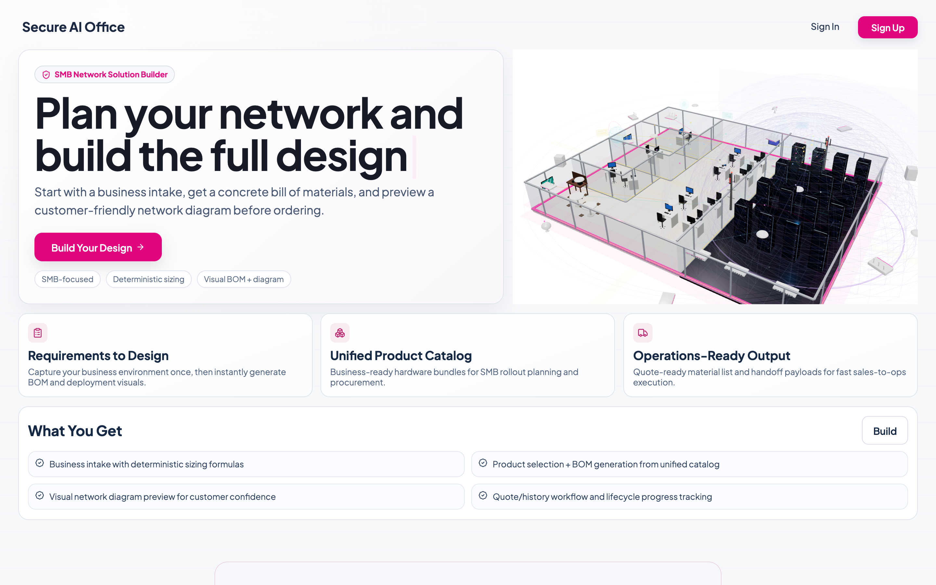
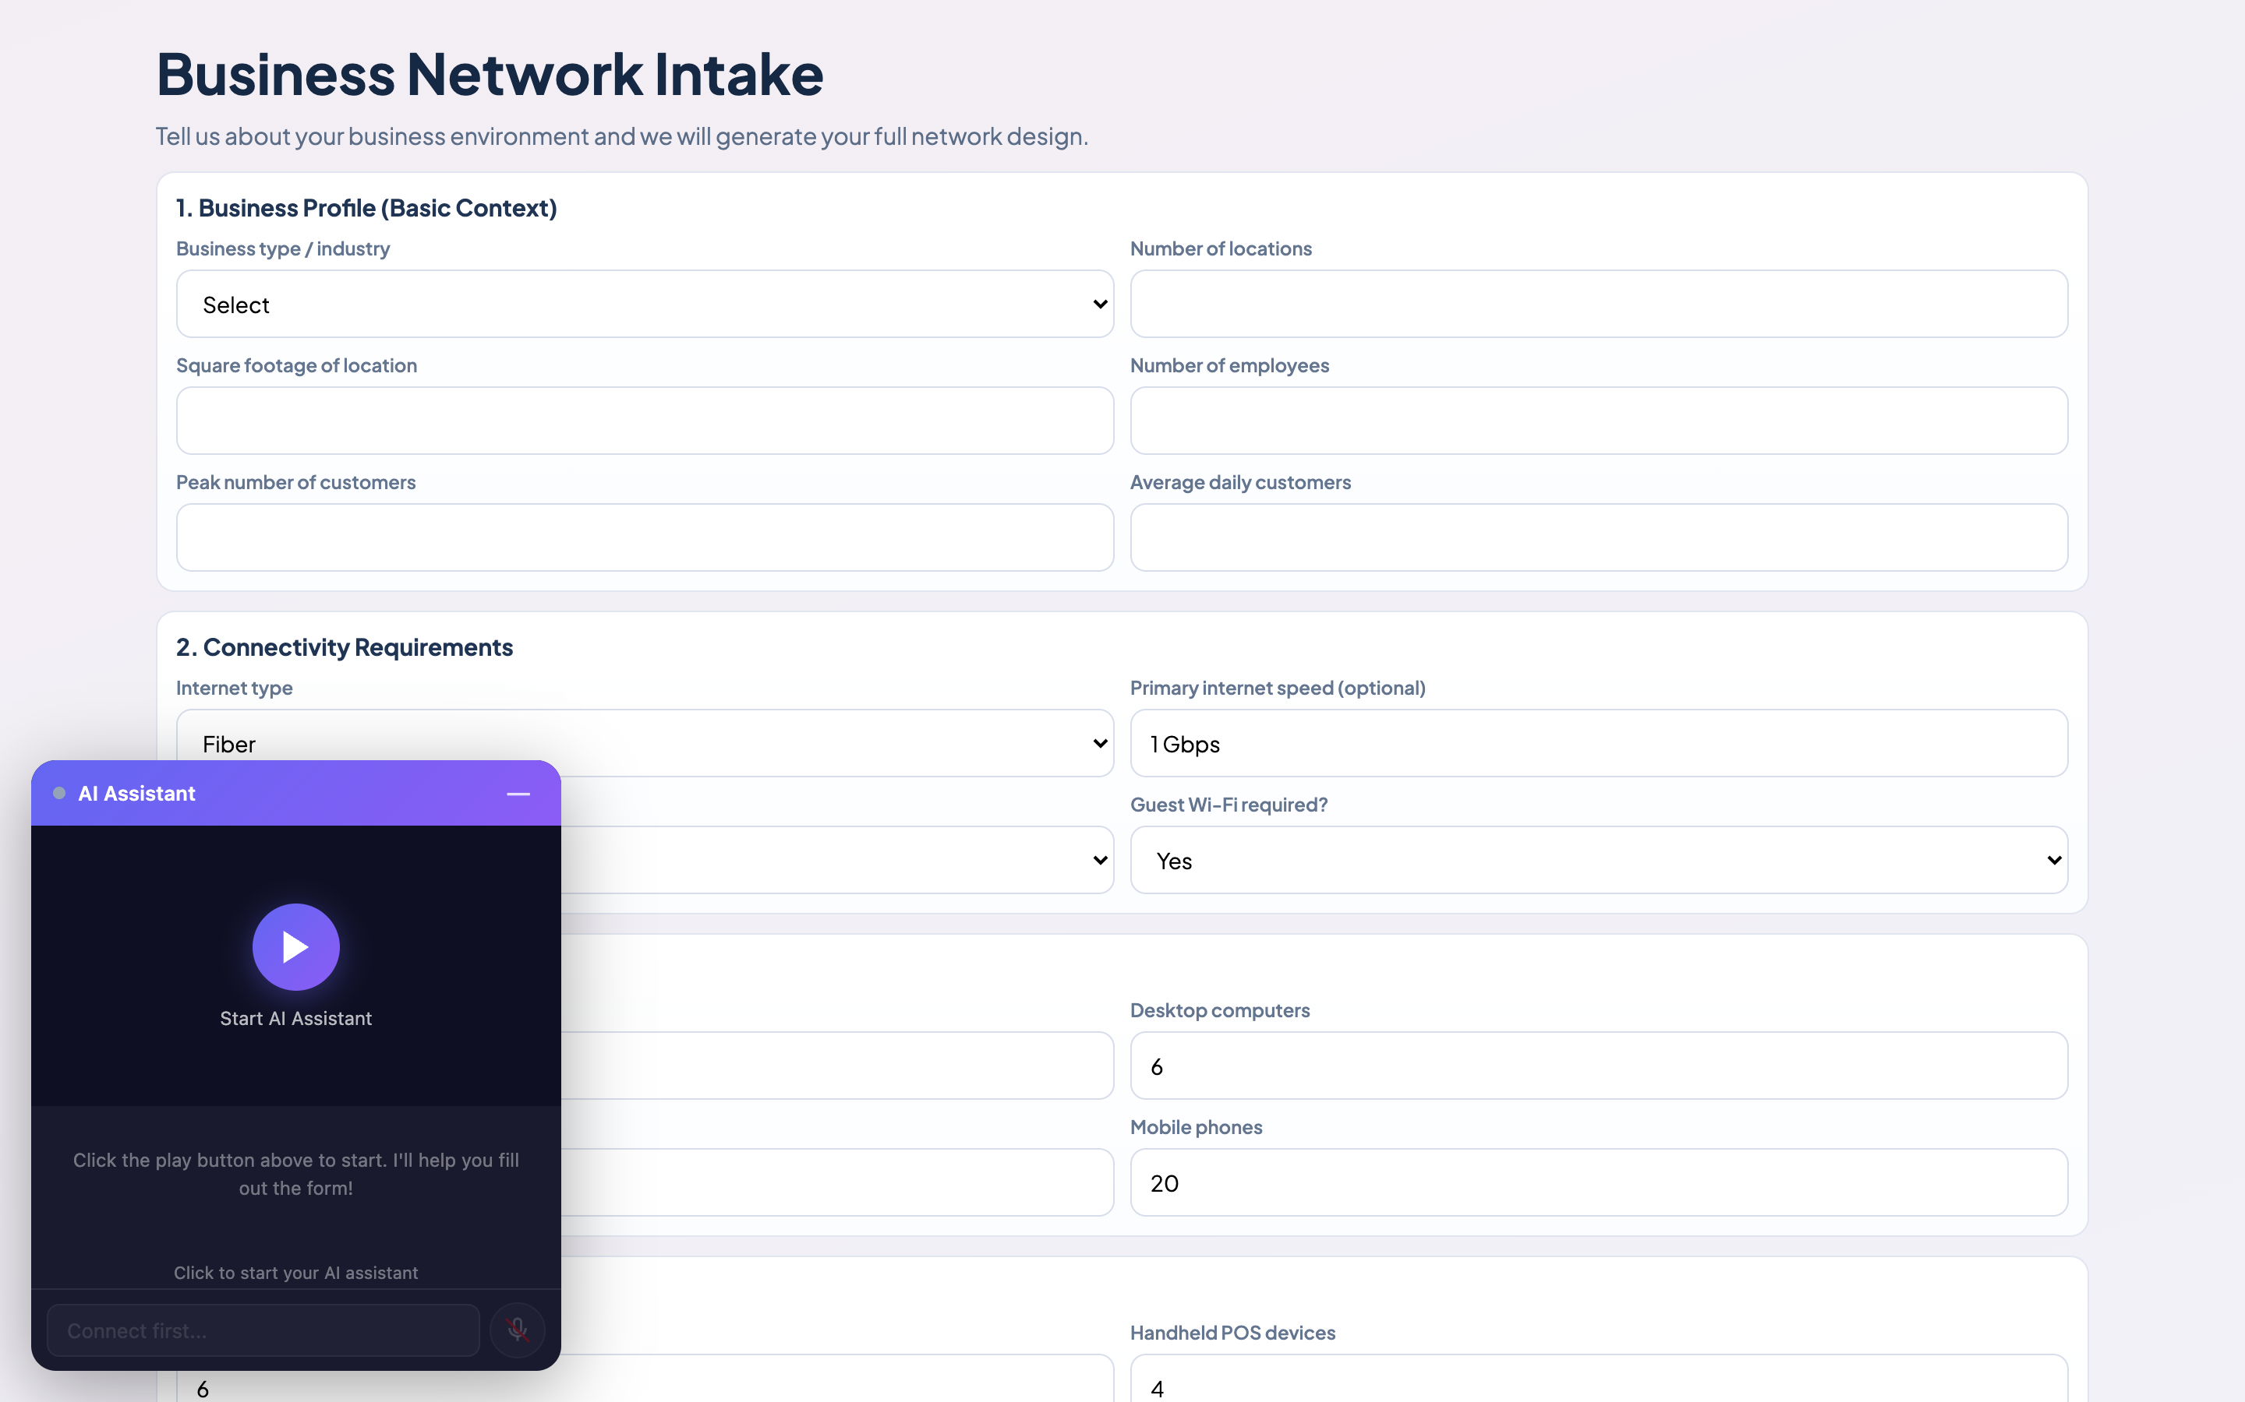
INSIDE THE PRODUCT — DESIGN
Customers go from blank page to BOM.
Marketing landing leads into an AI-assisted intake. Five minutes of answers becomes a sized network design.
PUBLIC LANDING
AI-GUIDED INTAKE
First impression and clear value proposition.
AI Assistant rides along with every form field.
SECURE AI OFFICE
05 / 15

Slide 6
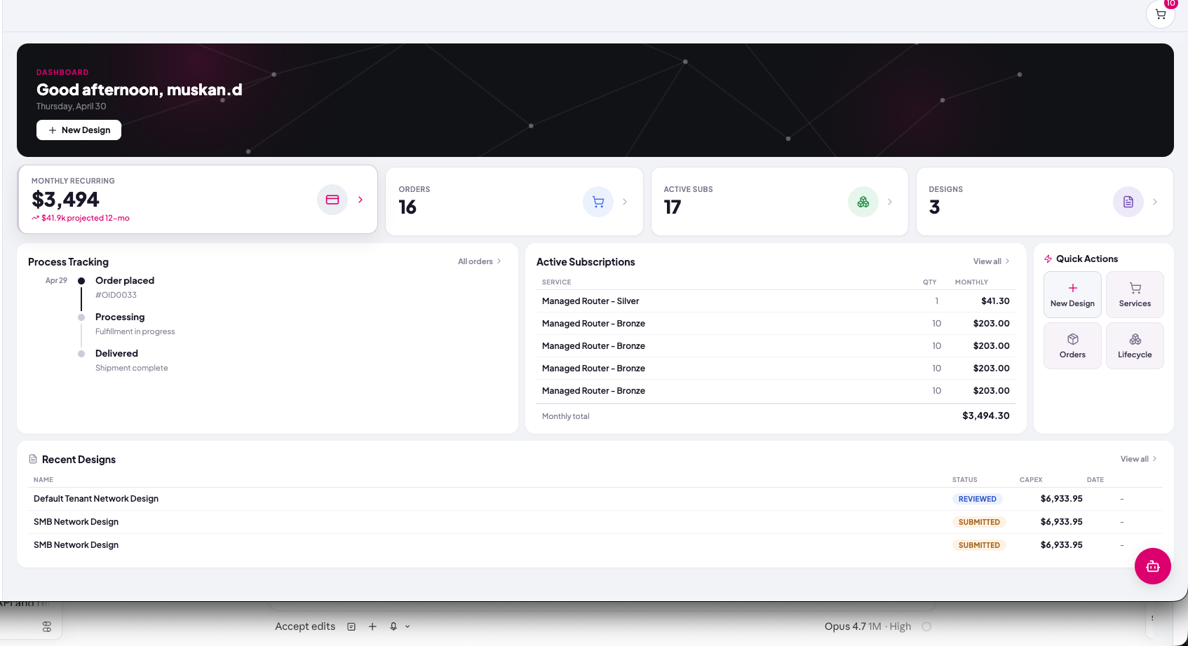
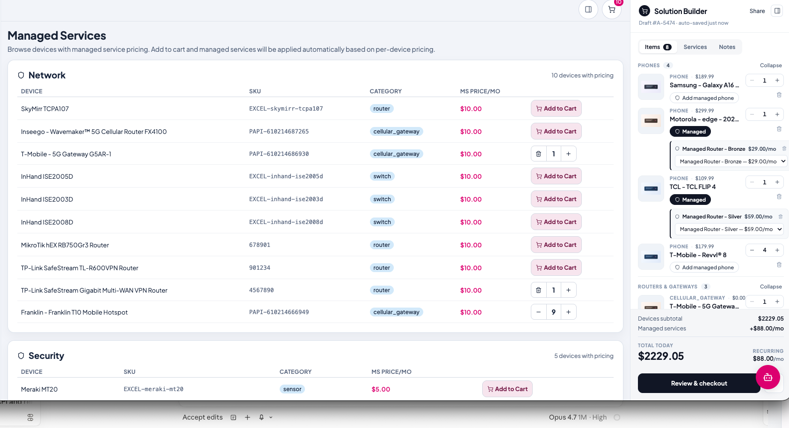
INSIDE THE PRODUCT — OPERATE
After the sale, the platform earns its keep.
A live customer dashboard tracks orders and recurring spend. Managed services flow into the same cart so every device can become a subscription.
CUSTOMER DASHBOARD
MANAGED SERVICES + CART
Recurring revenue, orders, active subs and recent designs at a glance.
Per-device managed pricing rolls into the same checkout flow.
SECURE AI OFFICE
06 / 15

Slide 7
CAPABILITIES
Six pillars, one workflow.
B
S
C
Business Intake
Deterministic Sizing
BOM Generator
Industry templates, conditional logic and security profiles built in.
Formulas (not vibes) translate headcount + sq ft into AP/switch counts.
Catalog-linked SKUs from real vendors with live pricing.
T
M
Z
Topology Diagrams
Vendor Marketplace
Live Monitoring
Drawio export so customers can review and approve visually.
Multi-vendor catalog (CellHub) — sell, fulfill, manage commissions.
Zabbix-powered health dashboards stitched into the customer portal.
SECURE AI OFFICE
07 / 15

Slide 8
AI AT THE CORE
Not a chatbot bolted on.
AI runs the whole pipeline.
Every step from intake to operations is enriched by purpose-built AI: a live consultant avatar, a contextual chatbot, automatic topology synthesis, and intelligent catalog matching against thousands of SKUs.
Anam Avatar
Contextual Chatbot
Topology Synthesis
Catalog Matching
Live AI consultant walks customers through intake and trade-offs.
Answers product, pricing and topology questions in-page.
AI assembles a Drawio diagram from raw BOM data.
Embeddings map fuzzy requirements to real vendor SKUs.
SECURE AI OFFICE
08 / 15

Slide 9
AI DESIGN FLOW
Customers design with AI, not against it.
An AI Assistant rides along through every step — interpreting answers, suggesting hardware, generating diagrams, and explaining trade-offs in plain English.
1
Answer in plain English
Customer types or speaks their requirements. AI fills the structured form behind the scenes.
2
AI sizes the network
Recommends AP, switch, router and security counts based on industry, headcount, square footage.
3
AI builds the topology
Generates a Drawio network diagram from the BOM — placement, links, labels, all auto-laid-out.
4
AI explains and adjusts
Customer can ask 'why this AP model?' or 'what if I add a second site?' and AI revises live.
Live AI Assistant in production today
SECURE AI OFFICE
09 / 15

Slide 10
MARKET
Built for the long tail.
33.2M
Wedge: under-served office segments
Where a deterministic builder + AI consultant beats hiring an MSP.
Professional services (1–50)
12.6M
Retail & hospitality
7.3M
U.S. small businesses
Healthcare & wellness
4.6M
Each one needs a network. Almost none of them have a dedicated network engineer.
Trades & manufacturing
5.9M
Other
2.8M
SECURE AI OFFICE
10 / 15

Slide 11
BUSINESS MODEL
Three ways we make money.
A SaaS subscription gets businesses planning. A marketplace fee captures procurement. Managed services lock in long-term recurring revenue.
MOST POPULAR
STARTER
PRO
ENTERPRISE
Free
$79
Custom
Self-serve
per office, per month
Annual contract
•
Business intake
•
Unlimited designs & sites
•
Multi-tenant org accounts
•
BOM preview
•
Vendor checkout & quotes
•
Managed services included
•
Single design
•
Live topology export
•
Dedicated CSM + SLA
•
Community support
•
Email + chat support
•
On-prem Zabbix integration
SECURE AI OFFICE
11 / 15

Slide 12
TRACTION & ROADMAP
Shipping fast, with a clear path.
v1.0
120+
9
Shipped Q1 2026 — full intake → BOM → diagram → cart
Pilot offices currently designed in the system
Vendors active in the marketplace catalog
12-month roadmap
Q2 '26
Q3 '26
Q4 '26
Q1 '27
Vendor onboarding flow
Live ops monitoring
Multi-tenant orgs
AI deployment runbook
Self-serve vendor portal + commission engine
Zabbix integration generally available
MSPs manage multiple customers from one console
Auto-generate install scripts and configs from BOM
SECURE AI OFFICE
12 / 15

Slide 13
WHY WE WIN
Faster than an MSP, smarter than DIY.
vs. Traditional MSP
vs. DIY (spreadsheets + reseller)
We deliver a finished BOM in minutes, not weeks. Customers stay in control instead of waiting for an account manager.
Deterministic sizing prevents over-/under-buying. Customers don't need to learn networking jargon.
vs. Vendor configurators
vs. Generic AI chatbots
We're vendor-agnostic. Best-fit hardware from a multi-vendor catalog, not whatever the rep is selling.
We close the loop — AI doesn't just suggest, it generates a real BOM, real diagram and a real order.
SECURE AI OFFICE
13 / 15

Slide 14
THE TEAM
Operators who have shipped this before.
M
S
P
Muskan
Co-founder
Advisor
AI Engineer & Co-Founder
Engineering
Product & GTM
Leads the AI pipeline — intake, sizing, topology synthesis. Previously AI engineer at Sensitek.
Full-stack platform, vendor marketplace and Zabbix monitoring integration.
Two-time SMB SaaS founder. Brings playbook for vendor onboarding and channel sales.
SECURE AI OFFICE
14 / 15

Slide 15
THE ASK
Let's secure
10,000 offices together.
Raising a $3M seed to scale vendor onboarding, ship multi-tenant orgs, and reach 1,000 paying offices by year end.
45%
30%
15%
10%
Engineering & AI
GTM & Vendor Ops
Customer Success
Reserves
hello@secureaioffice.com
secureaioffice.com

