Slide 1





International Business Research Project
EXPLORING THE IMPACT OF AUGMENTED REALITY (AR) IN TRANSFORMING ONLINE SHOPPING EXPERIENCES.
TERM -2
Presented By:
MUSKAN GUPTA
MS25MM049

Slide 2


Brief introduction
Research objectives
Brief summary of literature review
Research methodology and research framework
Data analysis and interpretation
Segmentation and Personas
Framework
Key findings and conclusions
Managerial Implications & Recommendations
Limitations and future scope of study
AGENDA

Slide 3

INTRODUCTION
Augmented Reality (AR) is an immersive digital technology that overlays virtual
elements onto the real world, enabling consumers to interact with products in real time and transforming traditional online shopping experiences.
Rapid growth of e-commerce has reshaped how consumers shop online
Online shopping lacks physical interaction, increasing uncertainty and perceived risk
Fashion retail faces challenges related to fit, appearance, and purchase confidence
AR enables interactive product visualisation through virtual try-on features
AR try-on tools are increasingly adopted to enhance online shopping experiences

Slide 4


RESEARCH PROBLEM AND OBJECTIVES
Despite the growing adoption of AR in online shopping, limited empirical research explains how AR influences customer trust and marketing outcomes, particularly considering the critical role of perceived accuracy in online fashion retail.
To examine the impact of AR try-on experience on technology acceptance beliefs
To analyse the mediating role of customer trust
To evaluate the effect of AR on customer engagement
To examine the impact of trust on purchase intention
To examine the role of perceived accuracy of AR in influencing customer trust and purchase decisions

Slide 5
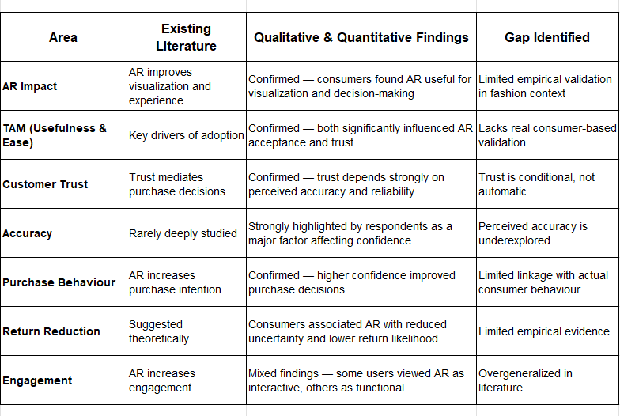
LITERATURE REVIEW AND GAPS

Slide 6
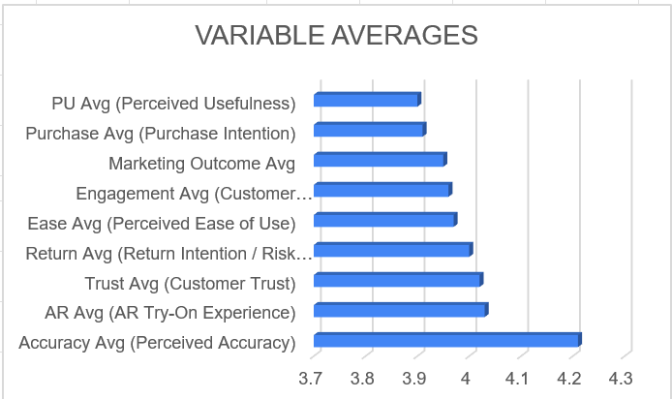

QUANTITATIVE ANALYSIS
Target population: Online fashion shoppers
Data collection tool: Structured online questionnaire
Sampling technique: Purposive sampling
( respondents have prior AR try-on experience)
Sample size: 162 respondents
Total valid responses used for analysis: 140
The highest average was Perceived Accuracy (4.21), showing respondents strongly value accurate AR visualization and fit prediction.
Customer Trust (4.02) and AR Experience (4.03) were also high, indicating positive acceptance of AR technologies.
Overall, all averages are close to 4, which suggests generally positive consumer perception toward AR-enabled online shopping experiences.

Slide 7

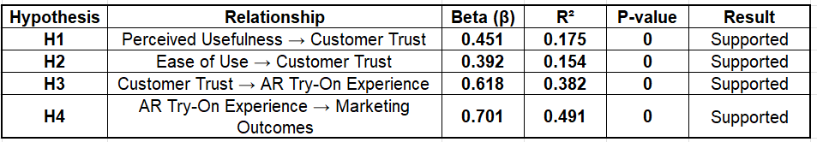
REGRESSION ANALYSIS RESULTS
✔ Perceived usefulness positively influenced customer trust.
✔ Ease of use also strengthened trust toward AR platforms.
✔ Customer trust significantly enhanced AR try-on experience.
✔ AR try-on experience showed the strongest impact on marketing outcomes.
✔ All hypotheses were supported as p-value < 0.05.

Slide 8
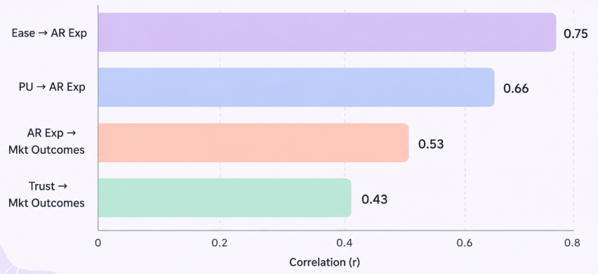
CORRELATION RELATIONSHIPS
The analysis shows positive correlations among all variables. Ease of Use has the strongest relationship with AR Experience (r = 0.75).

Slide 9
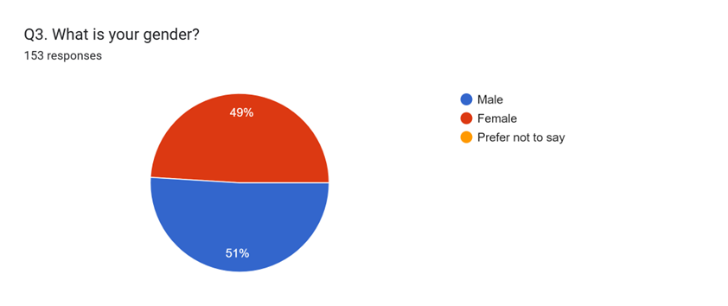
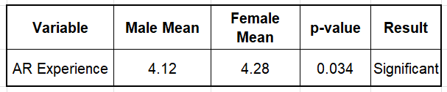
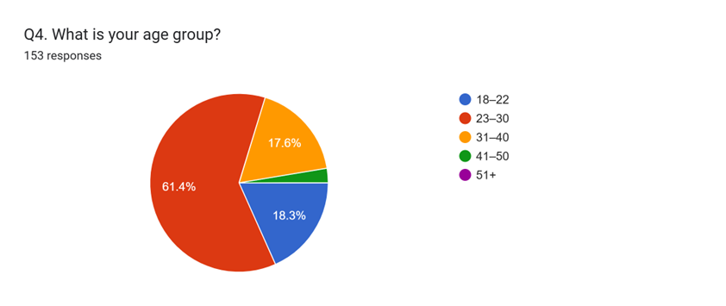
T-TEST RESULTS
GENDER
Female respondents showed slightly higher AR experience scores than male respondents.
• The p-value (0.034) indicates a statistically significant difference between groups.
• Findings suggest that demographic factors may influence AR adoption behaviour.
AGE

Slide 10

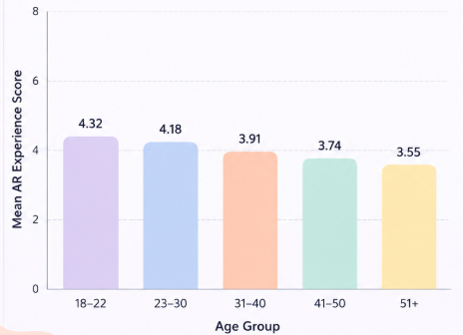


ONE-WAY ANOVA ANALYSIS
To examine whether different age groups show significant differences in their AR Try-On Experience.
Younger respondents reported higher AR experience scores compared to older age groups.
The ANOVA results showed a statistically significant difference (p < 0.05).
This suggests that age influences consumer perception and adoption of AR technologies.
Younger users may enjoy AR more
Older users may find it difficult
Age Group vs AR Experience

Slide 11

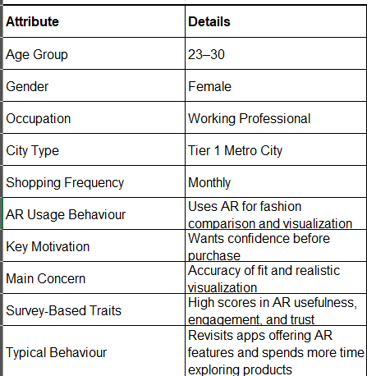

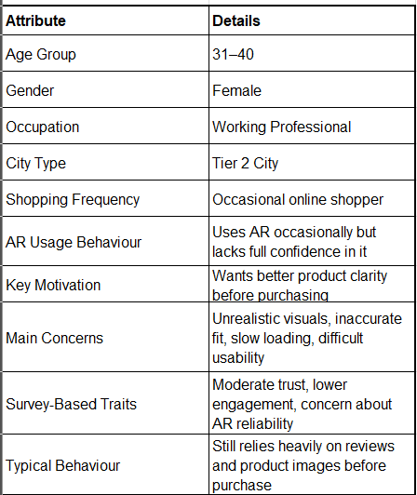
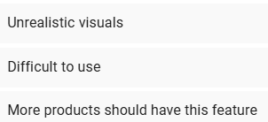
SEGMENTATION
PERSONAS
PERSONA 1
Younger consumers
Frequent online shoppers
High AR engagement
Positive ease of use perception
Riya Sharma:
The Digital Fashion Explorer
Tech-Driven Explorers
Value fit accuracy
Strong trust dependence
Use AR before purchase decisions
Accuracy
Oriented
Buyers
PERSONA 2
Neha Kapoor:
The Skeptical Shopper
Moderate AR adoption
Concerned about reliability
Depend on reviews
Cautious Functional Users

Slide 12

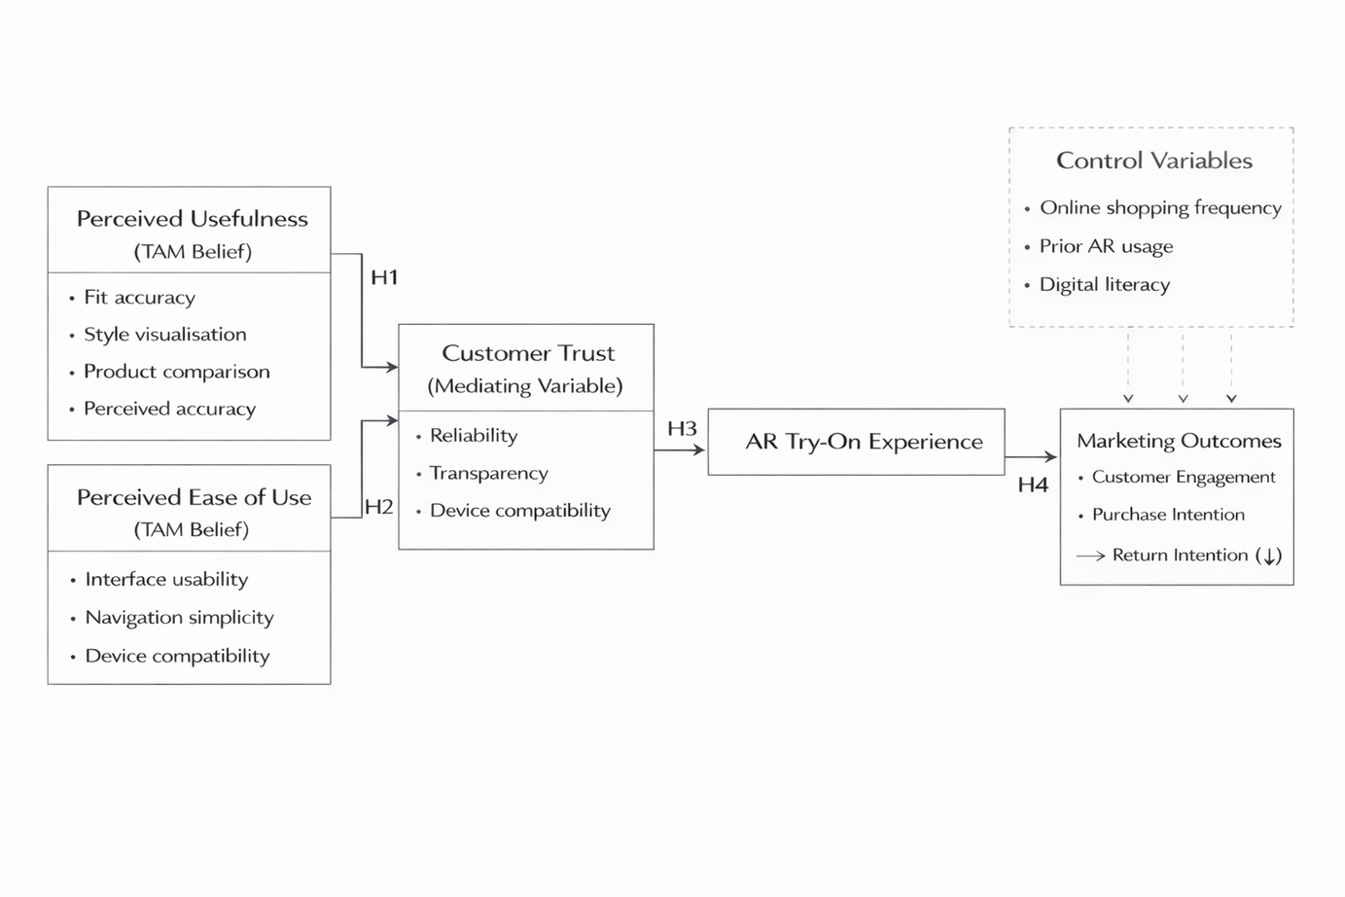
FRAMEWORK
The responses validated and strengthened the framework.
Perceived Accuracy emerged as an important dimension within Perceived Usefulness.

Slide 13

KEY FINDINGS & CONCLUSION
Key Findings
Conclusion
Perceived usefulness was the strongest factor influencing AR adoption.
Customer trust significantly impacted AR experience and purchase behaviour.
Perceived accuracy emerged as an important factor affecting trust and confidence.
Regression analysis confirmed positive impact of AR on marketing outcomes.
Younger consumers showed higher engagement with AR technologies.
AR Try-On Experience positively influences customer engagement and purchase intention.
TAM constructs (usefulness & ease of use) strongly support AR adoption.
Accurate and realistic AR experiences improve consumer confidence and reduce uncertainty.

Slide 14
MANAGERIAL IMPLICATIONS & RECOMMENDATIONS
Managerial Implications
Recommendations
Retailers can use AR to improve customer confidence and reduce uncertainty.
Brands should focus on realistic visualization and fit accuracy.
AR can increase engagement, product exploration, and purchase intention.
Customer personas can help brands personalize AR experiences.
Improve fit accuracy and realism of AR features.
Reduce slow loading and usability barriers.
Expand AR availability across more product categories.
Integrate AI with AR for personalized shopping experiences.

Slide 15
LIMITATIONS & FUTURE SCOPE
Limitations
Study focused mainly on Indian consumers with prior AR exposure.
Sample was concentrated among younger online shoppers.
Responses were perception-based and may include subjective bias.
Research focused primarily on online fashion retail.
Future Scope
Explore AR adoption in beauty, furniture, and luxury retail.
Conduct cross-cultural or international comparative studies.
Study AI personalization and metaverse-based shopping experiences.
Include additional variables such as perceived enjoyment and satisfaction.

Slide 16

THANK YOU
VERY MUCH !

