Slide 1


IOTA WATER
BLUE OCEAN STRATEGY
Submit to - Dr. Umesh Kothari
GMUSKAN GUPTA

Slide 2

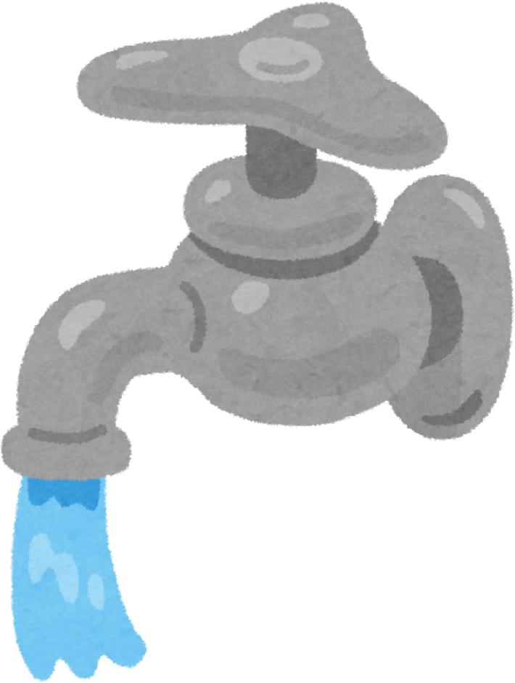
Introduction
Strategic Shift: Moves the UAE water sector entry-level filtration to a new "Functionalized Water Infrastructure" category.
Technological Edge: Utilizes the NICO Nanobubble platform to maximize dissolved oxygen and enable cost-efficient, on-site oxygen generation without heavy chemical reliance.
B2B Market Focus: Targets decentralized industries like healthcare and education, providing high-quality, specialized water that integrates directly into existing facility infrastructure.

Slide 3
Problem Addressed
Infrastructure Gaps: Addressing the need for high-quality water in decentralized locations.
System Reliance: Leveraging the widespread adoption of Reverse Osmosis (RO) systems in UAE institutions.
Market Shift: Moving beyond basic filtration to meet the demands of health-conscious consumer segments.

Slide 4

Market Analysis
Overview
PESTLE ANALYSIS
SWOT ANALYSIS

Slide 5
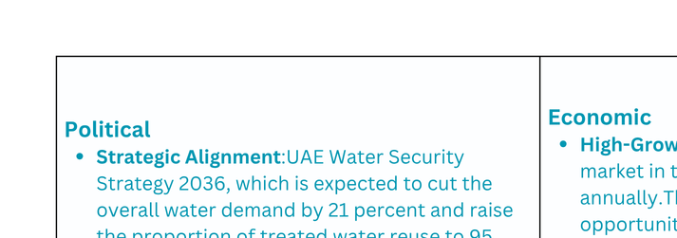

PESTLE Analysis

Slide 6
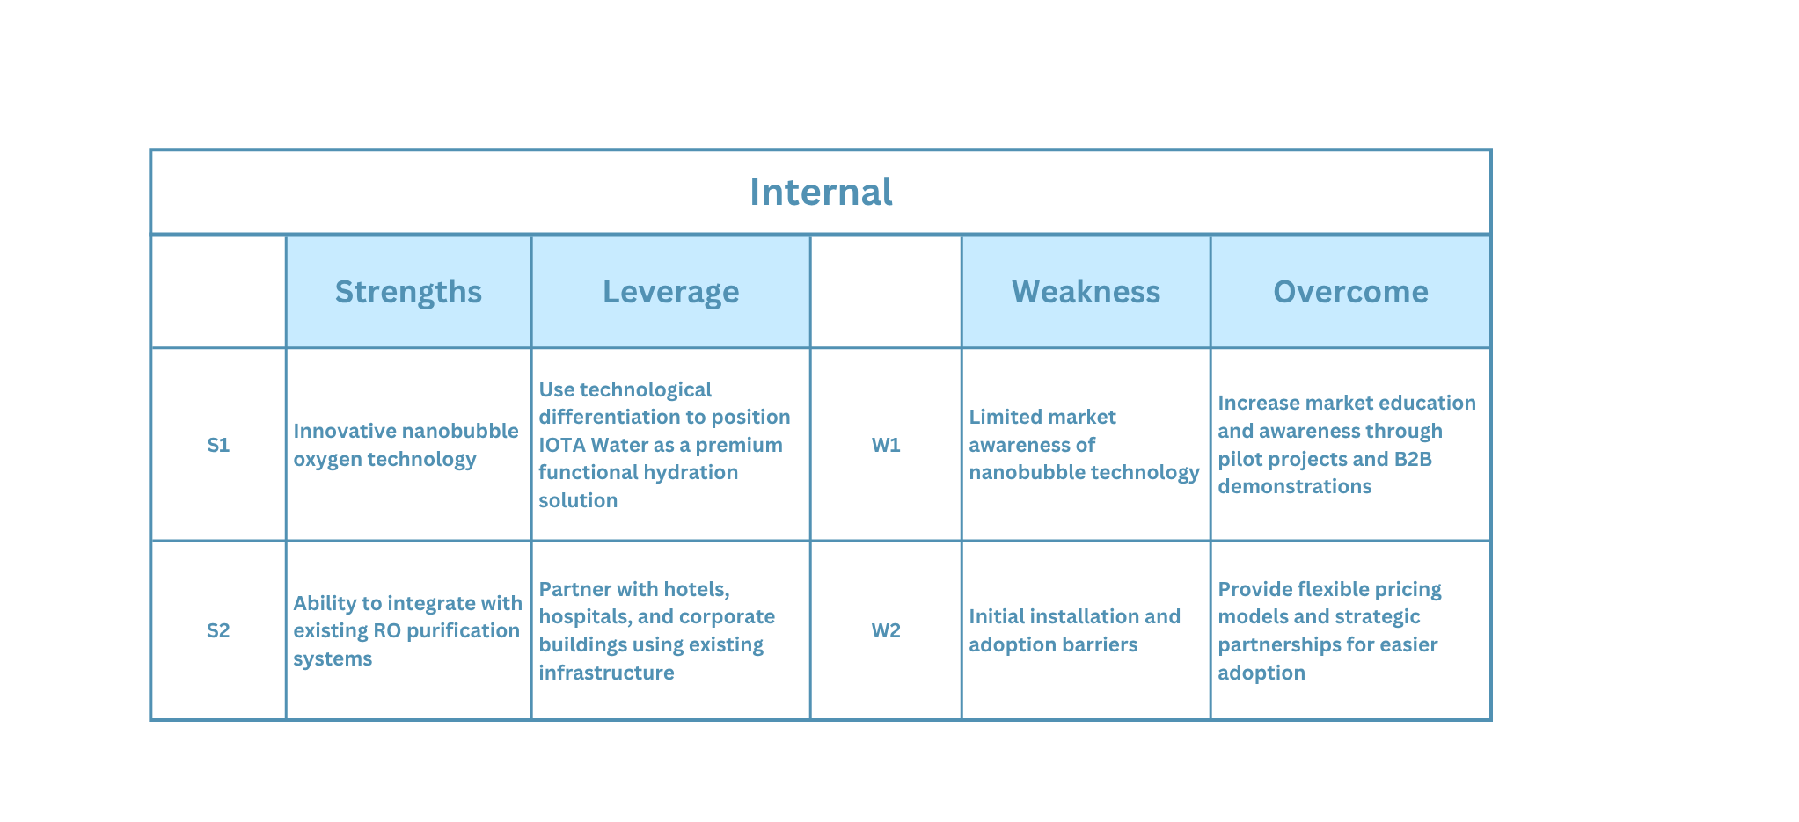
SWOT Analysis

Slide 7
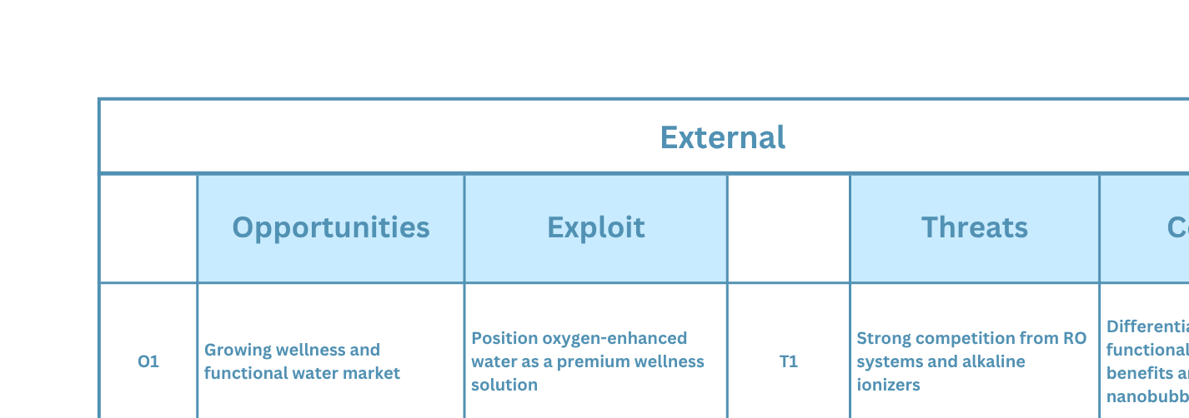
SWOT Analysis

Slide 8
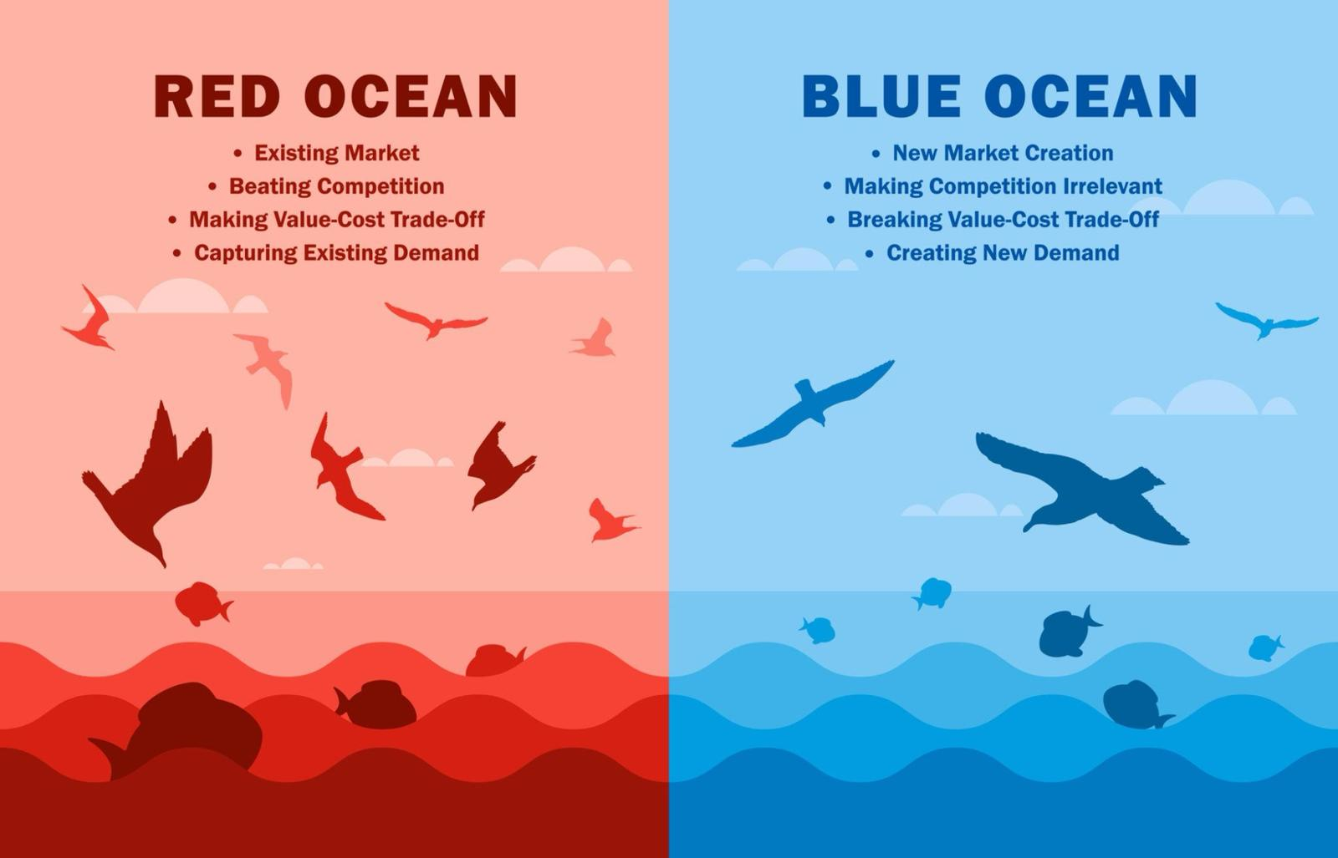
Blue Ocean Strategy Concept

Slide 9
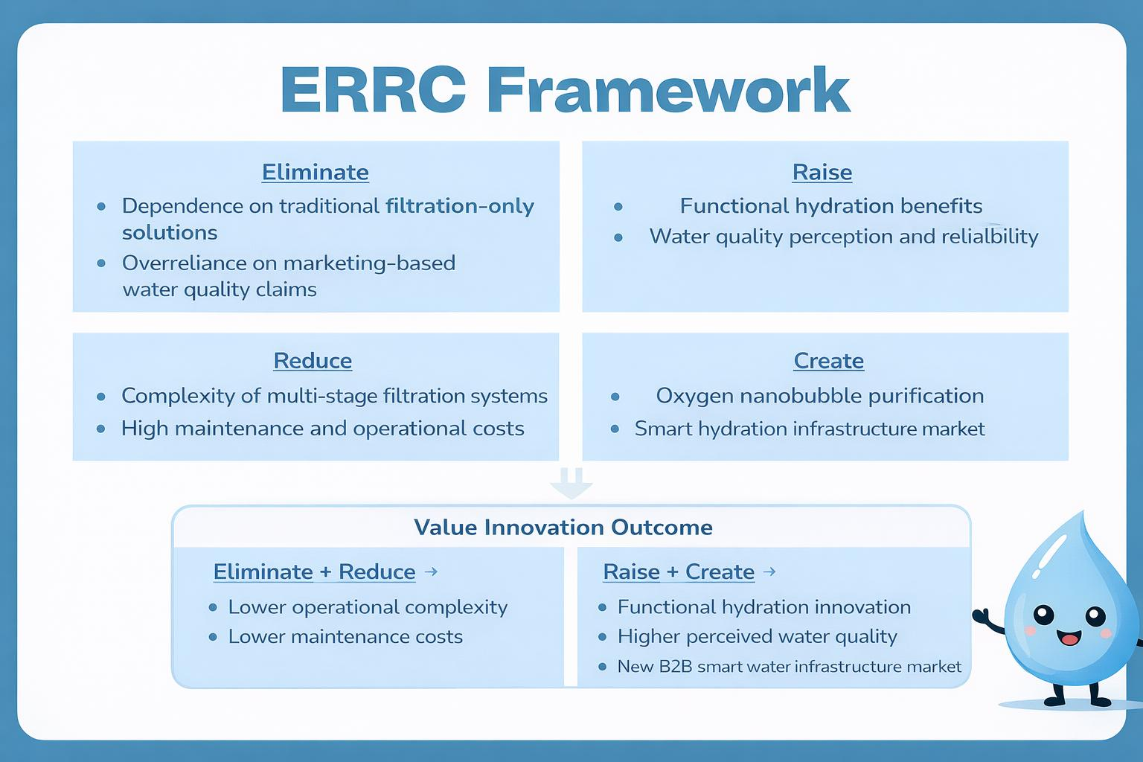

Slide 10
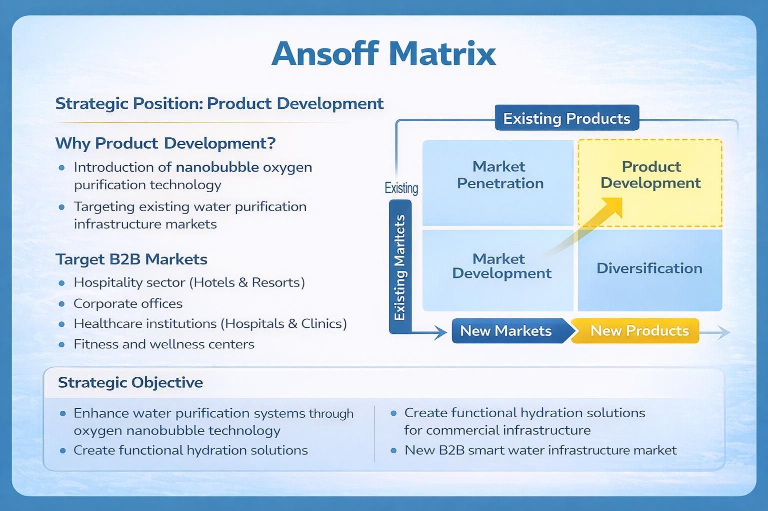

Slide 11
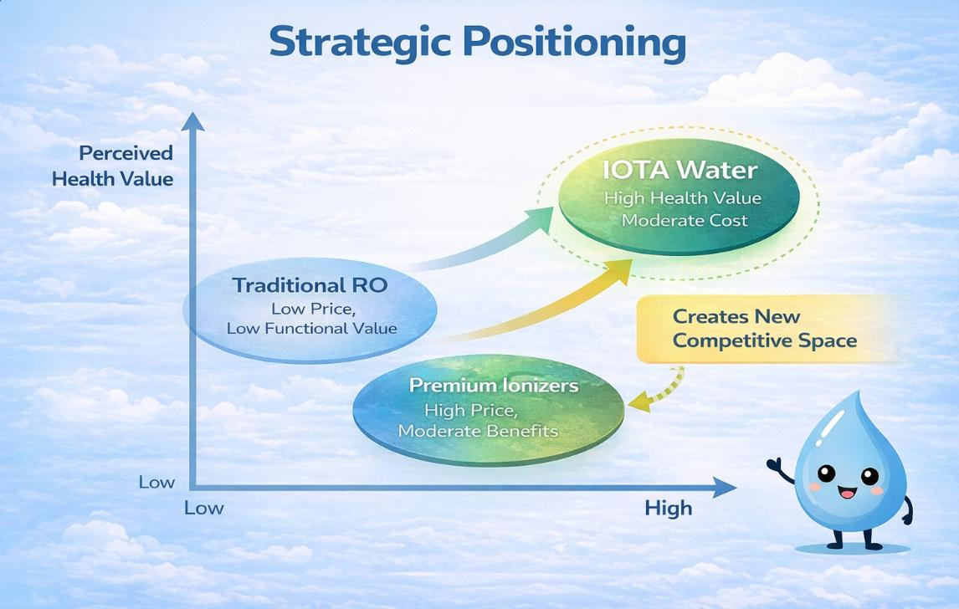

Slide 12
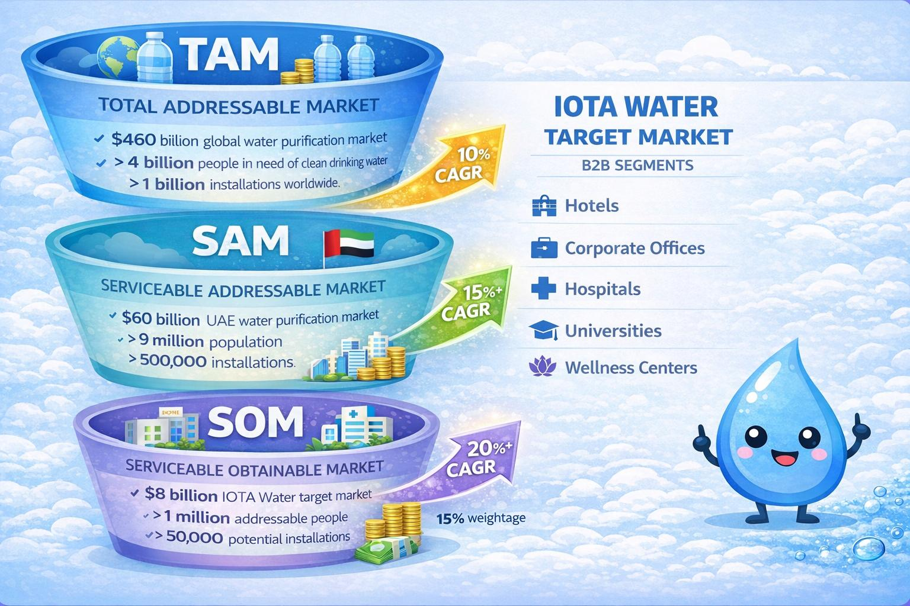

Slide 13
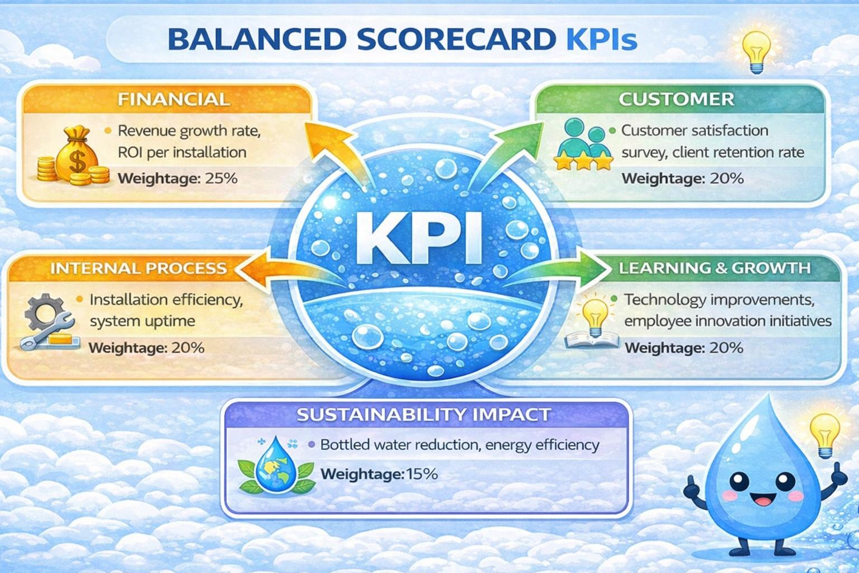

Slide 14

Conclusion
The UAE water purification market is a competitive Red Ocean with limited differentiation.
IOTA Water creates value innovation through nano-bubble oxygen technology and functional hydration.
The UAE offers strong market readiness to due to water scarcity, wellness demand, smart infrastructure and also for B2B sectors such as hotels, hospitals etc.
Overall, IOTA Water has the potential to create a Blue Ocean by redefining purified water as smart, oxygen-enhanced hydration.

Slide 15
References
Ecolab (2025). 2025 Ecolab Watermark™ Study: Rising UAE Confidence in Water Security.
Kim, W. C., & Mauborgne, R. (2015). Blue ocean strategy: How to create uncontested market space and make the competition irrelevant (Expanded ed.). Harvard Business Review Press.
Ministry of Energy and Infrastructure. (2023). UAE water security strategy 2036. United Arab Emirates Government. https://www.moewi.gov.ae
Grand View Research. (2023). Water purifier market size, share & trends analysis report. https://www.grandviewresearch.com
Mordor Intelligence. (2024). UAE water treatment market – Growth, trends, and forecast. https://www.mordorintelligence.com
Global Wellness Institute. (2023). Global wellness economy monitor. https://globalwellnessinstitute.org
UAE Ministry of Energy and Infrastructure (2024). The UAE Water Security Strategy 2036.
World Health Organization. (2022). Guidelines for drinking-water quality (4th ed.). https://www.who.int

Slide 16
THANK YOU!
OPEN TO QUESTIONS AND DISCUSSIONS

