Slide 1
MACHINE LEARNING PROJECT
Fake News Detection
BY GROUP 6
TEAM MEMBERS :
MOHAMMAD SHOAIB (1809113065)
MUKUL MOHAN VARSHNEY (1809113070)
MUSKAN JOSHI (1809113072)
NAMAN JAISWAL (1809113073)

Slide 2
INTRODUCTION
FAKE NEWS SPREADS LIKE A WILDFIRE AND THE ADVENT OF THE WORLD WIDE WEB AND THE ADOPTION OF SOCIAL MEDIA PLATFORMS HAVE PAVED THE WAY FOR INFORMATION DISSEMINATION THAT HAS NEVER BEEN WITNESSED IN THE HUMAN HISTORY BEFORE AND HENCE THIS IS A BIG ISSUE IN THIS ERA.
FORTUNATELY, THERE ARE A NUMBER OF COMPUTATIONAL TECHNIQUES THAT CAN BE USED TO MARK CERTAIN ARTICLES AS FAKE ON THE BASIS OF THEIR TEXTUAL CONTENT.
THIS PROJECT IS AIMED TO DISTINGUISH FAKE NEWS FROM REAL ONES USING SUPERVISED LEARNING TO IMPLEMENT A MODEL WHICH IS BEST SUITED FOR THIS CLASSIFICATION HAVING THE MAXIMUM RESULT.
WE HUMAN BEINGS, HAVE THE CAPABILITY TO INTERPRET THE WORDS WHENEVER WE READ ANY SENTENCE OR A PARAGRAPH.
GIVEN TODAY’S TIME, IT IS POSSIBLE TO EVEN TEACH A COMPUTER TO READ AND UNDERSTAND THE DIFFERENCES BETWEEN REAL NEWS AND FAKE NEWS WITH THE HELP OF NLP(NATURAL LANGUAGE PROCESSING) AND MACHINE LEARNING ALGORITHMS, THAT CAN BE USED TO DETECT ANOMALIES THAT SEPARATE A TEXT ARTICLE THAT IS DECEPTIVE IN NATURE FROM ARTICLES THAT ARE BASED ON FACTS.

Slide 3
LITERATURE REVIEW
1.Fake news detection using Naive Bayes Classifier(IEEE 2017): Out of 881 true news, 666 were correctly classified and out of 46 fake news, 33 were correctly classified. Precision was calculated which came out to be 0.71
2.Fake news detection using a Deep Neural Network(IEEE 2018): Shallow CNN gave accuracy of 91.3%. With VDCNN accuracy of the model was increased to 98.3%. With a combination of CNN and LSTM, accuracy was reduced by a bit to 97.3% but precision and recall were effectively improved. With Naive Bayes,Precision, Recall, f1-Score got the same value(90%), Decision tree, accuracy is 73%, Random forest, accuracy was 71% and for KNN we got an accuracy of 53%.

Slide 4
.
3.Synonyms-Based Augmentation to Improve Fake News Detection using Bidirectional LSTM(IEEE 2020): The F1 scores produced are 0.2096 and 0.2423 for both using the subword without augmentation and the subword with augmentation, respectively.
4.Fake News Detection on Social Media using K-Nearest Neighbor Classifier(IEEE 2020): Out of 402 True news articles, 331 news articles are classified as “mostly true”. We achieved an approximate 79% classification accuracy of this model. The weight average precision of this model is .75 and recall is .79. Model has achieved maximum accuracy when the value of K is taken between 15 to 20.

Slide 5
WORKFLOW
Extracting the training data
Test on Dataset
Train Models using algorithms such as Naive Bayes classifier,Passive aggressive algorithm etc
News classification
Pre-processing of the data
Fake News
Real News
Feature Extraction e.g countvectorizer, tfidf
Test-Train split

Slide 6

DATA COLLECTION
IT IS THE PROCESS OF COLLECTING LABELLED OR UNLABELLED DATA DEPENDING UPON THE PROJECT OR IN SHORT, TO CHOOSE THE MOST SUITABLE DATA SET FOR THE PROJECT. WE TOOK DATA FOR THIS PROJECT FROM THE WEBSITE KAGGLE.
OUR DATA SET LOOKS LIKE THIS :

Slide 7
DATA PRE-PROCESSING
Data preprocessing is a process of preparing the raw data and making it suitable for a machine learning model. It is the first and crucial step while creating a machine learning model. When creating a machine learning project, it is not always a case that we come across the clean and formatted data so it is mandatory to clean it and put in a formatted way.
Textual data pre-processing involves below steps:
Tokenization: Tokenization is a step which splits longer strings of text into smaller pieces, or tokens. Larger chunks of text can be tokenized into sentences, sentences can be tokenized into words, etc. Further processing is generally performed after a piece of text has been appropriately tokenized. Tokenization is also referred to as text segmentation or lexical analysis.
Normalization: Normalization generally refers to a series of related tasks meant to put all text on a level playing field: converting all text to the same case (upper or lower), removing punctuation, converting numbers to their word equivalents, and so on.

Slide 8
.
Normalization puts all words on equal footing, and allows processing to proceed uniformly. Normalizing text can mean performing a number of tasks, but for our framework we will approach normalization in 3 distinct steps:
(1) stemming: Stemming is the process of eliminating affixes (suffixed, prefixes, infixes, circumfixes) from a word in order to obtain a word stem.
(2) lemmatization: Lemmatization is related to stemming, differing in that lemmatization is able to capture canonical forms based on a word's lemma.
(3) everything else: Set all characters to lowercase, remove numbers (or convert numbers to textual representations), remove punctuation (generally part of tokenization, but still worth keeping in mind at this stage, even as confirmation), strip white space (also generally part of tokenization), remove default stop words (general English stop words)).

Slide 9
FEATURE EXTRACTION
CountVectorizer:
Bag-of-Words is a very intuitive approach to this problem, the methods comprise of:
1) Assigning a weight to each token(word) which is calculated by the number of times a token shows up in the sentence and uses this value as its weight.
2) Creating a sentence-term matrix with each row representing a sentence and each column addressing a token.
Tfidf:
TF-IDF stands for “term frequency-inverse document frequency”, meaning the weight

Slide 10
.
assigned to each token not only depends on its frequency in a document but also how recurrent that term is in the entire corpus.
The weight is calculated by the multiplication of term-frequency and inverse document frequency i.e.
TF = No. of repetition of word in a sentence / total no of words
IDF = log(no. of sentences / no. of sentences containing words)

Slide 11




MODEL SELECTION
MULTINOMIAL NAIVE BAYES
THE MULTINOMIAL NAIVE BAYES CLASSIFIER IS SUITABLE FOR CLASSIFICATION WITH DISCRETE FEATURES (e.g. WORD COUNTS FOR TEXT CLASSIFICATION). IT NORMALLY REQUIRES DISCRETE FEATURE COUNTS.
MULTINOMIAL NAIVE BAYES WITH HYPERPARAMETERS
HYPERPARAMETERS CAN BE LIKE ALPHA (float) , FIT_PRIOR (bool) , CLASS_PRIOR (array like of shape (n_classes)).

Slide 12

PASSIVE AGGRESSIVE CLASSIFIER
It is an online algorithm- it learns from massive streams of data.
It uses the concept that the classifier adjusts its weight vector for each misclassified training sample it receives, trying to recollect it.
Passive: If the prediction is correct, keep the model and do not make any changes. i.e., the data in the example is not enough to cause any changes in the model. Aggressive: If the prediction is incorrect, make changes to the model. i.e., some change to the model may correct it.
.

Slide 13
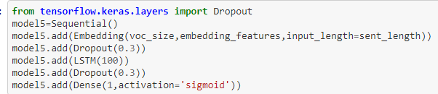



.
LSTM
Long Short-Term Memory (LSTM) networks are a modified version of recurrent neural networks, which makes it easier to remember past data in memory. The vanishing gradient problem of RNN is resolved here. LSTM is well-suited to classify, process and predict time series given time lags of unknown duration. It trains the model by using back-propagation. In an LSTM network, three gates are present.
LSTM(with dropout layer)
Dropout is a technique used to prevent a model from overfitting. Dropout works by randomly setting the outgoing edges of hidden units (neurons that make up hidden layers) to 0 at each update of the training phase.

Slide 14
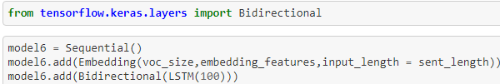



.
BI-DIRECTIONAL LSTM
In a bidirectional RNN, we consider 2 separate sequences. One from right to left and the other in the reverse order. The forward layer would feed the sentences as such. But, the backward layer would feed the sequence in the reverse order. Now, the outputs would be generated by concatenating the word sequences at each time and generating weights accordingly.
BI-DIRECTIONAL LSTM(with dropout layer)
Dropout is a technique used to prevent a model from overfitting. Dropout works by randomly setting the outgoing edges of hidden units (neurons that make up hidden layers) to 0 at each update of the training phase.

Slide 15
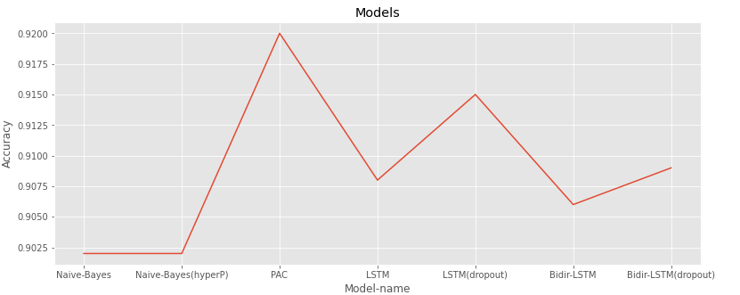
RESULTS
AFTER COMPARING ALL THE MODELS , IT WAS FOUND THAT PASSIVE AGGRESSIVE CLASSIFIER GIVES THE MAXIMUM ACCURACY.
AFTER COMPARING ALL THE MODELS, IT WAS FOUND THAT PASSIVE AGGRESSIVE CLASSIFIER GIVES THE MAXIMUM PRECISION.

Slide 16
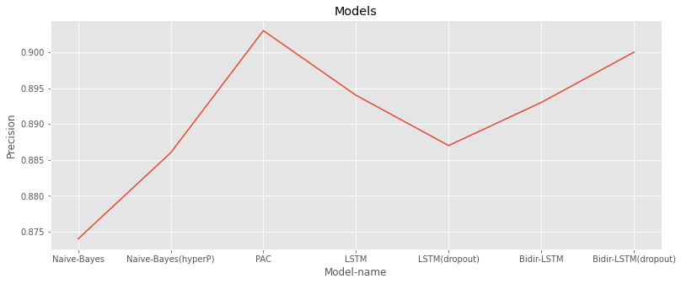
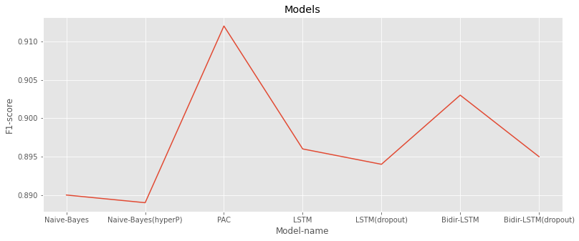
.
AFTER COMPARING ALL THE MODELS, IT WAS FOUND THAT PASSIVE AGGRESSIVE CLASSIFIER GIVES THE MAXIMUM PRECISION.

Slide 17
CONCLUSION
THE RISE OF FAKE NEWS HAS BECOME A GLOBAL PROBLEM THAT EVEN MAJOR TECH COMPANIES LIKE FACEBOOK AND GOOGLE ARE STRUGGLING TO SOLVE. IT CAN BE DIFFICULT TO DETERMINE WHETHER A TEXT IS FACTUAL WITHOUT ADDITIONAL CONTEXT AND HUMAN JUDGEMENT. NLP ALONG WITH ML MODELS CAN DETECT THE TOPIC AND FACTS OF NEWS ARTICLES, THEN CLASSIFY THEM AS REAL OR FAKE.
WE USED VARIOUS ML MODELS AND DL MODELS FOR THE SAME AND FOUND OUT THAT ML MODEL PASSIVE AGGRESSIVE CLASSIFIER IS GIVING THE HIGHEST ACCURACY, PRECISION AND F1-SCORE FOLLOWED BY LSTM(with dropout) IN TERMS OF ACCURACY, BIDIRECTIONAL LSTM RNN(with dropout) IN TERMS OF PRECISION AND BIDIRECTIONAL LSTM RNN IN TERMS OF TERMS OF F1-SCORE WHEREAS NAIVE BAYES GIVING THE LEAST ACCURACY, PRECISION AND F`-SCORE.
IT WAS ALSO NOTICED THAT APPLYING COUNT VECTORIZER FOR FEATURE EXTRACTION IS GIVING HIGHER ACCURACY(WHEREAS TFIDF IS RESULTING IN HIGHER PRECISION AND F1-SCORE.

