Slide 1
Vision Transformers for Satellite Image Classification
Zero-shot, linear probe and fine-tuning, with a robustness study
[Your name] · [Course / programme] · October 2026

Slide 2
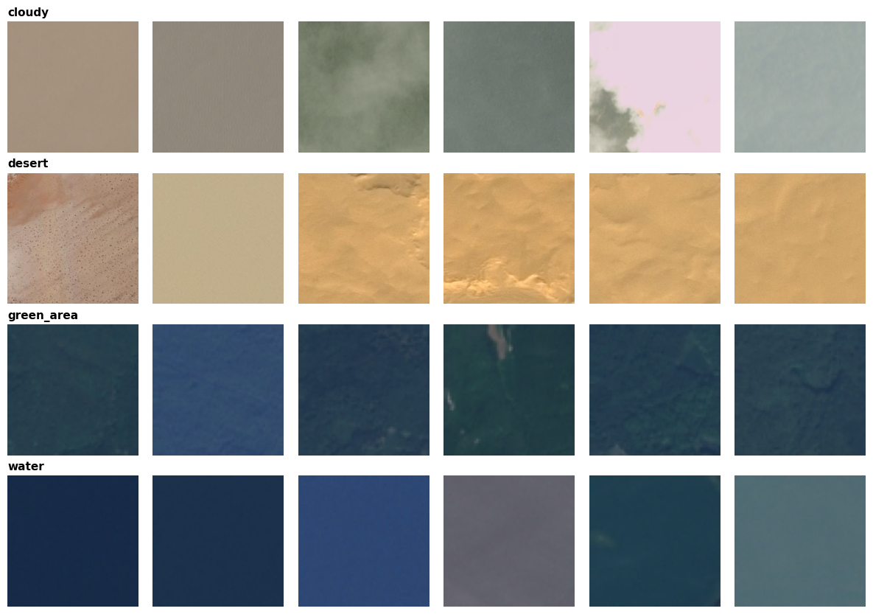
A tidy dataset hides a resolution shortcut
5,631
53.3%
images, 4 classes
split 3,942 / 846 / 843
from image size alone (chance 25%)
82.4%
77
from mean RGB colour alone
near-duplicate pairs found and kept in one split
Duplicate-aware, stratified 70/15/15 split. Model choices made on validation only; test set used once per model.
Cloudy and desert: 256×256 · green_area and water: 64×64

Slide 3
Four ways to use pre-trained transformers
Zero-shot CLIP
Linear probe: CLIP
ViT-B/32. No training: image–text similarity. Prompt wording chosen on validation (macro-F1 0.45 to 0.73).
Frozen 512-d embeddings, standardised, logistic regression, C chosen on validation.
Linear probe: DINOv2
Fine-tuned ViT-B/16
Frozen 1,536-d features (CLS + mean patch), same probe. Self-supervised, no text.
All 86M weights. AdamW, 4 epochs, flips + 90° rotations, no colour jitter. 3 seeds, 0.27 GPU-hours.

Slide 4
Supervision lifts accuracy from 75% to over 99%
No clear difference among the three trained methods
CLIP vs DINOv2: +0.24 pts, 95% CI −0.24 to +0.71. Only 0–3 errors in 843 images, so the test set is saturated.
Zero-shot is clearly worse
About 25 points below the others (p < 10⁻⁶⁰) and below the colour-only baseline.
Few labels needed
78 training images give 95% (CLIP) and 98% (DINOv2) validation accuracy.

Slide 5
Robustness, not accuracy, separates the models
−12.1 pts
CLIP probe when resolution cue is removed; desert recall falls to 52%
−24.1 pts
fine-tuned ViT on darkened images
88.5%
DINOv2 probe worst-case accuracy (best of all four)

Slide 6
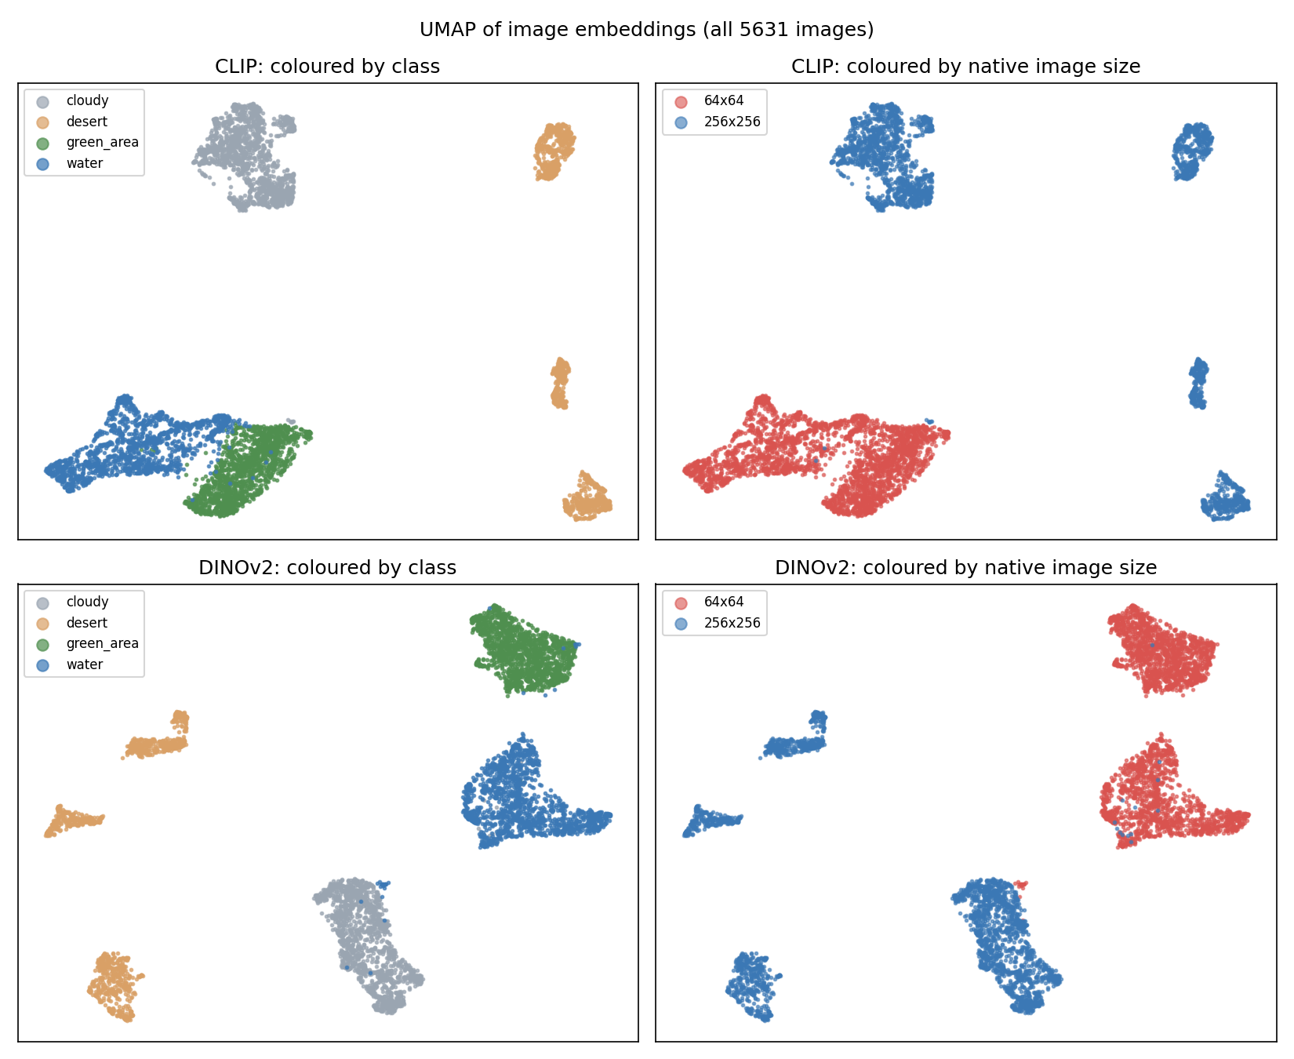
Retrieval works, except for water
99.2%
99.5%
CLIP image-to-image precision@1
DINOv2 image-to-image precision@1
Text-to-image (CLIP): clouds, desert and forest queries return only correct images in the top 10, but water queries score 0.0 to 0.1. “A satellite image of a lake” retrieves dark forest.
UMAP: DINOv2 forms four clean clusters; in CLIP, water and green_area overlap. In both, clusters follow native image size, which is the confound.

Slide 7
Biases, ethics and conclusion
Dataset biases
Ethical implications
Conclusion
Resolution tied to class. Colour dependence (−10 to −34 pts under greyscale or hue shift). Coarse labels. Unknown geography and sensor.
A 99% score can mislead: silent failure on new sensors or regions affects real decisions. Dual use for surveillance. Low compute cost (≤ 0.019 kWh).
Pre-trained features nearly solve the task. DINOv2 probe gave the best mix of accuracy, stability and cost. Next: matched-resolution, multi-region data.

