Slide 1

Project Title Arduino Smart Irrigation System Using ESP8266 and Blynk App
Major Project - II
CS- 806
Problem Statement: Traditional irrigation methods lack precision and fail to consider the specific water requirements of different crops, leading to water wastage, inefficient irrigation, and reduced crop yield. A one-size-fits-all irrigation approach does not account for varying soil moisture, temperature, and humidity needs across different plant species.
Project Group Number: 21
Group Member Details: Jayprakash bamniya (0187CS211079)
Krishnpal Rajput (0187CS211087)
Lucky Soni (0187CS211091)
Manish Ahirwar (0187CS211095)
Muskan Khaira (0187CS211104)
Guide Details: Dr Bhavna Gupta

Slide 2
Idea/Approach Details
Describe your idea Solution/Prototype here:
This project presents an IoT-based crop-specific smart irrigation system using the ESP8266 microcontroller and the Blynk app. The proposed system monitors soil moisture, temperature, and humidity using sensors and automatically adjusts irrigation based on the specific water requirements of different crops. A database stores predefined optimal conditions for various crops, ensuring precision irrigation. The system also enables remote monitoring and manual control via a mobile app, improving water efficiency, crop health, and overall agricultural productivity.
Abstract:
This project presents an IoT-based crop-specific smart irrigation system using the ESP8266 microcontroller and the Blynk app. The proposed system monitors soil moisture, temperature, and humidity using sensors and automatically adjusts irrigation based on the specific water requirements of different crops. A database stores predefined optimal conditions for various crops, ensuring precision irrigation.

Slide 3

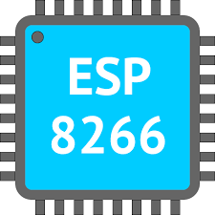
Technology stack
Describe your Technology stack here:
Front-End Technologies: Blynk Mobile App
Backend-Technology: ESP8266 Microcontroller, Blynk Cloud Service

Slide 4
Project Requirements
Functional Requirements
Non Functional Requirements
Sensor Integration
Automated Irrigation
Manual Control
Real-Time Monitoring
Remote Access
Performance
Scalability
Reliability
User Experience
Power Efficiency
Maintenance

Slide 5
Project Requirements
Hardware and Software requirements (Developer)
Hardware and Software
requirements (Client)
Hardware Requirements (Developer) :
ESP8266 Board
Capacitive Soil Moisture Sensor
DHT11 Sensor
Water Pump
Relay Module
3.7V Li-ion Battery
Connecting Wires
Software Requirements (Developer) :
Arduino IDE
Blynk App
Blynk Library for ESP8266
WiFi Library
DHT Library
Hardware Requirements (Client) :
Smartphone or Tablet
Wi-Fi Network
Software Requirements (Client) :
Blynk App
Internet Connection

Slide 6
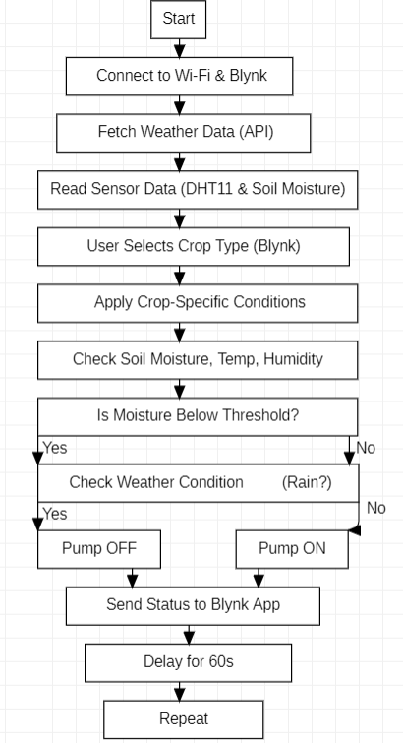
Design
Describe your Flow Chart here
Describe your Dependencies / Show stopper here
Dependencies
Sensor Accuracy: Critical for proper irrigation control.
Blynk Cloud Server: Downtime affects monitoring and automation.
Hardware Malfunction: Pump, relay, or sensor failure can disrupt functionality.
Limited Battery Life: If battery-operated, power issues can affect performance.
ESP8266 Overheating: Can cause system failures in extreme conditions.

Slide 7
Deployment Details
Describe Deployment Details here
Hardware Setup: Connect ESP8266, sensors, and water pump.
Software Configuration: Flash ESP8266 with the smart irrigation code.
Network Setup: Connect ESP8266 to Wi-Fi for Blynk communication.
Blynk App: Set up control and monitoring widgets.
Testing: Ensure sensors and pump work correctly.

Slide 8
Survey of crops
Crop | Ideal Soil Moisture (%) | Temperature Range (°C) | Humidity Requirement (%) | Irrigation Frequency
Rice | 70-80% (Flooded) | 20-35°C | 60-80% | Frequent (Paddy fields)
Wheat | 50-60% | 10-25°C | 40-50% | Moderate (Every 7-10 days)
Maize | 50-70% | 18-30°C | 50-60% | Moderate (Every 5-7 days)
Sugarcane | 60-80% | 20-40°C | 70-85% | Frequent
Cotton | 40-60% | 25-35°C | 50-60% | Less frequent (Every 10-12 days)
Tomato | 50-70% | 20-30°C | 60-80% | Moderate (Every 3-4 days)
Potato | 65-75% | 15-22°C | 70-80% | Moderate
Onion | 40-50% | 12-24°C | 50-60% | Less frequent
Soybean | 50-65% | 20-30°C | 50-70% | Moderate
Banana | 70-80% | 20-35°C | 70-90% | High water demand

Slide 9
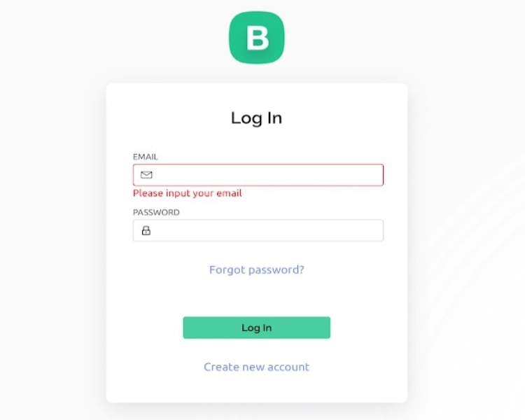
Project Screen shorts

Slide 10
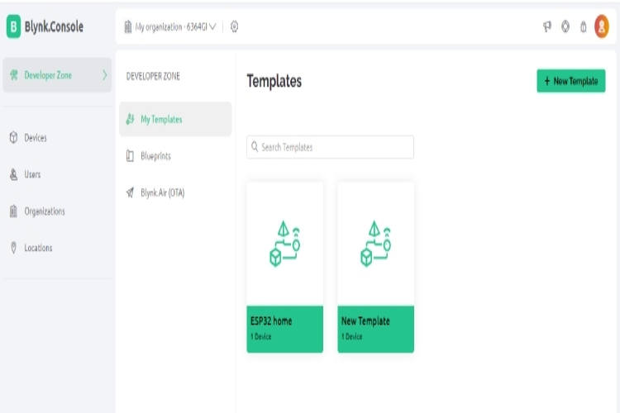
Project Screen shorts

Slide 11
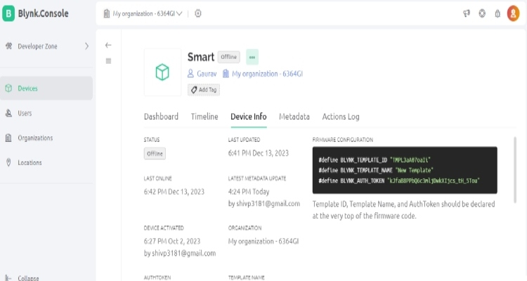
Project Screen shorts

Slide 12
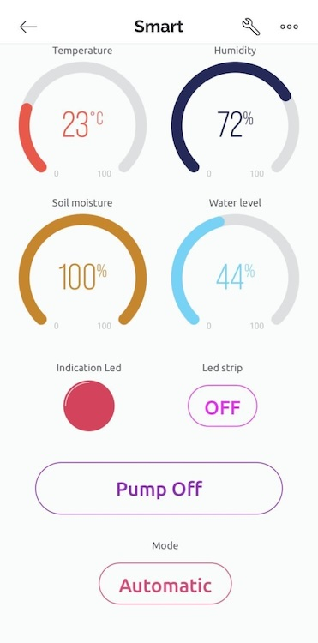
Project Screen shorts
12

Slide 13


