Slide 1
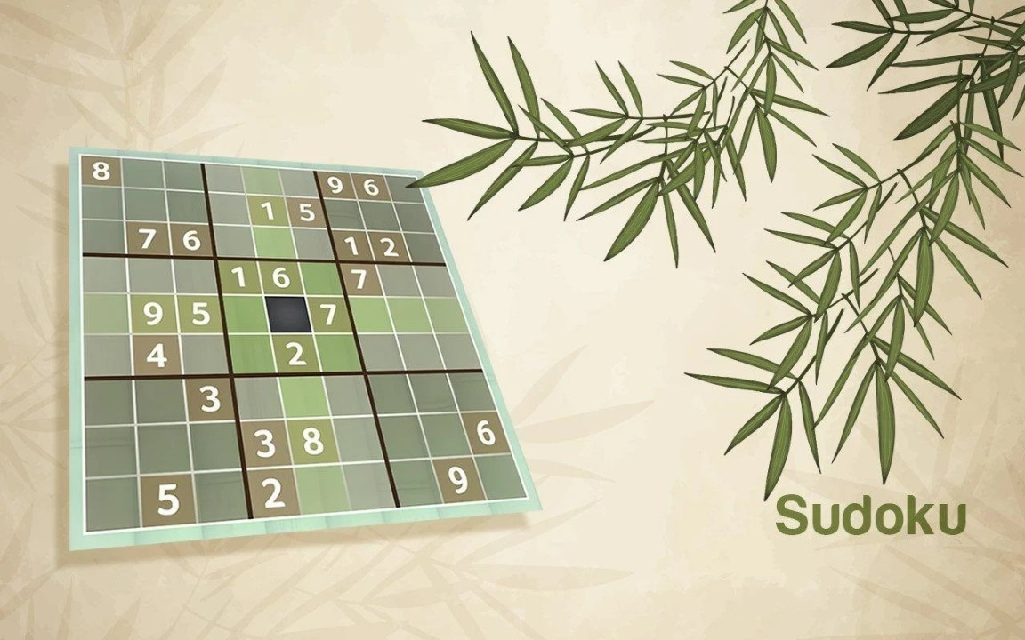
SUDOKU SOLVER VISUALIZER

Slide 2
INTRODUCTION
The number-placement puzzle game Sudoku has become incredibly popular all around the world. It entails populating a 9x9 grid with numbers so that every row, every column, and every one of the nine 3x3 subgrids that make up the grid has every number from 1 to 9. The puzzle in the game must be solved logically and methodically.
The goal of the SudokuSolver app is to help users solve Sudoku puzzles. Players can input a Sudoku puzzle through its user-friendly interface, and the application will try to solve it. By providing a tool to validate input, solve the puzzle, and show the solution process step-by-step, the programme seeks to improve the experience of solving Sudoku.

Slide 3
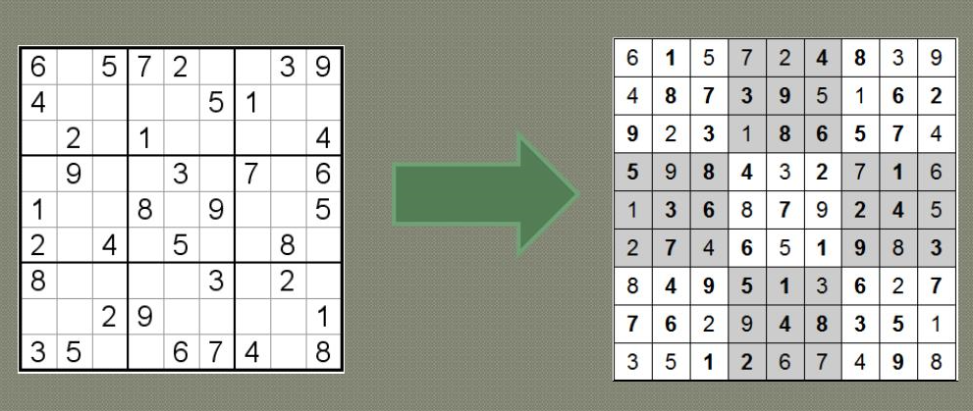
SUDOKU SOLVER

Slide 4
APPLICATION OVERVIEW
The SudokuSolver application is a graphical user interface (GUI) based program developed using Java Swing. It is designed to solve Sudoku puzzles entered by the user. The application's main features include:
Solving a Sudoku puzzle: The application can solve a Sudoku puzzle by finding a solution that satisfies all the rules of the game.
Clearing the board: The application allows the user to clear the board and input a new puzzle.

Slide 5
The user interface components are as follows:
Grid: The application features a 9x9 grid where users can input the numbers of the Sudoku puzzle they want to solve. Each cell in the grid is represented by a JTextField where users can enter numbers from 1 to 9.
Buttons: There are two main buttons on the interface:
Solve Button: When clicked, this button triggers the solving process. The application will attempt to solve the puzzle entered in the grid.
Clear Button: This button clears the grid, allowing users to input a new puzzle.
Message Label: A JLabel is used to display messages to the user. It provides feedback such as the status of the solving process or any errors encountered with the input.
The application utilizes a SwingWorker to perform the solving process in the background, ensuring that the user interface remains responsive. The solving algorithm checks for the validity of the input and uses a backtracking approach to find a solution. If a solution is found, the application updates the grid to show the solved puzzle. If the input is invalid or no solution exists, the application notifies the user via the message label.

Slide 6
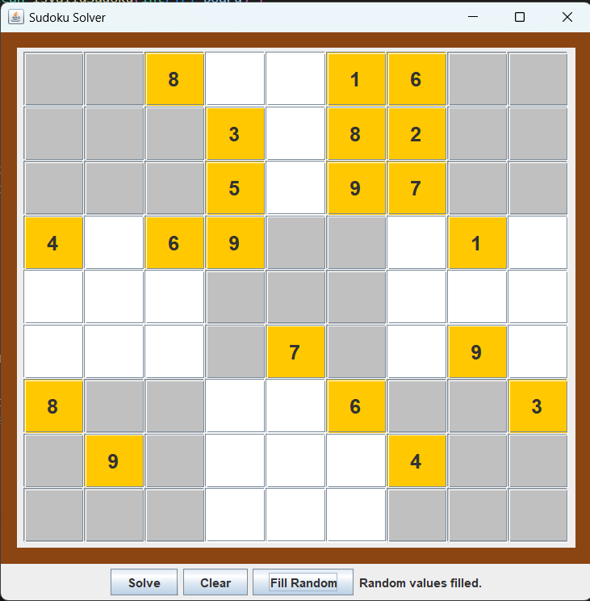

Slide 7
DEMONSTRATION
To demonstrate the SudokuSolver application, follow these steps:
Open the application by running the SudokuSolver class. This will launch the graphical interface with a 9x9 grid, two buttons labeled "Solve" and "Clear", and a message label at the bottom.
Enter a Sudoku puzzle into the grid. You can do this by hand, typing the numbers into the individual cells. Each row, column, and 3x3 box should contain the numbers 1 through 9 without repetition. If you have a pre-saved puzzle, you can enter it now.
Once the puzzle is entered, click the "Solve" button. This will initiate the solving process. The application will check the input for validity and then attempt to solve the puzzle using a backtracking algorithm.

Slide 8
It uses Java Swing, which is a part of Java's standard library for creating graphical user interfaces (GUIs). Here is a brief overview of the key components in your code:
JFrame: The main window of the application.
JTextField: Text fields for user input, arranged in a 9x9 grid to represent the Sudoku board.
JButton: Buttons for solving and clearing the Sudoku puzzle.
JLabel: A label for displaying messages to the user.
ActionListener: Interfaces for handling button click events.
SwingWorker: Used for performing background tasks, like solving the Sudoku puzzle, without freezing the GUI.
GridLayout: A layout manager that arranges components in a rectangular grid.
The code handles user input, checks for valid Sudoku configurations, and solves the Sudoku puzzle using a backtracking algorithm. Additionally, it updates the GUI to show the progress of the solver.
This Java code leverages object-oriented programming principles and is well-suited for building a simple but effective Sudoku solver application with a graphical interface.

Slide 9
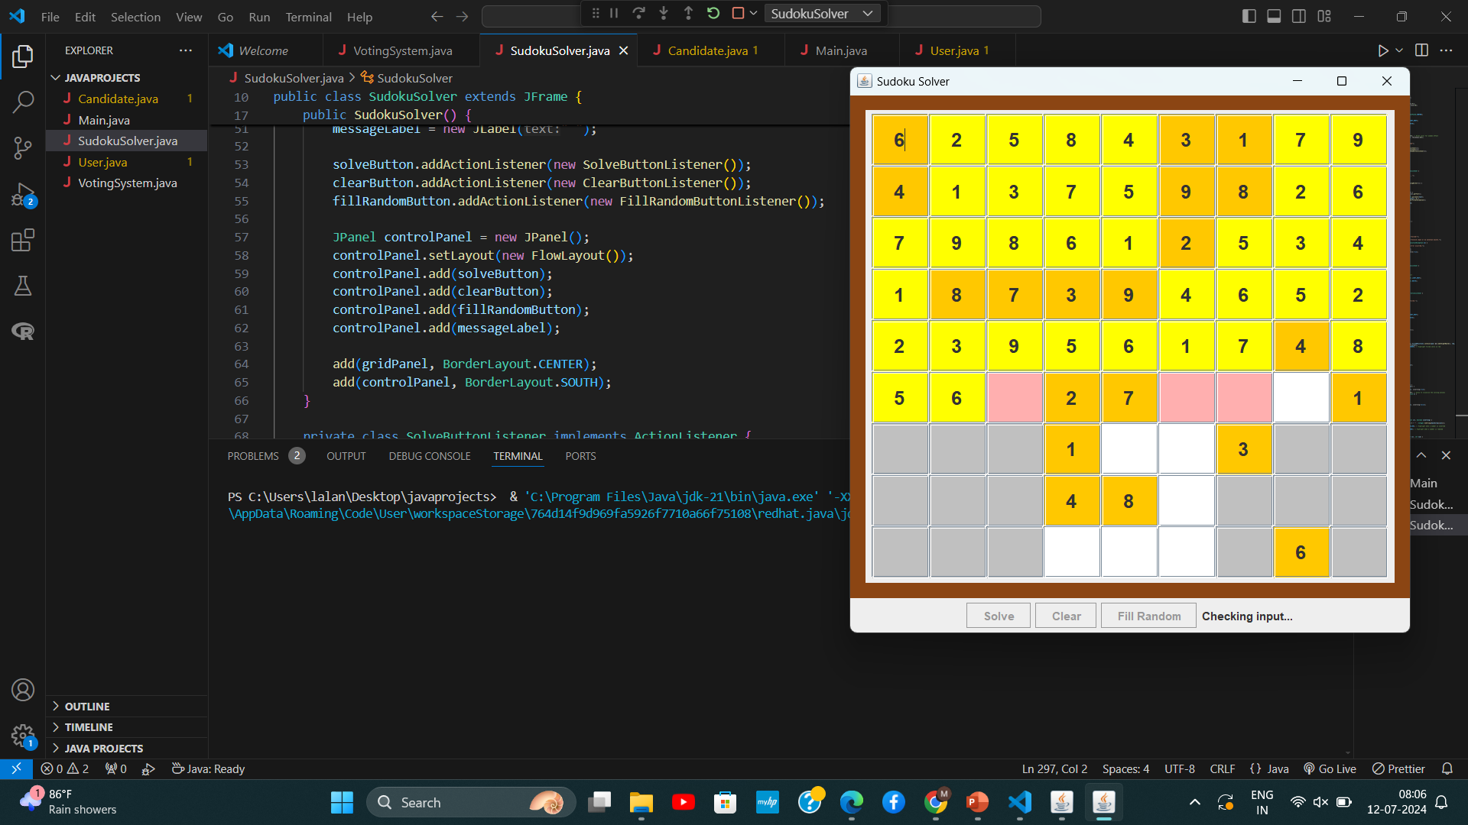

Slide 10
BACKTRACKING
Overview of Backtracking:
A recursive algorithm for solving constraint satisfaction problems.
Tries different possibilities and backtracks when a constraint is violated.
Algorithm Steps:
Start from the first empty cell.
Try filling the cell with numbers 1 to 9.
Check if the number is valid (does not violate Sudoku rules).
If valid, move to the next empty cell and repeat.
If no valid number is found, backtrack to the previous cell and try the next number.

Slide 11
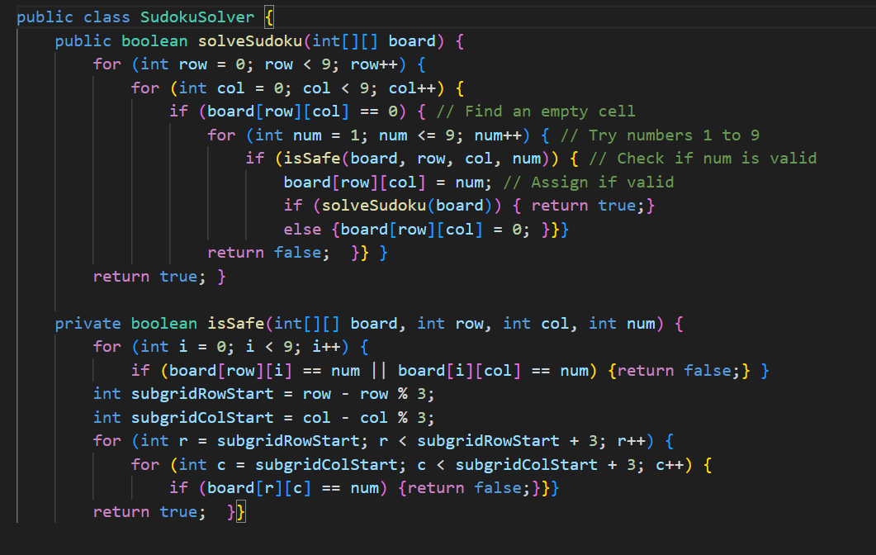

Slide 12
CONCLUSION
In conclusion, the SudokuSolver application presents a user-friendly interface for solving Sudoku puzzles, featuring a 9x9 grid, solve and clear buttons, and a message label for feedback. The application utilizes a backtracking algorithm to solve puzzles and ensures thread safety with SwingUtilities.invokeLater when updating the UI. It also includes error handling to respond to invalid inputs.

