Slide 1
GPRS (General Packet Radio Service)

Slide 2
What is GPRS?
General Packet Radio Switching Service(GPRS) is a packet-switched wireless technology
Introduced as a bearer service for Global System for Mobile Communications (GSM):
-circuit switched technology
-bandwidth: 900 MHz & 1800 MHz(Europe & Asia), 1900 MHz(Nort America)

Slide 3
Continue with what is GPRS
Used for mobile phones
From the beginning of 2001
Offer the possibility to charge by amount of data sent rather than connect time
ex:You aren’t charged when you are reading a page

Slide 4
Why GPRS?
GPRS is the world's most wide wireless data service
Available now with almost every GSM networks
It is a connectivity solution based on Internet Protocols that supports a wide range of enterprise and consumer applications

Slide 5
What are the usage areas?
Surf on Internet
Sending/receiving e-mails
Video conference
Connection with PC’s and other devices
Multimedia messages
Location-based services

Slide 6
The advantages of GPRS?
Spectral efficiency: Through the shared use of radio channels, GPRS allows a better traffic management,service access to a higher number of users
Web Browsing: access to the World Wide Web

Slide 7
Cont...
Email: access to mailboxes without protocol conversions
Remote LAN Access: network access to applications with the same desktop environment
Chat: end of SMS limitations (160 characters)
Audio: Stream audio capability with commercial quality

Slide 8
Cont...
File transfer using FTP, HTTP or other protocols without restrictions.
Speed: With a theoretical maximum of 171,2 Kbps (using all of the GSM 8 timeslots simultaneously) high gains can be achieved in the data transmission speed.

Slide 9
GPRS Technology Provides the Benefits
Enables the use of a packet-based air interface over the existing circuit-switched GSM network, which allows greater efficiency in the radio spectrum because the radio bandwidth is used only when packets are sent or received.

Slide 10
Cont.. Benefits
Supports minimal upgrades to the existing GSM network infrastructure for those network service providers who want to add GPRS services on top of GSM, which is currently widely deployed.
Supports virtual private network (VPN)/Internet service provider (ISP) corporate site access.

Slide 11
Cont… Benefits
Supports larger message lengths than Short Message Services (SMS).
Supports data rates of about 56 Kbps, which is greater than the traditional 14.4 Kbps rate available in a circuit-switched connection.

Slide 12
The speed of GPRS
Because of the technology that is been using there is not an exact speed number.
We can say as an avg. in teoritical 171.2 kilobit/sec but in our day of tech. in our country it is 56 kilobit/sec
Mostly the speed of GPRS communication is about with the sites speed

Slide 13
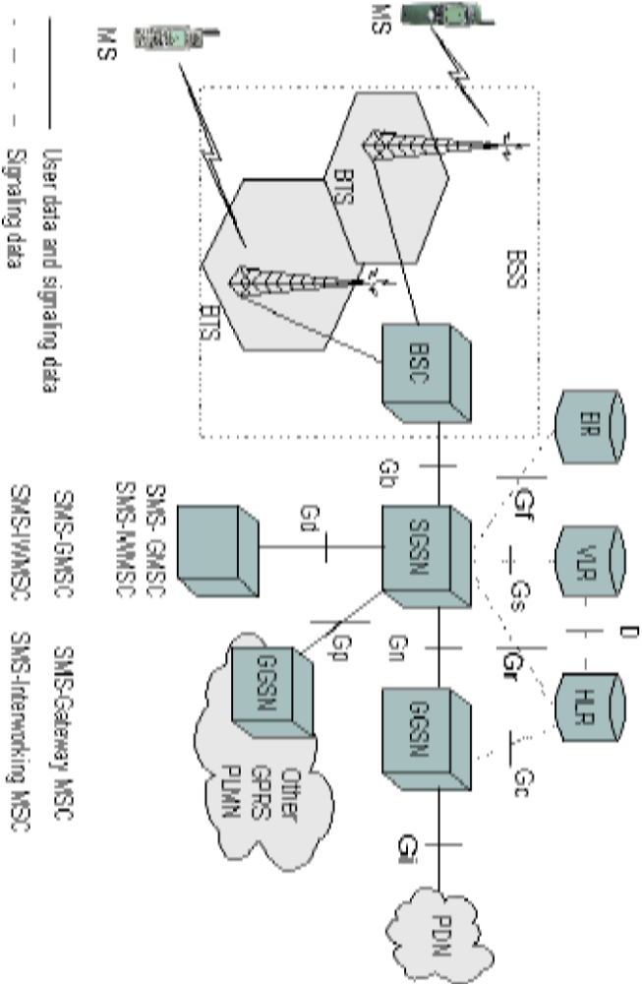
GPRS Network

Slide 14
Main components of a GPRS network:
Mobile Station (MS)
Base Station Subsystem (BSS)
Serving GPRS Support Node (SGSN)
Gateway GPRS Support Node (GGSN)
Packet Data Network (PDN)
Equipment Identity Register (EIR)
Visitors Location Register (VLR)
Home Location Register (HLR)

Slide 15
Cont..
The mobile station (MS)comprises all user equipment and software needed for communication with a Wireless telephone network.
The Base Station Subsystem (BSS) is the section of a traditional cellular telephone network which is responsible for handling traffic and signaling between a mobile phone and the Network Switching Subsystem.

Slide 16
Cont..
Visitor Location Register (VLR) is a database - part of the GSM mobile phone system - which stores information about all the mobiles that are currently under the authority of the MSC (Mobile Switching Center) which it serves.

Slide 17
SGSN (Serving GPRS Support Node)
The serving GPRS support node (SGSN) is responsible for routing the packet switched data to and from the mobile stations (MS) within its area of responsibility. The main functions of SGSN are packet routing and transfer, mobile attach and detach procedure (Mobility Management (MM)), location management, assigning channels and time slots (Logical Link Management (LLM)), authentication and charging for calls. It stores the location information of the user (like the current location, current VLR) and user profile (like IMSI addresses used in packet data networks) of registered users in its location register.

Slide 18
Gateway GPRS Support Node (GGSN)
The gateway GPRS support node (GGSN) acts as interface between the GPRS backbone and the external packet data network (PDN).
It converts the GPRS packet coming from the SGSN into proper packet data protocol (PDP) format (i.e. X.25 or IP) before sending to the outside data network.
Similarly it converts the external addresses to the GSM address of the destination user.
It sends these packets to proper SGSN. For this purpose the GGSN stores the current SGSN address of the user and his profile in its location register. The GGSN also performs the authentication and charging functions. In general there may be a many to many relationship between the SGSN and GGSN. However a service provider may have only one GGSN and few SGSNs due to cost constraints.
A GGSN proved the interface to several SGSNs to the external PDN.

Slide 19
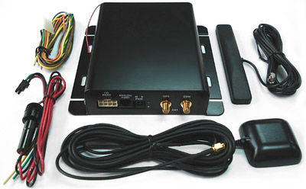
One of the using place
Equipments of The Vehicle Tracking System

Slide 20
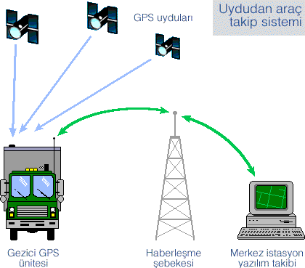
Cont.. Vehicle Tracking System

Slide 21
Cont.. Vehicle Tracking System
Q: Why it uses GPRS for vehicle tracking?
A: Because it is cheap and more efficent than other system (e.g SMS). You pay only that you used.
Q: How it works?
A: your receiver take you wave signals to the sattelite. By the help of GPRS it sends data to the map system that placed in Central Station. Customer connected to the system and tracking started.

Slide 22
Video Conference
For operators, the adoption of GPRS is a fast and cost-effective strategy that not only supports the real first wave of mobile Internet services, but also represents a big step towards 3GSM (or wideband-CDMA) networks and services.

Slide 23
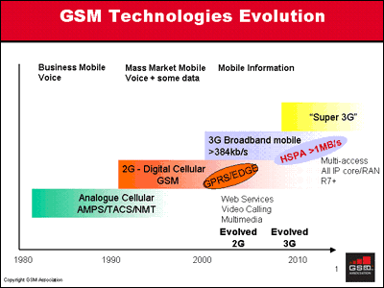
3 GSM

Slide 24
What is the 3 GSM
understood as third generation
latest addition to the GSM family
is a collective term for new procedures in communication, new standards, and new devices
will enhance the quality and speed of services in mobile telephony.

Slide 25
Cont… 3GSM
enables the provision of mobile multimedia services such as music, TV and video, rich entertainment content and Internet access
The technology on which 3GSM services are delivered is based on a GSM network enhanced with a Wideband-CDMA (W-CDMA) air interface - the over-the-air transmission element.

Slide 26
3GSM Network
ITU has approved, as official 3G standards, a set of systems that have arisen from agreement between various companies, grouped under the general name International Mobile Telecommunication 2000 (IMT2000), including five radio-transmission technologies:

