Slide 1

Chapter 10
Internet Group
Management Protocol
Objectives
Upon completion you will be able to:
Know the purpose of IGMP
Know the types of IGMP messages
Understand how a member joins a group and leaves a group
Understand membership monitoring
Understand how an IGMP message is encapsulated
Understand the interactions of the modules of an IGMP package
TCP/IP Protocol Suite

Slide 2
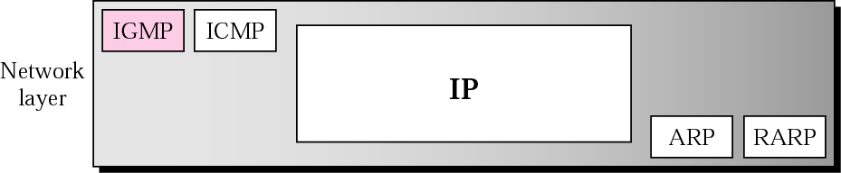
Figure 10.1 Position of IGMP in the network layer
TCP/IP Protocol Suite

Slide 3
10.1 GROUP MANAGEMENT
IGMP is a protocol that manages group membership. The IGMP protocol gives the multicast routers information about the membership status of hosts (routers) connected to the network. .
TCP/IP Protocol Suite

Slide 4

Note:
IGMP is a group management protocol. It helps a multicast router create and update a list of loyal members related to each router interface.
TCP/IP Protocol Suite

Slide 5
10.2 IGMP MESSAGES
IGMP has three types of messages: the query, the membership report, and the leave report. There are two types of query messages, general and special.
The topics discussed in this section include:
Message Format
TCP/IP Protocol Suite

Slide 6
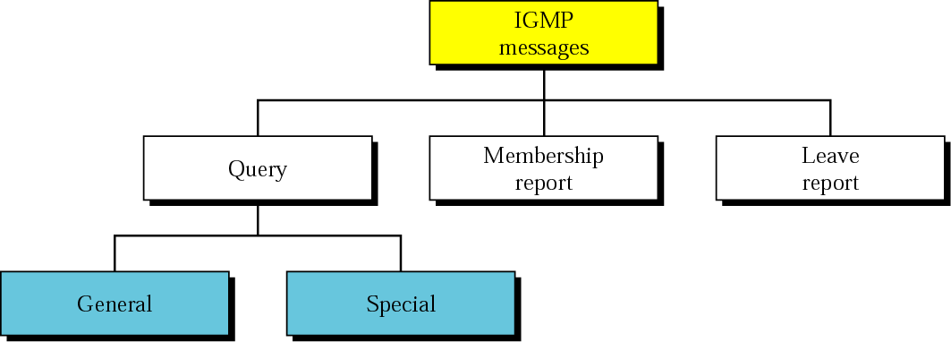
Figure 10.2 IGMP message types
TCP/IP Protocol Suite

Slide 7
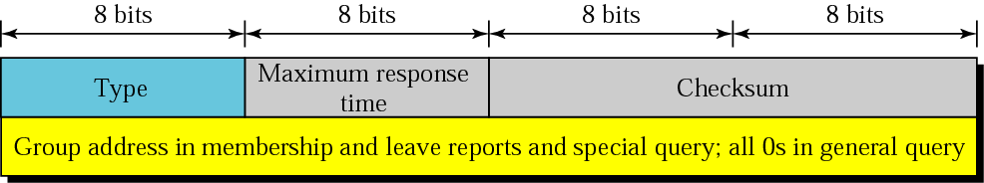
Figure 10.3 IGMP message format
TCP/IP Protocol Suite

Slide 8
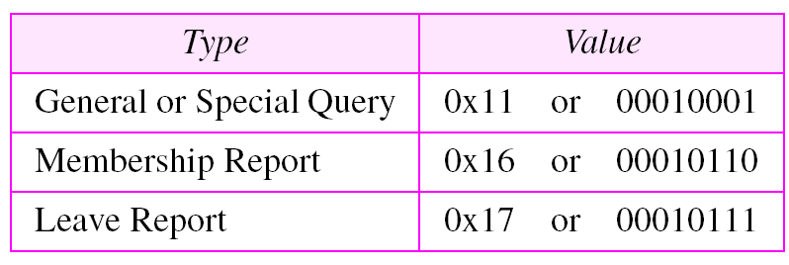
Table 10.1 IGMP type field
TCP/IP Protocol Suite

Slide 9
10.3 IGMP OPERATION
A multicast router connected to a network has a list of multicast addresses of the groups with at least one loyal member in that network. For each group, there is one router that has the duty of distributing the multicast packets destined for that group.
The topics discussed in this section include:
Joining a Group
Leaving a Group
Monitoring Membership
TCP/IP Protocol Suite

Slide 10
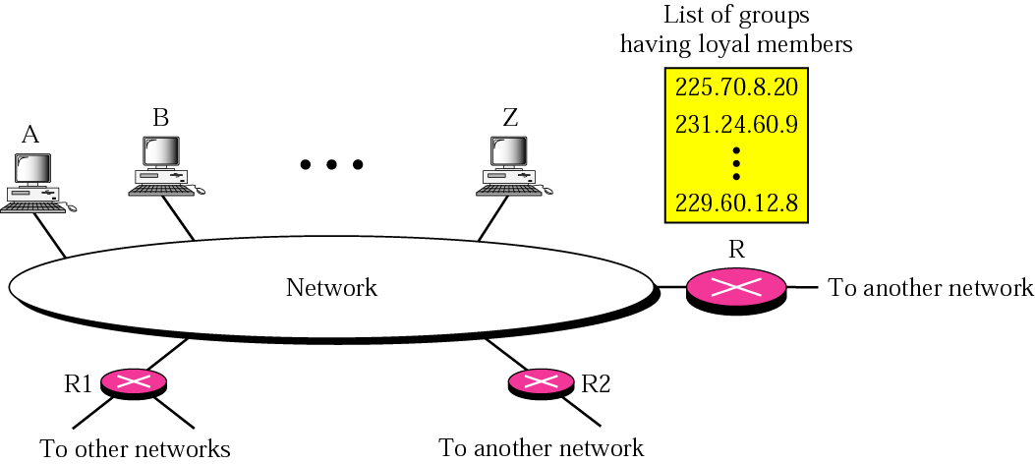
Figure 10.4 IGMP operation
TCP/IP Protocol Suite

Slide 11
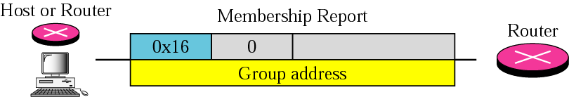
Figure 10.5 Membership report
TCP/IP Protocol Suite

Slide 12
Note:
In IGMP, a membership report is sent twice, one after the other.
TCP/IP Protocol Suite

Slide 13
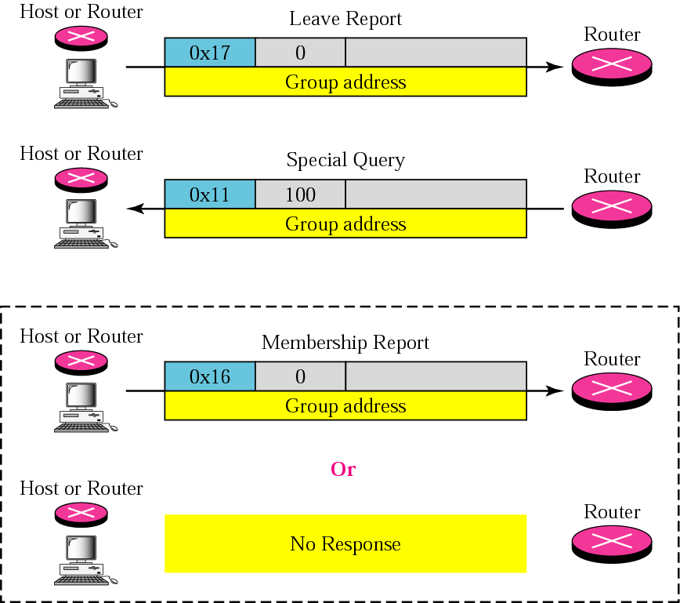
Figure 10.6 Leave report
TCP/IP Protocol Suite

Slide 14
Note:
The general query message does not define a particular group.
TCP/IP Protocol Suite

Slide 15
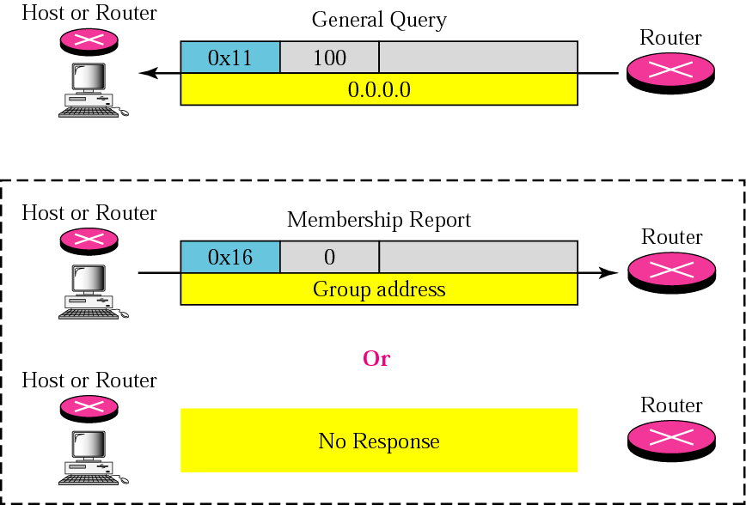
Figure 10.7 General query message
TCP/IP Protocol Suite

Slide 16
10.4 ENCAPSULATION
The IGMP message is encapsulated in an IP datagram, which is itself encapsulated in a frame.
The topics discussed in this section include:
IP Layer
Data Link Layer
Netstat Utility
TCP/IP Protocol Suite

Slide 17
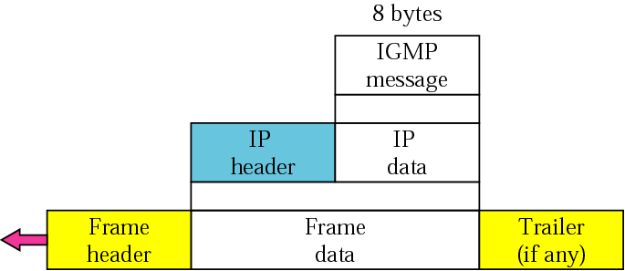
Figure 10.9 Encapsulation of IGMP packet
TCP/IP Protocol Suite

Slide 18
Note:
The IP packet that carries an IGMP packet has a value of 2 in its
protocol field.
TCP/IP Protocol Suite

Slide 19
Note:
The IP packet that carries an IGMP packet has a value of 1 in its
TTL field.
TCP/IP Protocol Suite

Slide 20
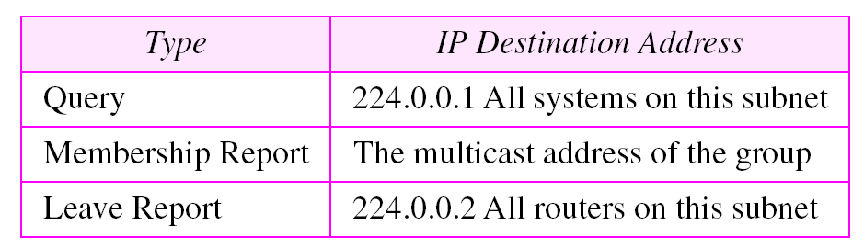
Table 10.2 Destination IP addresses
TCP/IP Protocol Suite

Slide 21
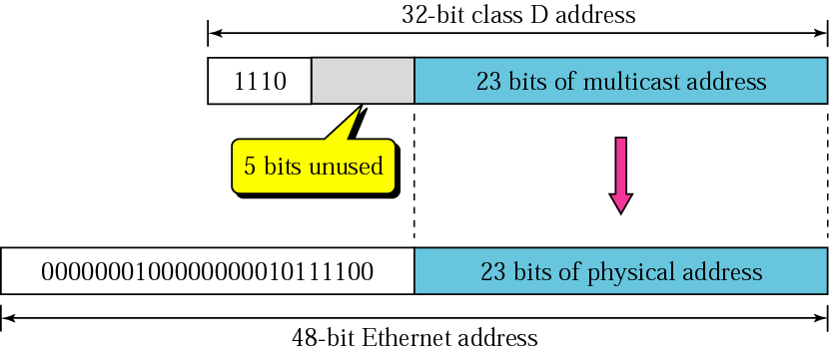
Figure 10.10 Mapping class D to Ethernet physical address
TCP/IP Protocol Suite

Slide 22
Note:
An Ethernet multicast physical address is in the range
01:00:5E:00:00:00
to
01:00:5E:7F:FF:FF.
TCP/IP Protocol Suite

Slide 23
10.5 IGMP PACKAGE
We can show how IGMP can handle the sending and receiving of IGMP packets through our simplified version of an IGMP package. In our design an IGMP package involves a group table, a set of timers, and four software modules.
The topics discussed in this section include:
Group Table
Timers
Group-Joining Module
Group-Leaving Module
Input Module
Output Module
TCP/IP Protocol Suite

Slide 24
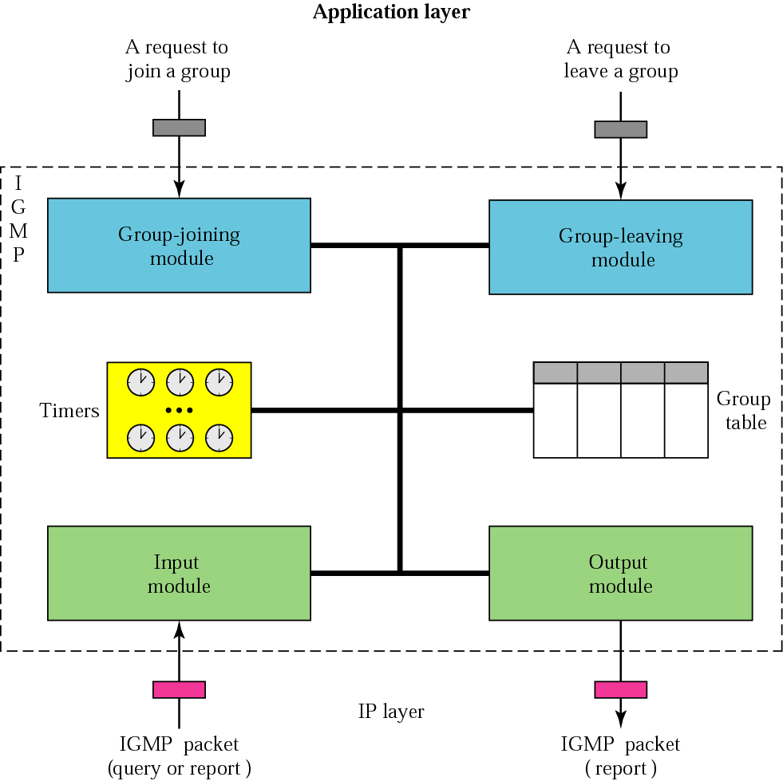
Figure 10.12 IGMP package
TCP/IP Protocol Suite

Slide 25
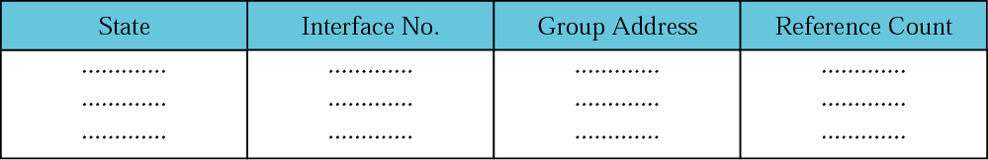
Figure 10.13 Group table
TCP/IP Protocol Suite

