Slide 1


Global Warming Hiatus?
https://github.com/zmlabe/MAPS_2018

Slide 2
Global Warming Hiatus?

Slide 3

Global Warming Hiatus?

Slide 4
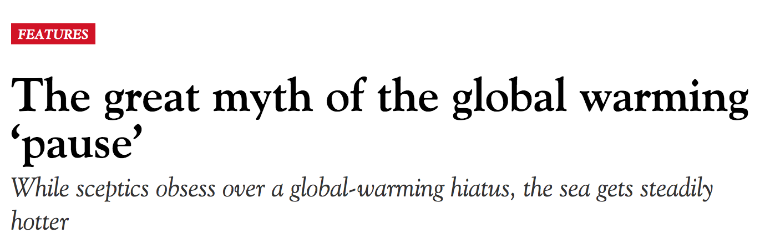
Global Warming Hiatus?

Slide 5

Global Warming Hiatus?

Slide 6

Global Warming Hiatus?

Slide 7
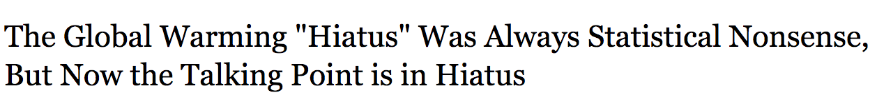
Global Warming Hiatus?

Slide 8
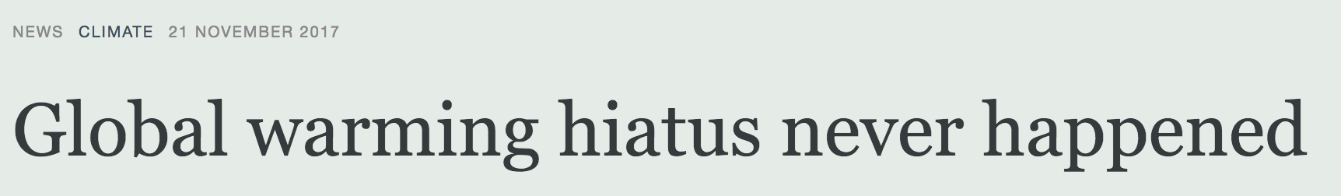
Global Warming Hiatus?

Slide 9

Global Warming Hiatus?

Slide 10
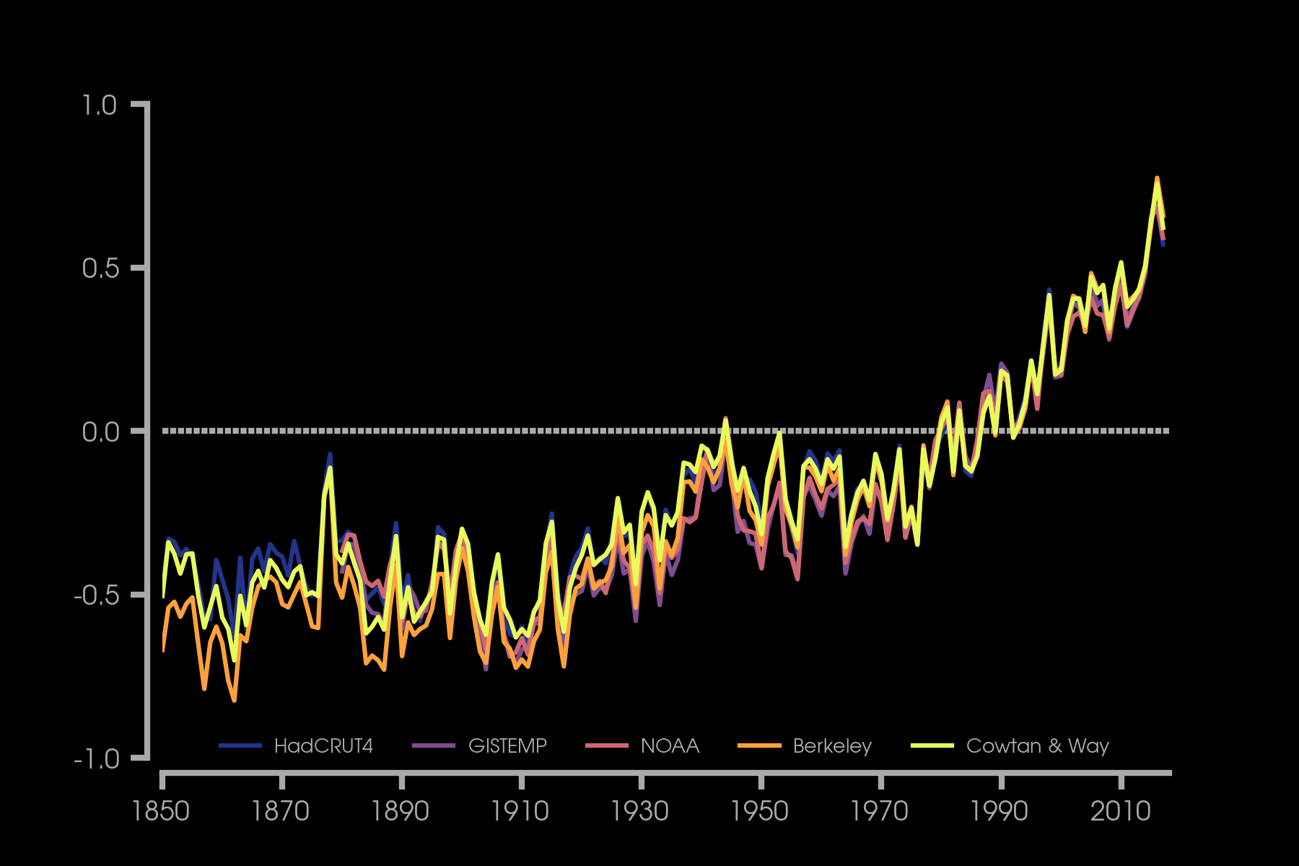
Global Warming Hiatus?
~224 papers, to-date

Slide 11
Global Warming Hiatus
“slowdown” of the increase in annual global mean surface temperature
Starting around 1998 to 2012
Definitions and statistics vary
Identified in the IPCC AR5 report
No consensus on cause of hiatus

Slide 12
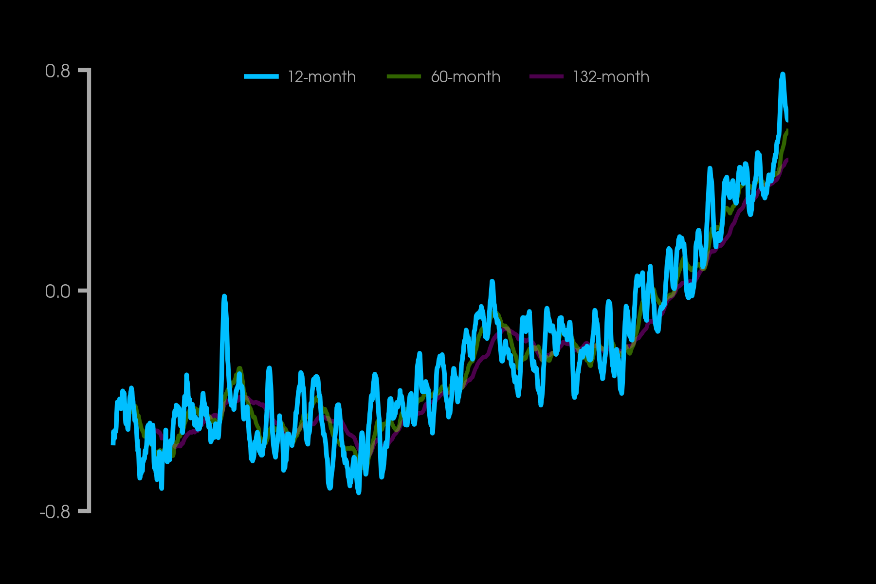
Temperature Anomaly (°C)
Minimizes influence of seasonality

Slide 13
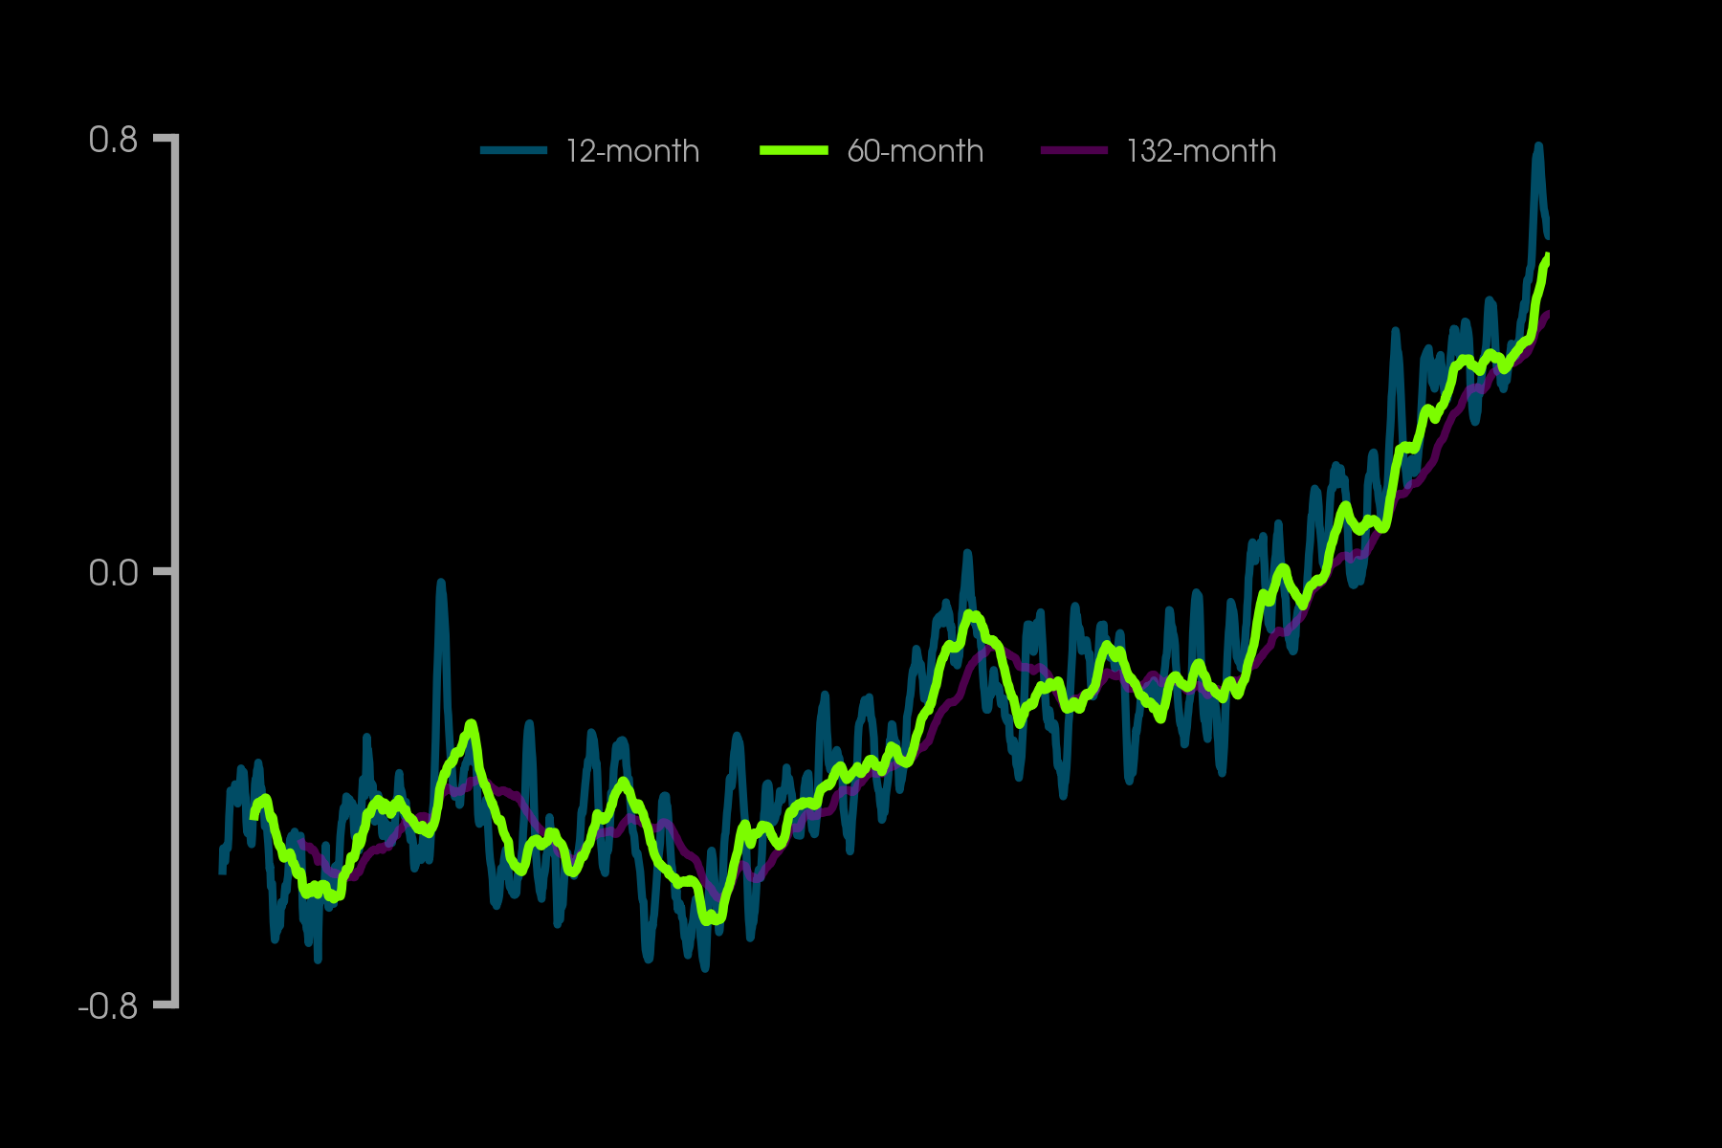
Temperature Anomaly (°C)
Minimizes influence of ENSO variability

Slide 14
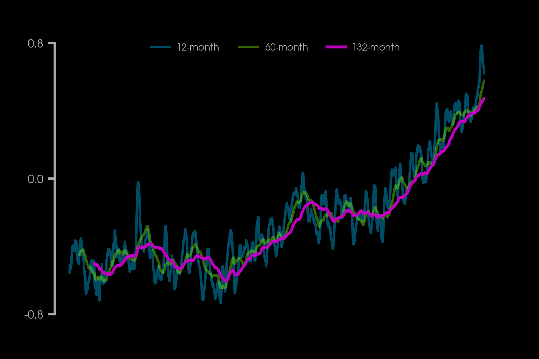
Temperature Anomaly (°C)
Minimizes influence of 11-year solar cycle

Slide 15
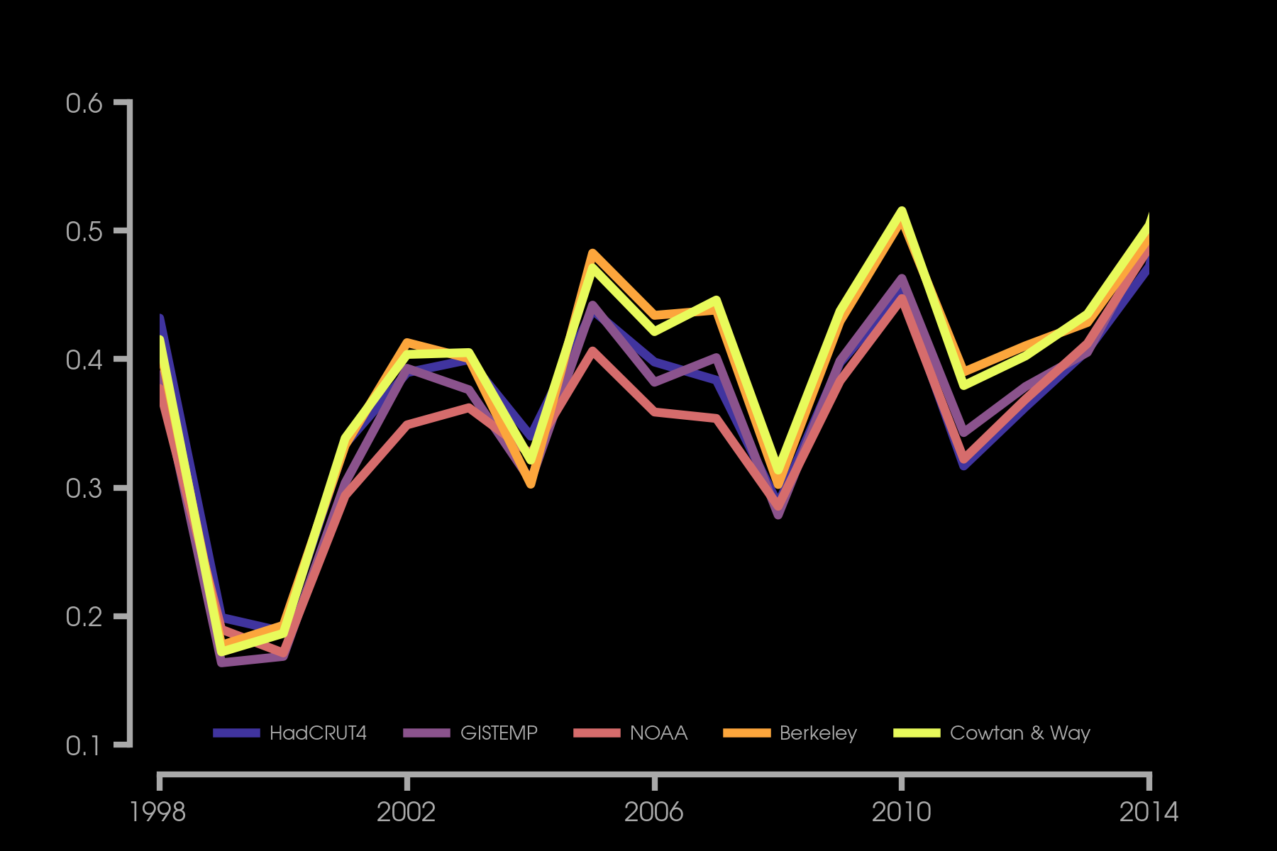
Hiatus period?
Temperature Anomaly (°C)

Slide 16
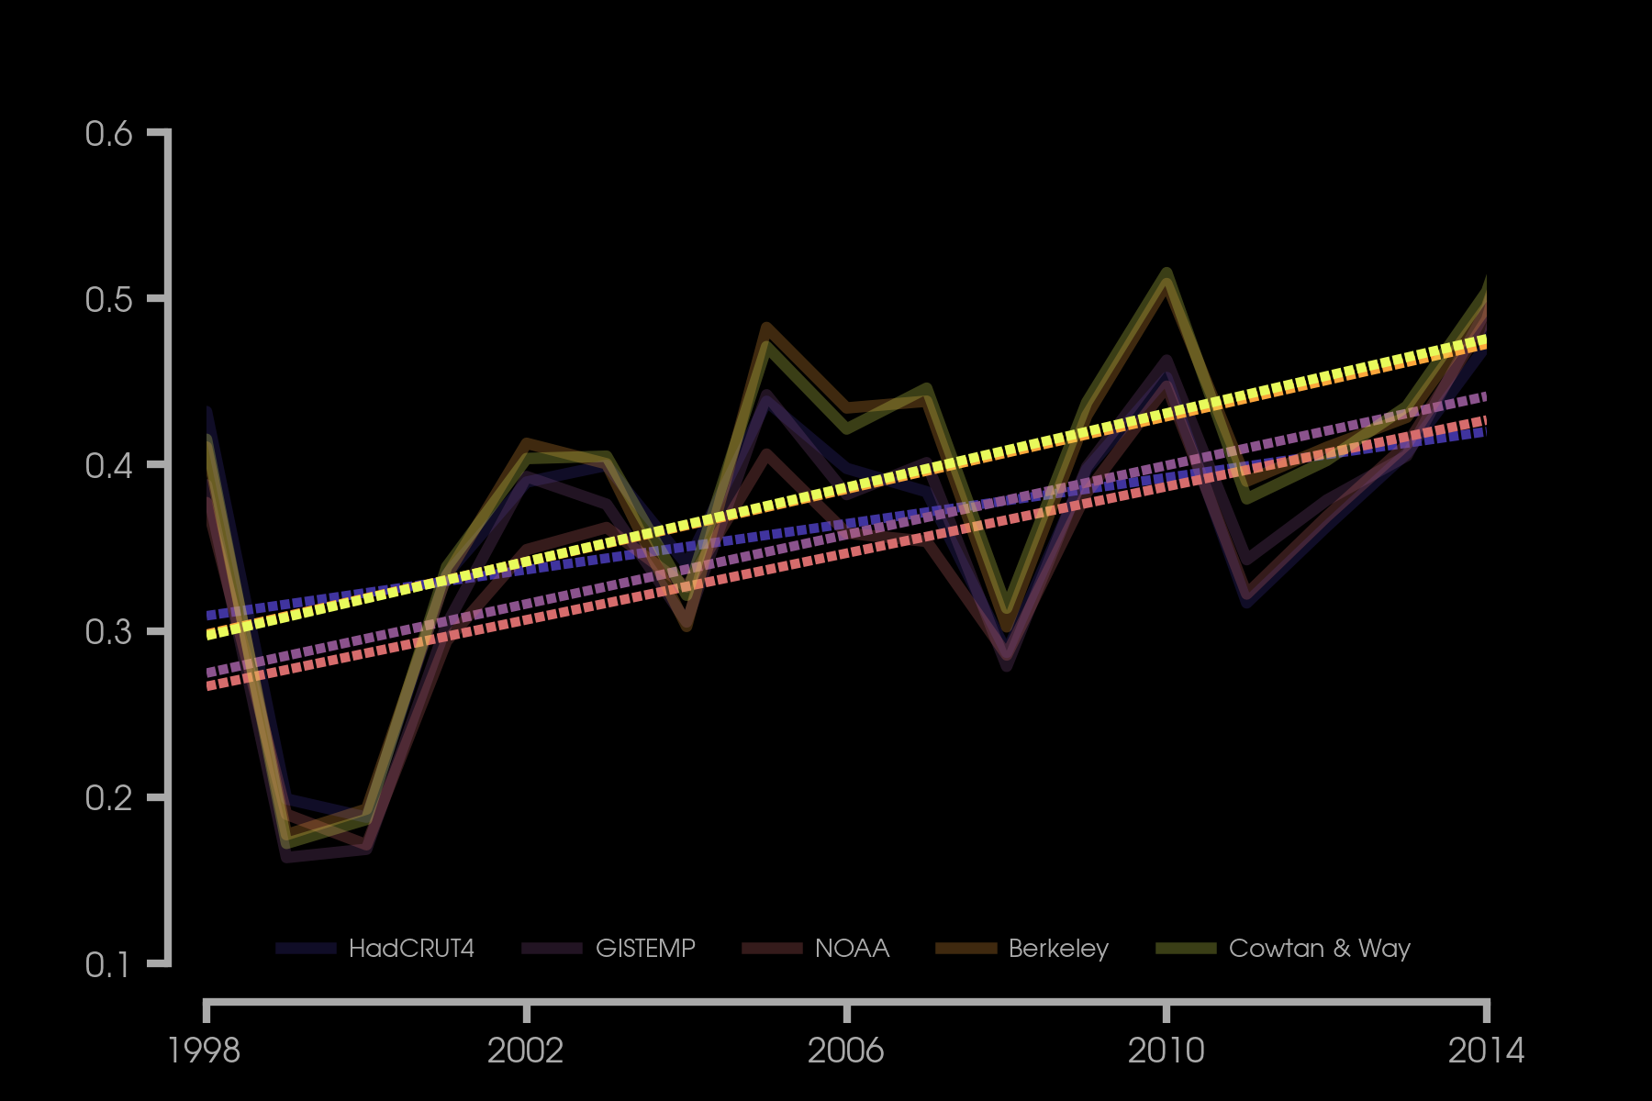
Hiatus period?
Temperature Anomaly (°C)

Slide 17
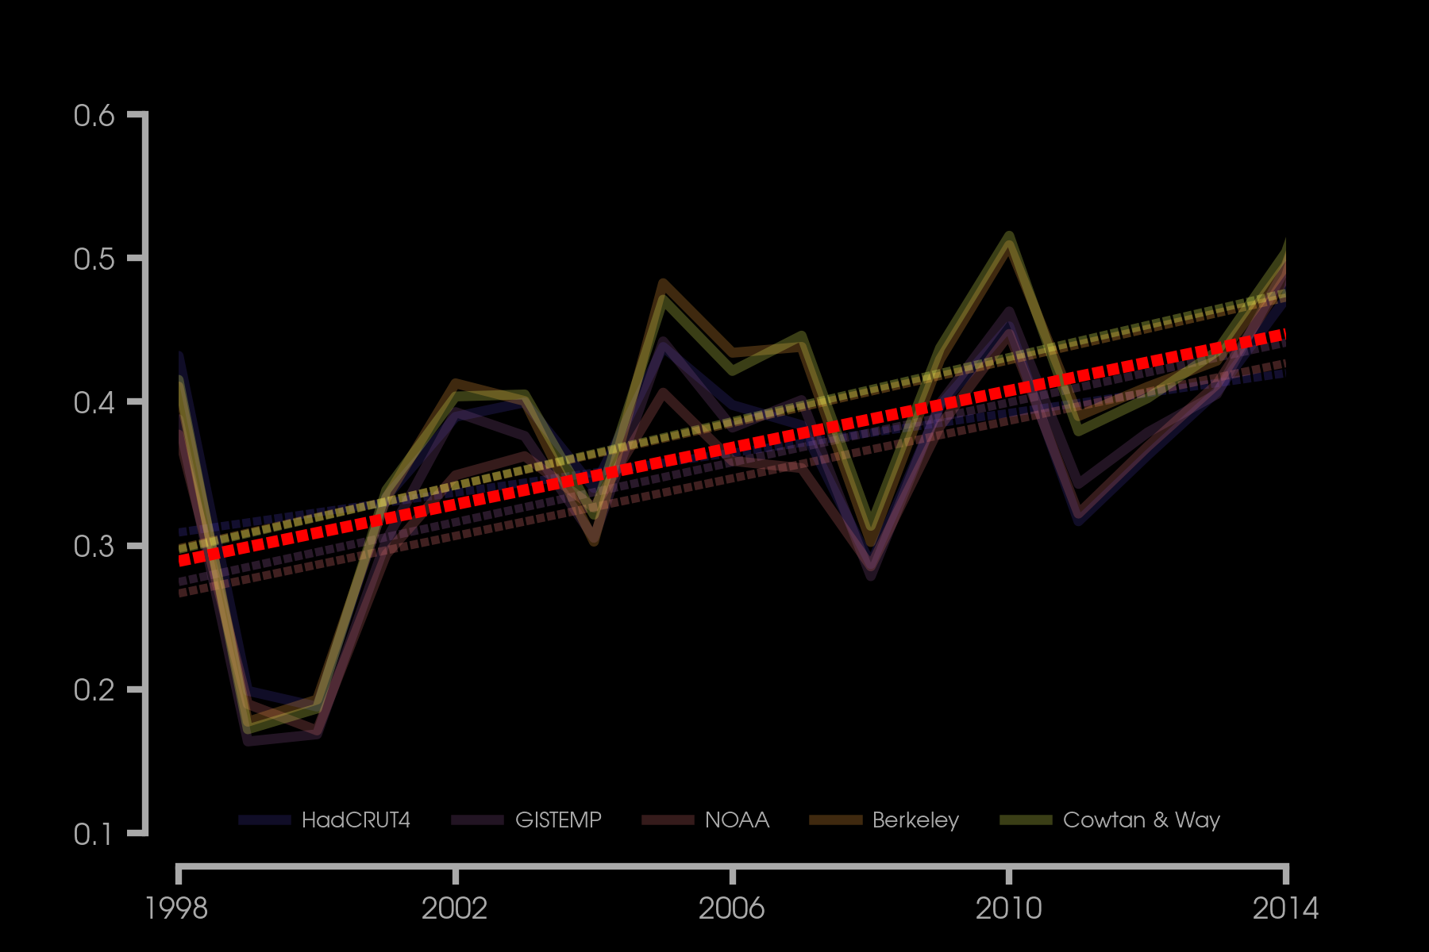
Hiatus period?
Temperature Anomaly (°C)

Slide 18
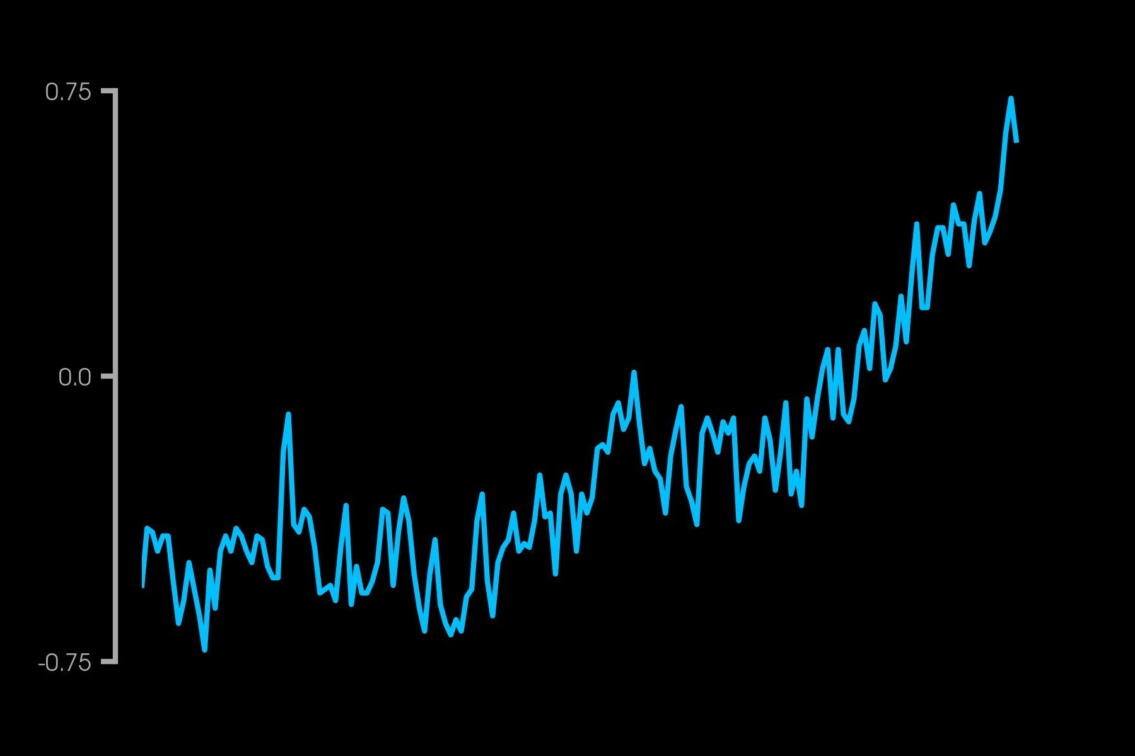
ANNUAL TEMPERATURES
Temperature Anomaly (°C)

Slide 19
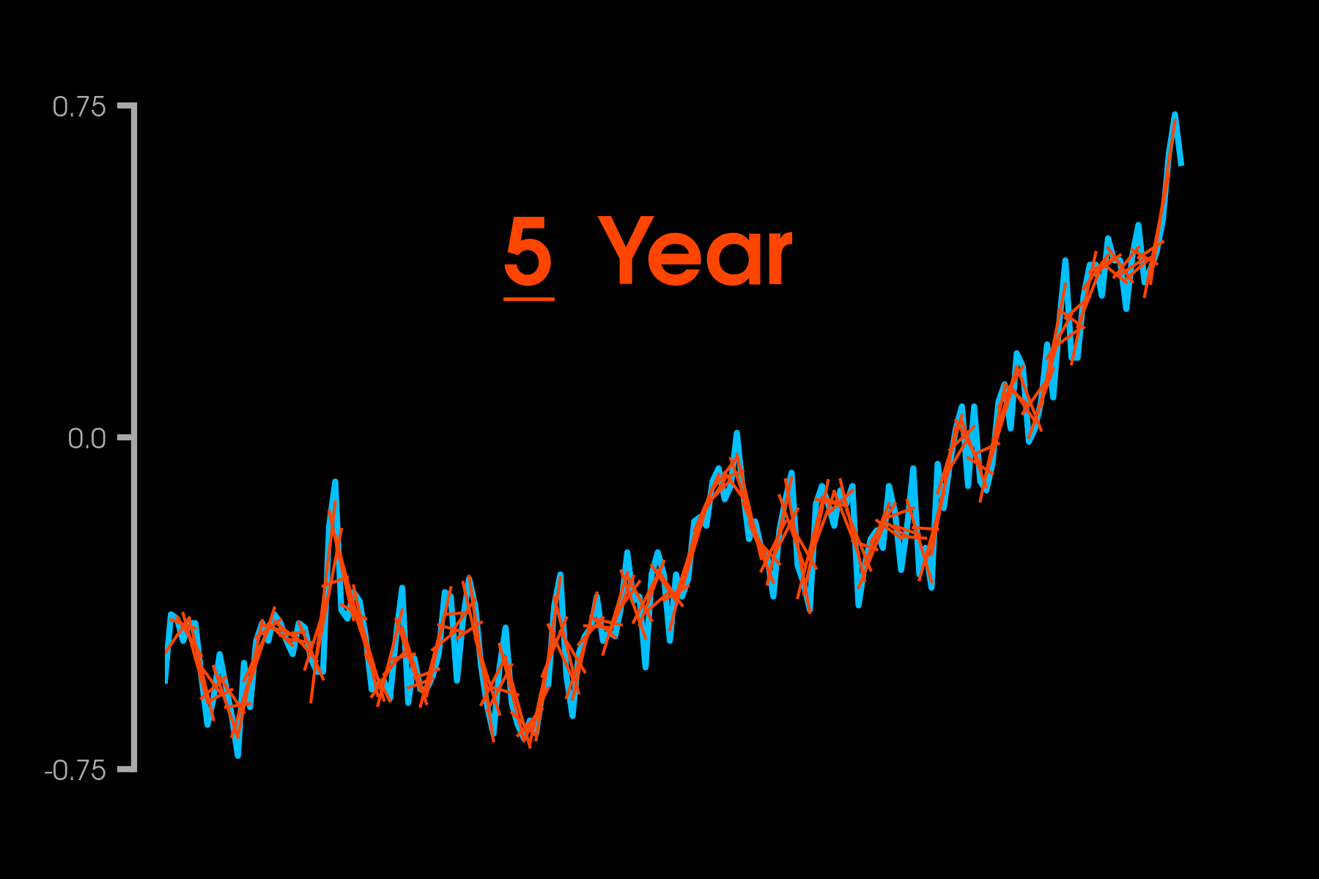
Temperature Anomaly (°C)

Slide 20
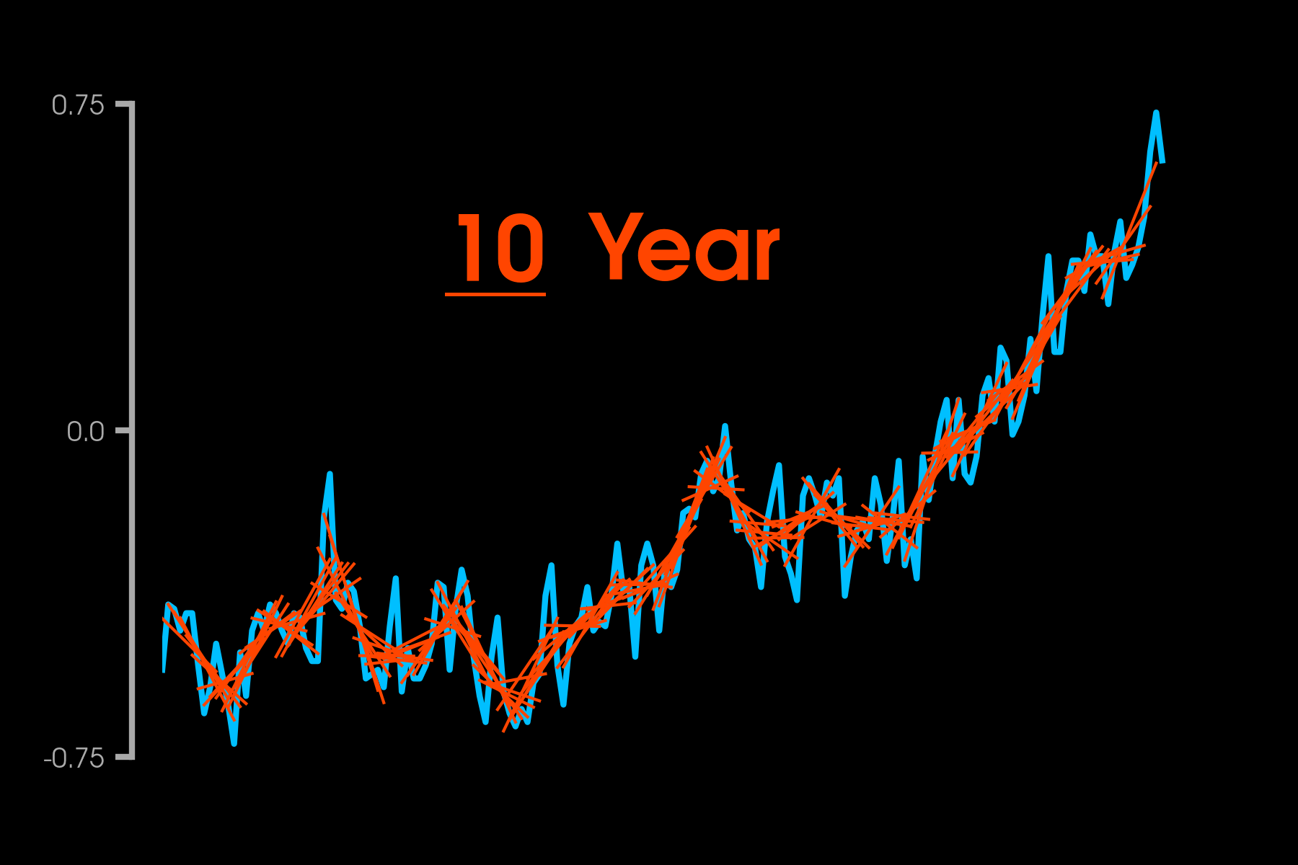
Temperature Anomaly (°C)

Slide 21
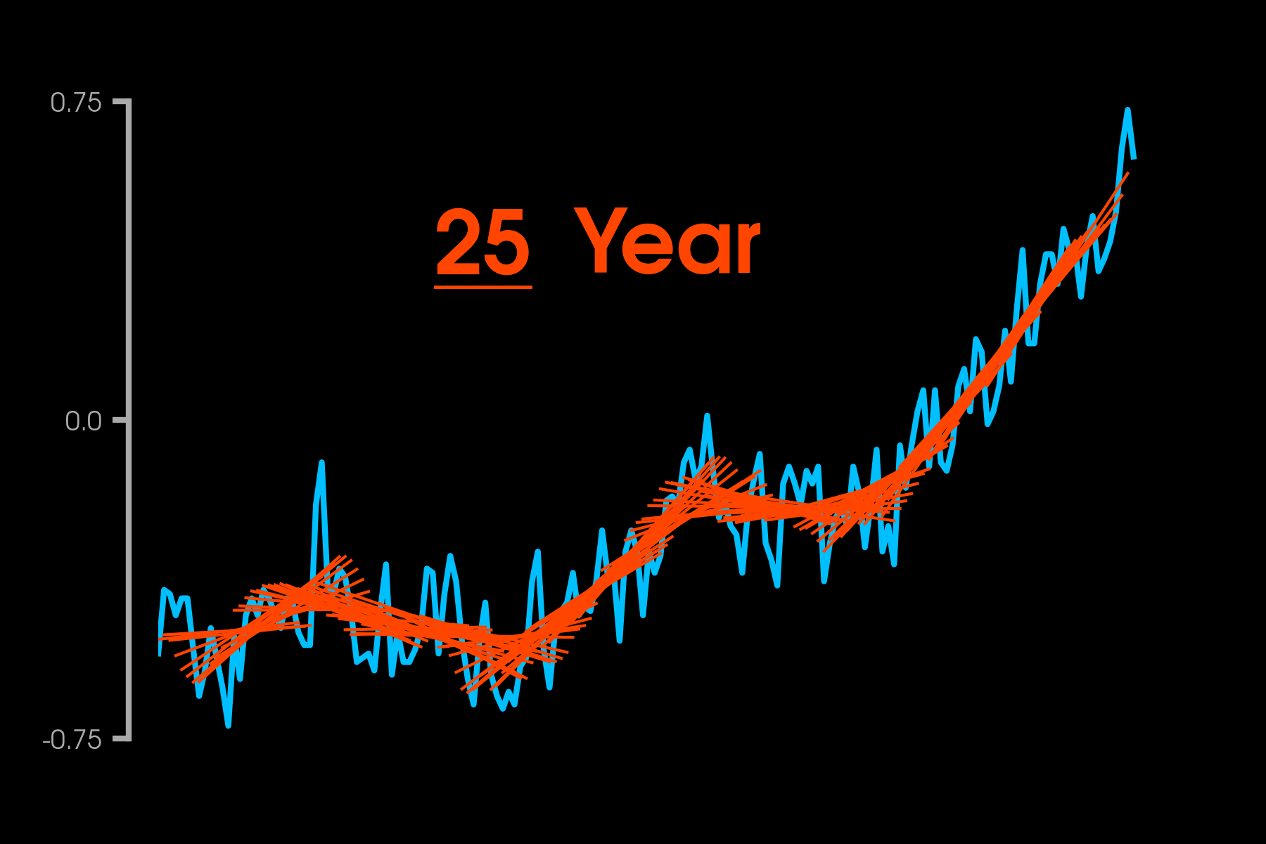
Temperature Anomaly (°C)

Slide 22
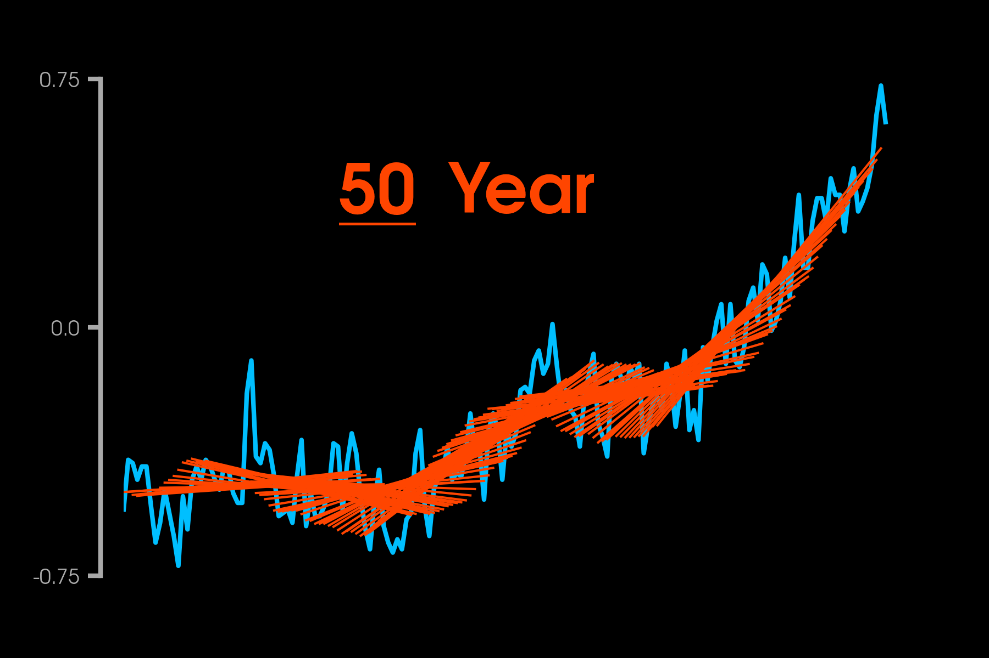
Temperature Anomaly (°C)

Slide 23
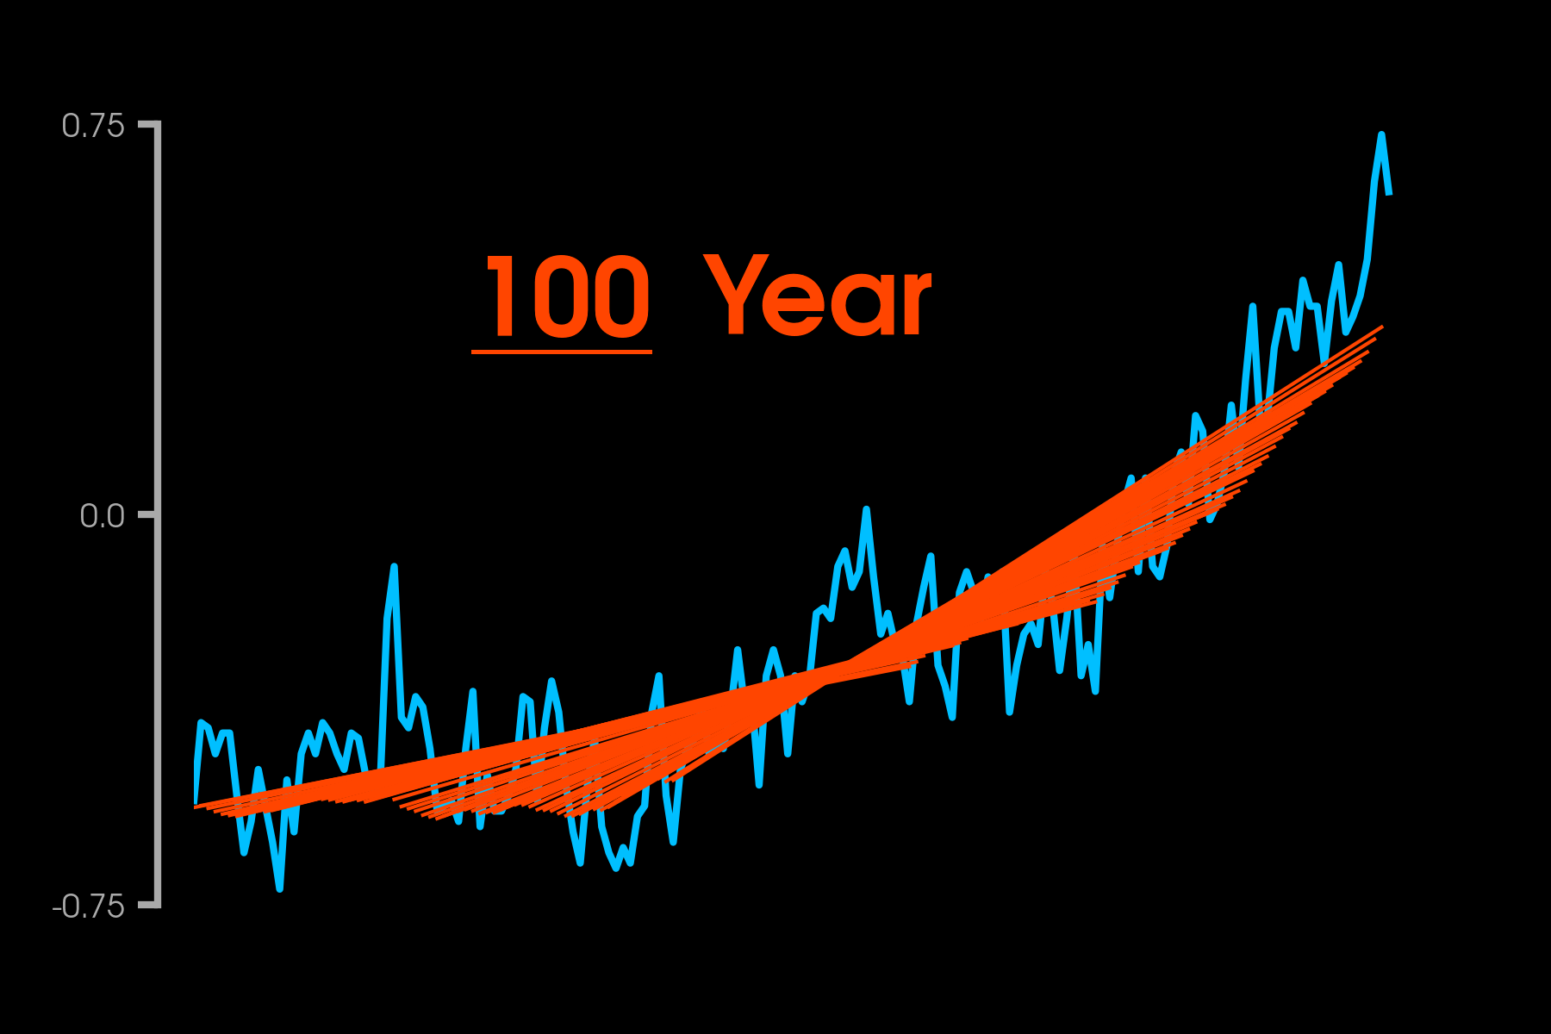
Temperature Anomaly (°C)

Slide 24
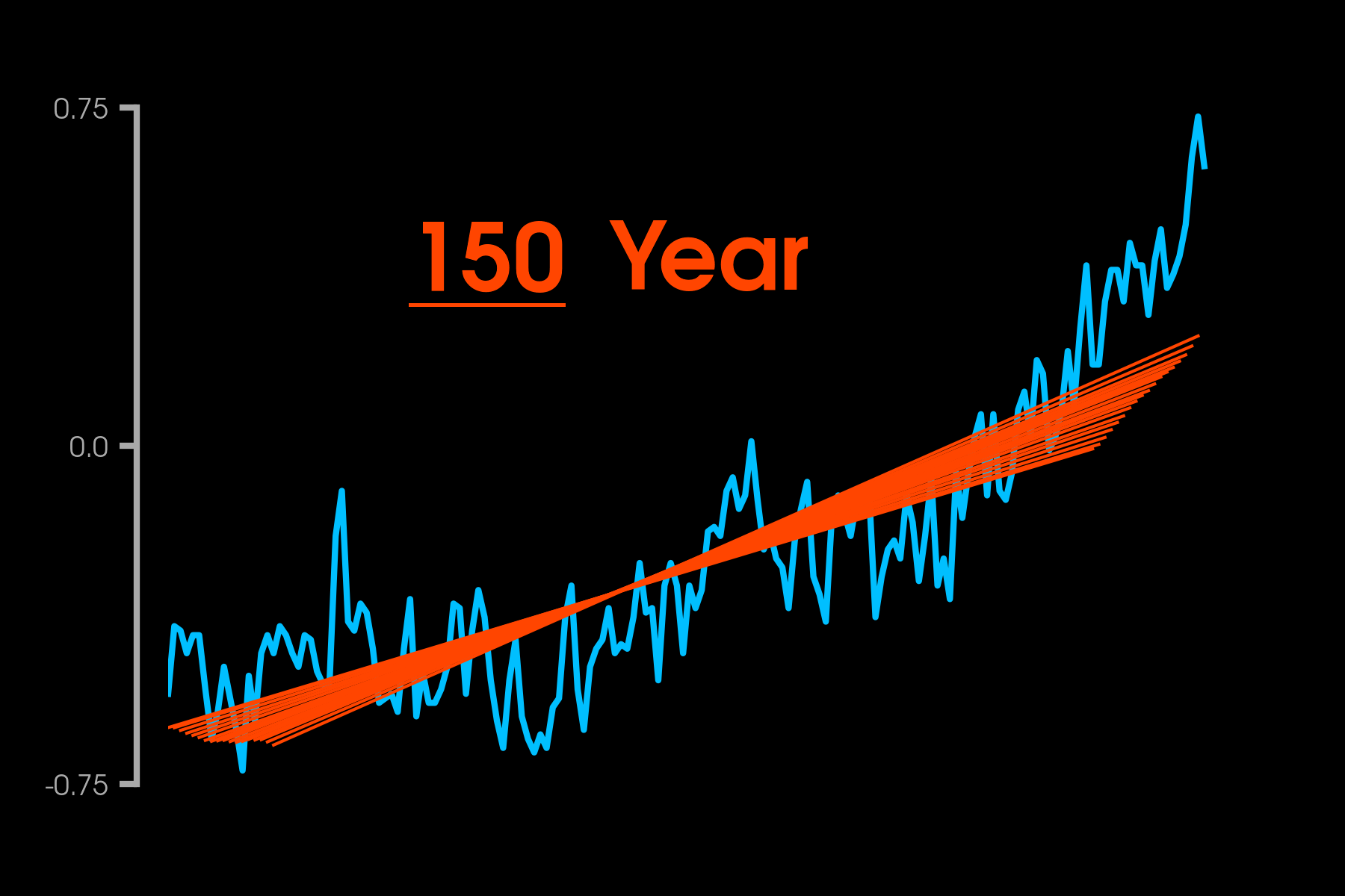
Temperature Anomaly (°C)

Slide 25
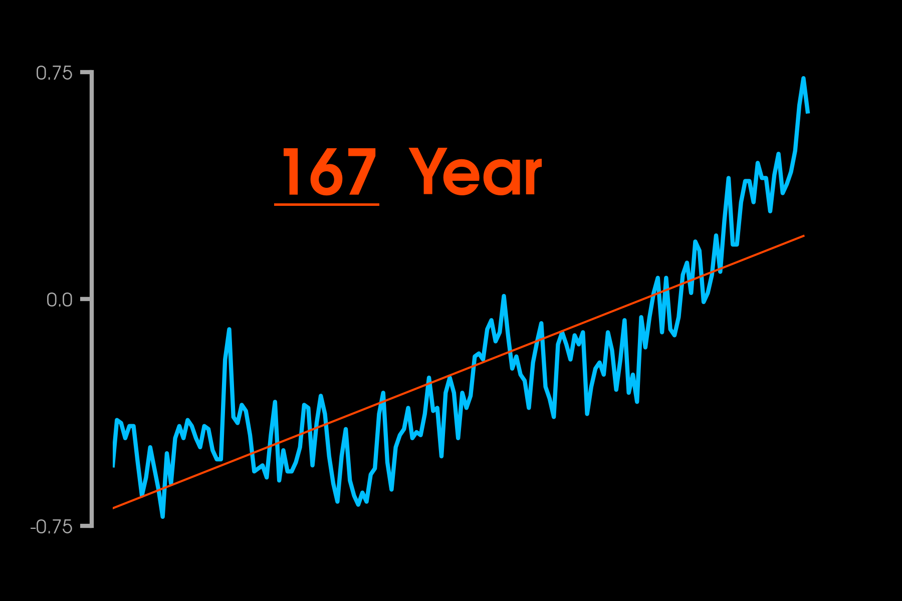
Temperature Anomaly (°C)

Slide 26
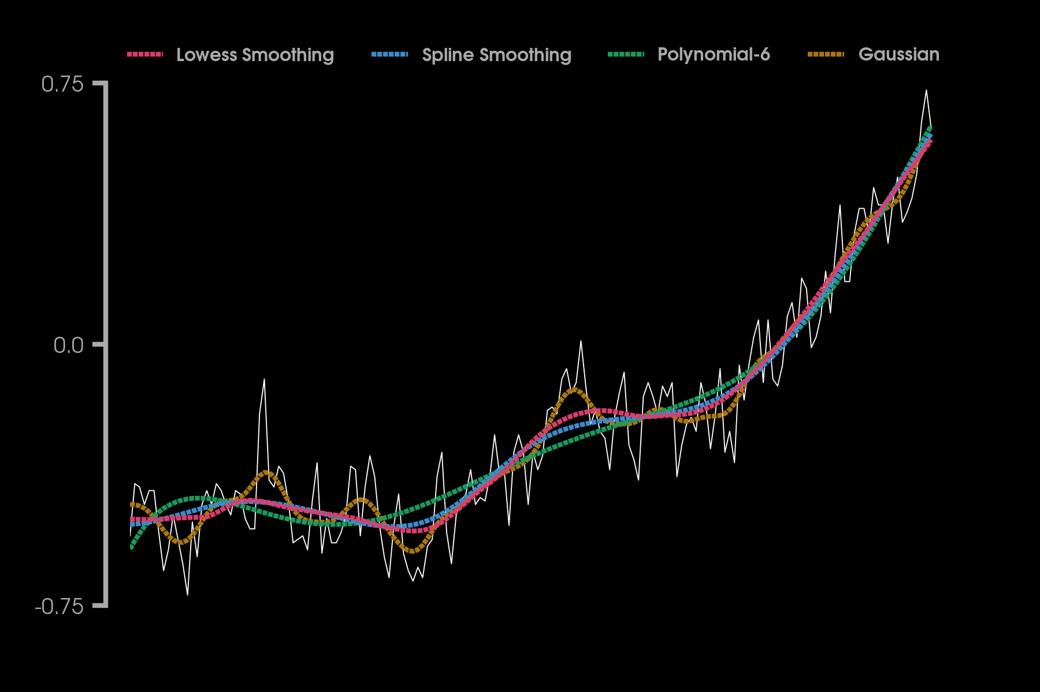
Temperature Anomaly (°C)

