Slide 1
What is mobile device and its various types
A portable computing device such as smartphone or tablet computer.
A mobile device is a general term for any type of handheld computer.
Some mobile devices are:-
tablets
e-readers
Smartphones
netbooks
personal digital assistant (e.g. iPod Touch)
GPS navigation device (a.k.a. car or personal navigation device)

Slide 2
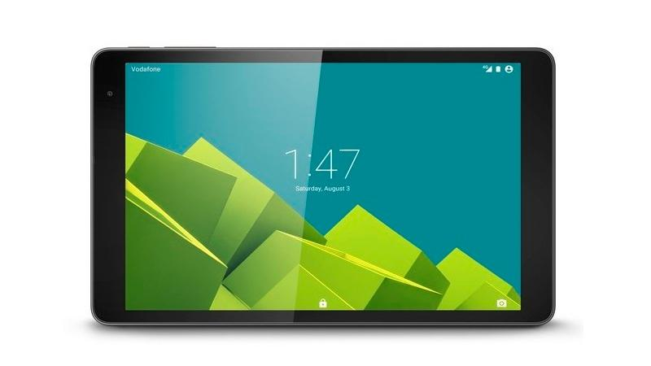
TABLETS
Like laptops, tablet computers are designed to be portable. However, they provide a different computing experience. The most obvious difference is that tablet computers don't have keyboards or touchpads. Instead, the entire screen is touch-sensitive, allowing you to type on a virtual keyboard and use your finger as a mouse pointer.

Slide 3
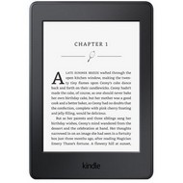
E- Readers
E-book readers—also called e-readers—are similar to tablet computers, except they are mainly designed for reading e-books (digital, downloadable books). Notable examples include the Amazon Kindle, Barnes & Noble Nook, and Kobo. Most e-readers use an e-ink display, which is easier to read than a traditional computer display. You can even read in bright sunlight, just like if you were reading a regular book.

Slide 4
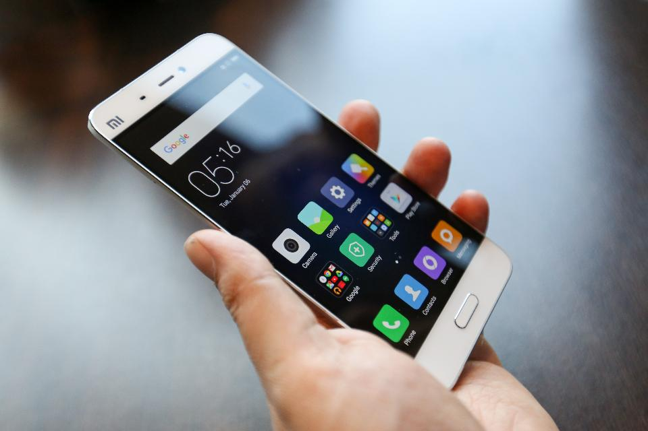
Smartphones
A smartphone is a more powerful version of a traditional cell phone. In addition to the same basic features—phone calls, voicemail, text messaging—smartphones can connect to the Internet over Wi-Fi or a cellular network (which requires purchasing a monthly data plan). This means you can use a smartphone for the same things you would normally do on a computer, such as checking your email, browsing the Web, or shopping online.

Slide 5
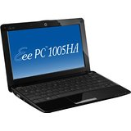
Netbooks
A netbook is a small, light, low-power notebook computer that has less processing power than a full-sized laptop but is still suitable for word processing, running a Web browser and connecting wirelessly to the Internet.

Slide 6
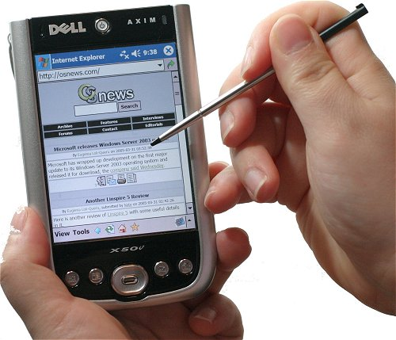
Personal digital assistant (e.g. iPod Touch)
PDA (personal digital assistant) is a term for any small mobile hand-held device that provides computing and information storage and retrieval capabilities forpersonal or business use, often for keeping schedule calendars and address book information handy.

Slide 7
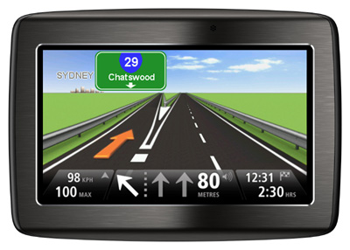
GPS navigation device
A GPS navigation system is a GPS receiver and audio/video (AV) components designed for a specific purpose such as a car-based or hand-held device or a smartphone app. The global positioning system (GPS) is a 24-satellite navigation system that uses multiple satellite signals to find a receiver's position on earth.

Slide 8
Application development
Application development
The term application development is often used to refer to the activity of computer programming, which is the process of writing and maintaining the source code, whereas the broader sense of the term includes all that is involved between the conception of the desired application through to the final manifestation of that application.
www programming model
The WAP programming model is similar to the WWW programming model.

Slide 9
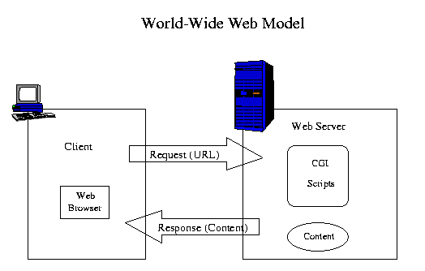

Slide 10
The WWW standards for building a an application environment includes:
Standard naming model - All servers and content on the WWW are named with an Internet-standard Uniform Resource Locator (URL).
Content typing - All servers and content on the WWW is given a specific type thereby allowing web browsers to correctly process the content based on its type.
Standard content formats - All web browsers support a set of standard content formats, including HTML and JavaScript.
Standard Protocols - Standard networking protocols allow any web browser to communicate with any web server. The most commonly used protocol on the WWW is HTTP.
Example https://www.google.co.in/

Slide 11
The WWW protocols define three classes of servers:
Origin Server - The server on which a given resource (content) resides or is to be created.
Proxy - An intermediary program that acts as both a server and a client for the purpose of making requests on behalf of other clients. The proxy typically resides between clients and servers that have not means of direct communications, eg across a firewall. Requests are either serviced by the proxy program or passed on, with possible transactions, to other servers. A proxy must implement both the client and server requirements of the WWW specifications.
Gateway - A server which acts as an intermediary for some other server. Unlike a proxy, a gateway receives requests as if it were the origin server for the requested resource. The requesting client may not be aware that it is communicating with a gateway

Slide 12
It borrows heavily from the WWW model and architecture and uses existing tools such as Web servers and XML tools. Optimizations and extensions have been made in order to support the characteristics of the wireless environment. Most of the existing WWW standards have been adopted and have been used as the starting point of the WAP technology.

Slide 13
Development environment for mobile devices
Mobile application development is a term used to denote the act or process by which application software is developed for mobile devices, such as personal digital assistants ,enterprise digital assistants or mobile phones. These applications can be pre-installed on phones during manufacturing platforms, or delivered as web applications using server-side or client-side processing (e.g., JavaScript) to provide an "application-like" experience within a Web browser. Application software developers also must consider a long array of screen sizes, hardware specifications, and configurations because of intense competition in mobile software and changes within each of the platforms. Mobile app development has been steadily growing, in revenues and jobs created.

