Slide 1
Motion detector
Bikesh Shrestha
Ari Rajamäki

Slide 2
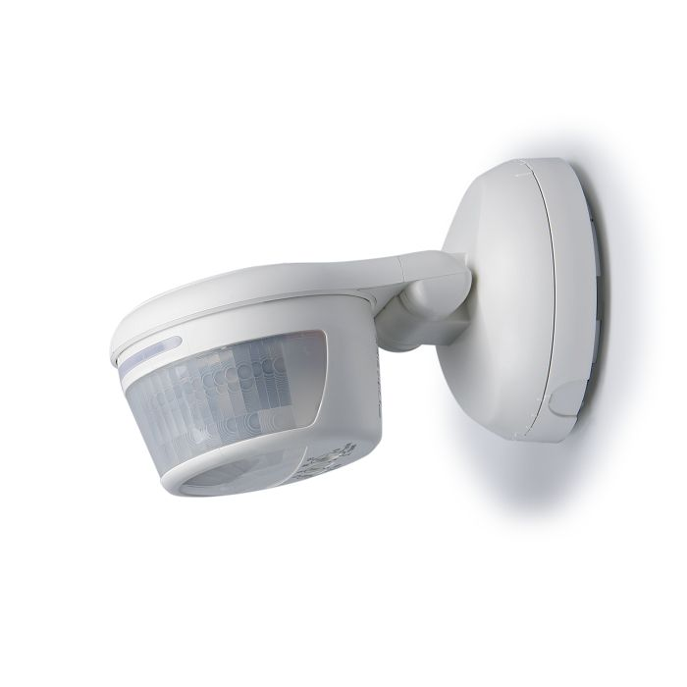
What is a motion detector?
introduction
A motion detector is a device that contains a motion sensor that detects moving objects and transforms the detection of motion into an electric signal.
The detector is often integrated as a component of a system that automatically performs a task or alerts a user of motion in an area. Motion detectors form a vital component of security, automated lighting control, home control, energy efficiency, and other useful systems.
section 01

Slide 3
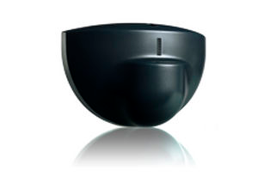
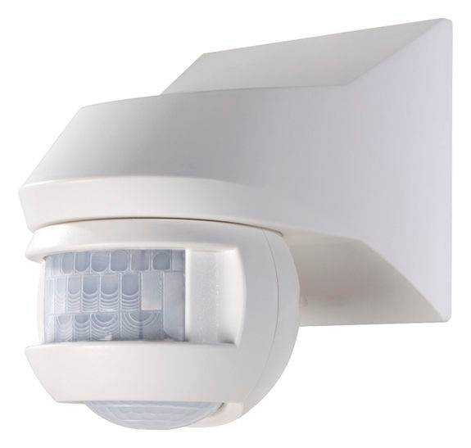
Motion sensor types
Motion sensor types
Active sensors
Motion detector has an active sensor if the sensor emits energy, such us microwaves or sound waves.
Passive sensors (PIR)
Passive sensors only detect incoming energy, such as infrared light.
section 01

Slide 4
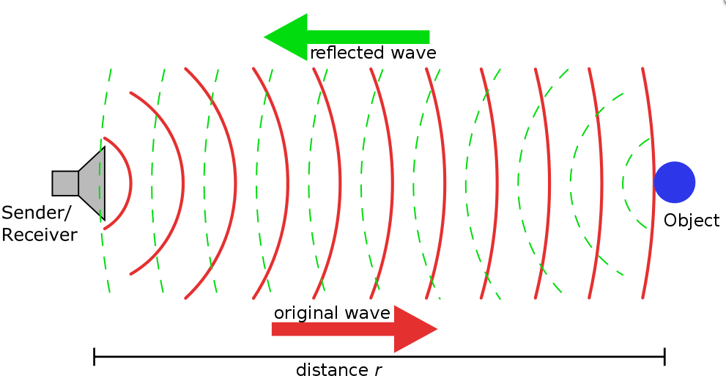
Active sensors
Motion sensor types
Active sensors work by sending out bursts of ultrasonic sound waves, after which the sensor waits for the energy to be reflected back. Good example of an active motion sensor is and automatic door opener. If there is nobody in the immediate area the waves will return in the same patter in which they were released. If someone or something disturbs the pattern, the sensor sends an alarm signal in the event of disturbance in the pattern. The disturbed pattern triggers the sensor and opens the door.
See page 67 to 81 at www.slidedocs.com

Slide 5
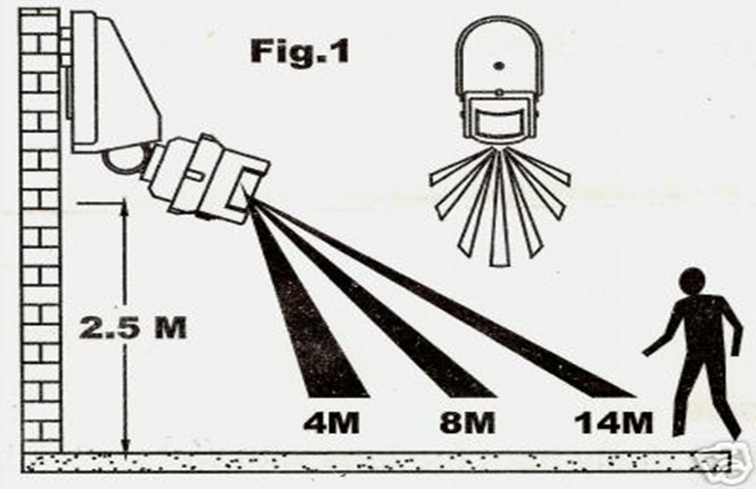
Passive sensors (PIR)
Motion sensor types
These sensors detect and measure incoming infrared energy. The infrared ray is emitted by the heat of the body or any light sources. Depending upon the purpose of the sensor the range of IR filter can be limited to certain level. Most passive infrared sensors can actually detect emissions in the range of 8 to 12 micrometers. They use a photo detector. which coverts light in these wavelengths into an electrical current, which is run through a tiny computer housed in the unit. The alarm is triggered when the photo detector detects large or fast variations in the distribution of the emitted infrared energy. The output power is almost entirely provided by the measured signal without an excitation voltage.
See page 67 to 81 at www.slidedocs.com

Slide 6
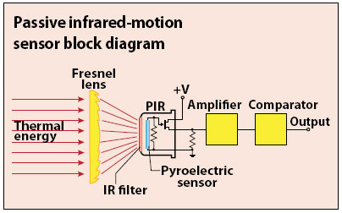
AMN31111
Sensor characteristics
AMN3111 is has singe-chip IC with built-in amplifier and comparator.
It detects variations in infrared rays. However, it may not detect in the following case: lack of movement, no temperature change in the heat source
Signal can converted to digital by external A/D converter. It also can be connected directly to microcomputer. Signal may not be need to convert to digital if digital version of the sensor is chosen.
It's calibrated to detect differences in the temperature between the background and the object, movement speed and the object(human body).
Some noise is detected in the sensor, typical noise value being 155 m Vp-p to maximum of 300 m Vp-p. A noise ﬁlter is recommended for applications requiring enhanced detection, reliability and noise withstanding capability.
See page 67 to 81 at www.slidedocs.com

Slide 7
Applications & Conclusions
Motion sensors
They are widely used for electronic devices like mobile phones, cameras and gadgets
Used for security purposes both in domestic and commercial areas like in doors and cctv cameras.
Cheap and easy to implement.
It saves energy by activating and deactivating devices.
Used to avoid accident in traffic lights and in vehicles.
Widely used in every field in almost every moving artificial things which are in air, water or land.
See page 67 to 81 at www.slidedocs.com

Slide 8
thank you

