Slide 1
Routing Protocols

Slide 2
Static Routing
Typically used in hosts
  Enter subnet mask, router (gateway), IP address
  Perfect for cases with few connections, doesn’t change much
    E.g. host with a single router connecting to the rest of the Internet
Internet
IP: 128.1.1.100
R1
H1
H2
H3
For H1
Next Hop:
128.1.1.100

Slide 3
Dynamic Routing
Most routers use dynamic routing
  Automatically build the routing tables
  As we saw previously, there are two major approaches
    Link State Algorithms
    Distance Vector Algorithms
First some terminology
AS = Autonomous System
  Contiguous set of networks under one administrative authority
  Common routing protocol
  E.g. DAV University
  E.g. Intel Corporation
  A connected network
    There is at least one route between any pair of nodes

Slide 4
Routing in an Autonomous System (AS)
Interior Routing Protocol
Exterior Routing Protocol

Slide 5
Routing in an AS
IRP = Interior Routing Protocol
  Also IGP ; Interior Gateway Protocol
  Passes routing information between routers within AS
  Can use routing metric, e.g. hop count

Slide 6
Routing in an AS
ERP = Exterior Routing Protocol
  Also EGP; Exterior Gateway Protocol
  Passes routing information between routers across AS
  May be more than one AS in internet
  Routing algorithms and tables may differ between different AS
  Finds a path, but can’t find an optimal path since it can’t compare routing metrics via multiple AS

Slide 7
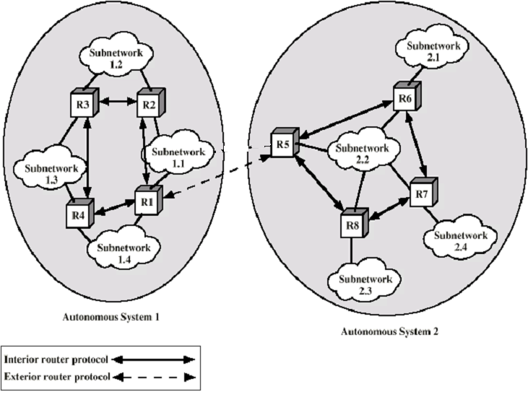
Application of IRP and ERP

Slide 8
Intra- Autonomous System Routing
Also known as Interior Router Protocols (IRP) or Interior Gateway Protocols (IGP)
Most common:
  RIP: Routing Information Protocol
  OSPF: Open Shortest Path First
  IGRP: Interior Gateway Routing Protocol (Cisco proprietary)

Slide 9
RIP ( Routing Information Protocol)
Distance vector algorithm
Included in BSD-UNIX Distribution in 1982
  routed
Distance metric: # of hops (max = 15 hops)
  Can you guess why?
Distance vectors: exchanged every 30 sec via Response Message (also called advertisement)
Each advertisement: route to up to 25 destination nets

Slide 10
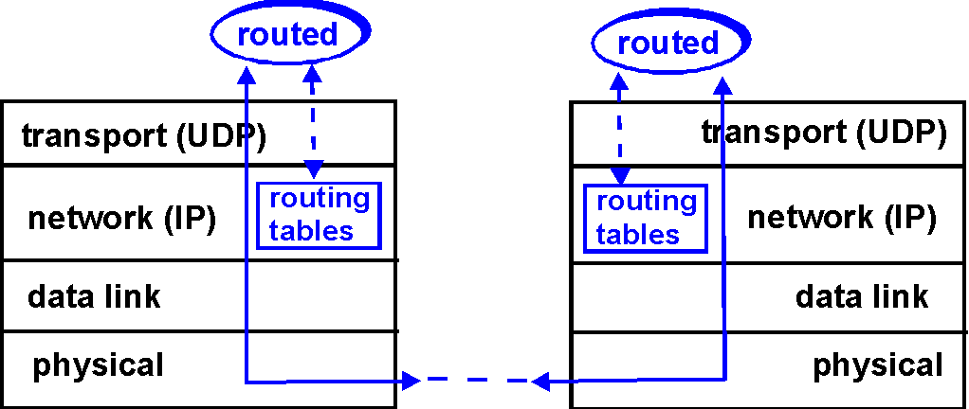
RIP Table processing
RIP routing tables managed by application-level process called route-d (daemon)
advertisements sent in UDP packets, periodically repeated

Slide 11
RIP
Advantages
  Simplicity ; little to no configuration, just start routed up
  Passive version for hosts
    If a host wants to just listen and update its routing table

Slide 12
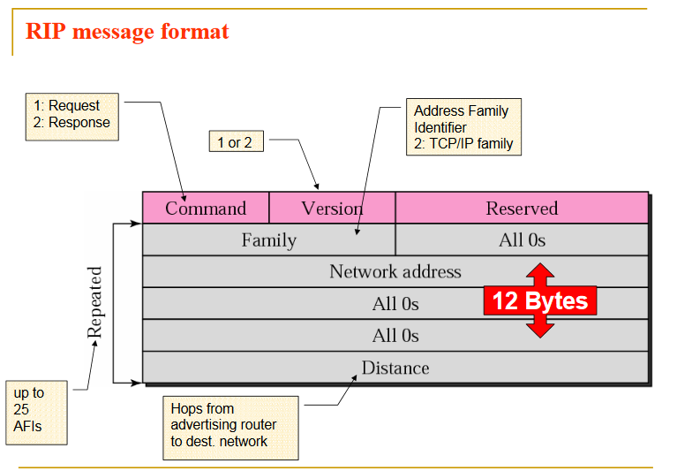
Packet Format of RIP

Slide 13
OSPF (Open Shortest Path First)
“Open”: publicly available
  RFC 2328
Uses Link State algorithm
  LS packet dissemination
  Topology map at each node
  Route computation using Dijkstra’s algorithm
OSPF advertisement carries one entry per neighbor router
Advertisements dispersed to entire AS (via flooding)
Conceived as a successor to RIP

Slide 14
OSPF “advanced” features (not in RIP)
Security: all OSPF messages authenticated (to prevent malicious intrusion); TCP connections used
Multiple same-cost paths allowed (only one path in RIP)
For each link, multiple cost metrics for different Type Of Service (e.g., satellite link cost set “low” for best effort; high for real time)
Integrated uni- and multicast support:
  Multicast OSPF (MOSPF) uses same topology data base as OSPF
Hierarchical OSPF in large domains.

Slide 15

Hierarchical OSPF

Slide 16
Internet inter-AS/ERP routing: BGP
BGP (Border Gateway Protocol): the de facto standard
  Version 4 the current standard
Path Vector protocol:
  similar to Distance Vector protocol
  each Border Gateway broadcast to neighbors (peers) entire path (i.e, sequence of ASs) to destination
  E.g., Gateway X may send its path to dest. Z:
Path (X,Z) = X,Y1,Y2,Y3,…,Z

Slide 17
Internet inter-AS routing: BGP
BGP messages exchanged using TCP.
BGP messages:
  OPEN: opens TCP connection to peer and authenticates sender
  UPDATE: advertises new path (or withdraws old)
  KEEPALIVE keeps connection alive in absence of UPDATES; also ACKs OPEN request
  NOTIFICATION: reports errors in previous msg; also used to close connection

Slide 18
Why different Interior/Exterior routing ?
Policy:
Inter-AS / Exterior: admin wants control over how its traffic routed, who routes through its net.
Intra-AS / Interior: single admin, so no policy decisions needed
Scale:
hierarchical routing saves table size, reduced update traffic, hierarchical scheme allows different interior routing protocols
Performance:
Intra-AS / Interior: can focus on performance, customization
Inter-AS / Exterior: policy may dominate over performance

