Slide 1
Car Price Prediction with Machine Learning
CodeAlpha Internship Project

Slide 2
Certificate Submission
Complete internship project report and presentation.

Slide 3
Problem Statement
Predict vehicle prices using machine learning techniques.

Slide 4
Project Objectives
Build accurate regression models and compare performance.

Slide 5
Introduction
Car price prediction helps buyers, sellers, and dealerships.

Slide 6
Dataset Overview
Rows: 2500 | Columns: 10

Slide 7
Dataset Features
Input features used for training the model.

Slide 8
Exploratory Data Analysis
Understanding distributions and relationships.

Slide 9
Data Cleaning
Encoding categorical variables and preparing data.

Slide 10
Feature Engineering
Selection and transformation of useful features.

Slide 11
Workflow Diagram
Data Collection → Cleaning → Training → Evaluation → Prediction

Slide 12
Train-Test Split
80% training and 20% testing data.

Slide 13
Linear Regression
Baseline regression model.

Slide 14
Decision Tree Regressor
Tree-based regression approach.

Slide 15
Random Forest Regressor
Ensemble model using multiple trees.

Slide 16
Python Libraries
Pandas, NumPy, Scikit-learn, Matplotlib.

Slide 17
Code Snippet 1
Load dataset and preprocess data.

Slide 18
Code Snippet 2
Train regression models.

Slide 19
Code Snippet 3
Evaluate R² Score and MAE.

Slide 20
Model Comparison
Compare multiple regression algorithms.

Slide 21
Performance Metrics
R² Score and Mean Absolute Error.

Slide 22
Feature Importance
Most influential variables affecting price.

Slide 23
Business Applications
Pricing, valuation, insurance, dealerships.

Slide 24
Advantages
Fast, scalable, and data-driven predictions.

Slide 25
Limitations
Dependent on data quality and available features.

Slide 26
Future Scope
Hyperparameter tuning and advanced ML models.

Slide 27
Conclusion
Random Forest provided the strongest predictive performance.

Slide 28
Viva Questions
What is regression? What is R² score? Why Random Forest?

Slide 29
References
Scikit-learn, Pandas Documentation, CodeAlpha Guidelines.

Slide 30
Thank You
Questions & Answers

Slide 31
Model Comparison Table
Model | R2 | MAE
Linear Regression | 0.0026 | 6.7617
Decision Tree | -0.6258 | 6.29
Random Forest | 0.1143 | 5.8412

Slide 32
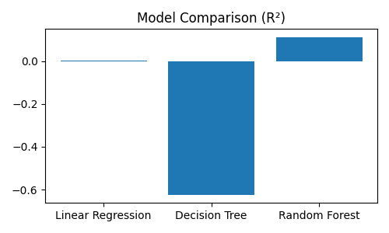
R² Comparison Chart

Slide 33
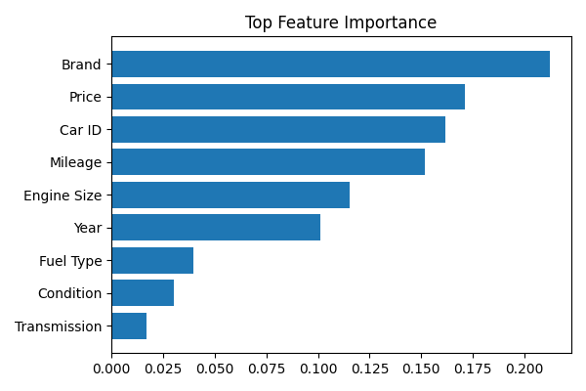
Random Forest Feature Importance

