Slide 1
Iris Flower Classification
CodeAlpha Internship Project

Slide 2
Certificate Project Overview
Complete ML workflow on Iris dataset.

Slide 3
Problem Statement
Classify Iris species using flower measurements.

Slide 4
Objectives
Build, train and evaluate a classification model.

Slide 5
Introduction to Machine Learning
ML enables systems to learn patterns from data.

Slide 6
About the Iris Dataset
Classic dataset with 150 samples and 3 classes.

Slide 7
Dataset Structure
4 numerical features and 1 target variable.

Slide 8
Feature 1
Sepal Length

Slide 9
Feature 2
Sepal Width

Slide 10
Feature 3
Petal Length

Slide 11
Feature 4
Petal Width

Slide 12
Data Preprocessing
Encoding labels and preparing features.

Slide 13
Train-Test Split
80% training and 20% testing.

Slide 14
Algorithm Selection
Random Forest chosen as primary model.

Slide 15
Random Forest Theory
Ensemble of decision trees.

Slide 16
Python Libraries
Pandas, Scikit-learn, Matplotlib.

Slide 17
Code Walkthrough 1
Load and inspect dataset.

Slide 18
Code Walkthrough 2
Prepare features and labels.

Slide 19
Code Walkthrough 3
Train the model.

Slide 20
Code Walkthrough 4
Evaluate predictions.

Slide 21
Model Results
Random Forest Accuracy: 100.00%

Slide 22
Algorithm Comparison
Comparison with KNN and SVM.

Slide 23
Performance Analysis
High accuracy due to well-separated classes.

Slide 24
Applications
Botany, education, pattern recognition.

Slide 25
Advantages
Fast, accurate and easy to interpret.

Slide 26
Limitations
Small dataset and limited real-world complexity.

Slide 27
Future Scope
Deep learning and deployment options.

Slide 28
Conclusion
Project objectives achieved successfully.

Slide 29
Viva Questions
What is classification? What is Random Forest?

Slide 30
Thank You
Questions and Discussion

Slide 31
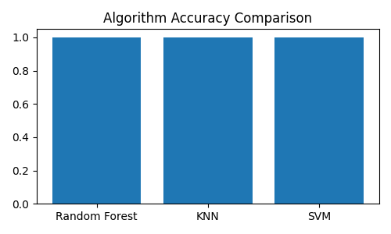
Accuracy Comparison Chart

