Slide 1



Exception Handling in Python

Slide 2

Python
Exceptions Exception Handling Try and Except Nested try Block
Handling Multiple Exceptions in single Except Block Raising Exception
Finally Block
User Defined Exceptions

Slide 3





Exception
When writing a program, we, more often than not, will encounter errors.
Error caused by not following the proper structure (syntax) of the language is called syntax error or parsing error
Errors can also occur at runtime and these are called exceptions.
They occur, for example, when a file we try to open does not exist (FileNotFoundError), dividing a number by zero (ZeroDivisionError)
Whenever these type of runtime error occur, Python creates an exception object. If not handled properly, it prints a traceback to that error along with some details about why that error occurred.

Slide 4
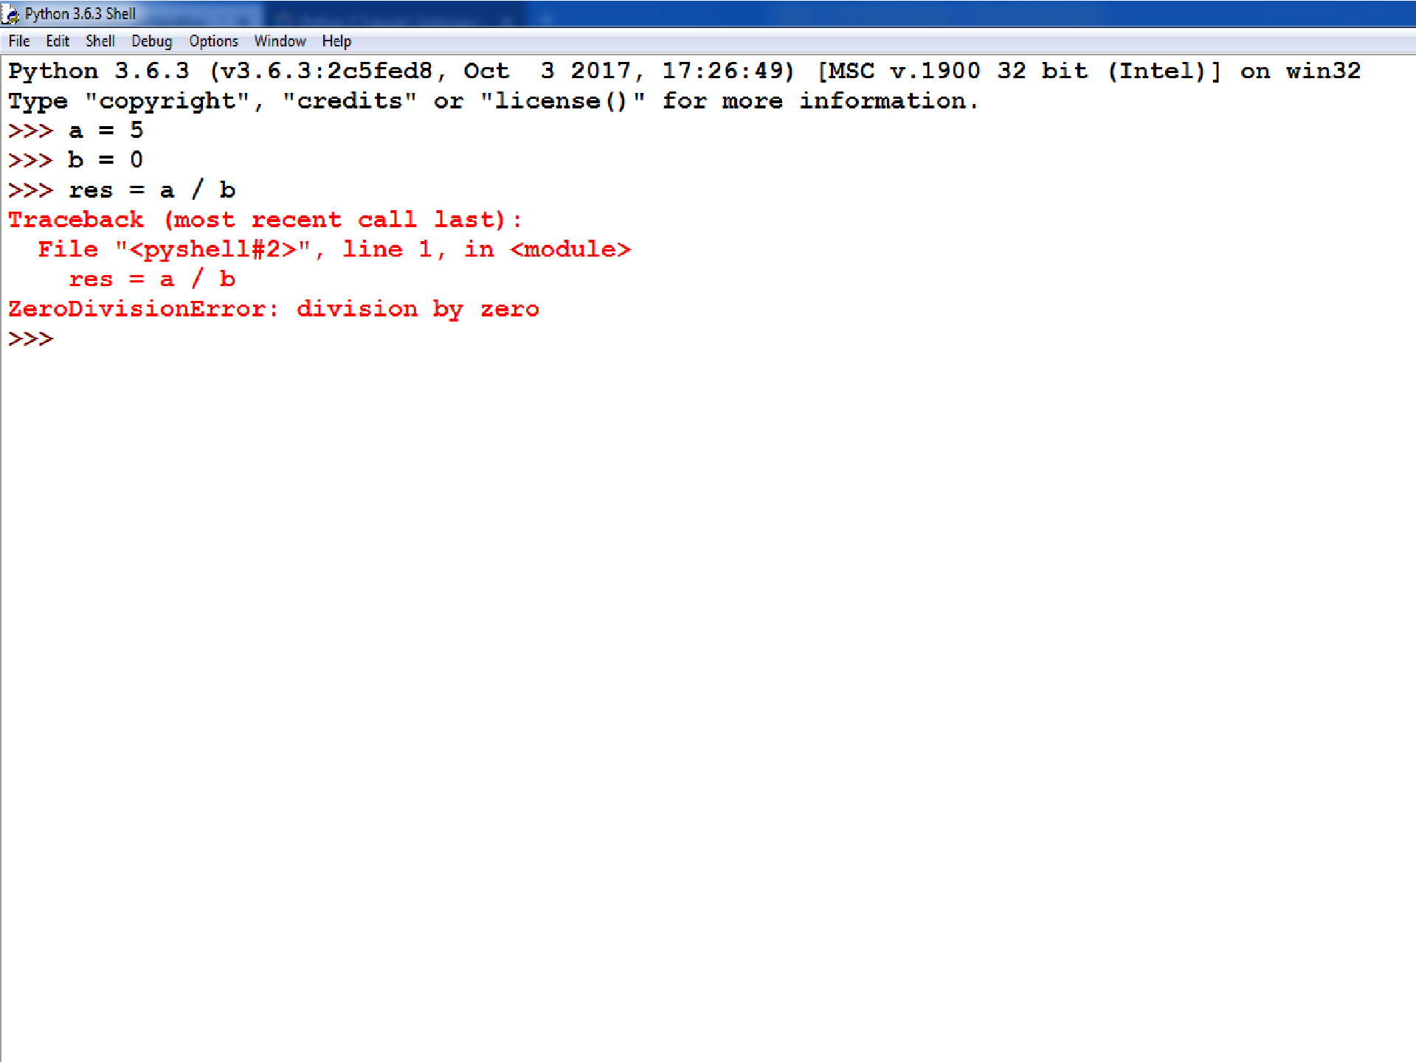

Slide 5

Exception Handling
To handle exceptions, and to call code when an exception occurs, we can use a try/except statement.
The try block contains code that might throw an exception.
If that exception occurs, the code in the try block stops being executed, and the code in the except block is executed.
If no error occurs, the code in the except
block doesn't execute.

Slide 6
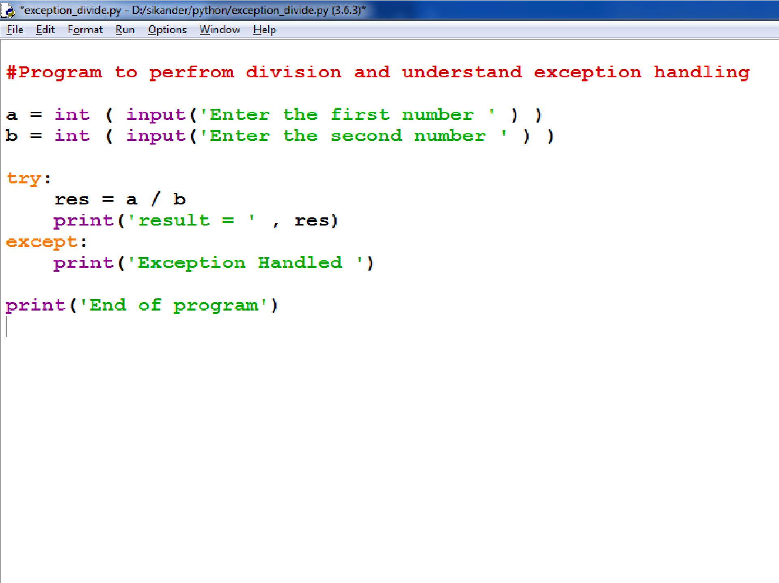

Slide 7

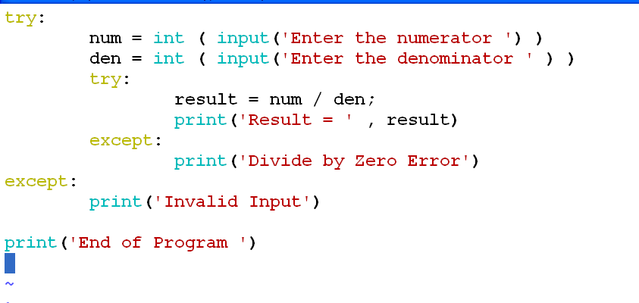
Nested Try Block

Slide 8
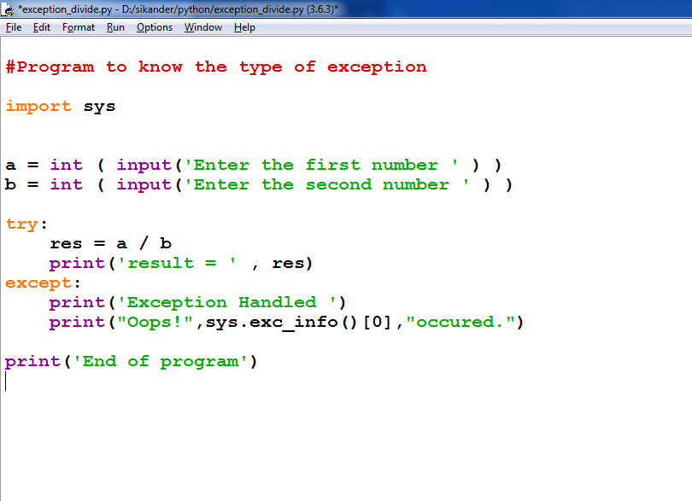

Slide 9
A try statement can have multiple different except blocks to handle different exceptions.

Slide 10
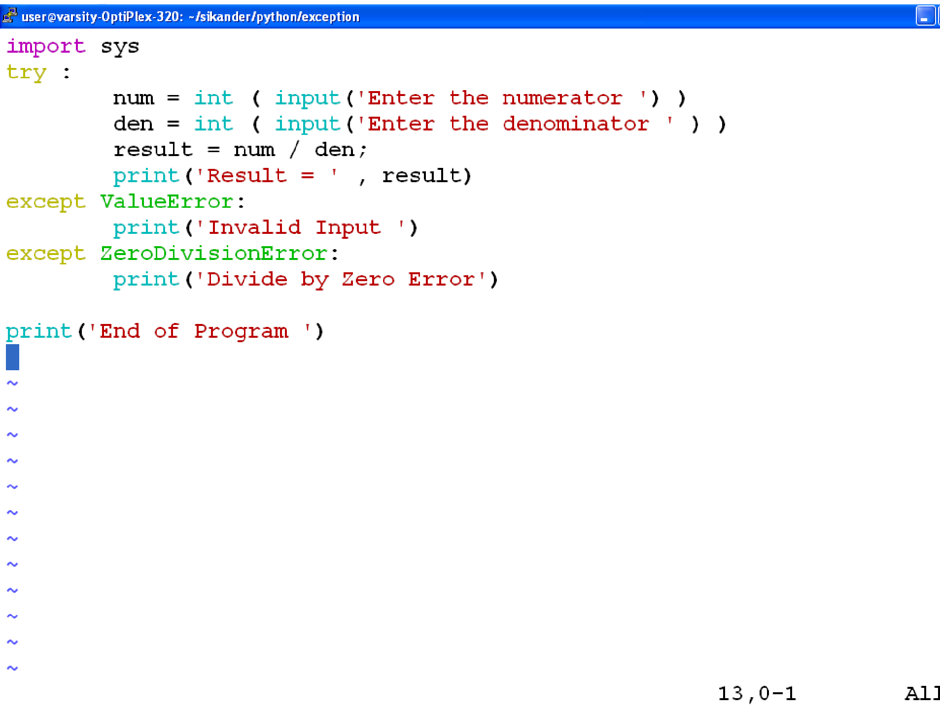

Slide 11

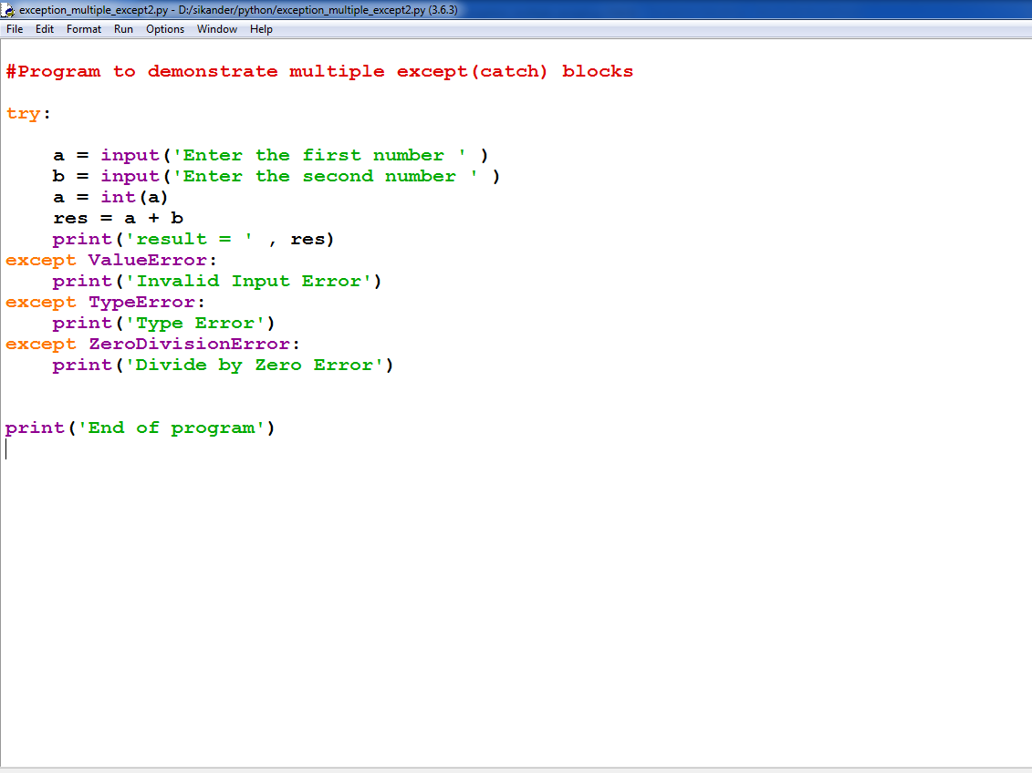
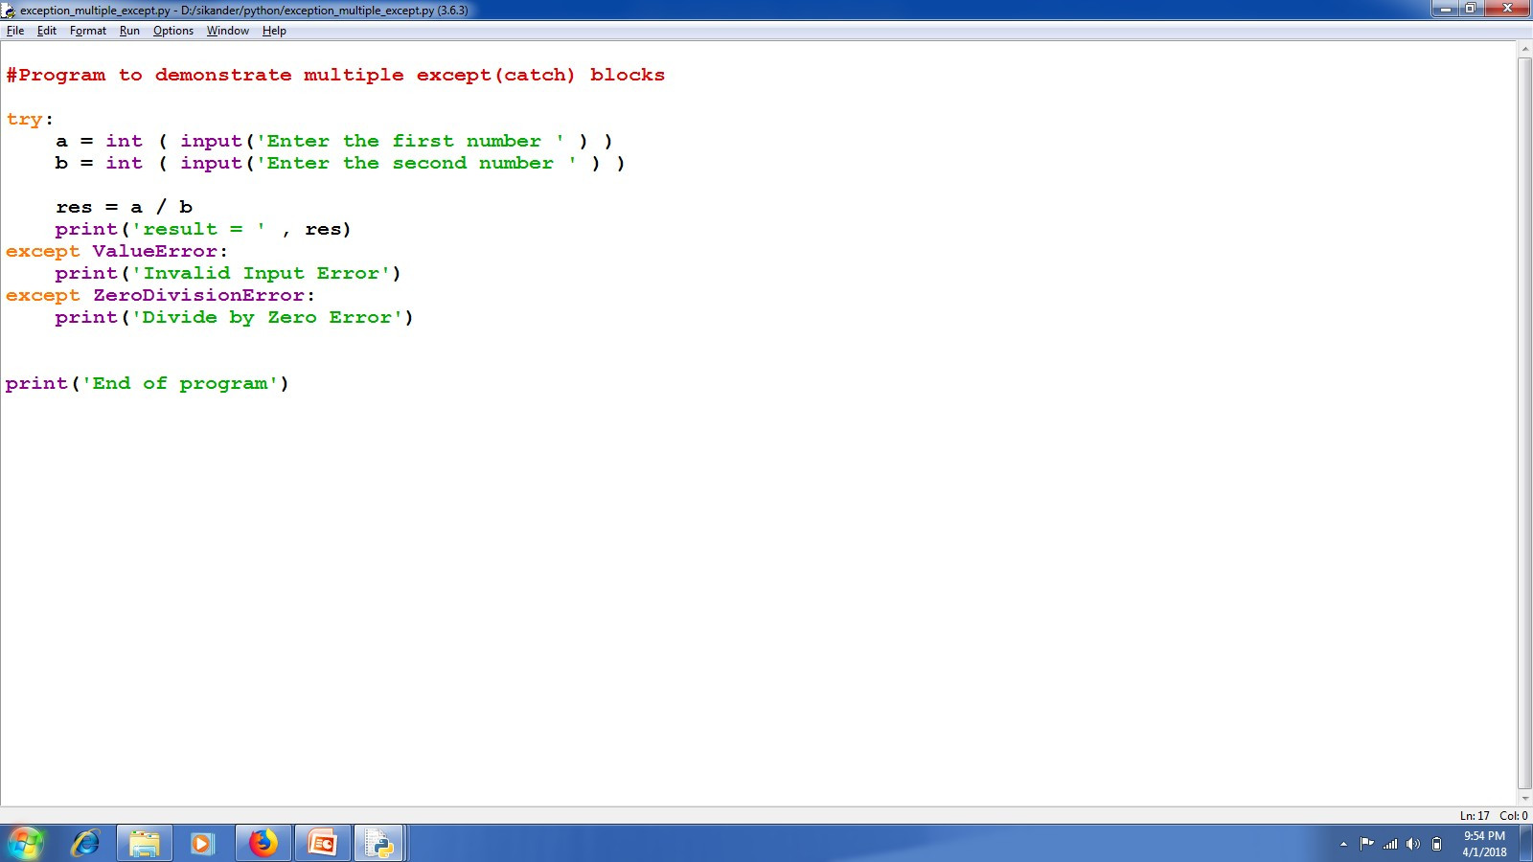

Slide 12
Multiple exceptions can also be put into a single except block using parentheses, to have the except block handle all of them.

Slide 13
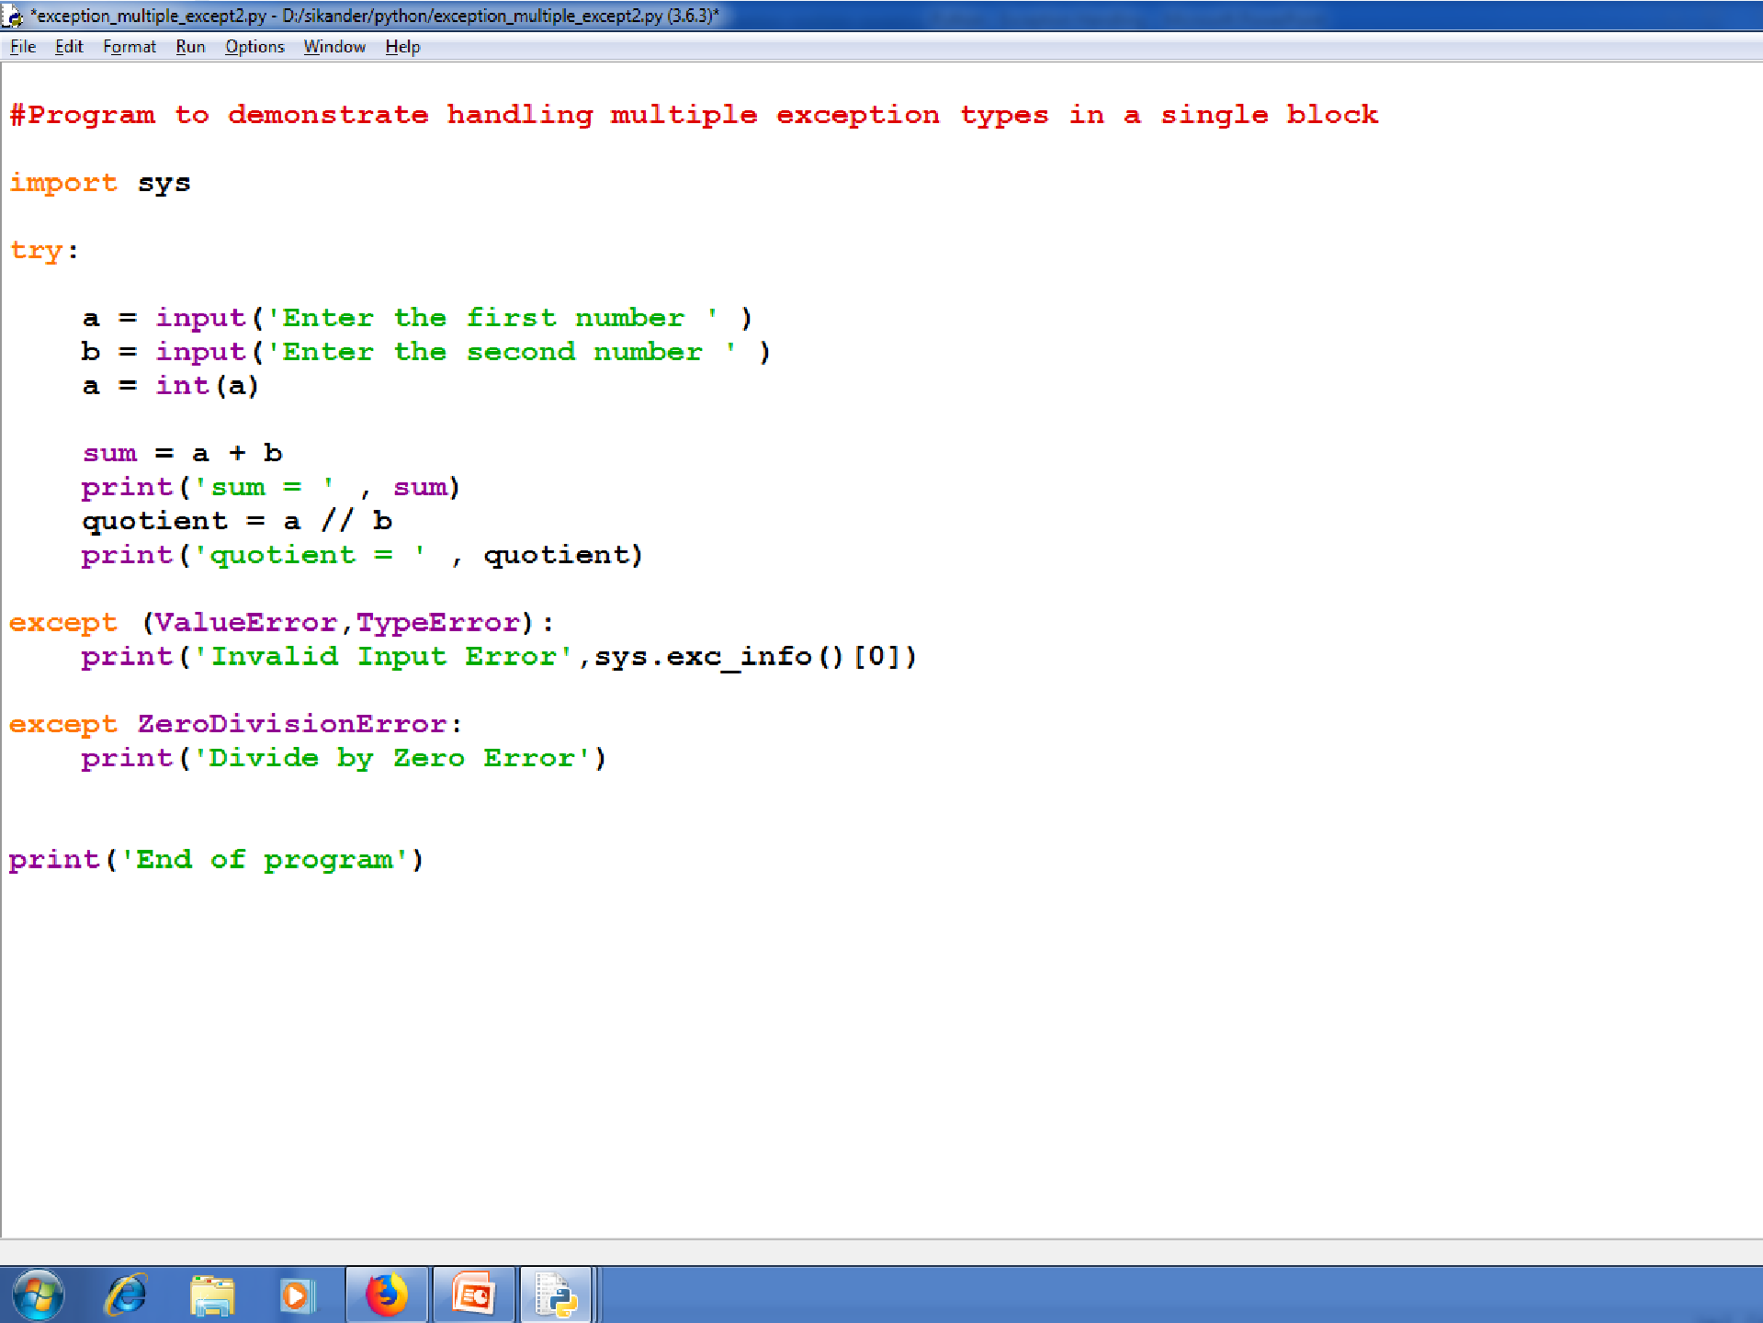

Slide 14

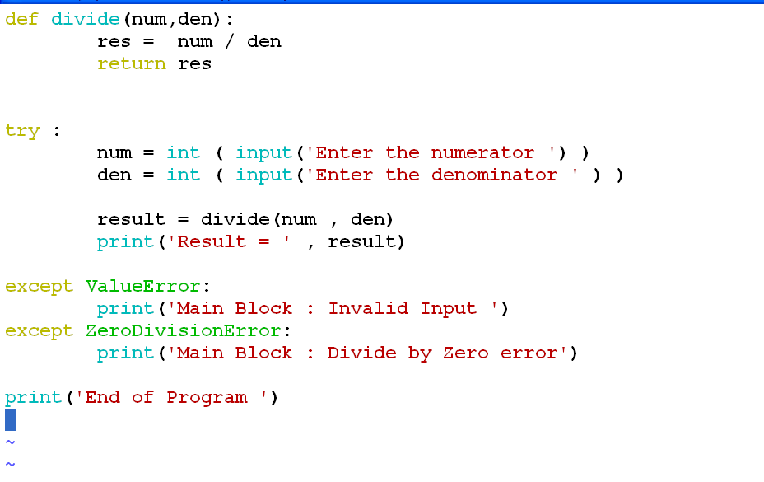

Slide 15

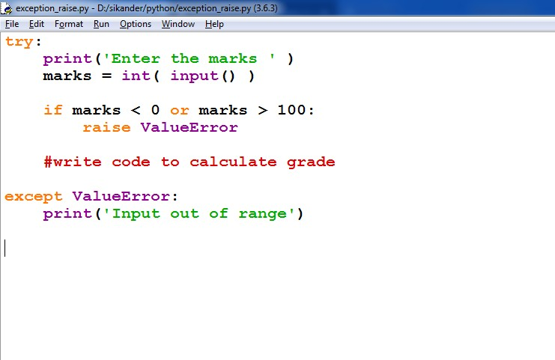
Raising Exceptions

Slide 16
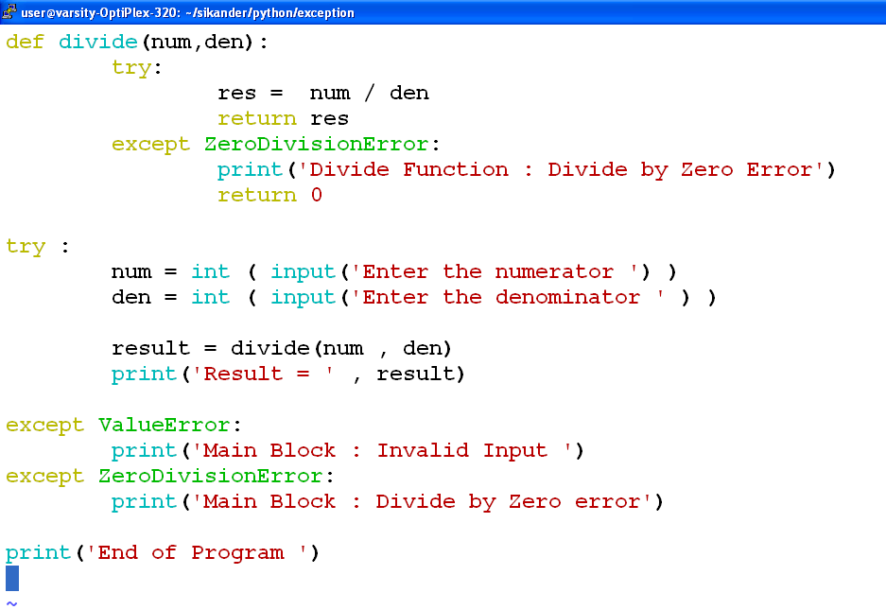

Slide 17

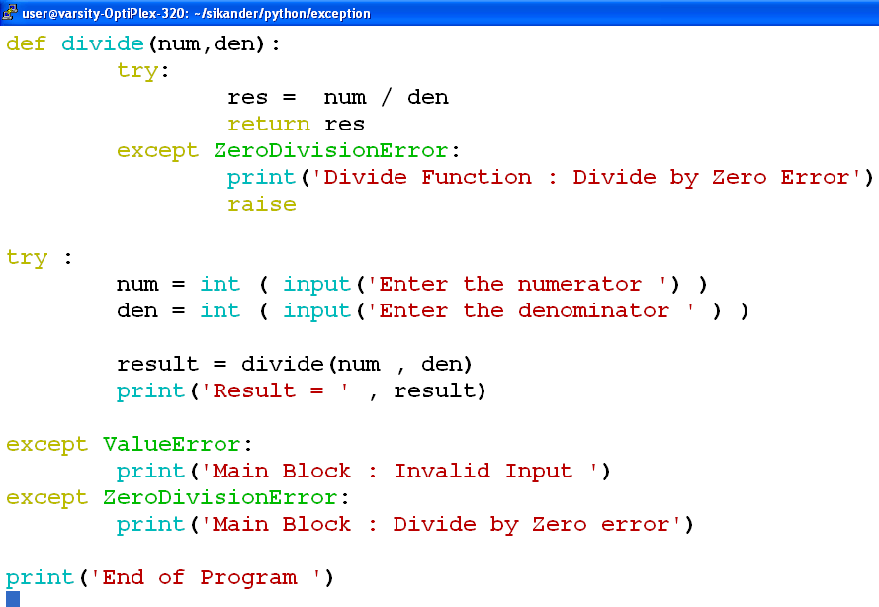
Raising Exception from Except Block

Slide 18

finally
To ensure some code runs no matter what errors occur, you can use a finally statement.
The finally statement is placed at the bottom of a try/except statement.
Code within a finally statement always runs after execution of the code in the try, and possibly in the except, blocks.

Slide 19
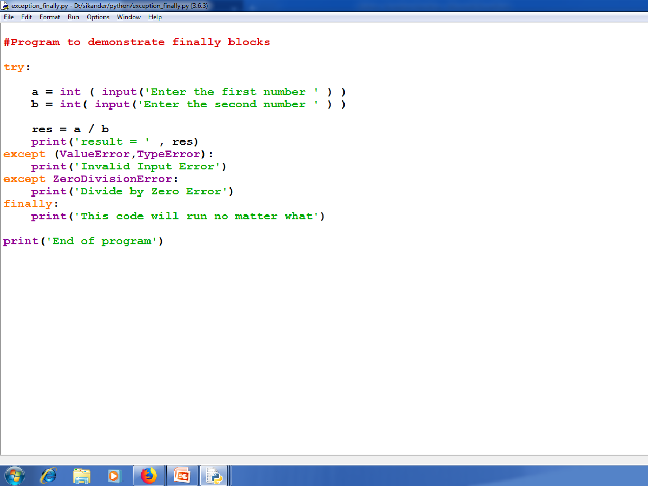

Slide 20
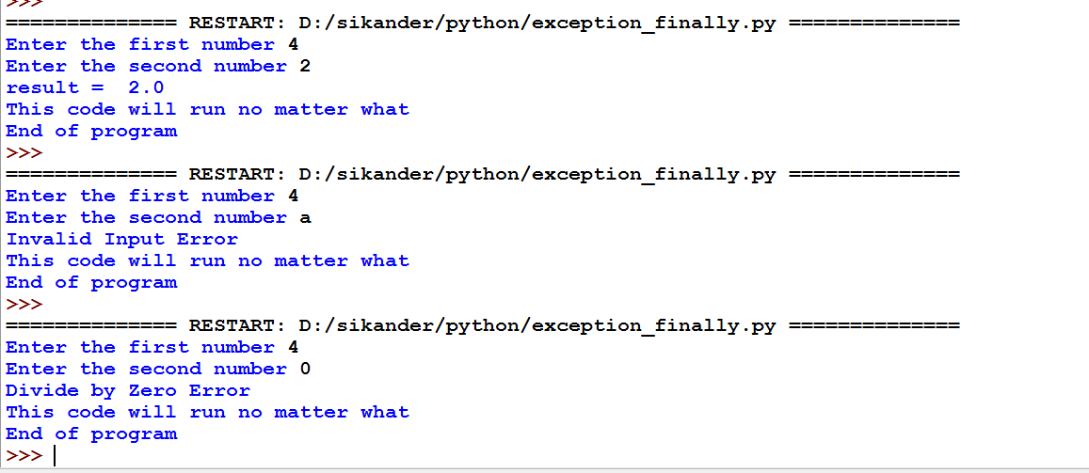

Slide 21
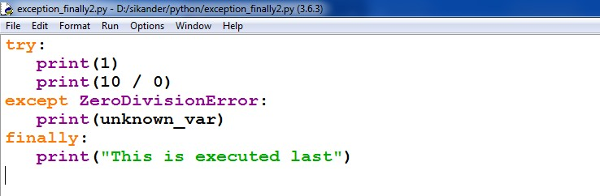
Code in a finally statement even runs if an uncaught exception occurs in one of the preceding blocks.

Slide 22

Raising Exception
Raising exception is similar to throwing exception in C++/Java.
You can raise exceptions by using the raise statement

Slide 23

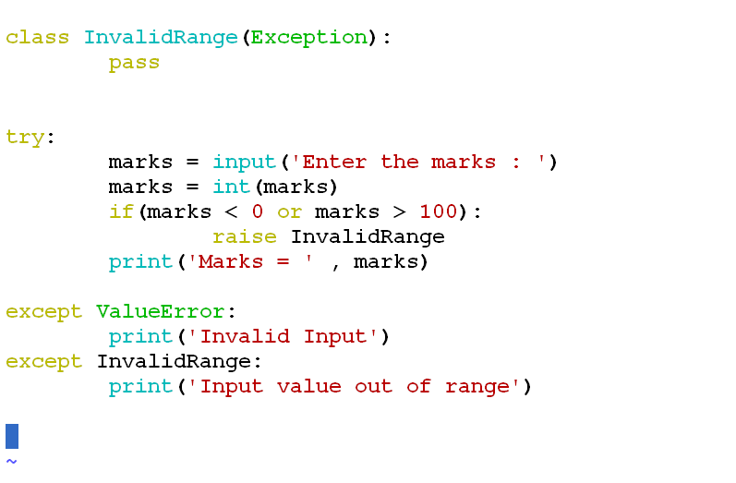
User Defined Exception

