Slide 1
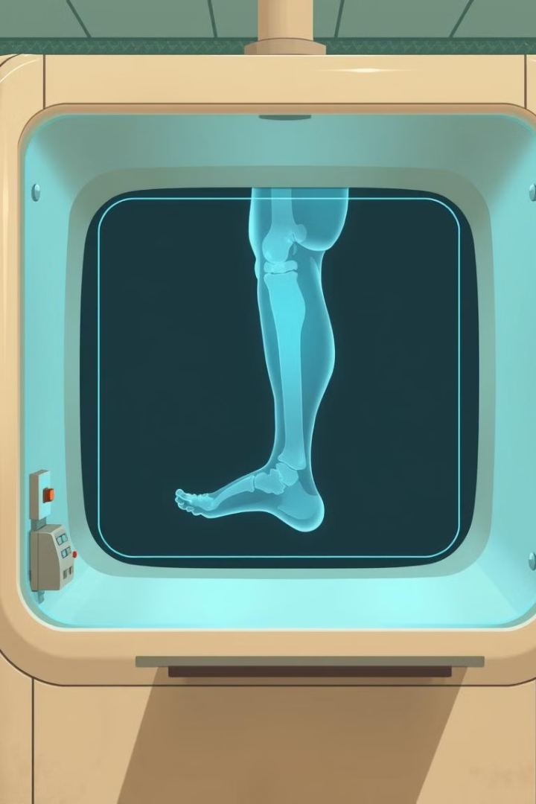
X-Ray Machine Simulation: A COSC 4372 Project
Welcome to our COSC 4372 project, showcasing a simulated X-ray machine that utilizes a 3D leg phantom for testing and validation.

Slide 2
Project Overview
Project Goals
Key Features
This project aims to create a virtual X-ray system capable of simulating real-world X-ray imaging. We developed a 3D leg phantom, implemented parameter adjustments like beam energy and angle, and created an interactive GUI for exploration.
The simulation features a 3D leg phantom that allows for realistic testing and validation. Users can adjust parameters like beam energy, angle, and distance, and explore the effects of these changes on the resulting image in real-time.

Slide 3
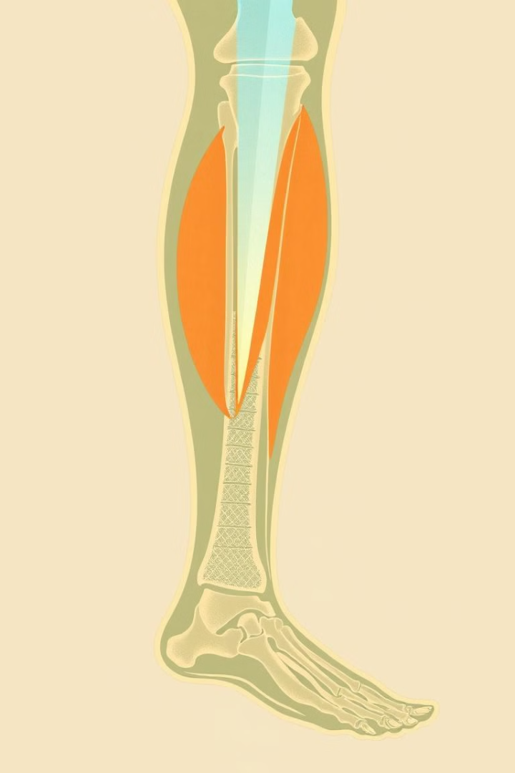
Why X-Ray and Leg Phantom?
1
1. X-Ray Significance
2
2. Leg Phantom Selection
X-rays are indispensable in medical diagnostics, allowing healthcare professionals to visualize internal structures like bones and soft tissues. They play a vital role in diagnosing fractures, infections, and other conditions.
We chose a leg phantom due to its cylindrical structure, which simplifies modeling and allows for clear differentiation between bone and soft tissue attenuation values.

Slide 4
Project Approach
Phantoms Generation
1
We used algorithms to create realistic 3D models of bone and soft tissue, incorporating accurate density and attenuation values.
2
Parameter Adjustments and Controls
We developed a user interface that allows users to adjust key X-ray parameters, such as beam energy, angle, and source distance, providing a flexible tool for experimentation and analysis.
Image Simulation
3
The simulation process involves projecting the X-ray beam through the phantom, capturing the attenuated signal, and reconstructing the image.
4
Contrast and Angle Analysis
We analyzed the effects of contrast and angle variations on image quality and visibility of different structures.
Testing and Validation
5
We rigorously tested our simulation by comparing results to actual X-ray images of legs.
6
Result Evaluation and Analysis
We analyzed the results obtained from the simulation, focusing on image quality, visibility of structures, and the impact of various parameters on the overall image output.

Slide 5

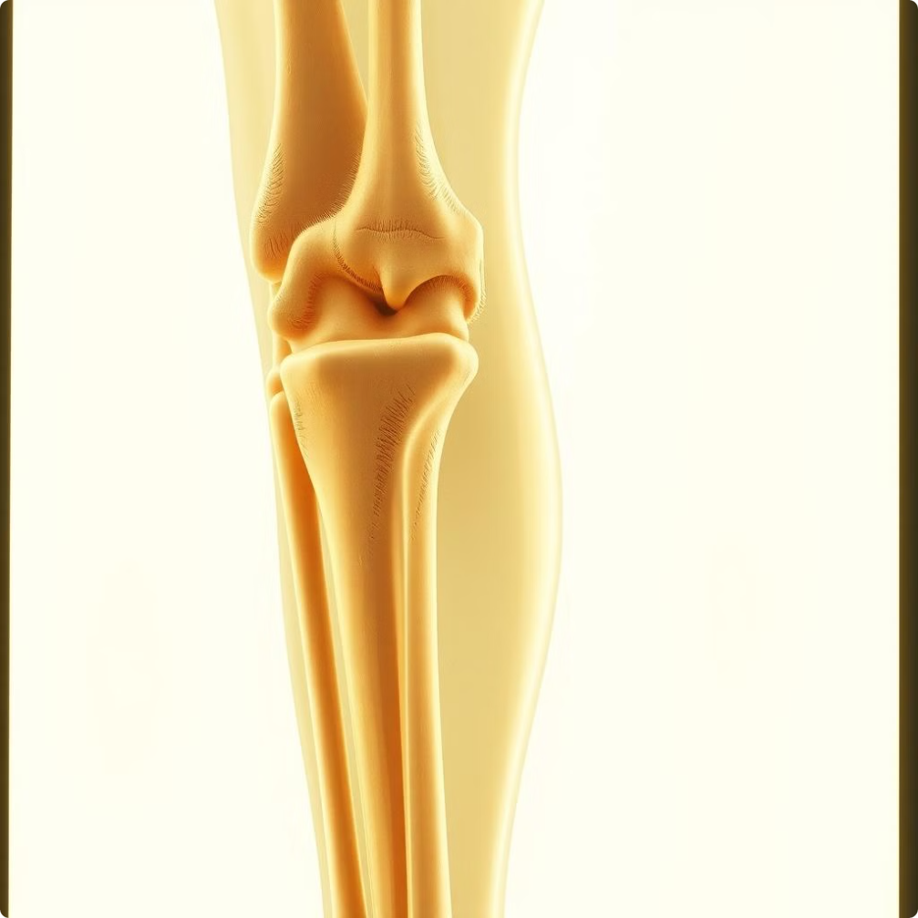
Simulation Results
Bone and Soft Tissue Distinction
Angle and Attenuation Effects
The simulated X-ray images demonstrated clear differentiation between bone and soft tissue, highlighting the effectiveness of the simulation in capturing these variations in density and attenuation.
Images taken at various angles, including orthogonal and angled splits, accurately reflected the attenuation effects of the bone and soft tissue, providing a realistic visual representation.
Interactive GUI Benefits
The interactive GUI allowed for real-time adjustments of parameters and immediate visualization of the corresponding changes, enhancing the learning experience and providing valuable insights.

Slide 6





Project Libraries and Tools
NumPy
Matplotlib
Scipy
Tkinter
NumPy was essential for array computations, matrix operations, and handling the numerical data associated with the X-ray simulation.
Matplotlib provided the core functionality for generating and visualizing the simulated X-ray images, enabling us to analyze and present the results effectively.
Scipy's advanced scientific computing capabilities, including signal processing and image analysis, were crucial for implementing the projection, reconstruction, and image analysis aspects of the simulation.
Tkinter was used to develop the user-friendly GUI, providing interactive controls for adjusting X-ray parameters and visualizing the resulting images in real-time.
mpl_toolkits.mplot3d
This library enabled us to create 3D visualizations of the leg phantom and the simulated X-ray beam, offering a comprehensive view of the system and its components.

Slide 7




Key Learnings and Insights
Parameter Significance
1
We learned that varying parameters like beam energy, X-ray angles, and source distances have a significant impact on the quality and clarity of the resulting X-ray images.
Contrast Importance
2
The clear contrast between bone and soft tissue in the images was crucial for accurately identifying different structures and making effective diagnoses.
Algorithm Efficiency
3
The effective use of projection, reconstruction, and contrast analysis algorithms enhanced the accuracy and fidelity of the simulated X-ray images, mimicking the capabilities of real-world X-ray machines.
GUI Advantages
4
The interactive GUI provided a valuable hands-on tool, enabling us to experiment with different parameters and directly observe the corresponding effects on the generated images, furthering our understanding of X-ray imaging techniques.

Slide 8
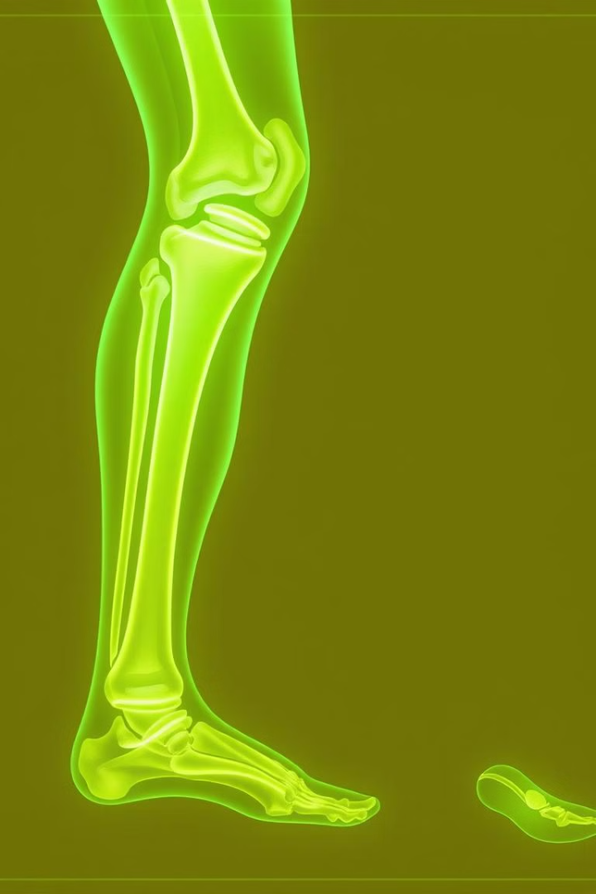
Conclusion and Future Directions
1
2
Simulation Success
Educational Impact
Our virtual X-ray machine simulation successfully demonstrated key principles of X-ray imaging, providing a valuable tool for learning and experimentation.
This project enhances the understanding of X-ray parameters, demonstrates the effects of contrast and angle variations, and provides a hands-on tool for exploring medical imaging techniques.

