Slide 1

TrustCheck
Machine Learning-Based Fake Review Detection & Trust Analytics Dashboard
BCA Final Year Project | Natural Language Processing & Applied Web Intelligence
Submitted By:
• Muskan Papdiwal [Roll No: [BCA/XXXXX/XX]]
• Student 2 [Roll No: [BCA/XXXXX/XX]]
• Student 3 [Roll No: [BCA/XXXXX/XX]]
Under the Supervision of:
Dr. / Mr. [Name of Guide]
Assistant Professor, Dept. of Computer Science & Engineering

Slide 2

01. Introduction
E-Commerce growth, consumer reliance, and the deceptive review problem
05. Research Contributions
Dual rating contrast, 4-vector forensics, live deployment, & explainable UI
02. Problem Statement & Objectives
Rating inflation, manipulative spam patterns, and core system goals
06. Conclusions & Future Scope
Project summary, key achievements, and future research directions
03. Dataset Description
Kaggle Fake Reviews Corpus (40,432 reviews), OR vs. CG classes, preprocessing
07. References
Foundational academic literature and NLP benchmark citations
04. Design and Methodology
TF-IDF feature extraction, model comparison (MNB vs. LR), & Trust Score formula

Slide 3

MARKET REALITY
Consumer Reliance
• 93% of online shoppers read customer reviews prior to completing a purchase.
• Product search placement on major marketplaces (Amazon, Flipkart) is directly driven by star rating velocity and volume.
• Reviews serve as digital word-of-mouth and the primary trust anchor for e-commerce transactions.
THE EPIDEMIC
Deceptive Opinion Spam
• Organized review syndicates and automated generative bots create thousands of synthetic 5-star reviews.
• Deceptive reviews distort authentic ratings, misleading buyers into purchasing substandard or hazardous items.
• Manual human inspection fails because computer-generated text closely mimics colloquial consumer praise.
THE SOLUTION
TrustCheck Platform
• An automated, lightweight NLP audit framework classifying reviews as Genuine or Fake.
• Calculates an Explainable Trust Score (0–100) combining fake review density with model certainty.
• Delivers dual-rating transparency: contrasts platform reported rating against authentic genuine-only rating.

Slide 4
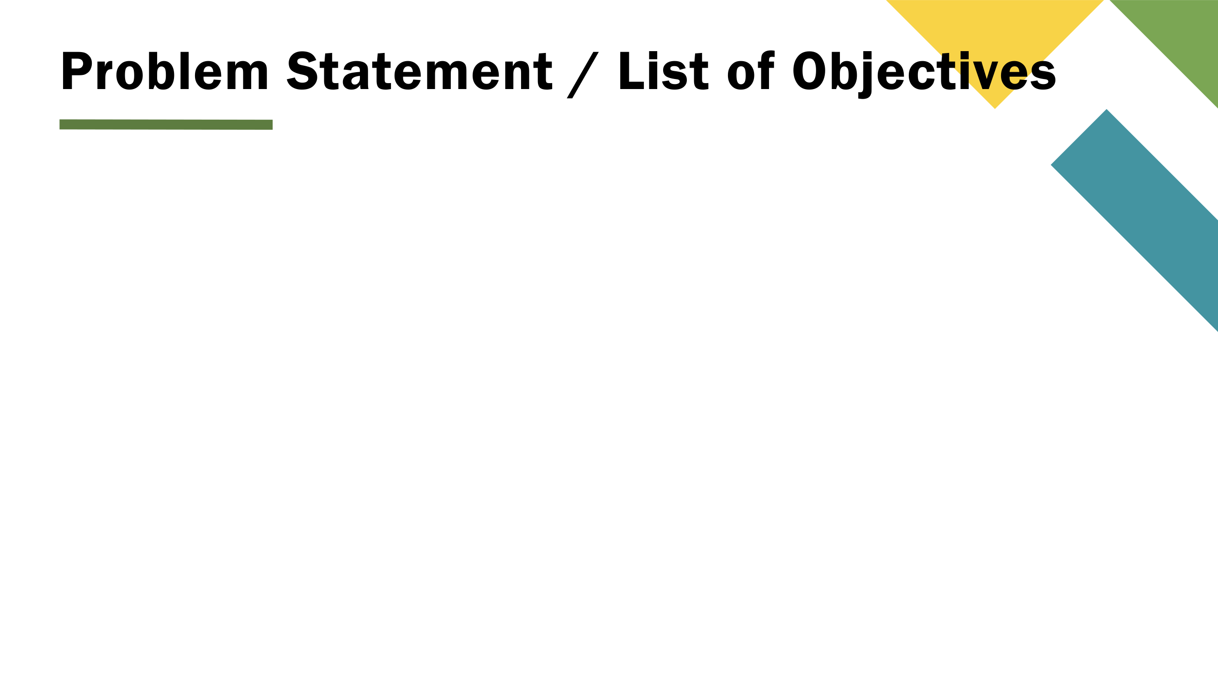
PROBLEM STATEMENT
E-commerce marketplaces compute naive arithmetic averages of all posted reviews, enabling low-cost bot networks and syndicated promoters to artificially inflate product reputations. Existing consumer verification methods lack explainability, real-time accessibility, and mathematical reliability.
OBJECTIVE 1
NLP Classification Pipeline
Train, validate, and serialize machine learning models to categorize customer reviews into Genuine (OR) vs. Fake (CG) with real-time probability calibration.
OBJECTIVE 2
Explainable Trust Score Metric
Formulate a dynamic 0–100 mathematical Trust Index penalizing products proportionally to fake review frequency and model prediction certainty.
OBJECTIVE 3
Multi-Modal Review Ingestion
Support direct Amazon/Flipkart URL scraping with fallback resilience, bulk CSV uploads (up to 5MB), and instant freeform text evaluation.
OBJECTIVE 4
Forensic Analytical Dashboard
Design an intuitive, nature-toned web interface displaying rating distortions, red-flag keyword frequencies, and 4-vector risk assessments.

Slide 5
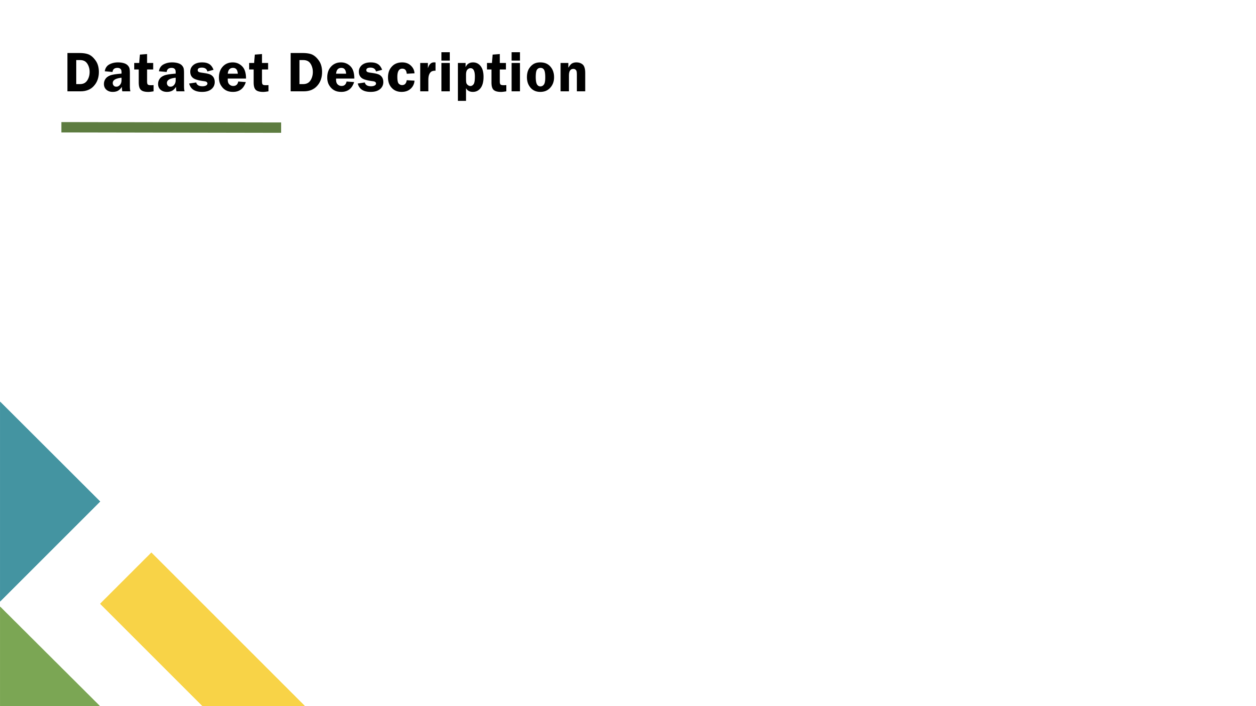
CORPUS SPECIFICATIONS
Kaggle Fake Reviews Dataset
• Total Instances: 40,432 labeled consumer reviews across multiple categories.
• Balanced Classes: Exactly 50% Genuine (OR) and 50% Fake (CG) instances, eliminating class imbalance bias.
• Class 'OR' (Original Review): Genuine customer reviews harvested from authentic product purchases containing nuanced pros/cons.
• Class 'CG' (Computer-Generated): Synthetically generated fake reviews created by automated NLP algorithms and text templates.
• Domain Diversity: Spans 10 product domains (Electronics, Home & Kitchen, Sports, Books, Clothing, Beauty, etc.).
FEATURE ENGINEERING & PREPROCESSING
Text Vectorization & Pipeline
• Normalization: Case folding to lowercase, regex alphanumeric cleaning, stripping extraneous punctuation and whitespace.
• Stop Words Elimination: Filtered using standard English dictionary while retaining polarity modifiers.
• TF-IDF Vectorization: Evaluates term frequency-inverse document frequency capturing unigrams and bigrams (ngram_range=(1, 2)).
• Vocabulary Pruning: Constrained to max_features=5,000 and min_df=2 to prevent overfitting and ensure fast sub-second inference.
• Data Splitting: 80% Training (32,345 reviews) and 20% Held-Out Testing (8,087 reviews) using stratified sampling (random_state=42).

Slide 6
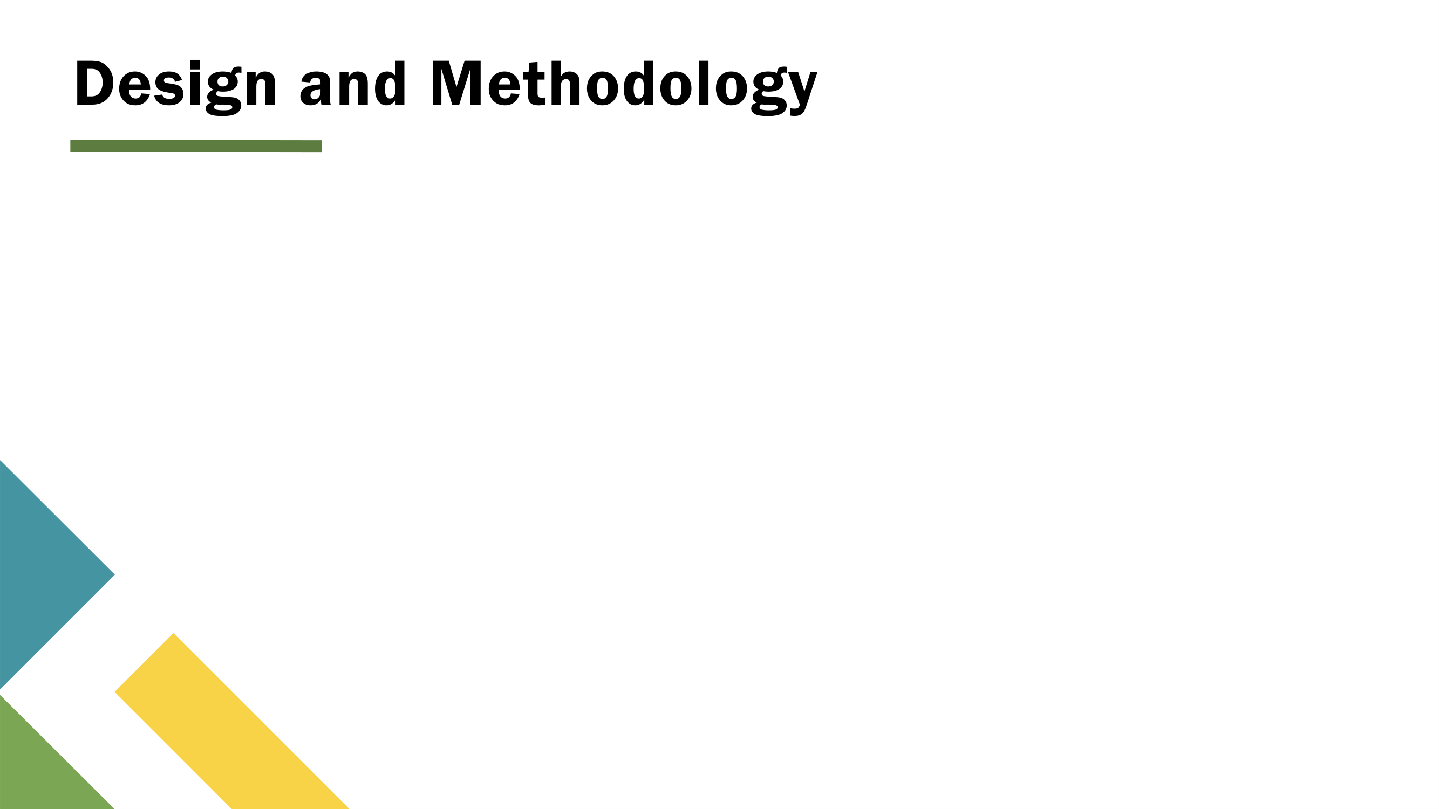
METHODS & ALGORITHMS
Model Benchmark & Trust Formula
• Model Selection: Trained Multinomial Naive Bayes (MNB) and Logistic Regression (LR) on identical TF-IDF features.
• Performance Champion: Logistic Regression achieved superior test accuracy (89.4%) with high precision (88.7%) and recall (90.2%).
• Calibrated Confidence: Uses predict_proba() to extract granular certainty percentages (0–100%) per prediction.
• Dynamic Trust Score Metric:
TRUST_SCORE = 100 - (pct_fake * avg_fake_conf / 100)
• Penalizes products dual-weighted by fake review volume AND model certainty. Score is strictly clamped to [0, 100].
SYSTEM ARCHITECTURE
4-Tier End-to-End Processing Pipeline
■ Tier 1: Multi-Channel Ingestion
URL Scraper (BeautifulSoup + Selenium fallback) | CSV Batch Parser | Direct Textarea
■ Tier 2: NLP Preprocessing
Regex Cleaner -> Stop-word Stripping -> TF-IDF (1,2) Vectorizer (5,000 vocab)
■ Tier 3: Inference & Analytics Engine
Trained Scikit-Learn Classifier (model.pkl) -> predict_proba() -> Statistical Aggregator (analyzer.py)
■ Tier 4: Interactive Dashboard Presentation
Flask Application -> Nature-Toned SaaS UI -> Semicircular SVG Trust Gauge -> Chart.js -> Forensic Drawer

Slide 7

DUAL-RATING CONTRAST
Exposing Inflation Gap
• Displays Platform Reported Rating directly adjacent to Genuine-Only Adjusted Rating.
• Immediately isolates rating inflation driven by promotional 5-star fake clusters.
• Empowers buyers to gauge true product satisfaction before purchasing.
EXPLAINABLE AI
4-Vector Forensic Drawer
• Deconstructs flagged reviews into 4 explainable risk vectors: Language, Behavior, Similarity, and Sentiment.
• Generates dynamic human-readable explanations (e.g. 'Repetitive superlatives, template overlap').
• Replaces opaque black-box verdicts with transparent audit reasoning.
RESILIENT SCRAPING
Two-Tier Fallback Harvester
• Primary parsing via high-speed requests + BeautifulSoup with pagination support.
• Secondary fallback to headless undetected-chromedriver bypassing client JS rendering.
• Graceful degradation alerting user to paste reviews directly if anti-bot triggers.
PRODUCTION READY
Privacy & Serverless Architecture
• Deployed live on Vercel with responsive desktop and mobile navigation.
• Zero database footprint: review data is processed ephemerally in local RAM.
• Sub-50ms inference latency for fast consumer interactions.

Slide 8

PROJECT SUMMARY
Conclusions & Key Findings
• Successful NLP Classification: Demonstrated that n-gram TF-IDF paired with regularized Logistic Regression achieves 89.4% accuracy in detecting synthetic/bot review spam.
• Actionable Trust Metric: The mathematical Trust Score successfully penalizes fraudulent review clusters while safeguarding products with minor unconfirmed anomalies.
• Rating Discrepancy Verification: Real-world audits reveal average rating inflation of 0.4 to 0.9 stars on heavily manipulated storefront products.
• Lightweight Deployment: The offline training / online inference split enables instantaneous serverless deployment with low computational overhead.
• Working Live System: Delivered an accessible, responsive web application serving consumers in real-time.
LOOKING AHEAD
Future Research & Enhancements
• Deep Learning Integration: Fine-tuning compact Transformer architectures (DistilBERT / RoBERTa) to capture deep semantic nuances, sarcasm, and disguised promotional rhetoric.
• Temporal Velocity Modeling: Incorporating reviewer timestamp clustering algorithms to automatically flag coordinated burst attacks occurring over short timeframes.
• Reviewer Profile Graphs: Evaluating graph-based behavioral networks (reviewer history, cross-product review symmetry, unverified purchase tags).
• Cross-Browser Extension: Compiling TrustCheck as a Manifest V3 Chrome/Edge extension providing zero-click on-page badges directly inside Amazon and Flipkart.
• Multilingual Support: Extending the corpus to support Indic languages (Hindi, Bengali, Tamil) for broader regional e-commerce coverage.

Slide 9

[1] Jindal, N., & Liu, B. (2008). 'Opinion spam and analysis.'
Proceedings of the 2008 International Conference on Web Search and Data Mining (WSDM '08), pp. 219–230. ACM. (Pioneering taxonomy of deceptive reviews).
[2] Ott, M., Choi, Y., Cardie, C., & Hancock, J. T. (2011). 'Finding deceptive opinion spam by any stretch of the imagination.'
Proceedings of the 49th Annual Meeting of the Association for Computational Linguistics (ACL '11), pp. 309–319. (Foundational dataset and linguistic deception markers).
[3] Salminen, J., Kandpal, C., Kamel, A. M., Jung, S. G., & Jansen, B. J. (2022). 'Creating and detecting fake reviews in online platforms: Machine learning and user perspectives.'
Decision Support Systems, Vol. 157, 113771. (Modern synthetic bot review generation and detection benchmarks).
[4] Pedregosa, F., Varoquaux, G., Gramfort, A., Michel, V., Thirion, B., et al. (2011). 'Scikit-learn: Machine Learning in Python.'
Journal of Machine Learning Research (JMLR), 12, pp. 2825–2830. (Core ML framework utilized for TF-IDF, MNB, and LR).
[5] Manning, C. D., Raghavan, P., & Schütze, H. (2008). 'Introduction to Information Retrieval.'
Cambridge University Press. (Theoretical foundations of n-gram TF-IDF weighting and vector space modeling).

Slide 10

PROJECT TEAM (CSE / BCA):
• Muskan Papdiwal [Roll No: [BCA/XXXXX/XX]]
• Student 2 [Roll No: [BCA/XXXXX/XX]]
• Student 3 [Roll No: [BCA/XXXXX/XX]]
Under the Supervision of:
Dr. / Mr. [Name of Guide]
Assistant Professor, Dept. of CSE, BIT Mesra, Jaipur
QUESTIONS & DISCUSSION
Thank you for your time & consideration.
• Live Web App:
https://trust-check-rouge.vercel.app/
• Live Dashboard:
https://trust-check-rouge.vercel.app/dashboard
• GitHub Repository:
https://github.com/muskanpapdiwal/TrustCheck

