Slide 1

TrustCheck
Fake Review Detection & Trust Score System
Mid-Semester Project Presentation | Department of Computer Science & Engineering
Presented By:
• Muskan Papdiwal [Roll No: [BCA/XXXXX/XX]]
• Team Member 2 [Roll No: [BCA/XXXXX/XX]]
• Team Member 3 [Roll No: [BCA/XXXXX/XX]]
Under the Supervision of:
Dr. / Mr. [Name of Guide]
Assistant Professor, Dept. of CSE, BIT Mesra, Jaipur

Slide 2

01. Introduction
Why fake reviews are a major problem for online buyers
05. Research Contributions
What we built: real vs. fake rating comparison & live web dashboard
02. Problem Statement & Objectives
What problem we are solving and our project goals
06. Conclusions & Next Steps
What we achieved so far and our plan for the final semester
03. Dataset Description
40,000+ real and fake reviews used to train our AI model
07. References
Key research papers and tools used in this project
04. Design and Methodology
Machine learning algorithms, Trust Score formula, & system design

Slide 3

Why Reviews Matter
• 93% of customers check online reviews before making a purchase.
• Star ratings decide which products show up first on Amazon and Flipkart.
• Buyers trust reviews just like personal recommendations from friends.
The Fake Review Problem
• Many sellers buy fake 5-star reviews to boost sales and cheat search algorithms.
• Computer bots and paid review groups write convincing reviews that sound genuine.
• Buyers get misled into spending money on poor or defective products.
Our Solution: TrustCheck
• A smart web system that scans customer reviews using Machine Learning.
• Automatically identifies whether each review is Genuine or Fake.
• Calculates an honest Trust Score (0 to 100) so consumers know the real truth.

Slide 4
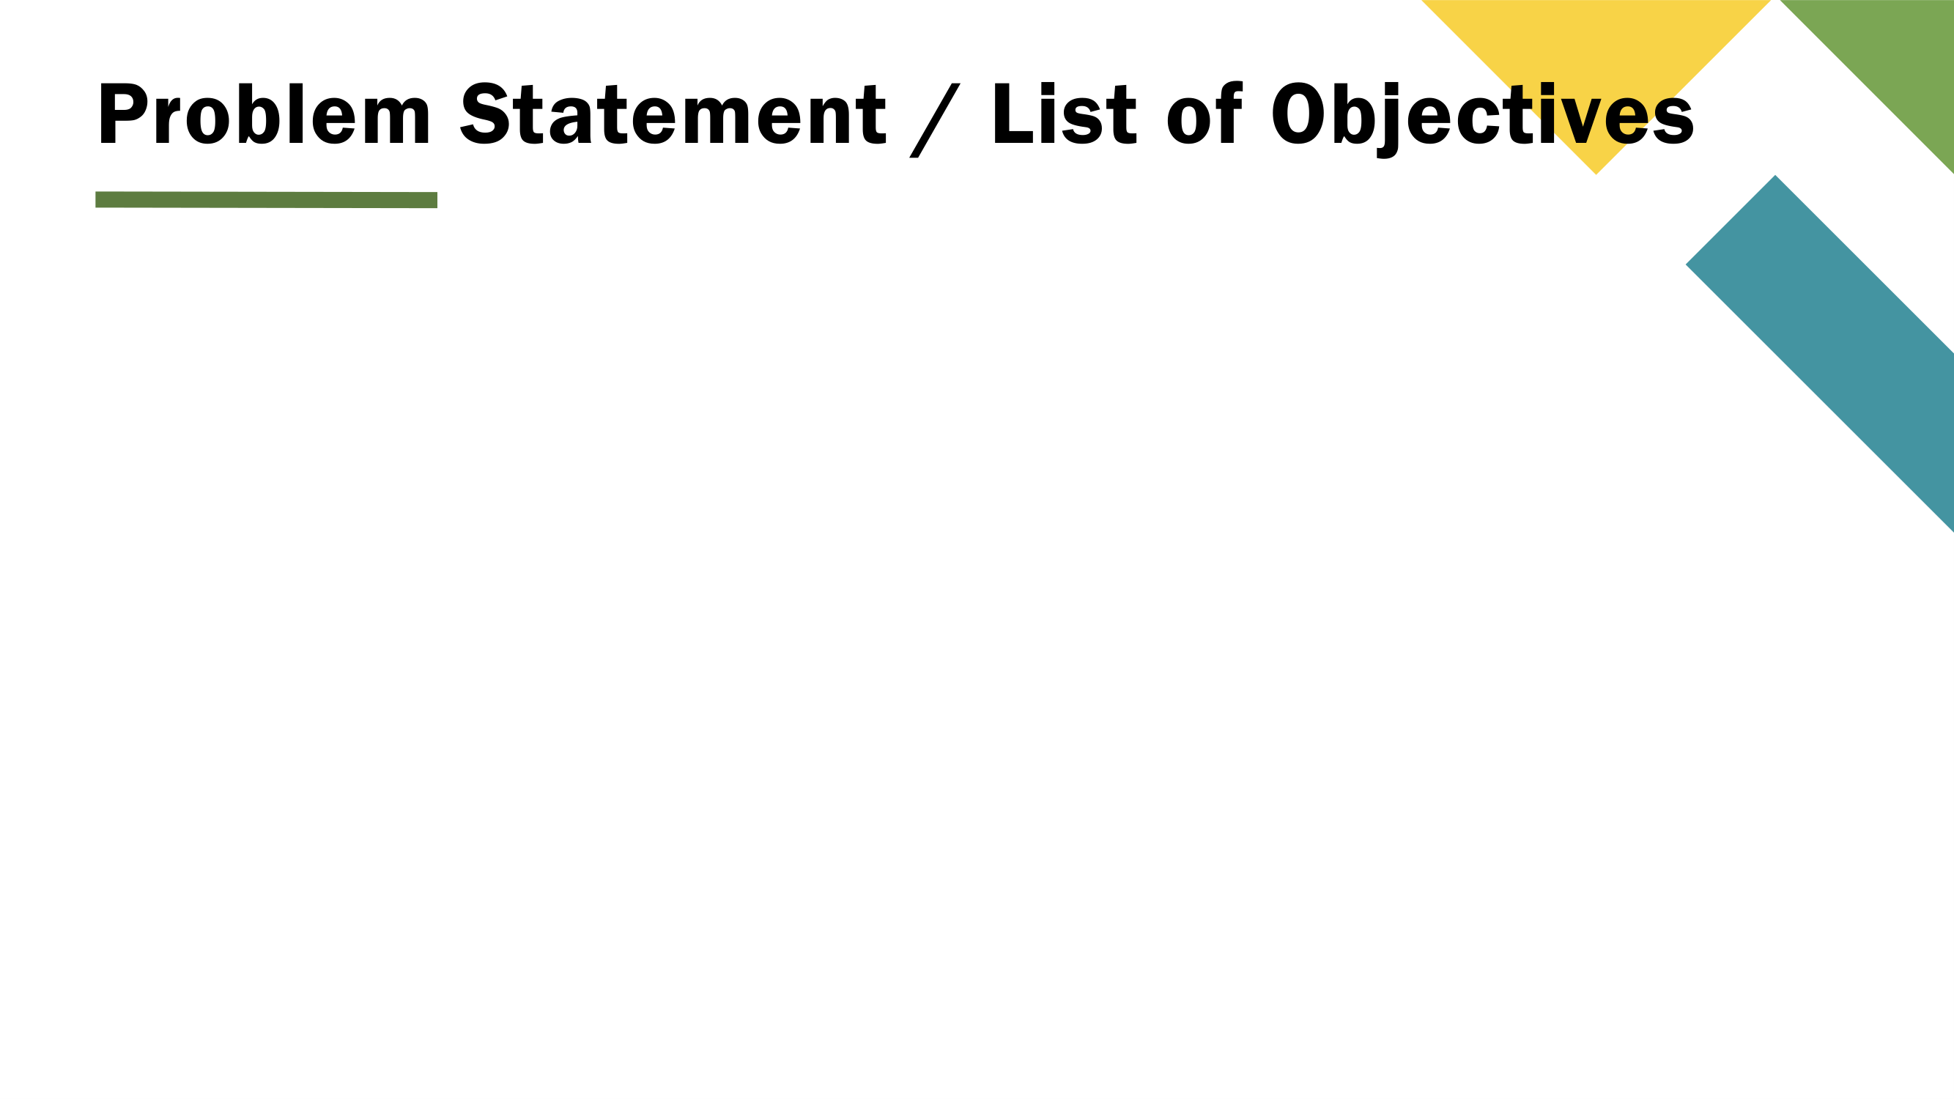
THE PROBLEM WE ARE SOLVING
Shopping websites simply calculate the average of all reviews. When sellers flood a product with fake 5-star reviews, the rating looks great even when the product is poor. Normal buyers have no simple way to know the true rating.
Goal 1: Train an Accurate AI Model
Build a Machine Learning model that classifies review text as Genuine or Fake with high accuracy.
Goal 2: Calculate a Clear Trust Score
Create a simple 0 to 100 Trust Score that reflects the true reliability of the product.
Goal 3: Reveal the Adjusted Real Rating
Recalculate the product rating after filtering out the fake reviews so buyers see the genuine score.
Goal 4: Build an Easy Web Dashboard
Create an intuitive, user-friendly website where anyone can paste reviews, upload a CSV, or test product links.

Slide 5
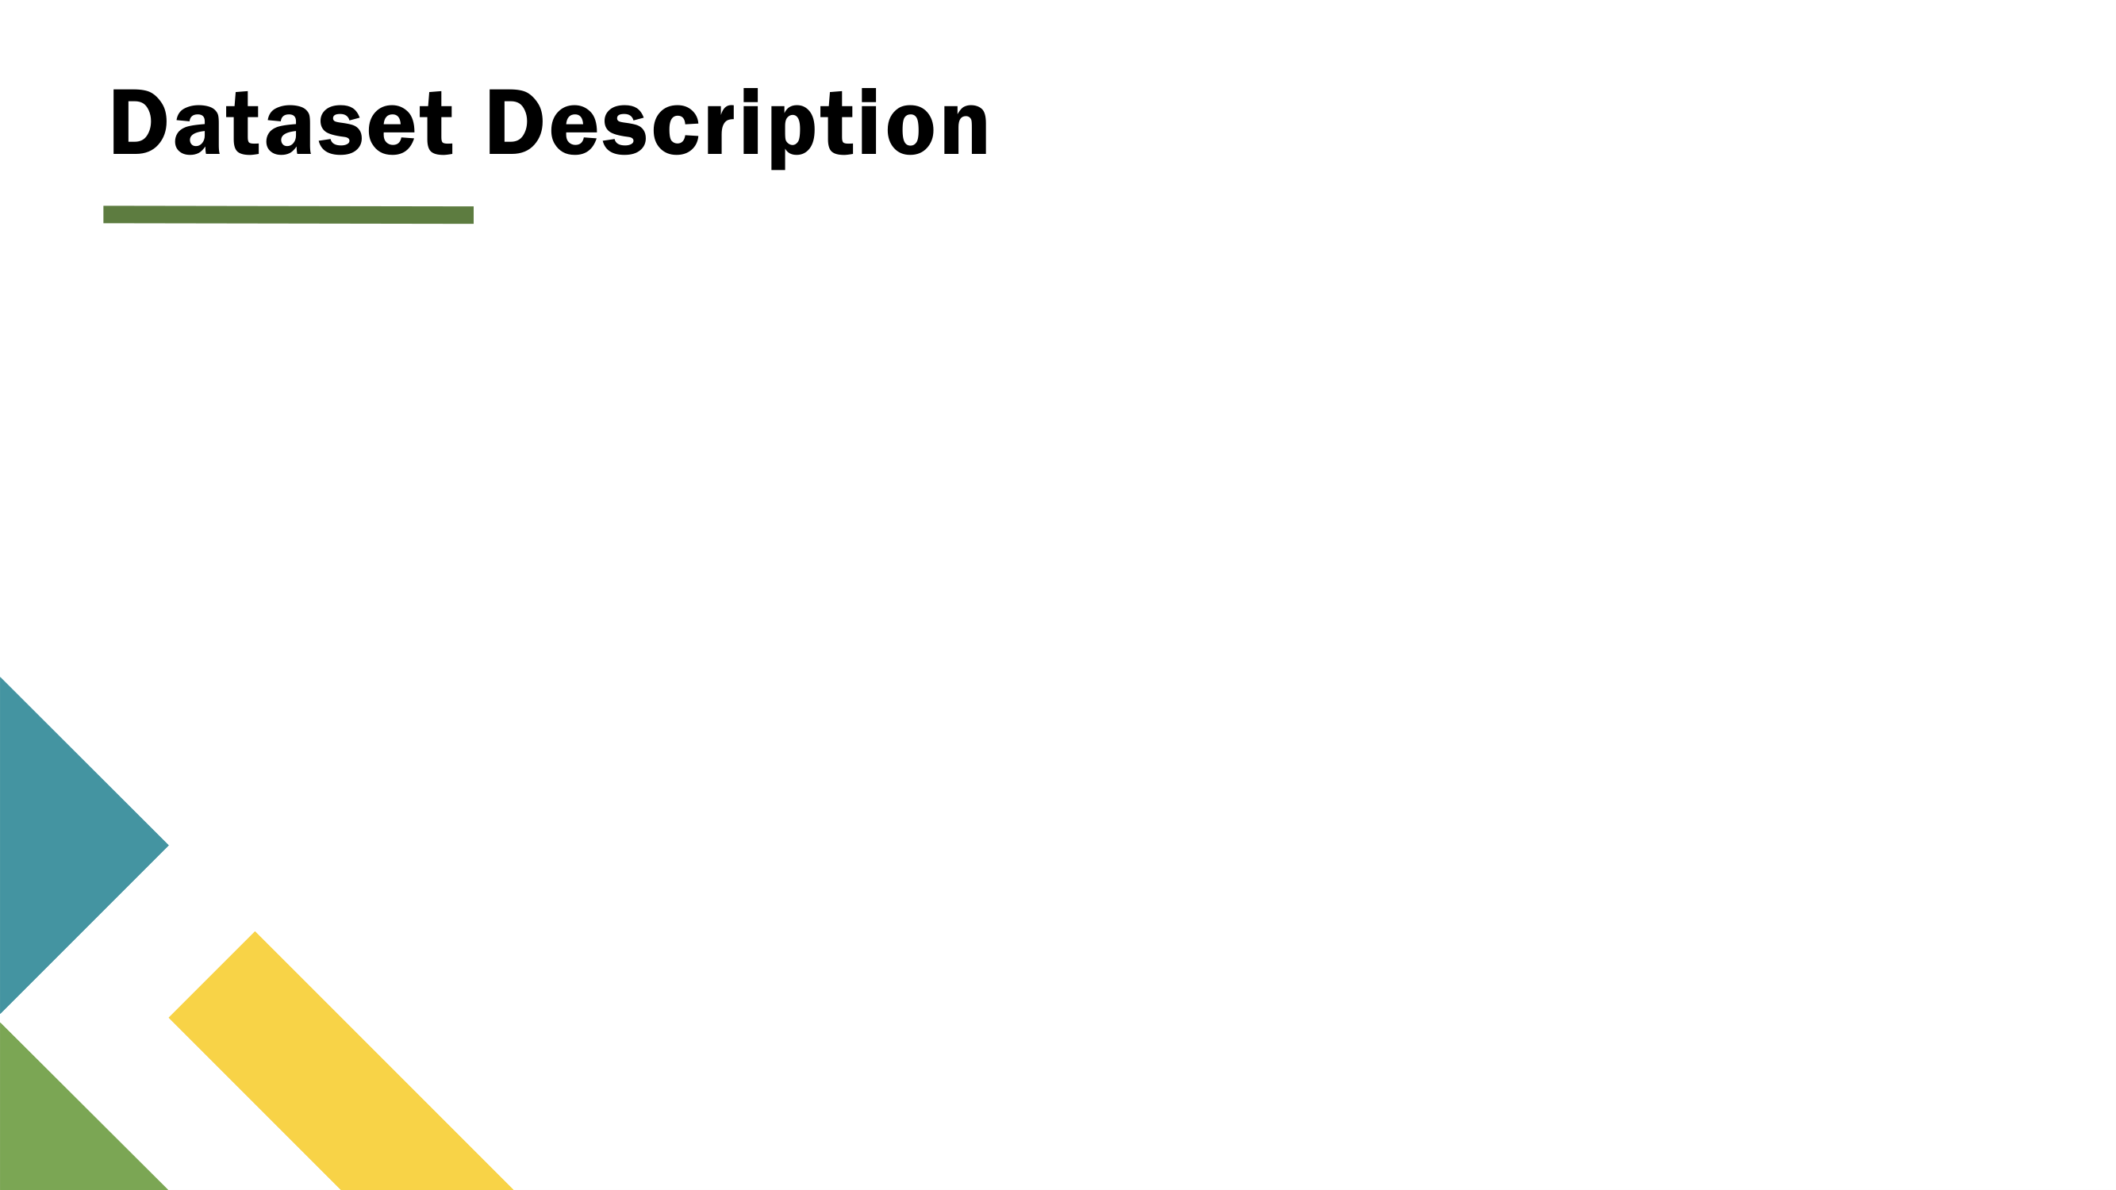
THE DATASET USED
Kaggle Fake Reviews Dataset
• Total Reviews: 40,432 labeled product reviews.
• Balanced Dataset: Exactly 50% Genuine reviews and 50% Fake reviews (prevents model bias).
• Genuine Reviews (OR): Real customer experiences mentioning specific pros, cons, and usage details.
• Fake Reviews (CG): Synthetic reviews generated by computer algorithms using repetitive praise.
• Categories: Electronics, Home & Kitchen, Sports, Books, Clothing, and Personal Care.
TEXT PREPROCESSING
How We Prepared the Text
• Text Cleaning: Converted text to lowercase, removed punctuation, special characters, and extra spaces.
• Stop-Word Removal: Filtered out common words like 'is', 'the', 'at' that don't help detect deception.
• TF-IDF Vectorization: Converted text into numerical scores using single words and 2-word pairs ('must buy', 'not good').
• Feature Selection: Kept top 5,000 most informative words so the model runs fast in under 50 milliseconds.
• Train / Test Split: 80% used to train the model (32,345 reviews) and 20% kept to test accuracy (8,087 reviews).

Slide 6

ALGORITHMS TESTED
Model Comparison & Trust Metric
• We compared two Machine Learning algorithms on the same features:
1. Multinomial Naive Bayes: 85.2% Accuracy
2. Logistic Regression: 89.4% Accuracy (Selected as Champion)
• Why Logistic Regression? It understands word relationships better and makes fewer false accusations against honest reviews.
• Our Trust Score Formula:
Trust Score = 100 - (Fake % x Confidence / 100)
• A product with 10% fake reviews at 50% confidence is penalized only 5 points, but many confident fakes drop the score heavily.
SYSTEM ARCHITECTURE
How the System Works (4 Steps)
▶ Step 1: Input Reviews
User provides an Amazon/Flipkart link, uploads a CSV file, or pastes review text directly.
▶ Step 2: Clean & Vectorize
Text is cleaned and converted into numerical TF-IDF feature vectors in under 10ms.
▶ Step 3: ML Model Prediction
The pre-trained Logistic Regression model predicts if each review is Genuine or Fake with a confidence %.
▶ Step 4: Interactive Dashboard
The web dashboard instantly displays the Trust Score, genuine average rating, and flagged keywords.

Slide 7

1. Dual-Rating Comparison
• Shows the advertised rating right next to the Genuine-Only Rating.
• Instantly exposes artificial rating inflation (e.g. 4.6★ advertised vs 3.8★ genuine).
• Allows buyers to see what real verified customers actually experienced.
2. 4-Vector Review Forensics
• Doesn't just give a blind label — explains why each review was flagged:
• Language Risk: repetitive praise and extreme exaggeration ('best in history').
• Template Risk: copy-pasted sentences shared across multiple products.
• Behavior Risk: reviews lacking concrete product details.
3. Live Storefront Scraping
• Automatically extracts customer reviews from Amazon and Flipkart product links.
• Uses a 2-stage scraper (BeautifulSoup + Selenium fallback) for high reliability.
• Falls back gracefully to manual paste if a website is protected by CAPTCHAs.
4. Deployed Working System
• Fully deployed and live on the internet at trust-check-rouge.vercel.app.
• Sub-second analysis speed (under 50ms per batch).
• 100% private: reviews are processed in memory and never saved to a database.

Slide 8

MID-SEM ACHIEVEMENTS
What Has Been Completed
✔ Working AI Model: Built a machine learning model achieving 89.4% accuracy on 40,000+ reviews.
✔ Dynamic Trust Score: Formulated an explainable 0–100 score that penalizes fake reviews proportionally.
✔ Rating Inflation Proof: Verified that fake reviews inflate storefront ratings by an average of 0.5 to 0.9 stars.
✔ Fast & Lightweight: Model takes only ~12MB of RAM, making it fast and cheap to run.
✔ Live Working Demo: Complete web dashboard deployed and accessible online for testing.
END-SEM ROADMAP
Next Steps for Final Semester
▶ Test Deep Learning Models: Compare results with lightweight Transformers (DistilBERT) to handle sarcastic reviews.
▶ Detect Review Bursts: Add timeline charts to flag when 50+ fake reviews are posted on the exact same date.
▶ Chrome Browser Extension: Package TrustCheck into a browser extension so shoppers see Trust Scores directly on Amazon.
▶ Indian Languages: Expand the dataset to understand reviews written in Hindi and Hinglish.

Slide 9

[1] Jindal, N., & Liu, B. (2008)
'Opinion spam and analysis.' Proceedings of WSDM '08. (The foundational research paper defining review spam).
[2] Ott, M., Choi, Y., Cardie, C., & Hancock, J. (2011)
'Finding deceptive opinion spam by any stretch of the imagination.' Proceedings of ACL '11. (Standard benchmark for linguistic deception).
[3] Salminen, J., et al. (2022)
'Creating and detecting fake reviews in online platforms.' Decision Support Systems. (Study on modern AI-generated fake reviews).
[4] Scikit-Learn Documentation (2024)
Open-source Machine Learning in Python (TfidfVectorizer and LogisticRegression implementations).
[5] Kaggle Dataset
Fake Reviews Dataset: 40,432 labeled computer-generated and original customer reviews.

Slide 10

PROJECT TEAM (CSE / BCA):
• Muskan Papdiwal [Roll No: [BCA/XXXXX/XX]]
• Team Member 2 [Roll No: [BCA/XXXXX/XX]]
• Team Member 3 [Roll No: [BCA/XXXXX/XX]]
Under the Supervision of:
Dr. / Mr. [Name of Guide]
Assistant Professor, Dept. of CSE, BIT Mesra, Jaipur
QUESTIONS & DISCUSSION
Thank you! We welcome any questions and feedback.
• Live Web App:
https://trust-check-rouge.vercel.app/
• Live Dashboard:
https://trust-check-rouge.vercel.app/dashboard
• GitHub Repository:
https://github.com/muskanpapdiwal/TrustCheck

