Slide 1
LIFE INSURANCE DATASET
UNDER THE GUIDANCE OF: JAY VEER SINGH NANDA.
TEAM DETAILS:
ASHISH KHOBRAGADE
BHAVIKA NANKANI
DEVASSY PAULY
MUSKAN SAHU
SIDDHARTH DWIVEDI
SHASHWAT MISHRA

Slide 2
Problem Definition
Analyze insurance provider customer base, discover distinct groups with specific requirements. This enables you to develop a deeper understanding of your customers and target them with relevant offers encouraging. This personalization will build relationships with customers and grow loyalty.
Why it is important problem :
Customized policies.
To automate the underwriting process.

Slide 3
Features
Attributes | Type | Description
Product_Info_1-7 | Categorical | 7 normalized attributes concerning the product applied for
Ins_Age | Numeric | Normalized age of an applicant
Height (Ht) | Numeric | Normalized height of an applicant
Weight (Wt) | Numeric | Normalized weight of an applicant
BMI | Numeric | Normalized Body Mass Index of an applicant
Employment_Info_1-6 | Numeric | 6 normalized attributes concerning employment history of an applicant
InsuredInfo_1-7 | Numeric | 6 normalized attributes offering information about an applicant
Insurance_History_1-9 | Numeric | 9 normalized attributes relating to the insurance history of an applicant
Family_Hist_1-5 | Numeric | 5 normalized attributes related to an applicant’s family history
Medical_History_1-41 | Numeric | 41 normalized variables providing information on an applicant’s medical history

Slide 4
About Dataset
The data set consists of 59,381 applications with 128 attributes, which describe the characteristics of life insurance applicants.
The task is to predict the "Response" variable for each Id in the test set. "Response" is an ordinal measure of risk that has 8 levels.

Slide 5
Data Challenges
The data source doesn't provide a detailed overview of the column description ,so it is difficult to generate any concrete inferences/insights.
The column description that we’ve provided in the report is based on general idea derived from life insurance terminology.

Slide 6
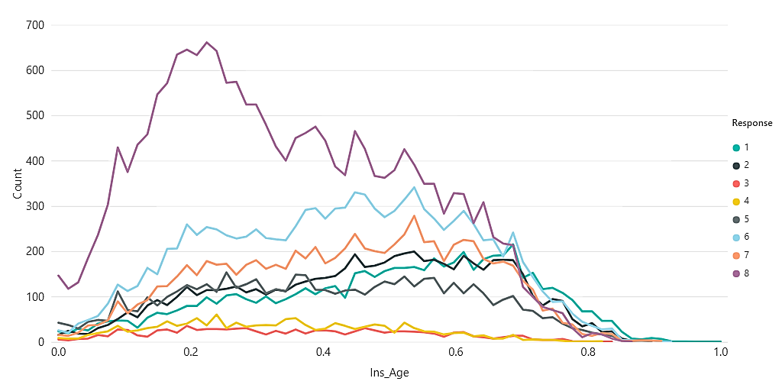
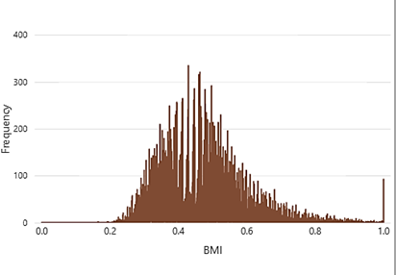
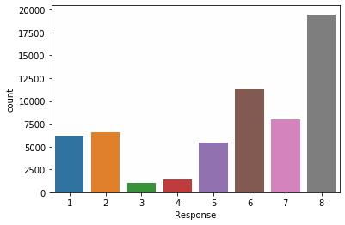
Exploratory Data Analysis(EDA)
Check significance between Response and Ins_Age
Response
BMI

Slide 7
Check Missing Values
Dropped the columns which have more than 50% missing Values.
Dropped “Id” columns as it don’t give any meaningful information.
Using Backward Elimination method we found below variables to be considered ['Product_Info_4', 'Ins_Age', 'Wt', 'BMI', 'Employment_Info_1', 'Employment_Info_4', 'Employment_Info_6'].
Checked association using ANOVA Test to impute null values.
The accuracy score was too low, so we cant use this model.
Impute features with MEDIAN.
We used CAPPING for outlier treatment.

Slide 8
Feature Extraction
We added all the columns from Medical_Keyword_1 to 48
We multiplied two important features BMI and Ins_Age. Make them into one column.
In Product_Info-2, we have a combination of character and numbers in dataset for each row. We split the column into character and digit. Created two columns Product_Info _2_char and Product_Info_2_digit.
We have done Label Encoding in Product_Info_2_char.
Divide the target variable i.e. Response into clusters.
Responses | Clusters
8 | 4
6,7 | 3
3,4,5 | 2
1,2 | 1

Slide 9
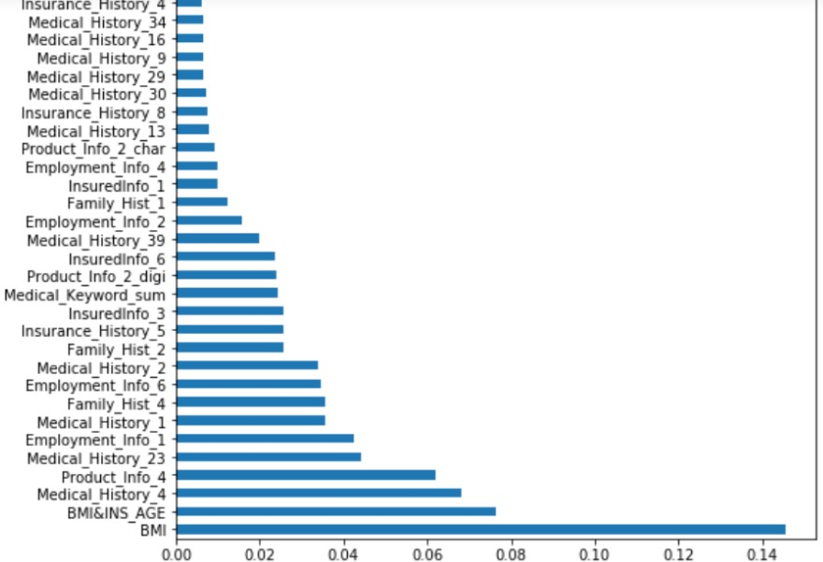
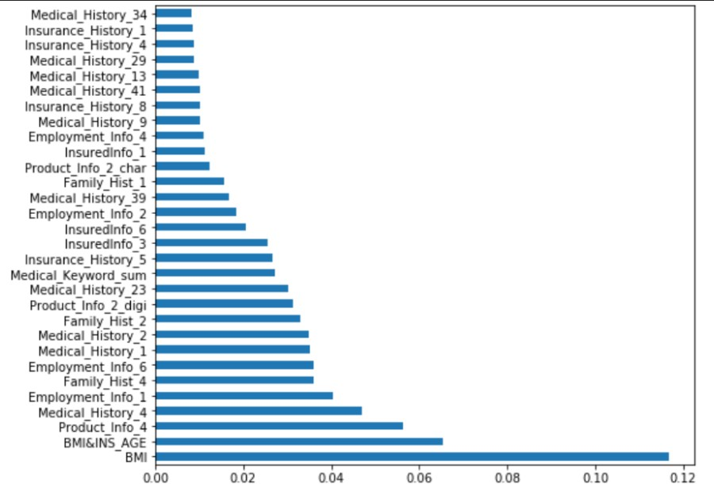
Feature Selection
Feature selection has done by using DECISION TREE And RANDOM FOREST

Slide 10
COMPARISION OF ALL MODELS WITHOUT OUTLIER:
Models | Train score | Test score | CV Score | Kappa score | CV kappa Score
Logistic Regression | 0.5139 | 0.5230 | 0.5135 | 0.50614 | 0.35090
Decision Tree | 0.635126 | 0.599764 | 0.58300 | 0.49737 | 0.44403
KNN | 0.666533 | 0.32362 | 0.49611 | 0.19065 | 0.3281
Random Forest Classifier | 0.65645 | 0.60195 | 0.60374 | 0.52017 | 0.47100
XGBoost Classifier | 0.6323026 | 0.6150867 | 0.61002 | 0.5398466 | 0.4839
SGD Classifier | 0.382117 | 0.303754 | 0.407632 | 0.16360 | 0.164287

Slide 11
Business Inference
We can also establish that there’s a positive correlation between the age of the applicant and the premium rate of the life insurance policy that they’ve applied for, i.e. as the age of the applicant increases so does the total amount of premium.
Although, BMI isn’t a one-size-fits-all score because it can’t perfectly describe everyone, but it is still used as a strong determinant of acceptance or denial of a life insurance application. From the analysis we have observed that there is a significant difference in the responses for applicants whose BMI ranges between 0.5 to 1.
we failed to establish that there is a significant relation between the total salaries of the applicant and the premium amount that they’re willing to pay.

Slide 12
Thanks!

