Slide 1

MCA Major Project
FlowSight
Smart Testing Insights/Validation Tool for Pcaps
Under the guidance of
Dr. Devershi Pallavi Bhatt
Department of Computer Applications
Faculty of Science, Technology and Architecture
Manipal University Jaipur
By
Muskan Satwani
23FS20MCA000073
2023-25

Slide 2
Outline
Introduction
Motivation
Methodology
Software Requirement
Process Flow Diagram
Output
Conclusion
Future Scope

Slide 3
Introduction :
Why FlowSight?
Automated Analysis
Proven in real world environment
Eliminates manual efforts
Enhanced Troubleshooting
Scalability and flexibility
Accelerates root cause
Comprehensive Reports
Future ready
Structured reports, Statistics and visual flow diagram
FlowSight is an advanced automation tool designed to streamline SIP call flow analysis from PCAP files.
It efficiently extracts, categorizes, and visualizes call data, enabling network engineers and VoIP professionals to quickly troubleshoot, optimize performance, and ensure seamless communication.
The tool automatically identifies call scenarios, flags errors, and generates detailed call flow diagrams, delivering structured insights for effective decision-making.

Slide 4
Addressing Industry Challenges in Telecom
Manual analysis is labour-intensive and error-prone
Results in insufficient troubleshooting and prolonged issue resolution
Enhanced Network diagnostics through Automation
Manual methods lack speed and accuracy
Automated decoding, analysis and validation ensures accuracy
Future-Ready and scalable solution
Designed to adapt evolving telecom protocols and standards
Offers a future-proof and scalable solution for automated call flow analysis.
Motivation :

Slide 5
Methodology : Implementation Overview
Requirement analysis
Identified project objective, scope and key features
Design Phase
Define the architecture for the tool, including frontend, backend, and processing components.
Development Phase
Implement SIP packet extraction and analysis
Gathered information about SIP call flow analysis, protocol support and reporting
Design workflows for SIP analysis, visualization, and report generation.
Create data handling, processing, and error management modules
Monitoring & Maintenance
Provide continuous monitoring for performance optimization.
Deployment
Deployed on CentOS
Testing & Validation
Conduct unit, integration, and system testing to ensure functionality.
Validate results by comparing outputs against expected values.
Host on Nokia’s internal server for seamless access
Regularly update the tool for protocol enhancements and bug fixes.

Slide 6
Software Requirement :
Operating System: CentOS (for deployment) but compatible with other OS.
Front-end Technologies: HTML, JavaScript (for UI)
Back-end Processing: Python (for SIP packet analysis and report generation)
Libraries Used: PyShark, OpenPyXL, Pandas, Matplotlib, Numpy, Json, Logging, Time, Re, Os, Subprocess, Shutil, Binascii, Xlwings, Flow, Sys, BinAscii, Shlex, Json, Logging.
Supported : Any Browser like Chrome, brave, etc.

Slide 7
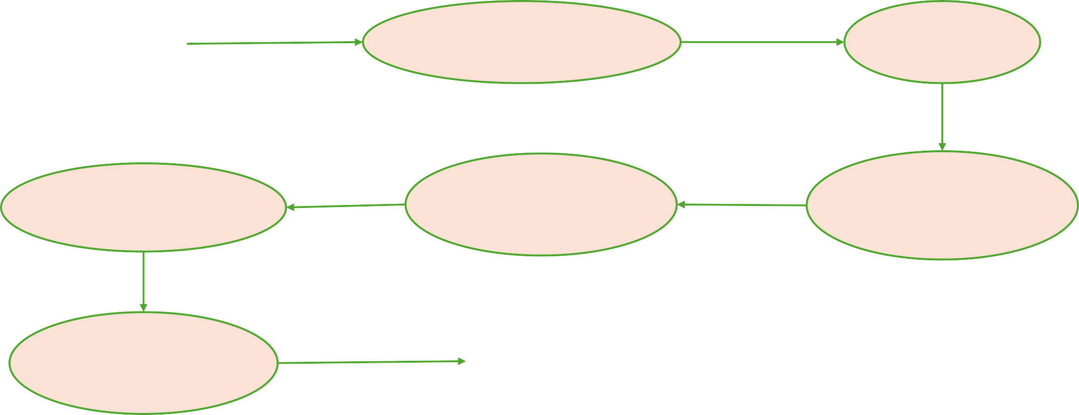
Process Flow Diagram:
User
Executes the program
Iterate through each file in folder
Trims each PCAP
Creates call summary in another tab
Extracts data and print in ‘Call Flow’ Tab
Reads config.json and process accordingly
Creates Visual Flow & Statistics for each file
Output Generated
Macro enabled Excel
file

Slide 8
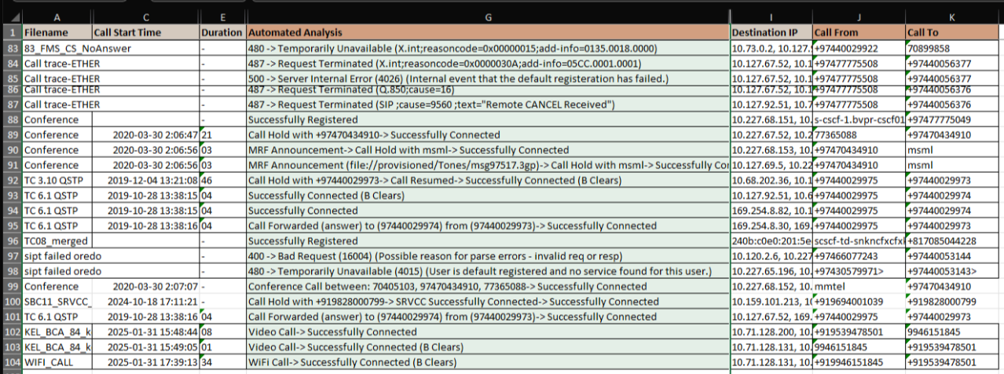
Call Summary:

Slide 9
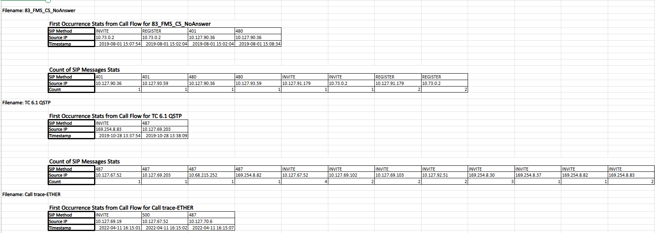
Stats tab:

Slide 10
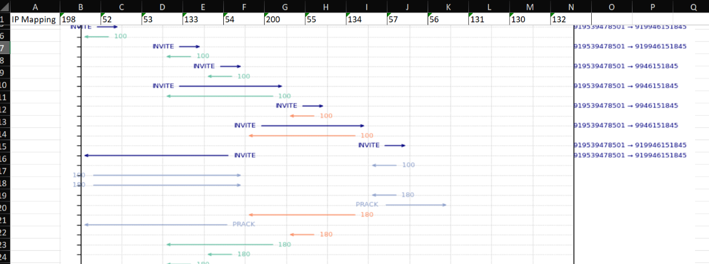
Flow Diagram:

Slide 11
Conclusion :
Business Impact -
Enables faster diagnosis, network optimization, and improved service reliability.
Scalable and Extensible
Can be expanded to support additional protocols for versatile network analysis.
Seamless Deployment
Deployed on CentOS with a user-friendly interface for quick, reliable analysis.
Efficient Automation
Automates SIP call flow analysis, reducing manual effort and errors.
Enhanced Troubleshooting
Offers visual call flow diagrams, error categorization, and detailed reports for faster issue resolution.

Slide 12
Future Scope :
1. Multi-Protocol Support:
Expand support beyond SIP to include GTPv2, S1AP, DNS, and Diameter Protocols.
Enable seamless analysis across different network layers for comprehensive telecom insights.
2. Enhanced Visualization & Reporting:
Introduce interactive call flow diagrams with dynamic filtering and searching.
Leverage advanced data visualization for deeper insights into call performance and failure patterns.
3. AI & Machine Learning Integration:
Implement ML models for anomaly detection and automated root cause analysis.
Predict call quality based on SIP parameters, jitter, latency, and packet loss.

