Slide 1

Customer Engagement & Product Utilization Analytics for Retention Strategy
European Bank
Muskan Sharma

Slide 2
RESEARCH PAPER PRESENTATION
Introduction & Background
Engagement Profiling: Categorizes customers into key behavioral segments (e.g., Active Engaged, Inactive Disengaged, Active Low-Product, and Inactive High-Balance).
Product Utilization Analysis: Examines how relationship depth (holding 1 vs. multiple bank products) impacts churn and customer retention.
Financial Commitment vs. Activity: Identifies "At-Risk Premium Customers"—high-balance account holders who are inactive and single-product users, making them vulnerable to silent churn.
Retention Strength & KPIs: Tracks key metrics such as Engagement Retention Ratio, Product Depth Index, High-Balance Disengagement Rate, and Relationship Strength Index to measure overall account loyalty.
Interactive Streamlit Web App: A dynamic analytics platform allowing stakeholders to filter by geography, product counts, active status, and financial thresholds to explore churn drivers in real time.
This project evaluates bank customer churn through the lens of customer behavior, engagement levels, and product usage rather than relying solely on traditional demographics. The goal is to build a data-driven framework and an interactive dashboard to help banks design targeted retention strategies and reduce customer churn—especially among high-value, disengaged accounts.
Engagement Profiling: Categorizes customers into key behavioral segments (e.g., Active Engaged, Inactive Disengaged, Active Low-Product, and Inactive High-Balance).
Product Utilization Analysis: Examines how relationship depth (holding 1 vs. multiple bank products) impacts churn and customer retention.
Financial Commitment vs. Activity: Identifies "At-Risk Premium Customers"—high-balance account holders who are inactive and single-product users, making them vulnerable to silent churn.
Retention Strength & KPIs: Tracks key metrics such as Engagement Retention Ratio, Product Depth Index, High-Balance Disengagement Rate, and Relationship Strength Index to measure overall account loyalty.
Interactive Streamlit Web App: A dynamic analytics platform allowing stakeholders to filter by geography, product counts, active status, and financial thresholds to explore churn drivers in real time.

Slide 3
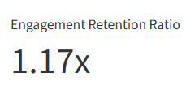
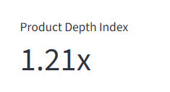
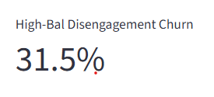
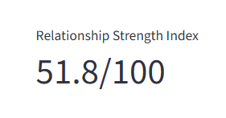
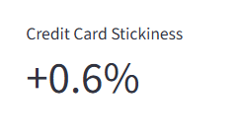
RESEARCH PAPER PRESENTATION
Key Performance Indicators

Slide 4
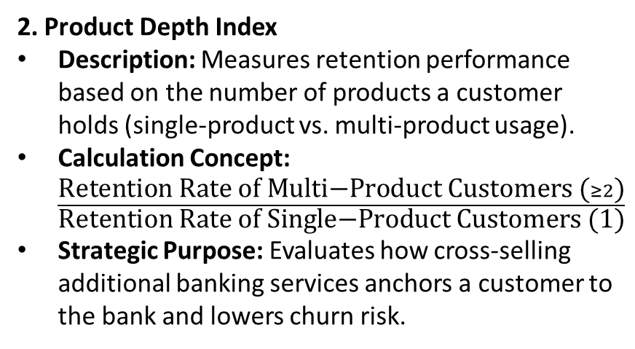
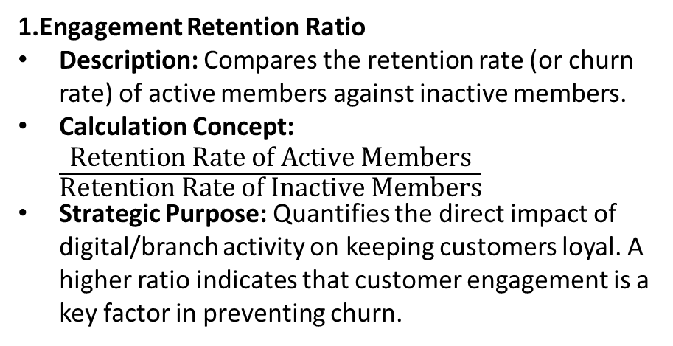
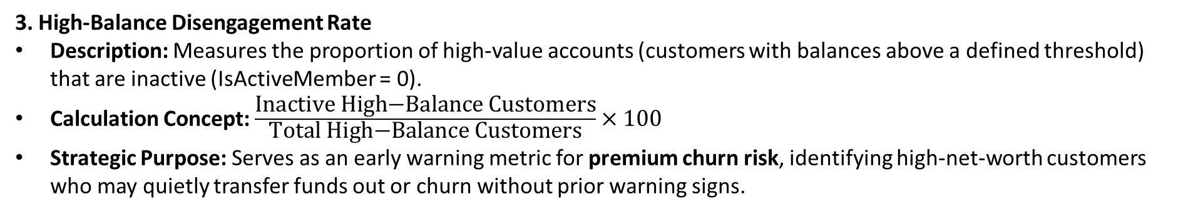
Key Performance Indicators (KPIs)
1.Engagement Retention Ratio
Description: Compares the retention rate (or churn rate) of active members against inactive members.
Calculation Concept: $\frac{\text{Retention Rate of Active Members}}{\text{Retention Rate of Inactive Members}}$
Strategic Purpose: Quantifies the direct impact of digital/branch activity on keeping customers loyal. A higher ratio indicates that customer engagement is a key factor in preventing churn.
2. Product Depth Index
Description: Measures retention performance based on the number of products a customer holds (single-product vs. multi-product usage).
Calculation Concept: $\frac{\text{Retention Rate of Multi−Product Customers (}≥2\text{)}}{\text{Retention Rate of Single−Product Customers (1)}}$
Strategic Purpose: Evaluates how cross-selling additional banking services anchors a customer to the bank and lowers churn risk.
3. High-Balance Disengagement Rate
Description: Measures the proportion of high-value accounts (customers with balances above a defined threshold) that are inactive (IsActiveMember = 0).
Calculation Concept: $\frac{\text{Inactive High−Balance Customers}}{\text{Total High−Balance Customers}}×100$
Strategic Purpose: Serves as an early warning metric for premium churn risk, identifying high-net-worth customers who may quietly transfer funds out or churn without prior warning signs.

Slide 5
Problem Statement
Despite collecting vast amounts of data on customer engagement and product usage, banks frequently lack clear, actionable insights into actual customer behavior. As a result, retention strategies are often generic, reactive, and misaligned with real customer loyalty dynamics.
1. Quantitative Insight Into Which Behaviors Drive Retention
The Core Gap: Banks track basic transactional data but often fail to isolate specific engagement signals—such as digital platform logins, feature utilization, or recurring transactions—that directly prevent churn.
The Impact: Retention teams end up targeting broad demographics rather than specific behavior-based customer segments, missing early warning signs of disengagement before a customer leaves.
2. Clarity On Whether Product Depth Reduces Churn
The Core Gap: While cross-selling is standard practice, banks lack quantitative proof regarding the threshold of products required to create true "stickiness." It is often unclear whether holding multiple basic products (e.g., credit card + savings) meaningfully reduces churn compared to deep relationship products (e.g., mortgage + primary checking).
The Impact: Cross-selling efforts risk pushing irrelevant products that add operational cost without effectively improving long-term retention.
3. Evidence On Whether High Balances Alone Ensure Loyalty
The Core Gap: There is a common assumption that high-balance accounts are inherently loyal. However, high-balance customers who are inactive or hold only a single product pose a severe "silent churn" risk—they may suddenly transfer funds to a competitor offering better rates or experience.
The Impact: Banks often over-focus retention efforts on low-balance active accounts while inadvertently ignoring high-value, disengaged accounts until it is too late.

Slide 6
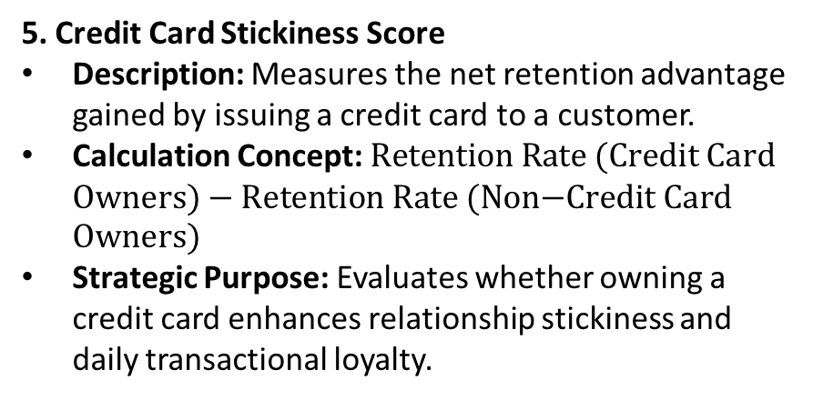
4. Relationship Strength Index (RSI)
Description: A composite score (scaled from 0 to 100) combining member activity, product adoption depth, and baseline retention stability.
Calculation Concept: A weighted sum combining active status percentage, average product utilization depth, and overall customer retention rate.
Strategic Purpose: Provides executive leadership with a single overarching metric to track health and overall customer loyalty across the portfolio.
5. Credit Card Stickiness Score
Description: Measures the net retention advantage gained by issuing a credit card to a customer.
Calculation Concept: $\text{Retention Rate (Credit Card Owners)}−\text{Retention Rate (Non−Credit Card Owners)}$
Strategic Purpose: Evaluates whether owning a credit card enhances relationship stickiness and daily transactional loyalty.

Slide 7
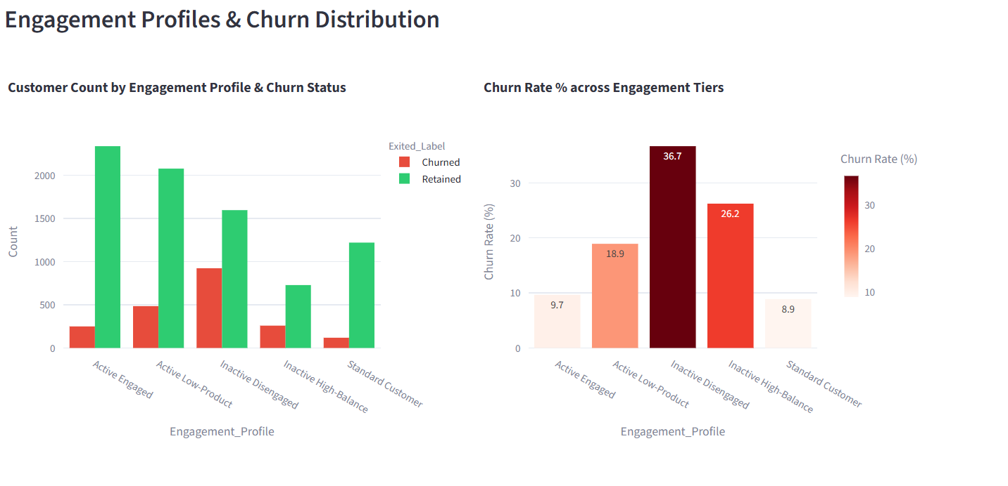
RESEARCH PAPER PRESENTATION
Engagement Classification & Risk Analysis
Breakdown of customer share and churn risk across engagement profiles

Slide 8
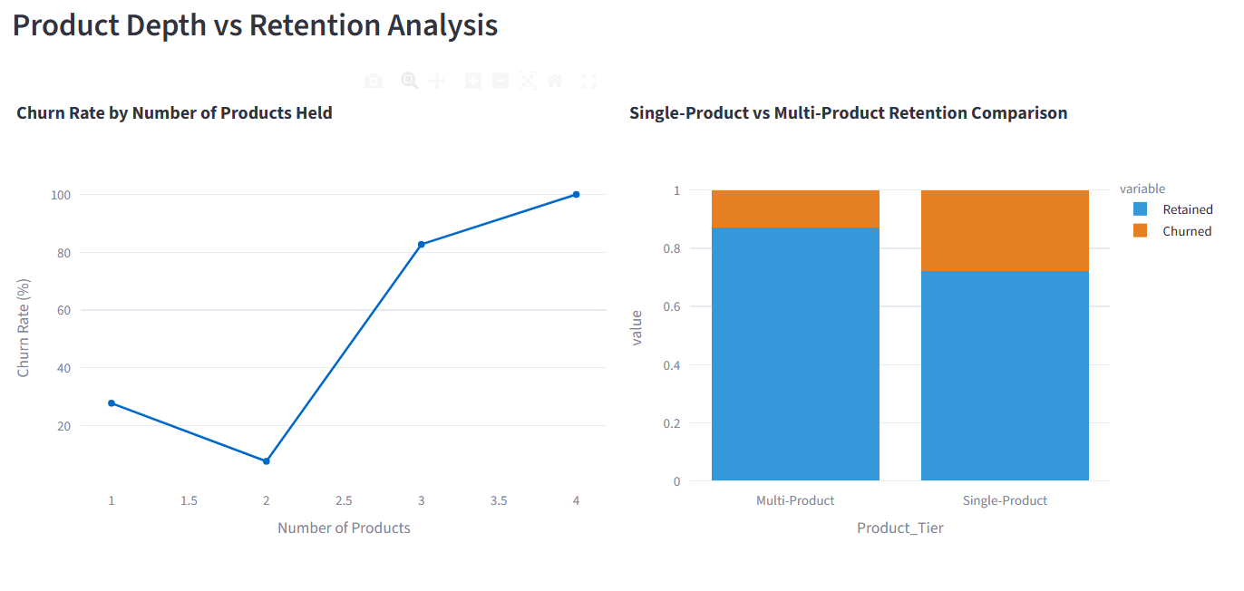

Slide 9
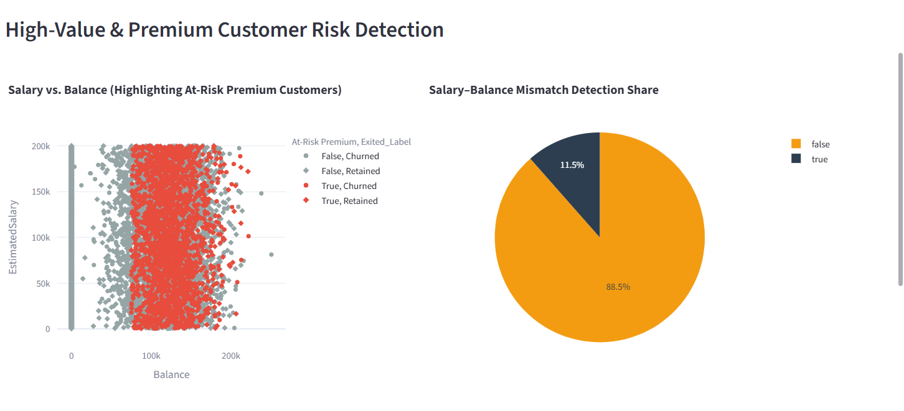

Slide 10
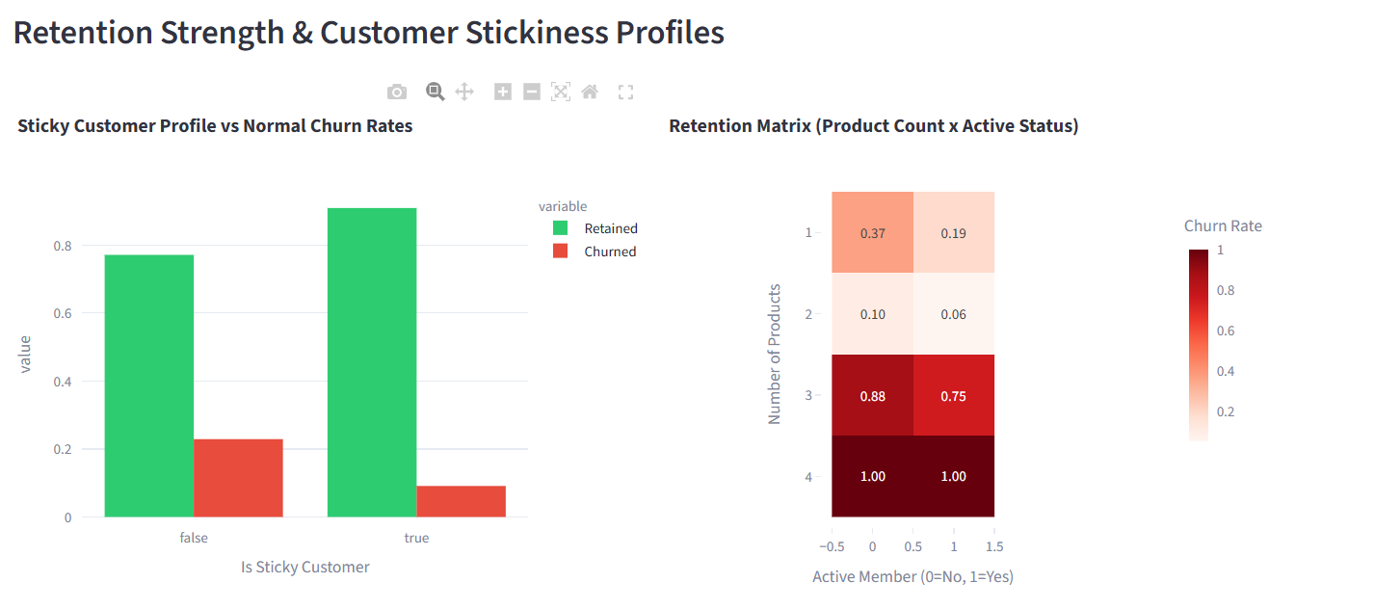

Slide 11
RESEARCH PAPER PRESENTATION
Engagement Classification
Active Engaged Customers
Definition: Highly active members (IsActiveMember = 1) who utilize multiple bank products (NumOfProducts >= 2).
Characteristics: Strong brand loyalty, multi-product adoption, and low churn risk.
Inactive Disengaged Customers
Definition: Non-active members (IsActiveMember = 0) holding only a single product (NumOfProducts = 1).
Characteristics: Low interaction, minimal relationship depth, and high risk of silent churn.
Active but Low-Product Customers
Definition: Active members (IsActiveMember = 1) who rely on only one product (NumOfProducts = 1).
Characteristics: Frequent platform interactions but shallow relationship depth; prime targets for cross-selling.
Inactive High-Balance Customers
Definition: Non-active members (IsActiveMember = 0) holding a high account balance (Balance >= Threshold).
Characteristics: High financial value but low activity; represents "at-risk premium customers" with high revenue loss if churned.

Slide 12
2. Financial Commitment vs Engagement Analysis
Balance vs Activity Cross-Analysis: Evaluates the interaction between account balance (Balance) and active membership (IsActiveMember). It separates passive wealth hoarders from actively engaged depositors.
Salary–Balance Mismatch Detection: Identifies customers with low estimated salaries but disproportionately high balances (or vice versa), highlighting potential anomalous account behavior, wealth transfers, or miscategorized customer segments.
Identification of "At-Risk Premium Customers": Flags customers who maintain substantial balances (Balance >= Threshold), hold a single product, and are currently inactive. These accounts represent high potential revenue loss if they churn silently.
1. Product Utilization Analysis
Churn Rate by Number of Products: Calculates and compares the churn percentage across customers holding 1, 2, 3, or 4 products. Typically, holding 2 products yields the lowest churn, while holding 3 or 4 products (or just 1) often shows sharp increases in churn.
Single-Product vs Multi-Product Retention: Compares the retention rate of customers with only 1 banking product against those with 2+ products to quantify the churn-reduction benefit of product adoption.
Product Depth vs Churn Relationship: Evaluates how relationship depth (how integrated a customer is with multiple offerings) acts as an anchor to reduce churn risk up to an optimal saturation point.

Slide 13
3. Retention Strength Assessment
Define "Sticky Customer" Profiles: Establishes the ideal retention profile—typically defined as an active member (IsActiveMember = 1) who owns a credit card (HasCrCard = 1) and utilizes multiple products (NumOfProducts >= 2).
Measure Churn Stability Across Engagement Tiers: Analyzes churn consistency across defined engagement categories to determine which tiers exhibit stable retention versus high churn volatility.
Identify Engagement Thresholds Linked to Retention: Determines the exact behavioral inflection points (e.g., minimum product count or activity status) required to significantly boost long-term customer retention.

