Slide 1

INSTRUCTOR PERFORMANCE AND COURCSE QUALITY EVALUATION ON EDUPROEDUCATION
Muskan Sharma

Slide 2
RESEARCH PAPER PRESENTATION
Introduction & Background
Engagement Profiling: Categorizes customers into key behavioral segments (e.g., Active Engaged, Inactive Disengaged, Active Low-Product, and Inactive High-Balance).
Product Utilization Analysis: Examines how relationship depth (holding 1 vs. multiple bank products) impacts churn and customer retention.
Financial Commitment vs. Activity: Identifies "At-Risk Premium Customers"—high-balance account holders who are inactive and single-product users, making them vulnerable to silent churn.
Retention Strength & KPIs: Tracks key metrics such as Engagement Retention Ratio, Product Depth Index, High-Balance Disengagement Rate, and Relationship Strength Index to measure overall account loyalty.
Interactive Streamlit Web App: A dynamic analytics platform allowing stakeholders to filter by geography, product counts, active status, and financial thresholds to explore churn drivers in real time.
In the rapidly expanding ecosystem of online education, platforms face intense competition to attract and retain learners. While initial marketing campaigns and course catalog breadth drive platform acquisition and enrollment, long-term viability and growth are governed by instructional quality and course design consistency.
Within platforms like EduPro, instructional quality directly impacts core platform metrics, including:
Learner Satisfaction & Trust: High-quality teaching fosters positive learning experiences and high course ratings.
Course Completion & Retention: Clear, engaging instruction reduces drop-out rates and encourages repeat enrollments across different categories.
Platform Credibility: High rating consistency reinforces brand reputation and drives organic student acquisition.
Conversely, poor instructional quality leads to widespread negative feedback, high refund requests, reduced course ratings, and diminished trust in the platform's overall offerings.

Slide 3
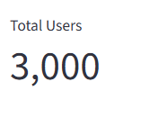
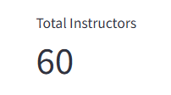
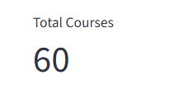
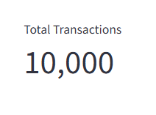
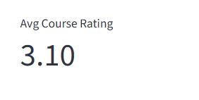
RESEARCH PAPER PRESENTATION
Data Integration across Users ↔ Teachers ↔ Courses ↔ Transactions

Slide 4
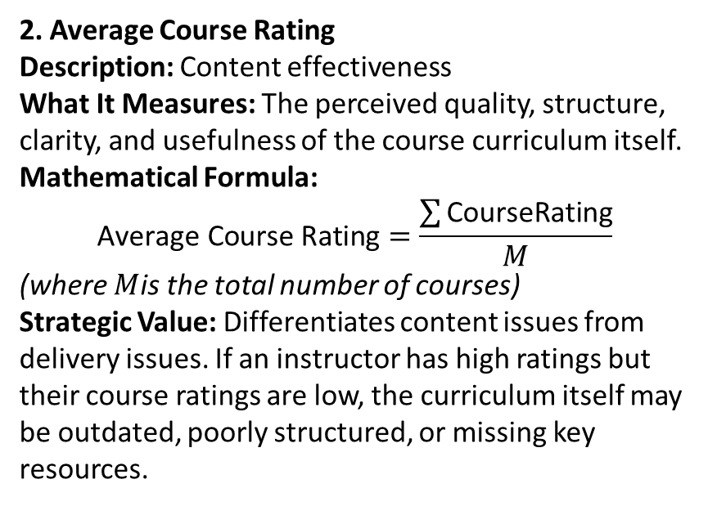
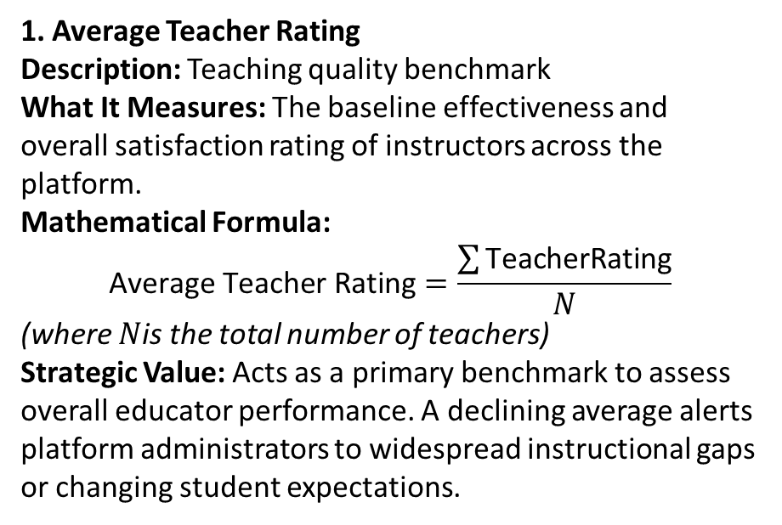
Key Performance Indicators (KPIs)
1. Average Teacher Rating
Description: Teaching quality benchmark
What It Measures: The baseline effectiveness and overall satisfaction rating of instructors across the platform.
Mathematical Formula:
$$\text{Average Teacher Rating}=\frac{\sum{\text{TeacherRating}}}{N}$$
(where $N$is the total number of teachers)
Strategic Value: Acts as a primary benchmark to assess overall educator performance. A declining average alerts platform administrators to widespread instructional gaps or changing student expectations.
2. Average Course Rating
Description: Content effectiveness
What It Measures: The perceived quality, structure, clarity, and usefulness of the course curriculum itself.
Mathematical Formula:
$$\text{Average Course Rating}=\frac{\sum{\text{CourseRating}}}{M}$$
(where $M$is the total number of courses)
Strategic Value: Differentiates content issues from delivery issues. If an instructor has high ratings but their course ratings are low, the curriculum itself may be outdated, poorly structured, or missing key resources.

Slide 5
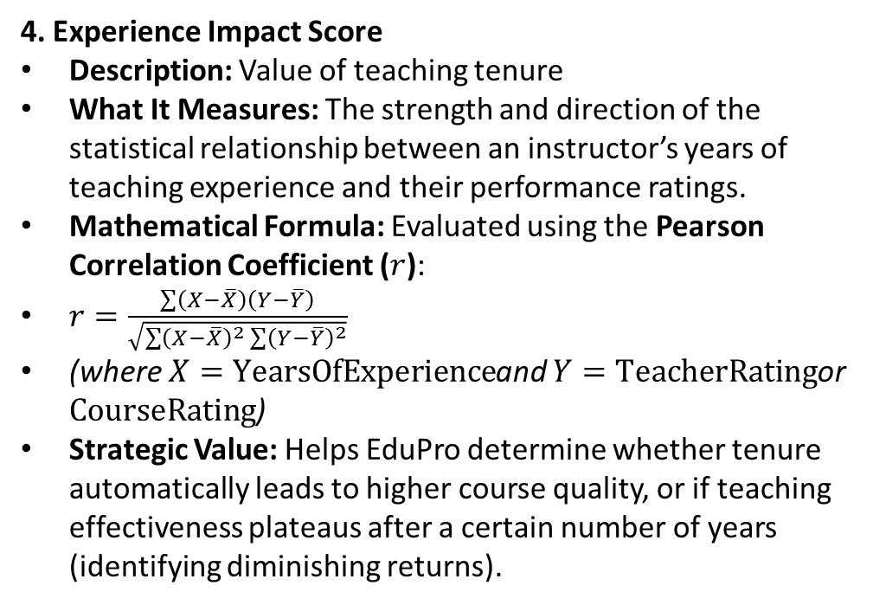
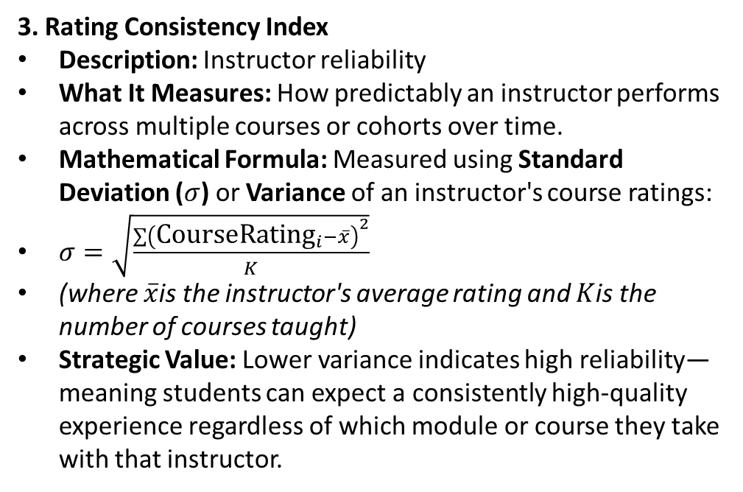
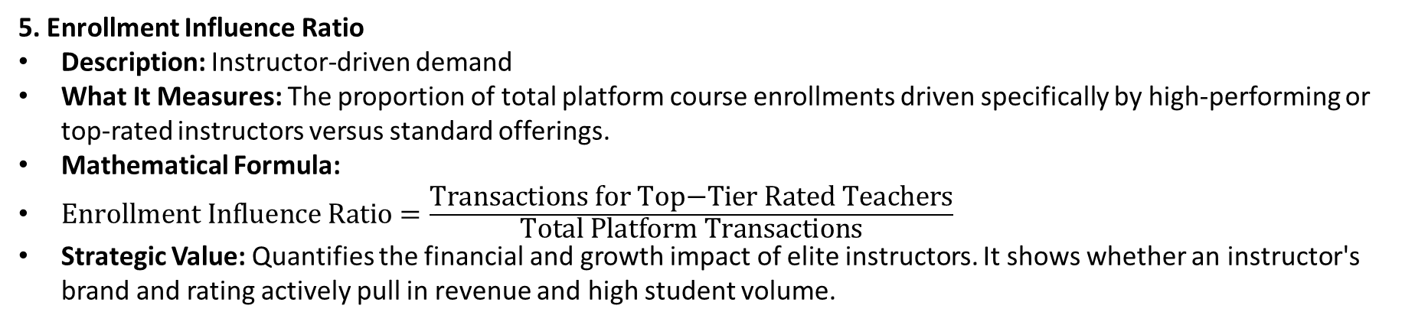
3. Rating Consistency Index
Description: Instructor reliability
What It Measures: How predictably an instructor performs across multiple courses or cohorts over time.
Mathematical Formula: Measured using Standard Deviation ($σ$) or Variance of an instructor's course ratings:
$σ=\sqrt{\frac{\sum{{\left({\text{CourseRating}}_{i}−\overline{x}\right)}^{2}}}{K}}$
(where $\overline{x}$is the instructor's average rating and $K$is the number of courses taught)
Strategic Value: Lower variance indicates high reliability—meaning students can expect a consistently high-quality experience regardless of which module or course they take with that instructor.
4. Experience Impact Score
Description: Value of teaching tenure
What It Measures: The strength and direction of the statistical relationship between an instructor’s years of teaching experience and their performance ratings.
Mathematical Formula: Evaluated using the Pearson Correlation Coefficient ($r$):
$r=\frac{\sum{\left(X−\overline{X}\right)}\left(Y−\overline{Y}\right)}{\sqrt{\sum{{\left(X−\overline{X}\right)}^{2}}\sum{{\left(Y−\overline{Y}\right)}^{2}}}}$
(where $X=\text{YearsOfExperience}$and $Y=\text{TeacherRating}$or $\text{CourseRating}$)
Strategic Value: Helps EduPro determine whether tenure automatically leads to higher course quality, or if teaching effectiveness plateaus after a certain number of years (identifying diminishing returns).
5. Enrollment Influence Ratio
Description: Instructor-driven demand
What It Measures: The proportion of total platform course enrollments driven specifically by high-performing or top-rated instructors versus standard offerings.
Mathematical Formula:
$\text{Enrollment Influence Ratio}=\frac{\text{Transactions for Top−Tier Rated Teachers}}{\text{Total Platform Transactions}}$
Strategic Value: Quantifies the financial and growth impact of elite instructors. It shows whether an instructor's brand and rating actively pull in revenue and high student volume.

Slide 6
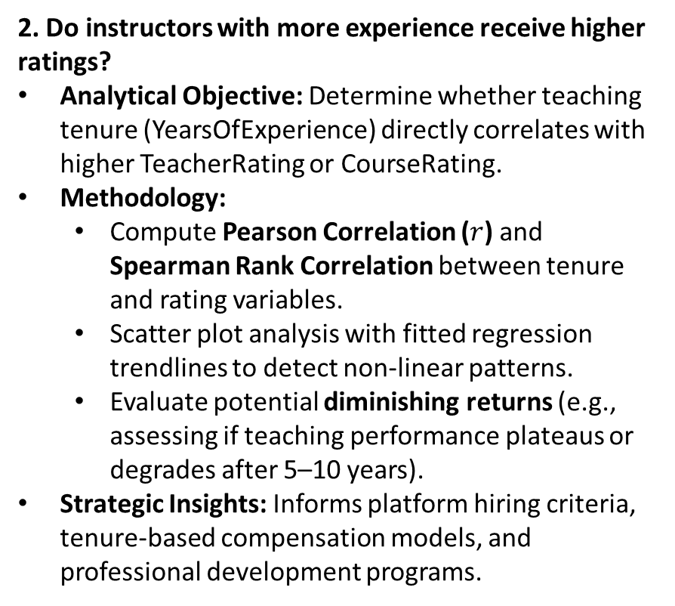
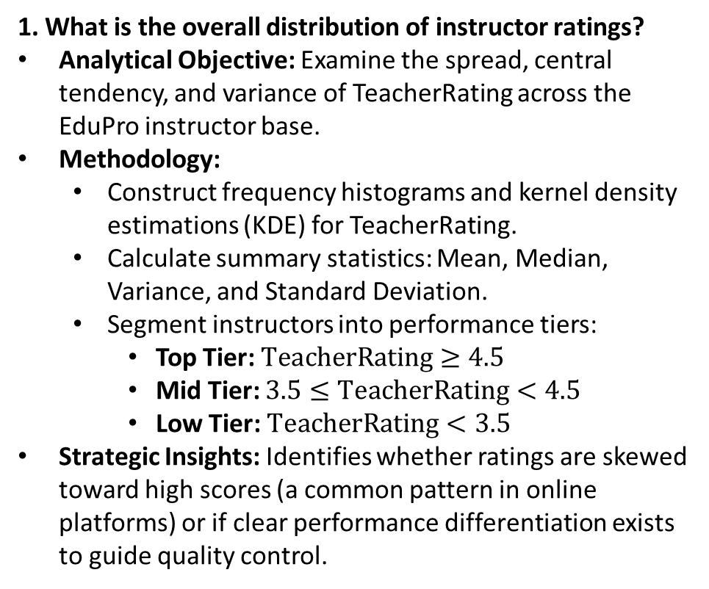
Key Analytical Questions & Investigation Framework
1. What is the overall distribution of instructor ratings?
Analytical Objective: Examine the spread, central tendency, and variance of TeacherRating across the EduPro instructor base.
Methodology:
Construct frequency histograms and kernel density estimations (KDE) for TeacherRating.
Calculate summary statistics: Mean, Median, Variance, and Standard Deviation.
Segment instructors into performance tiers:
Top Tier: $\text{TeacherRating}≥4.5$
Mid Tier: $3.5≤\text{TeacherRating}<4.5$
Low Tier: $\text{TeacherRating}<3.5$
Strategic Insights: Identifies whether ratings are skewed toward high scores (a common pattern in online platforms) or if clear performance differentiation exists to guide quality control.
2. Do instructors with more experience receive higher ratings?
Analytical Objective: Determine whether teaching tenure (YearsOfExperience) directly correlates with higher TeacherRating or CourseRating.
Methodology:
Compute Pearson Correlation ($r$) and Spearman Rank Correlation between tenure and rating variables.
Scatter plot analysis with fitted regression trendlines to detect non-linear patterns.
Evaluate potential diminishing returns (e.g., assessing if teaching performance plateaus or degrades after 5–10 years).
Strategic Insights: Informs platform hiring criteria, tenure-based compensation models, and professional development programs.

Slide 7
3. Is there a relationship between TeacherRating and CourseRatingalignment?
Analytical Objective: Understand if high instructor ratings translate directly to high course quality ratings, or if course content issues exist independently of teaching effectiveness.
Methodology:
Bivariate regression and correlation analysis between TeacherRating and CourseRating.
Residual analysis to highlight outlier courses (e.g., highly rated teachers with poorly rated course materials, or vice versa).
Strategic Insights: Helps isolate whether course dissatisfaction stems from pedagogy (instructor delivery) or curriculum (course structure, materials, and difficulty).
4. Which expertise areas consistently deliver high-quality courses?
Analytical Objective: Compare average ratings, consistency, and overall quality across different subject domains (Expertise) and CourseCategory.
Methodology:
Aggregated grouping of CourseRating and TeacherRating by Expertise and CourseLevel (Beginner, Intermediate, Advanced).
Heatmap visualization mapping domain expertise against course ratings.
Calculate the Rating Consistency Index (Standard Deviation) per domain.
Strategic Insights: Highlights high-performing domains to model best practices after, while identifying expertise gaps requiring targeted instructional mentorship or course revamps.

Slide 8
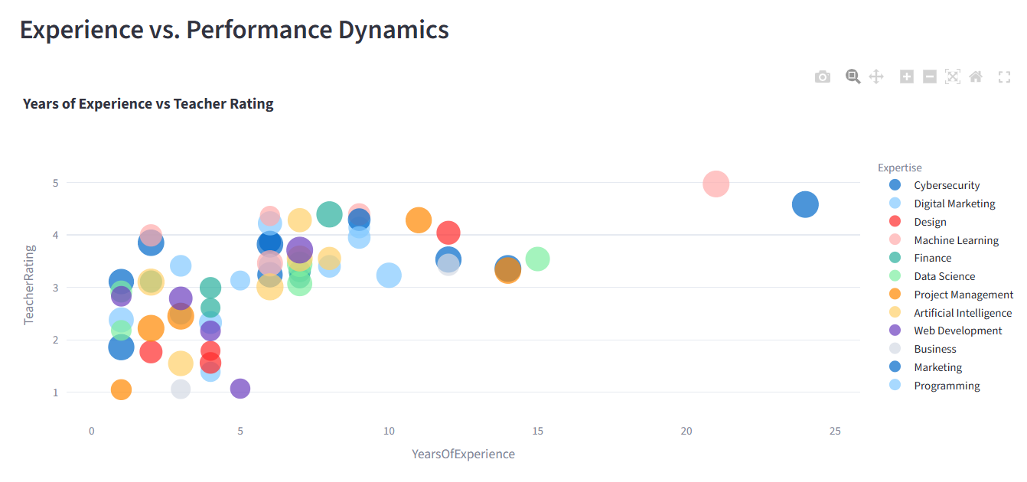

Slide 9
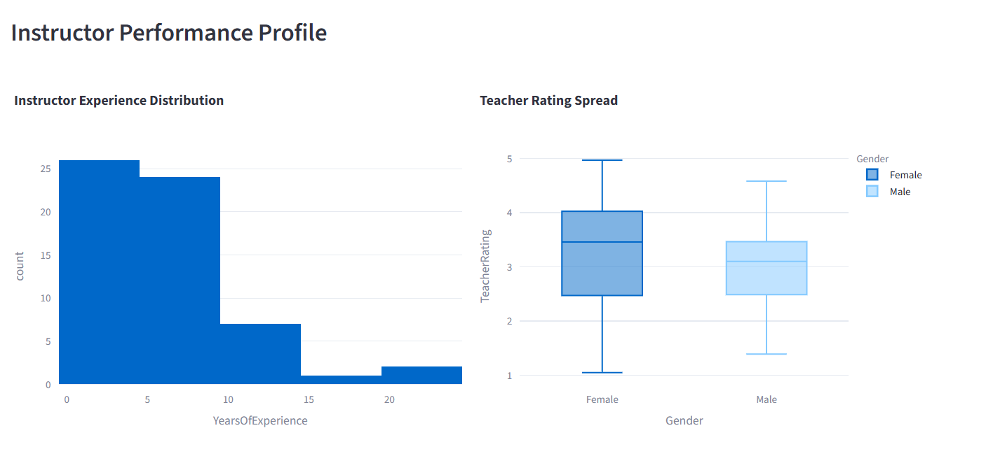

Slide 10
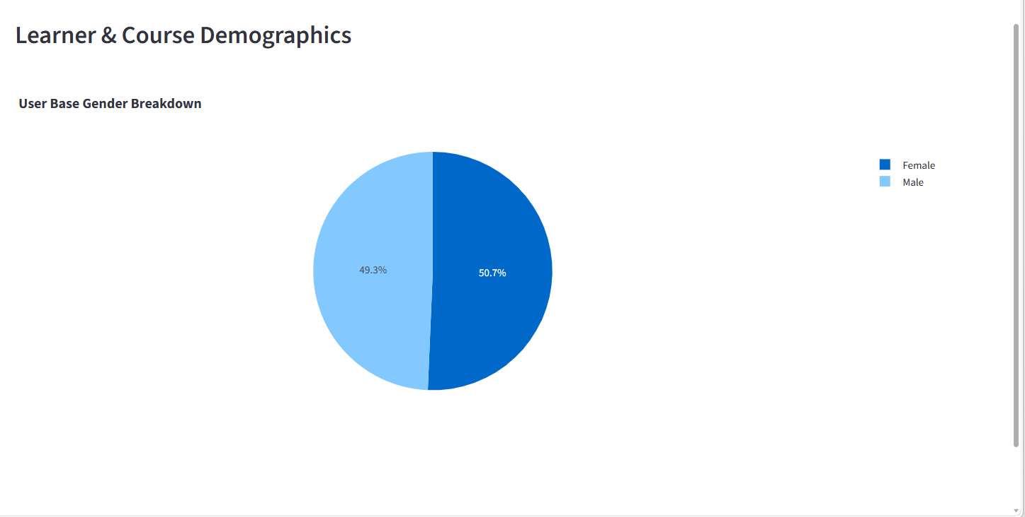

Slide 11
Thank you

